Slide 1
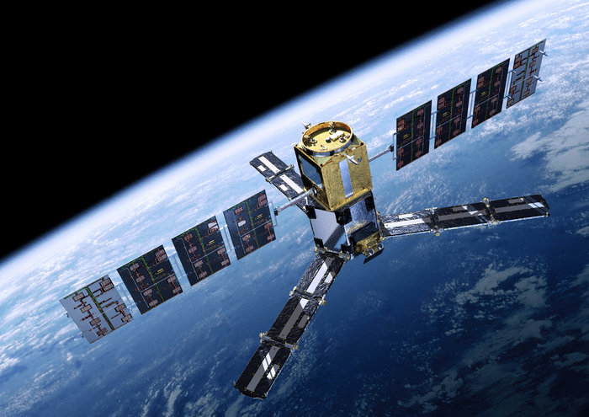
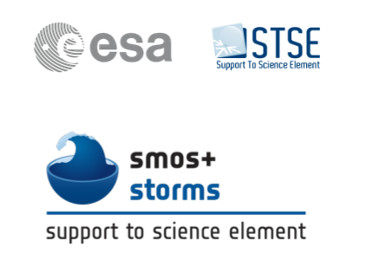
International Workshop on Measuring High Wind Speeds over the Ocean
Craig Donlon, ESTEC,
The Netherlands
15-17th November 2016 | Met Office, Exeter, UK

Slide 2
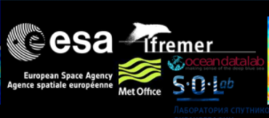
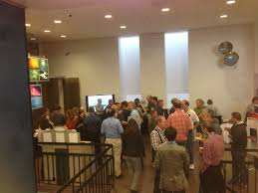
Thanks
Thanks to the SMOS+ STORM team for the organization of the workshop
Thanks to the Met Office for hosting us
Thanks to you for attending

Slide 3
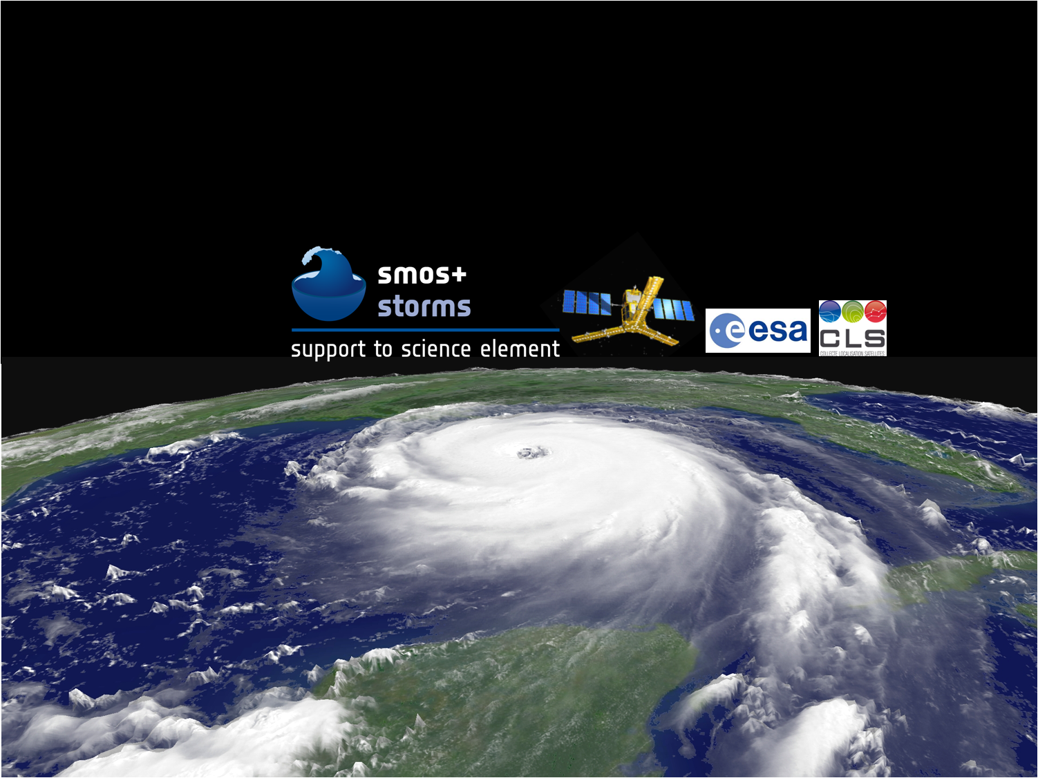
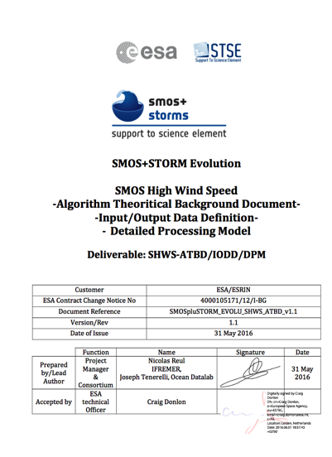
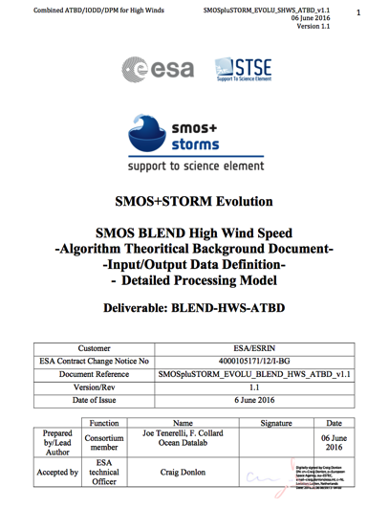
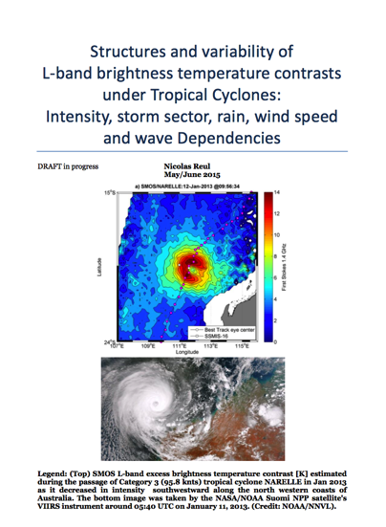
The aim of the SMOS+ STORM Evolution project is to:
Demonstrate the performance, utility and impact of SMOS L-band measurements at high wind speeds over the ocean during Tropical and Extra-Tropical storm conditions.

Slide 4
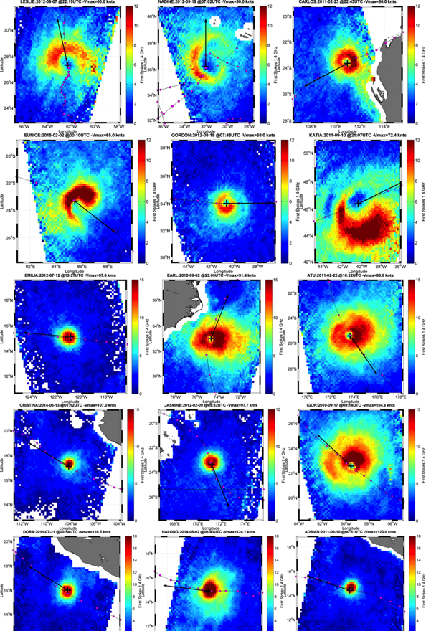
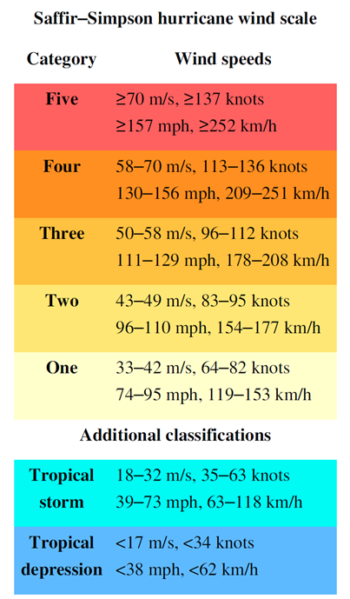
Tropical
Storms
Category 1
Category 2
Category 3
Category 4

Slide 5
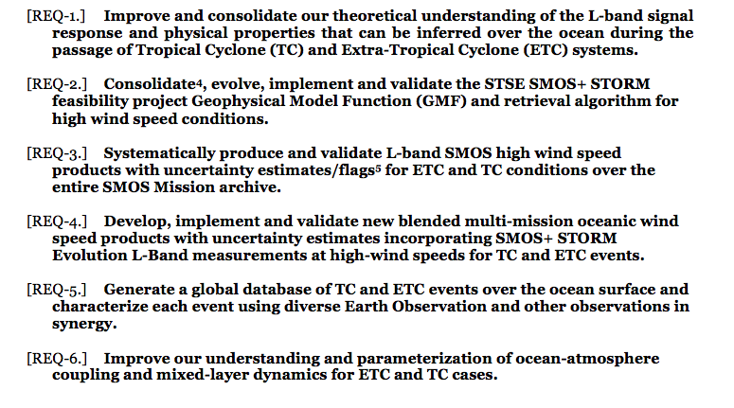
SMOS+ STORM Evolution Main Requirements

Slide 6
SMOS+ STORM Evolution (KO – KO+24)
KO
KO+3
KO+6
KO+9
KO+12
KO+15
KO+18
KO+21
KO+24
Task-1: Cross cutting requirements management and coordination, outreach, communication and promotion
Task-2: L-band signal response over the
ocean in very high wind speed conditions
and SMOS GMF development.
Task-3: Algorithm development
Task-4: Production and validation of SMOS
and blended wind speed products
Task-5: Implementation of SMOS+ STORM Evolution TC and ETC database
Task-6: Demonstrate the performance, utility and impact of SMOS L-band measurements at high wind speeds over the ocean during Tropical and Extra-Tropical storm conditions
Task-7 Final Workshop (WS)
Final Reporting (FR)
KO
PM-1/SRR
PM-2
PM-3
MTR
PM-4
PM-5
PM-6
FM
Proposal
Meeting
Teleconference

Slide 7
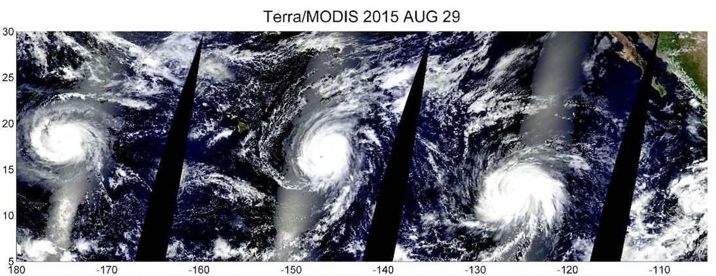
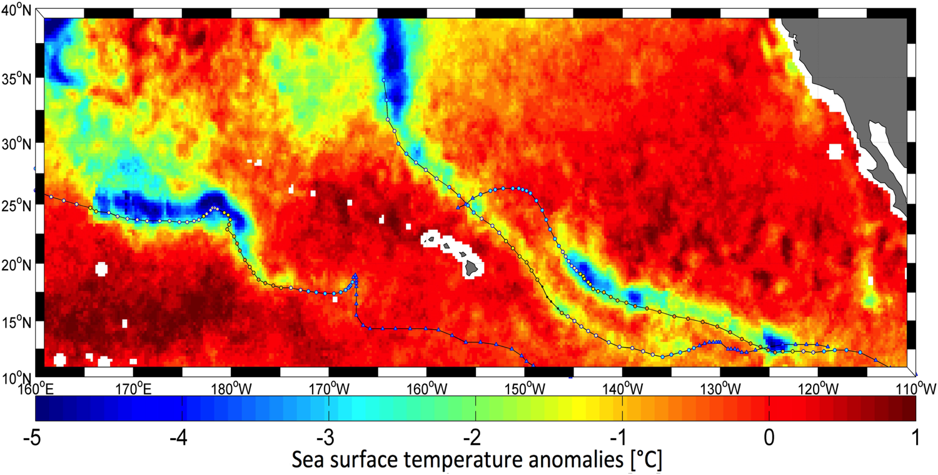
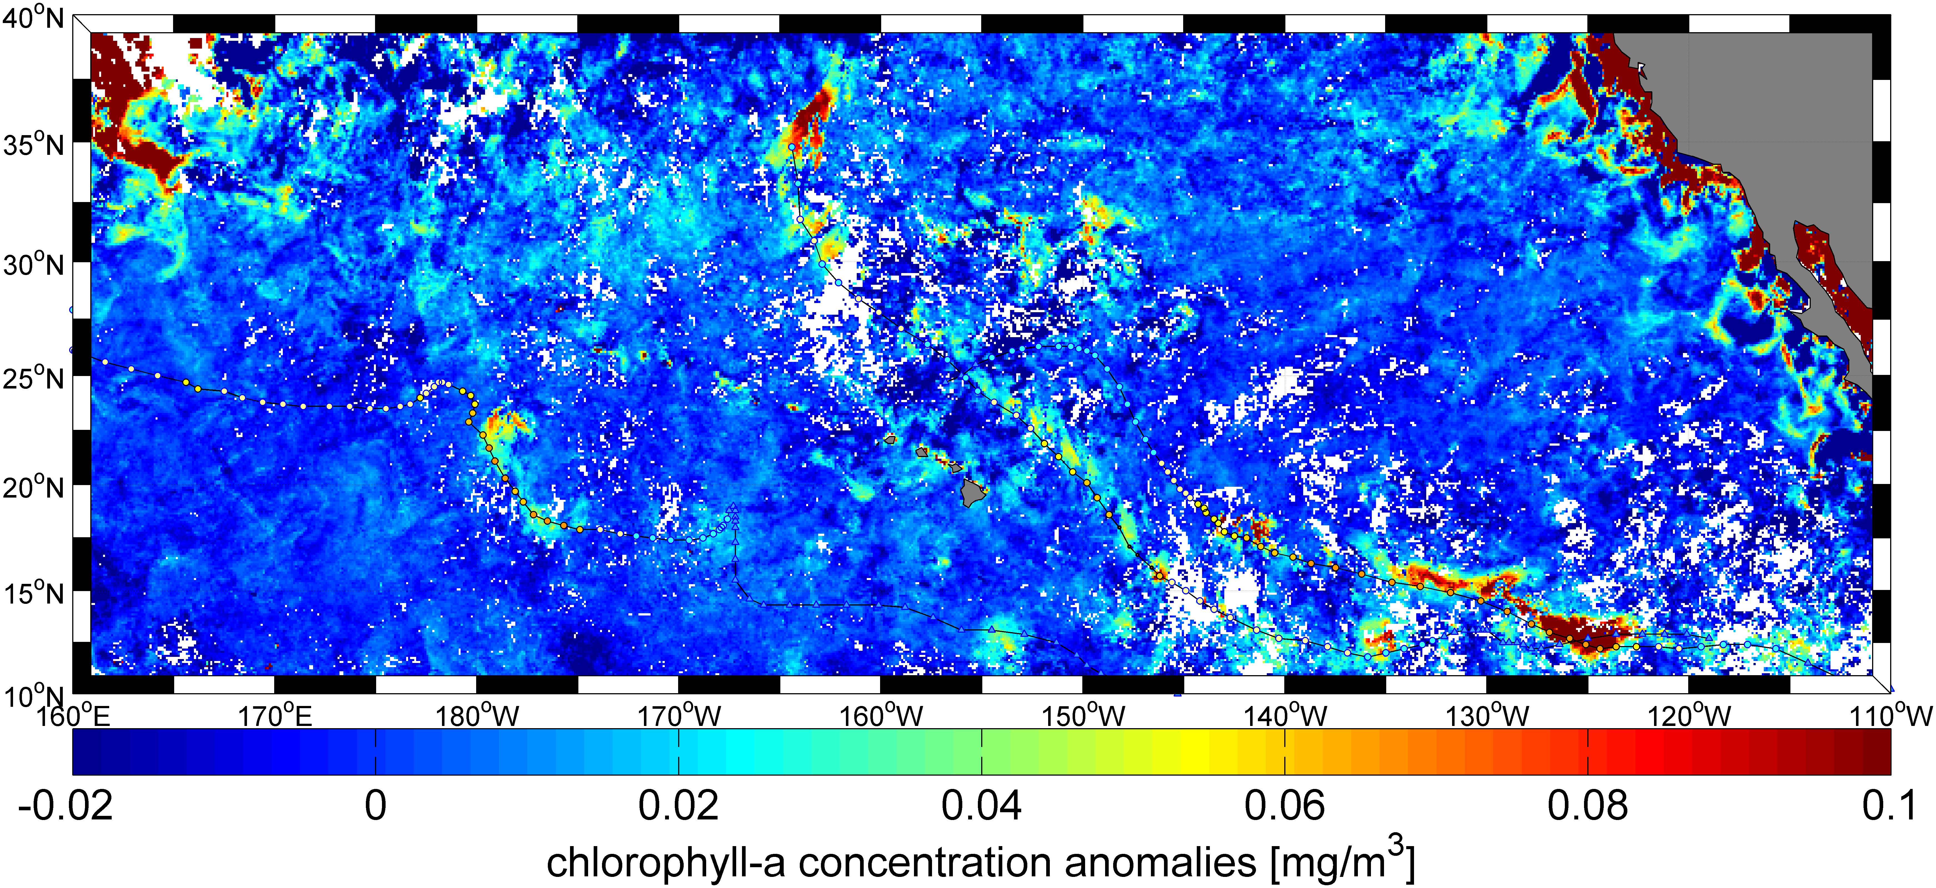
The Three Brothers of the Pacific Kilo (left), Ignacio (centre) and Jimena (right) on 29 August 2015. All three were category-4 hurricanes
http://www.esa.int/spaceinvideos/Videos/2015/09/The_storms_below
Notes:
True-colour composite from the MODIS instrument on NASA’s Terra satellite of hurricanes Kilo (left), Ignacio (centre) and Jimena (right) on 29 August 2015. All three were category-4 hurricanes and spanned the central and eastern Pacific basins. The bright bands in the images are sunglint where solar radiation from the Sun has reflected from Earth back to the satellite sensor.
A time-series mosaic of surface wind speed measurements under Hurricanes Kilo, Ignacio and Jimena is shown in this animation. Data from three satellite microwave radiometer missions: ESA’s L-band SMOS, NASA’s L-band SMAP and Japan’s C-band AMSR-2 are combined to reveal the track of each hurricane and maximum wind speed measured by each sensor at the ocean surface.
SST cold Wakes after the storms
Chrolophyll emerging in the cold wakes following the storms

Slide 8
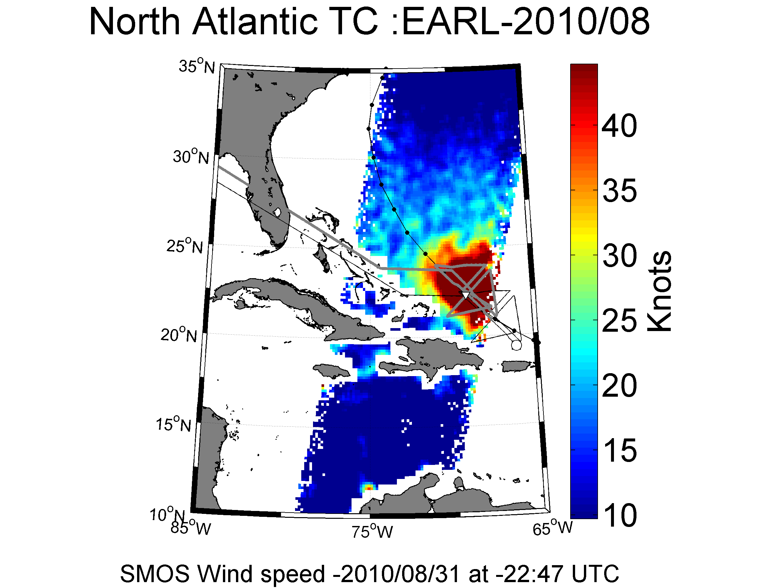

Slide 9
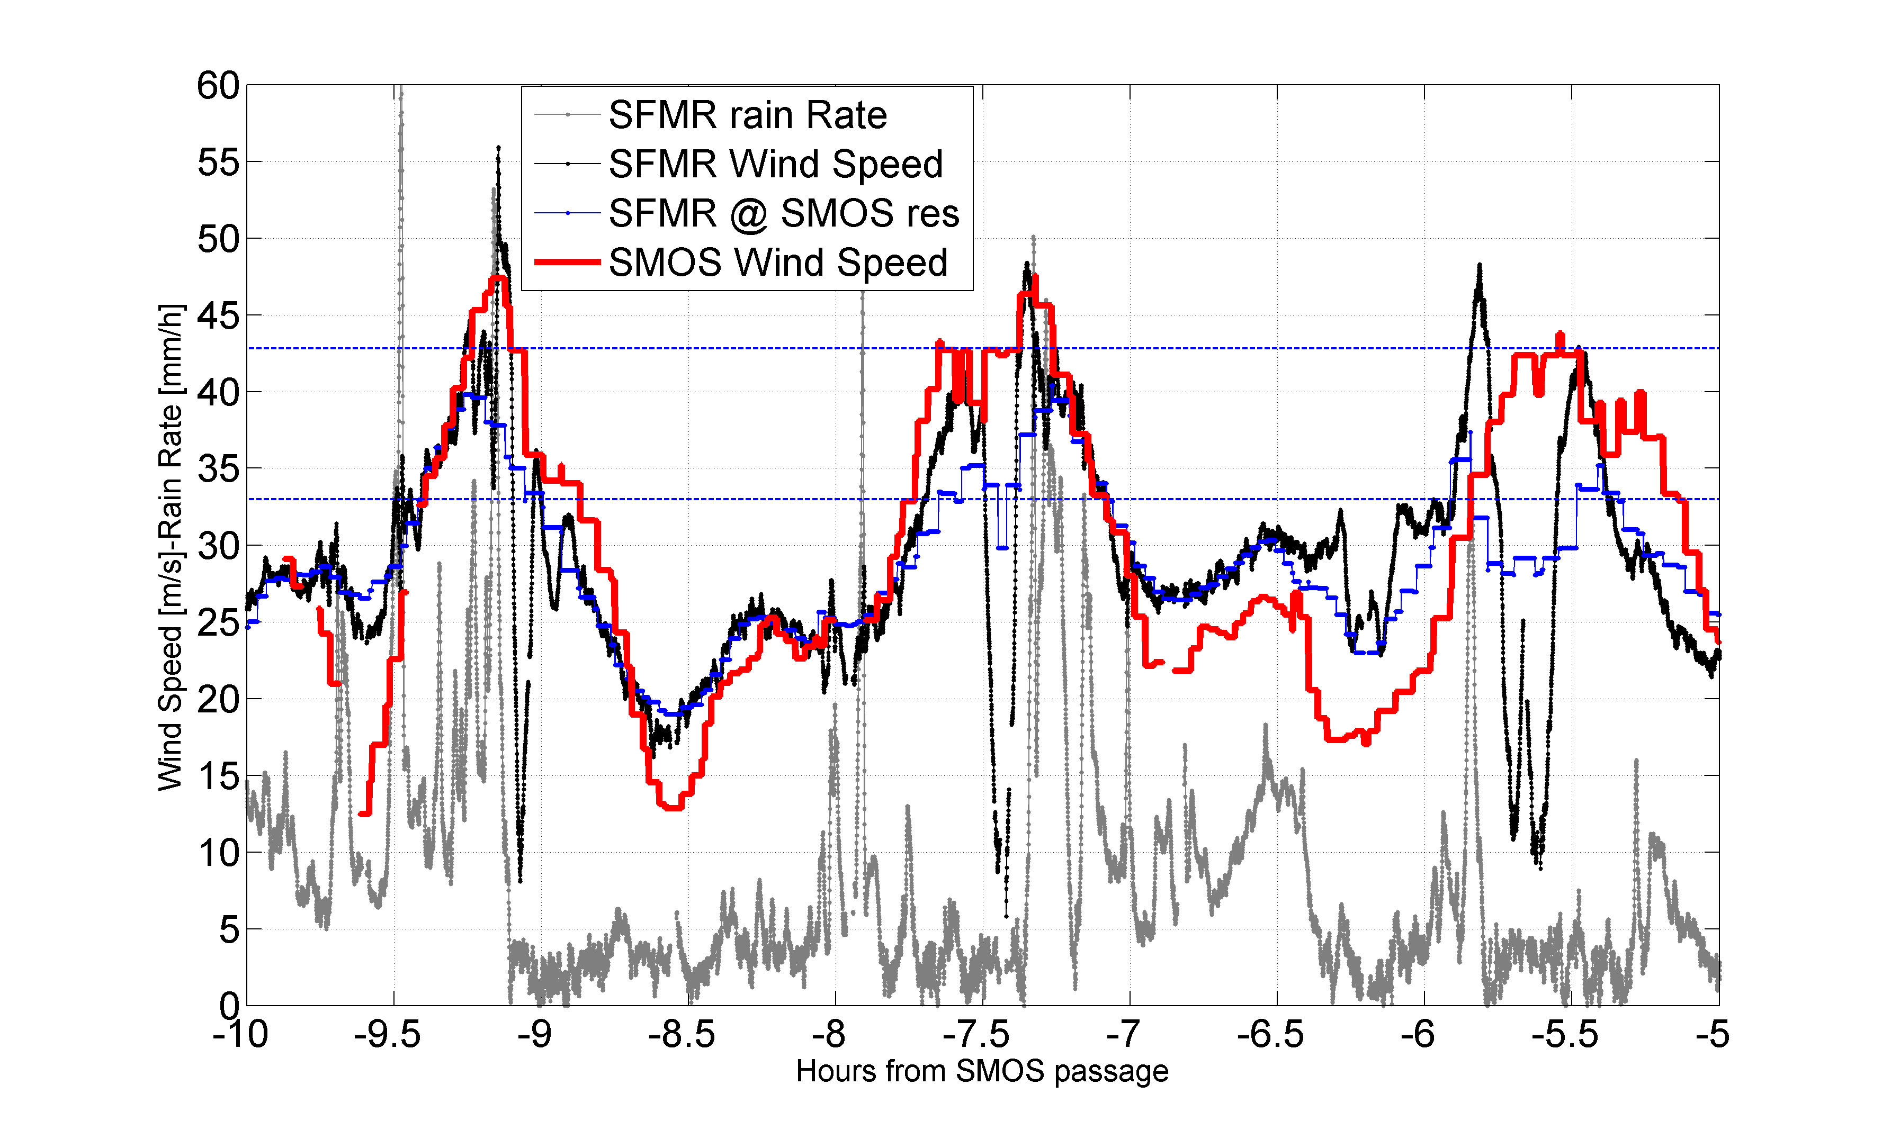

Slide 10
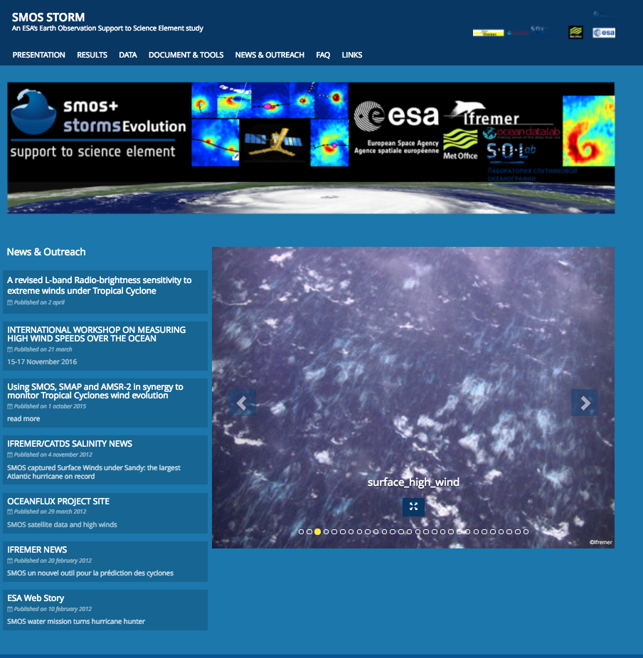
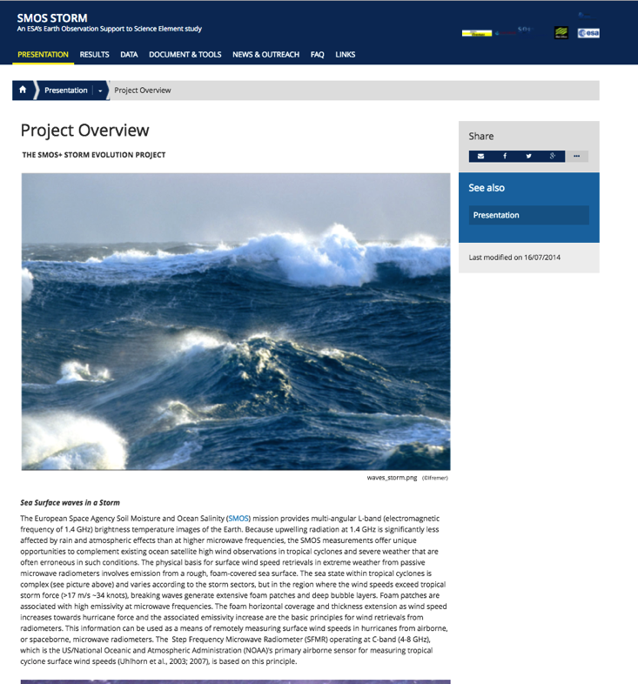
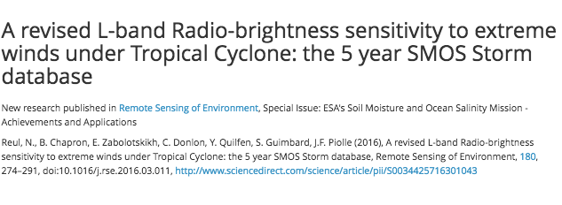

Slide 11
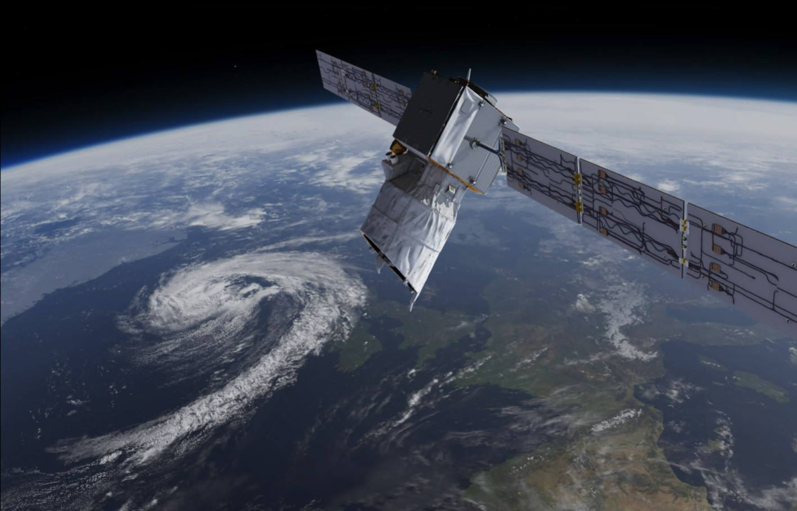
Aeolus Mission - Launch late 2017
Doppler Wind Lidar
Direct Detection System
High Spectral Resolution
355 nm

Slide 12
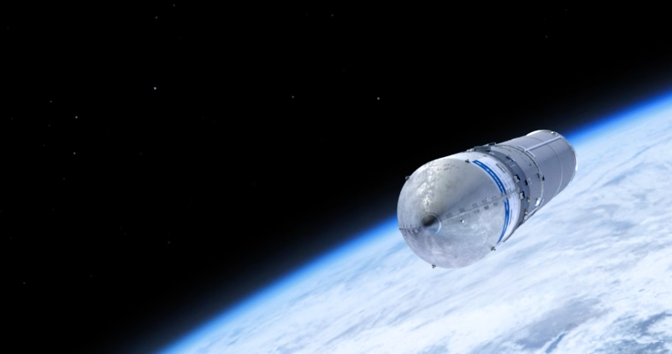
What is needed from Earth Observation?
Fundamental: tailored scientific R&D using satellite data for Extreme Winds.
The Science of today is the operational applications of Tomorrow
The “currency” of Satellite data is Scientific Measurement
BUT… measurements need to be translated into useful knowledge for successful outcomes
Notes:
This is an exceptionally important slide…please keep!

Slide 13
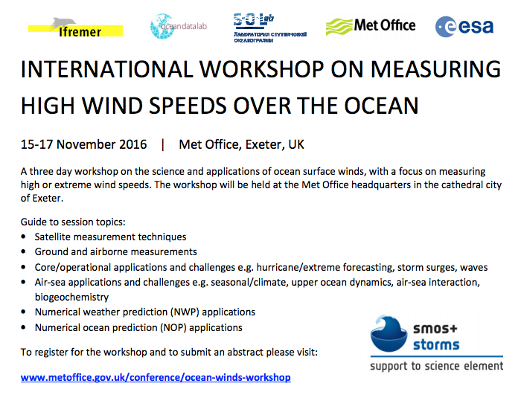
Objectives for this workshop
What are the next steps required to develop measurements of high wind speeds and validate them?

Slide 14
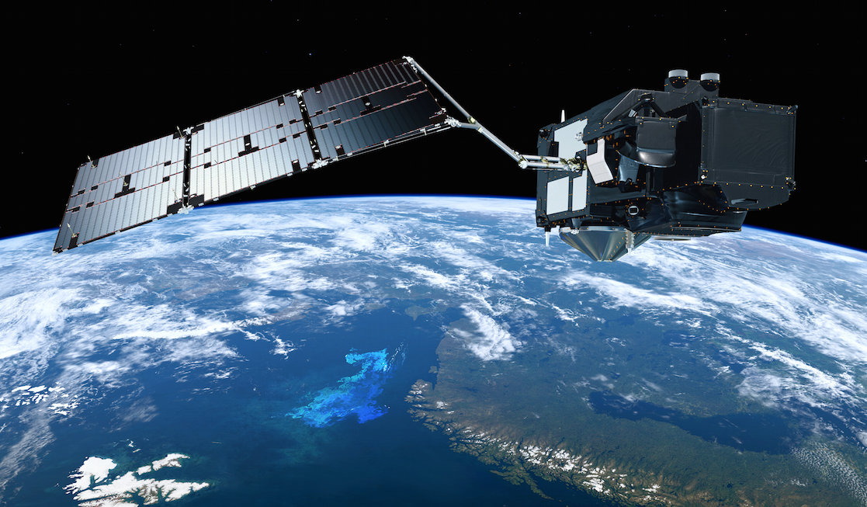
Thank You – any Questions
Contact: Craig.Donlon@esa.int

