Slide 1
We provide services for…
Notes:
Climate Services
Oil and Gas business
Wimbledon
Aviation
Open Road
Retail
Defence
Renewables

Slide 2
Seamless Prediction
Essential support to decision making on all timescales
Past climate
Now
Hours
Days
1-week
1-month
Seasonal
Decadal
Climate
Confidence boundary
Analysis of past weather observations to manage climate risks
Eg. Agriculture: informs crop choice, planting to yield optimisation and minimise crop failure risk.
Predicting routine and hazardous weather conditions.
Public, emergency response, international Disaster Risk Reduction
Monthly to decadal predictions - probability of drought, cold, hurricanes….
Contingency planners, national and international humanitarian response, government and private infrastructure investment
Global and regional climate predictions.
Informs mitigation policy and adaptation choices. Impacts on water resources, heat stress, crops, infrastructure.
Forecast lead-time
Notes:
The Vuvuzela of seamless prediction:
The Met Office is able to make predictions on all timescales from now until a century ahead.
Analysis of past weather data is also useful to understand weather risks today – for example what is the likelihood of a particular storm event occurring.
On longer timescales the confidence boundary gets wider – however if the climate information is applied in an appropriate manner it provides extremely useful information to inform adaptation decision making.

Slide 3
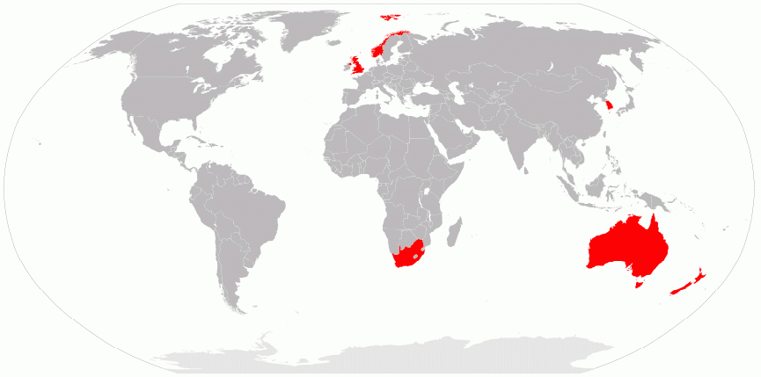
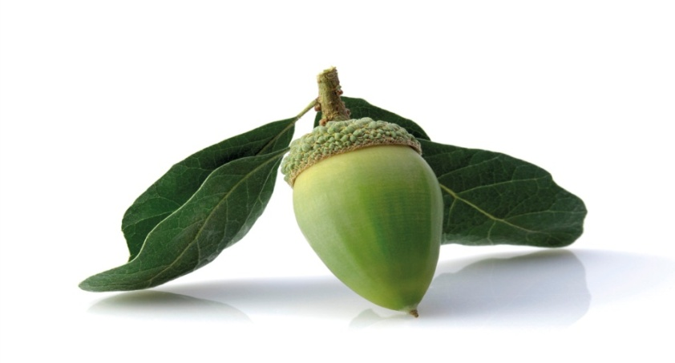
International Unified Model Partners
Met Office Academic Partnership
International Organizations
Joint weather and
climate research programme
© Crown copyright Met Office
Notes:
3
Note Chris Gordon now in post full-time, and a lot of promising activity
Select Committee report is particularly complementary of approach to science partnerships

Slide 4
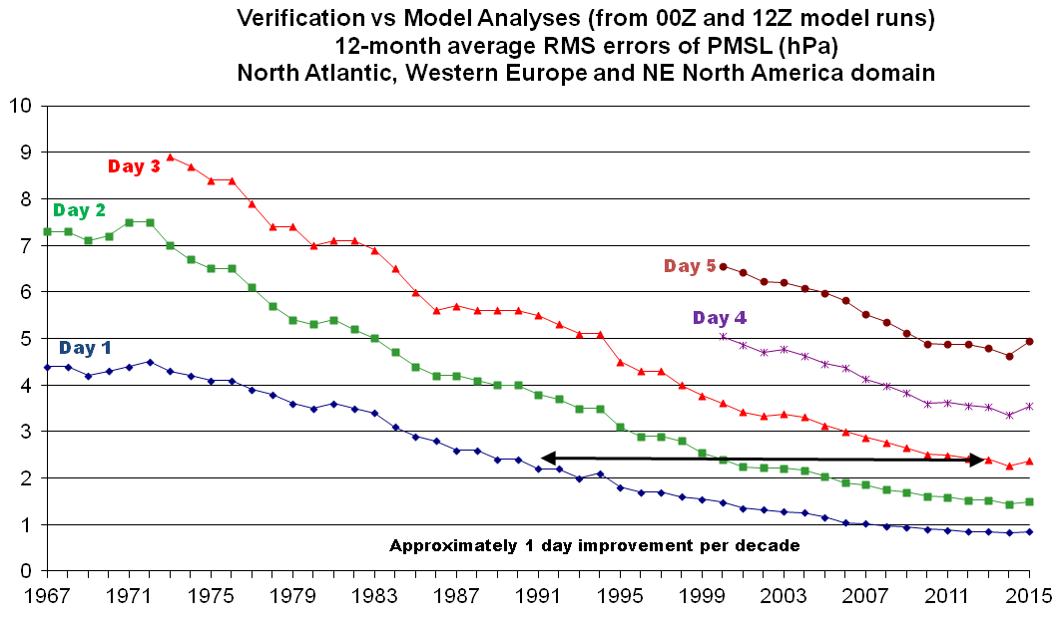
Providing Accurate Forecasts

Slide 5
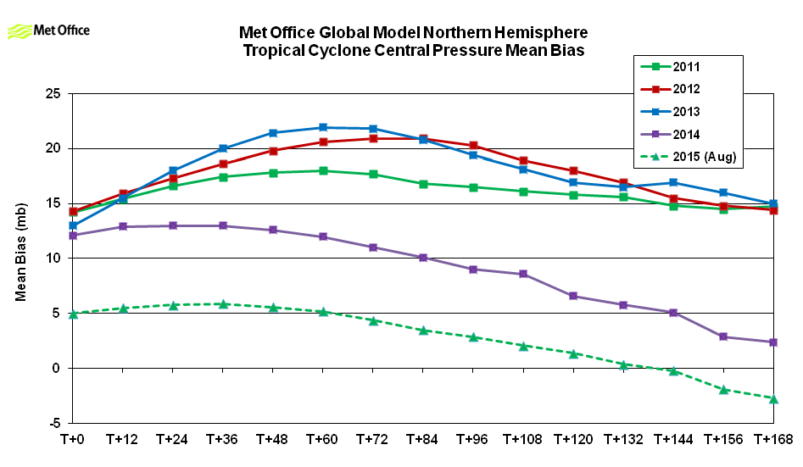
Tropical Cyclone Intensity Forecasts
2014 – introduction of new model / physics
2015 – introduction of improved way of initializing tropical cyclones
2014
2015
Notes:
Intensity errors now trending towards zero with increasing lead time, but still a weak bias in the analysis and short period forecasts.

