Slide 1
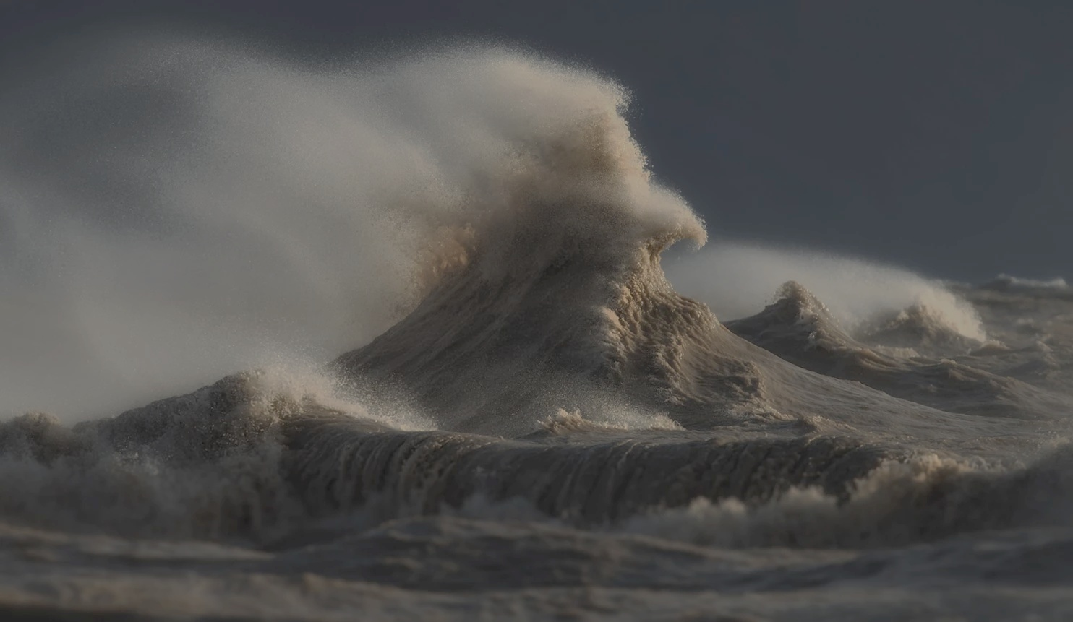
Ocean Vector Winds in Storms from the SMAP L-Band Radiometer
International Workshop on Measuring High Wind Speeds over the Ocean
15 – 17 November 2016
UK Met Office, Exeter
Thomas Meissner, Lucrezia Ricciardulli, Frank Wentz
Remote Sensing Systems, Santa Rosa, CA
submitted to BAMS
Photo courtesy: www.DaveSandfordphotos.com

Slide 2
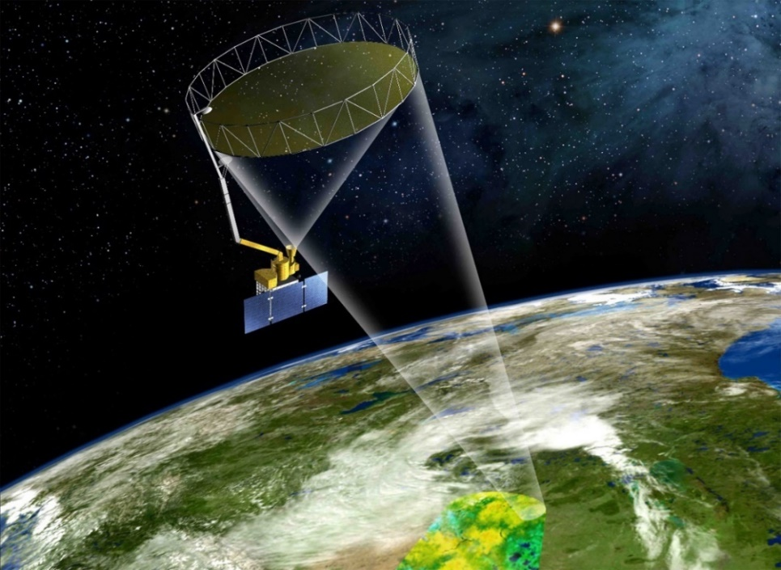
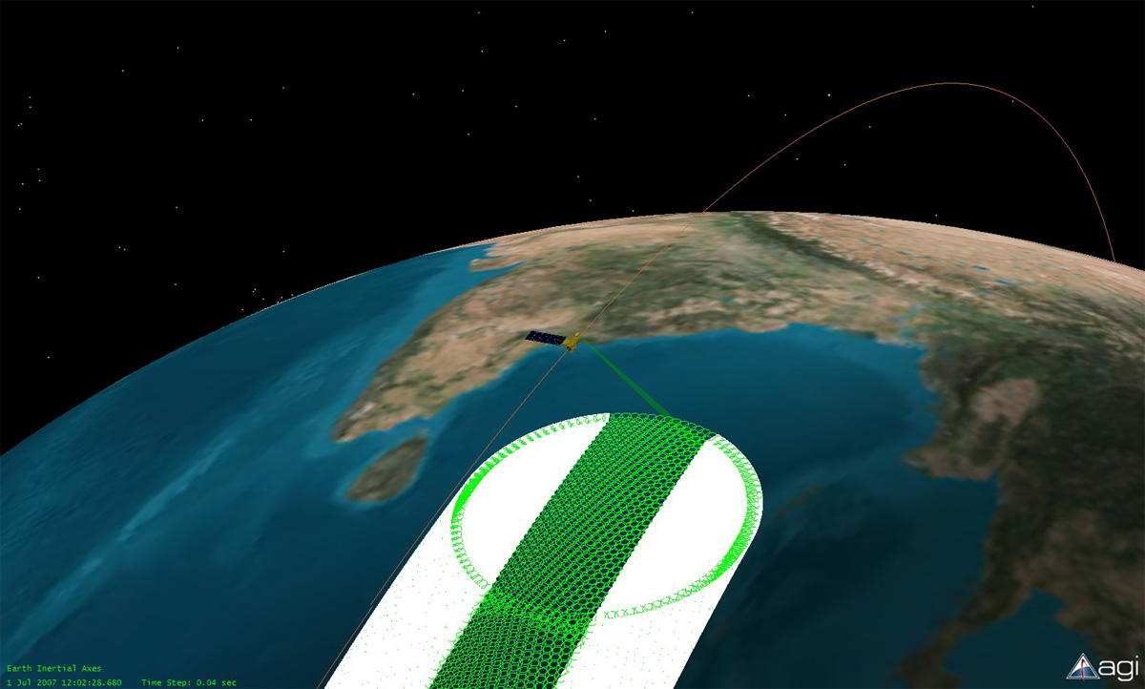
SMAP Soil Moisture Active Passive Ocean Products: Sea Surface Salinity + Wind Speed
http://smap.jpl.nasa.gov/multimedia
6-meter mesh antenna.
Conical scanning @ 14.6 rpm. Scan time: 4.1 sec.
Earth Incidence Angle: 40º.
Radiometer: Center frequency: 1.41 GHz Radar.
Full 360º scan views the Earth. 1000 km wide swath.
3-dB (half power) footprint size: 40 km.
Time for sampling 1 footprint: 17 msec.
Orbit Altitude: 685 km.
Inclination: 98 deg.
Local ascending/descending time: 6 PM/AM.
8-day repeat orbit.

Slide 3
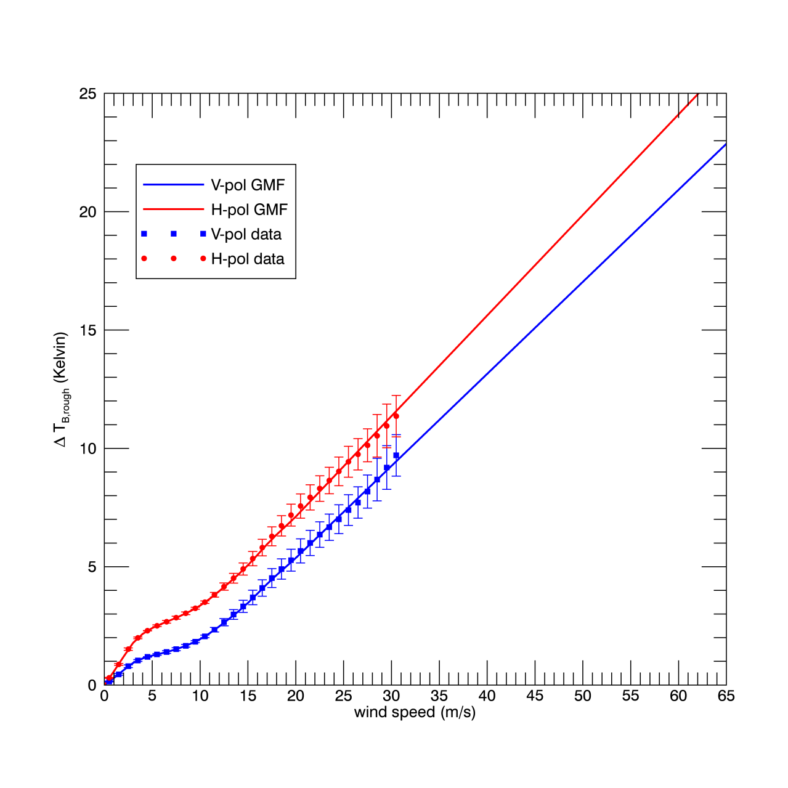
Wind Speed Response Geophysical Model Function (GMF)
Derived "off-line"
Wind induced (excess) emissivity: ΔT_{B} = T _{B rough} – T _{B flat}
Derived from SMAP TB – WindSat wind speed match-ups.
Rain free scenes.
Linear increase above 18 m/s.
Emissivity signal from sea foam
Extrapolate to high wind speeds.
Consistent with results from Aquarius L-band radiometer.
Meissner, Wentz + Ricciardulli, JGR Oceans, 2014.
This L-band wind GMF is used in salinity and wind speed retrievals for Aquarius and SMAP.

Slide 4
Wind Speed Retrieval Algorithm
SMAP wind speed W
SMAP Level 1B swath ordered
antenna temperature measurements T_{A}
V-pol and H-pol
average for/backward looks
noise reduction
optimum interpolated onto fixed 0.25°Earth grid
MLE
match to GMF for wind response
V-pol + H-pol
remove spurious signals at L-band: emissive SMAP antenna
cold space radiation (spillover)
antenna cross polarization
galactic radiation
solar + lunar radiation
land emission in antenna sidelobes
Faraday rotation (ionosphere)
atmospheric attenuation (O₂, clouds)
T_{B,surf} -T_{B,surf,flat}
roughness induced part
calculate brightness temperature of flat ocean surface T_{B,surf,flat}
Meissner-Wentz dielectric model
ancillary fields
Salinity (HYCOM)
SST (CMC)
gridded brightness temperatures at rough ocean surface T_{B,surf}
separate for for/backward looks
no NWP input necessary

Slide 5
Wind Speed Retrieval Uncertainty Sources
Uncertainty Source | Estimated Contribution to Global Error in Wind Speed
Radiometer Noise | 1.20 m/s | dominant uncertainty source
Ancillary Salinity | 0.60 m/s | can be much higher in fresh-water plumes
Ancillary SST | 0.45 m/s
Wind Direction | 0 m/s (W < 10 m/s) 1.5 m/s (W > 15 m/s) | only relevant at high winds
RTM | < 0.3 m/s. very accurate. used for retrieving ocean salinity which is the most unforgiving environmental parameter
Instrument Calibration
Total Global Wind Speed Uncertainty | 1.5 m/s | Validation SMAP - WindSat
The strength of L-band radiometers is in high winds (> 15 m/s).

Slide 6
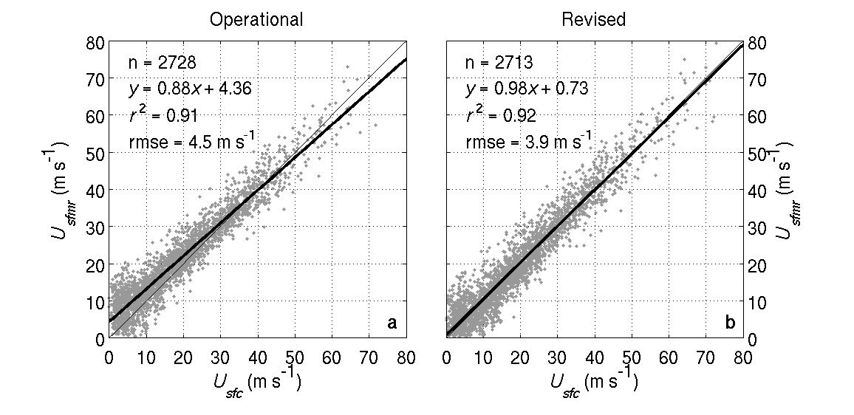
Validation Stepped Frequency Microwave Radiometer SFMR
SFMR correlate well with GPS dropsonde wind speeds
No systematic biases. Estimated accuracy about 3 m/s.
SFMR has not been used in deriving GMF.
Provides independent source for validation.
Uncertainties:
Horizontal displacement
Vertical interpolation to surface.
SFMR calibration
from: B. Klotz and E. Uhlhorn, J. of Atmosph. Ocean. Tech., 2014, 41, 2392 – 2408.
observations between 1999 - 2012
Data available from NOAA AOML HRD http://www.aoml.noaa.gov/hrd/data_sub/

Slide 7
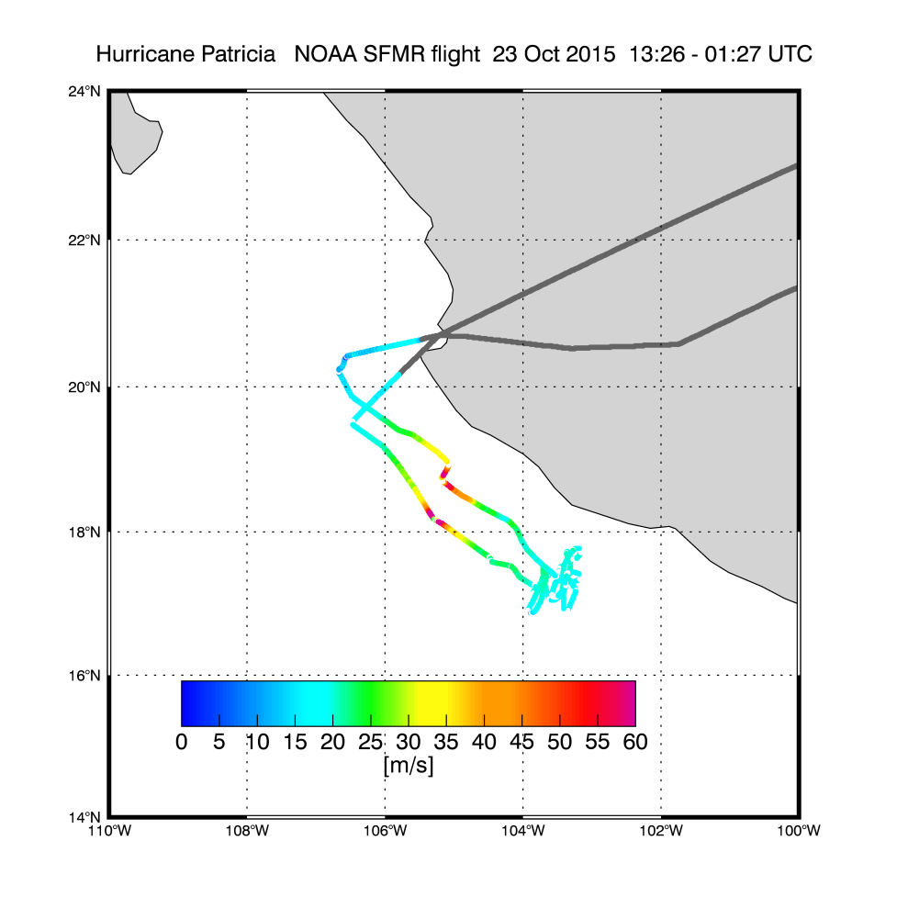
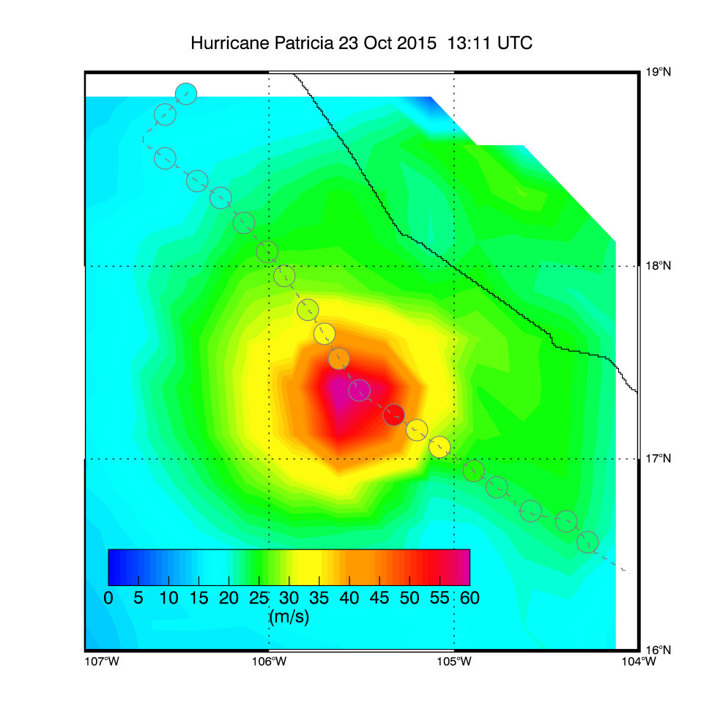
SMAP – SFMR Match-Ups Method
Lower SFMR segment (17:30 h ) closest in time to SMAP overpass (13:10 h).
Shift SMAP segment so that SMAP and SFMR storm centers align.
Average SFMR observations (≈1 sec, 0.1 km) into 0.25º cells to represent approximate resolution of SMAP (and other spaceborne sensors).
Notes:
SFMR reports about every 1 sec and every 0.1 km.
Lower segment: 17.5 hour
Upper segment: 20.5 hour

Slide 8
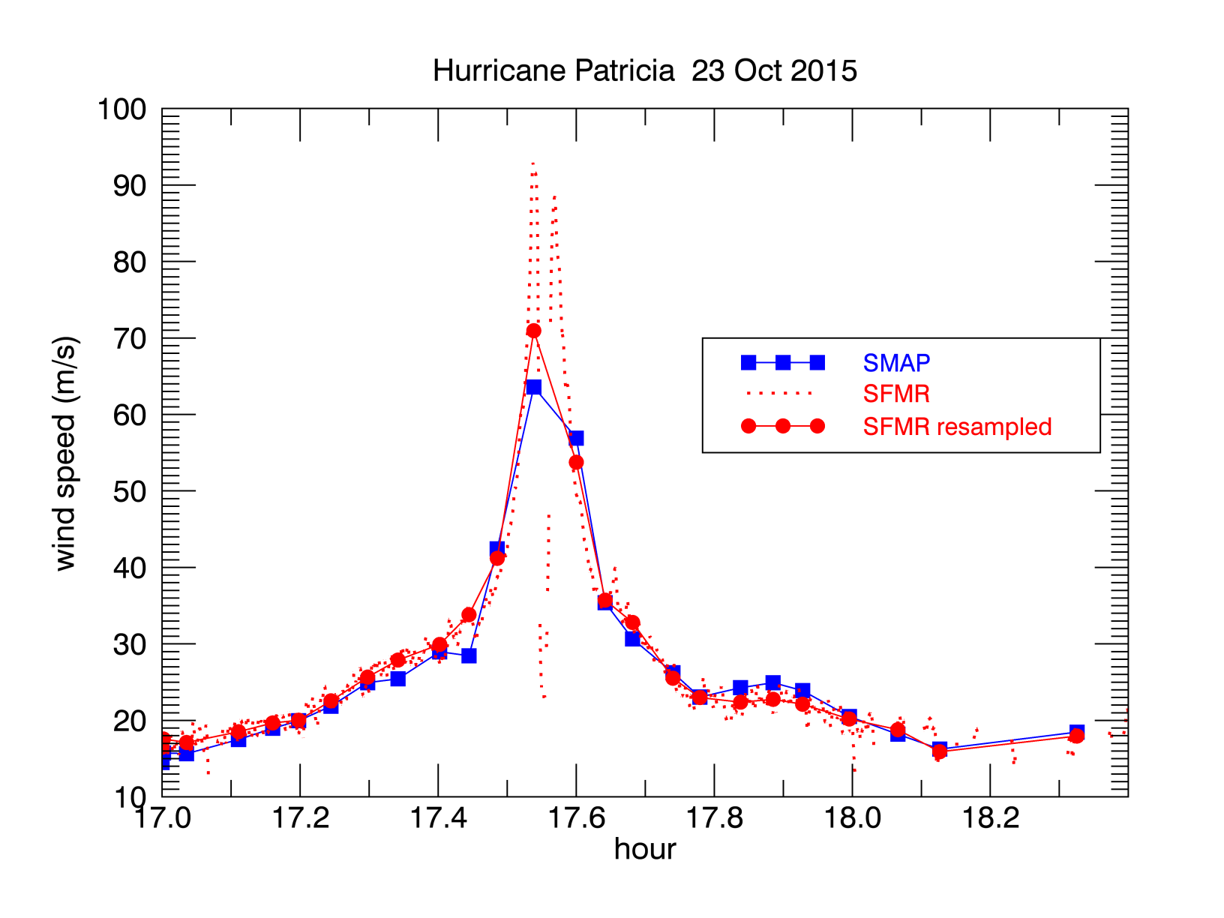
SMAP-SFMR Match-Ups Time Series
Resampled SFMR wind speeds reach 70 m/s.
They should be observable by spaceborne sensors (SMAP, ASCAT, RapidScat, WindSat).
35 km

Slide 9
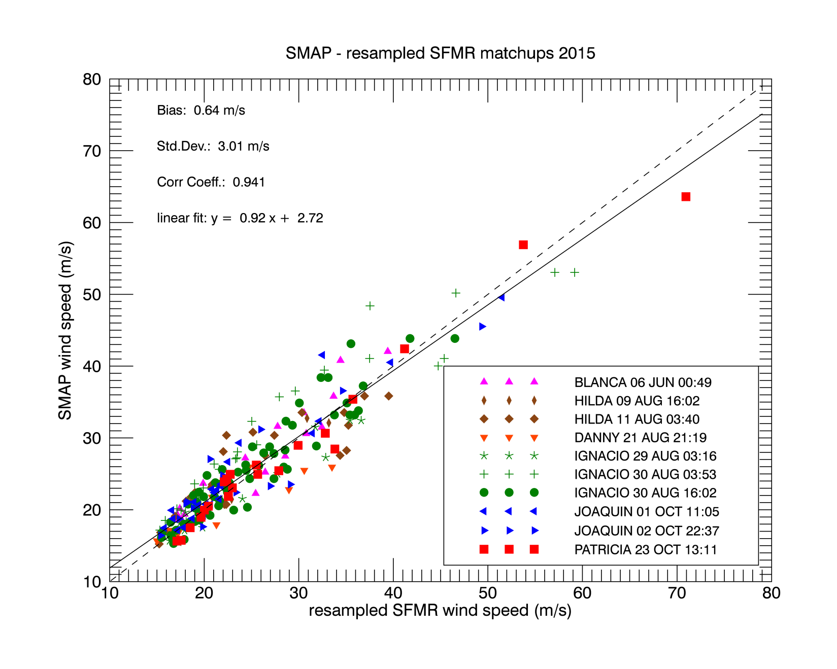
SMAP-SFMR Match-Ups Statistics
227 match-ups in 2015

Slide 10
SMAP-SFMR Match-Ups Statistics for different wind speed ranges
SMAP - SFMR
Wind speed (m/s) | Bias (m/s) | Std.Dev (m/s)
15 – 25 | 0.76 | 1.86
25 – 35 | 0.21 | 3.83
35 – 45 | 2.40 | 4.50
> 45 | -2.40 | 3.96
Small biases above 35 m/s: potential fine tune of GMF.
1. Estimated uncertainty for SMAP wind speeds above 15 m/s:
10% or better.
2. RMS does NOT grow in very high winds.
Notes:
skip

Slide 11
Rain Impact SMAP – SFMR as function of SFMR Rain Rate
SMAP – SFMR The SFMR rain rates were averaged to 0.25° to represent the rain rate that is approximately seen by SMAP
Rain Rate (mm/h) | Bias (m/s) | Std.Dev (m/s)
0 – 5 | 0.68 | 2.55
5 - 10 | 1.57 | 3.37
10 - 15 | 0.46 | 2.85
> 15 | -1.86 | 3.69
No systematic degradation in rain.

Slide 12
Some Very Intense TC Comparison Data Sets
Instrument / Data Source | Description/Algorithm/Resolution
SMAP | L-band Radiometer RSS algorithm. 40 km
ASCAT-A | EUMETSAT C-band Scatterometer RSS algorithm. 25 km
RapidScat | NASA Ku-band Scatterometer JPL Science 12.5 km (uncorrected)
WindSat | US Navy Polarimetric Radiometer RSS All-Weather (AW) Winds (statistical algorithm C/X band to mitigate rain) Rain Rates
NCEP GDAS | 0.25°
JTWC best track | scaled to maximum 10 min sustained winds
 | minimum sea level pressure (MSLP) characterizes intensity of storm

Slide 13
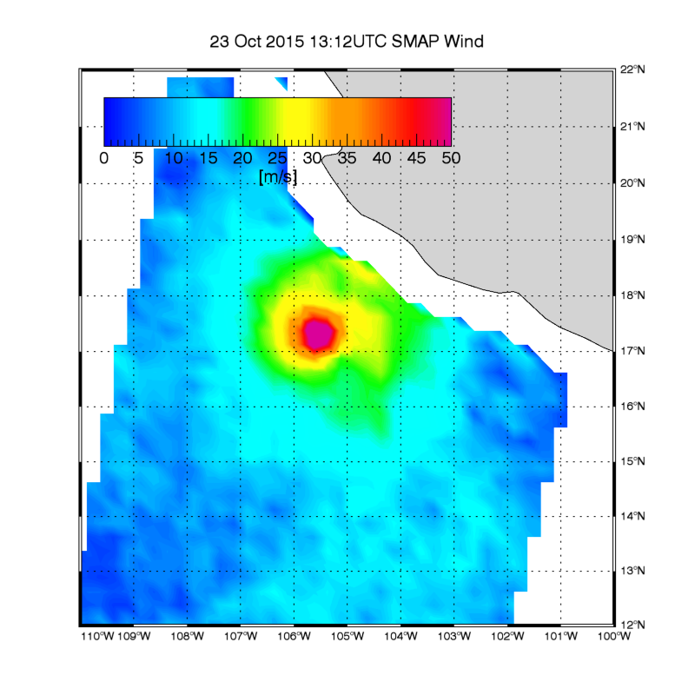
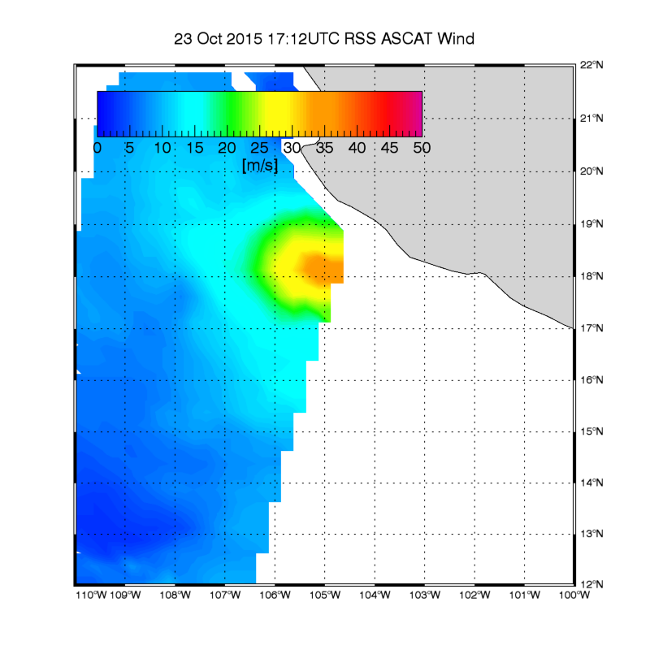
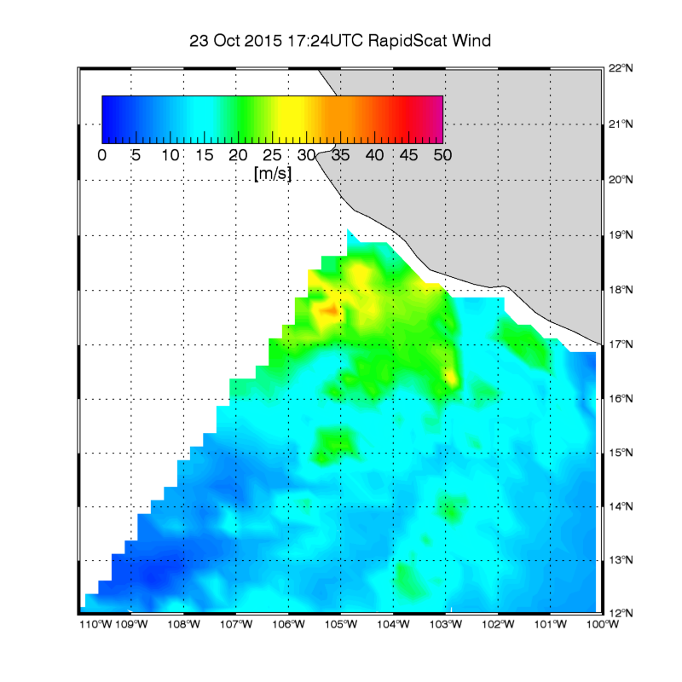
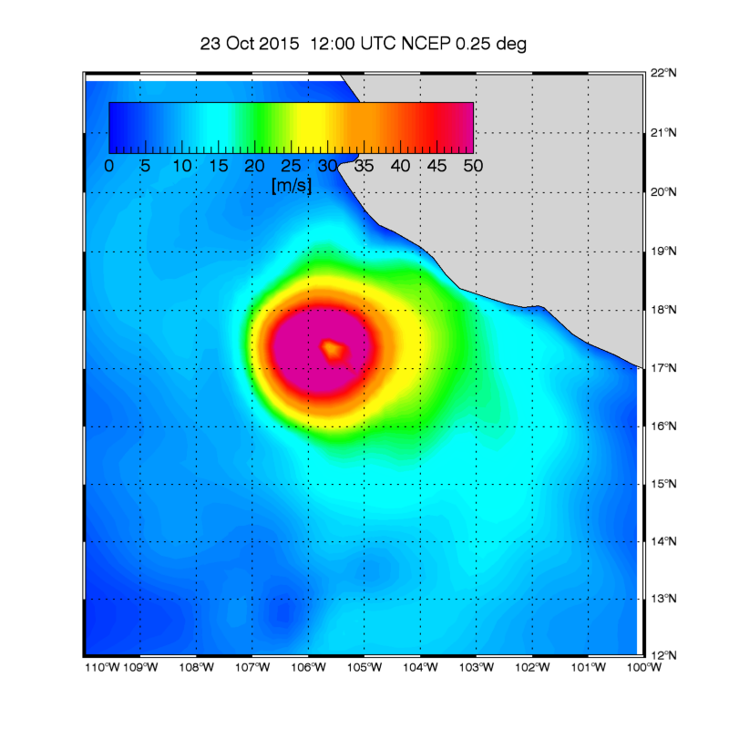
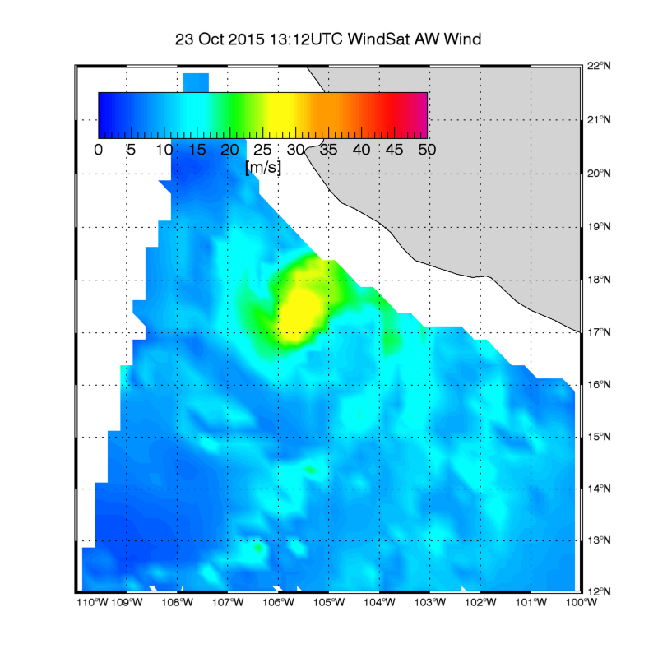
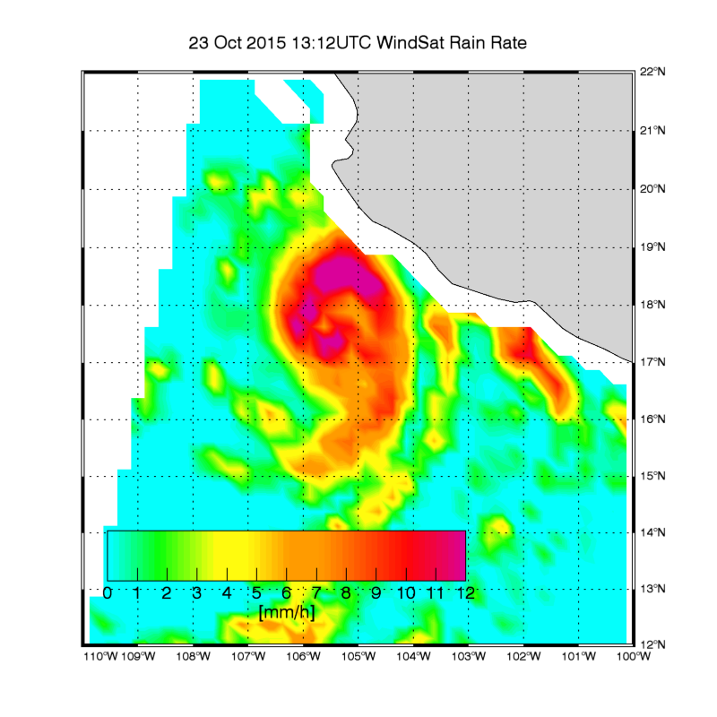
Hurricane Patricia
SMAP
ASCAT
RapidScat
WindSat Rain Rate
NCEP
WindSat All-Weather

Slide 14
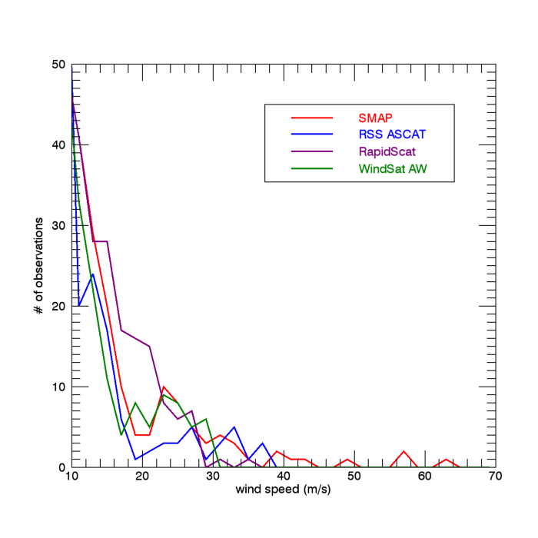
Hurricane Patricia Collocated Wind Speed Distribution SMAP – ASCAT – RapidScat – WindSat
 | Max wind in storm | collocated area (km²) W > 30 m/s
SMAP | 64 m/s | 10105
ASCAT | 36 m/s | 7130
WindSat | 29 m/s | 0
RapidScat | 28 m/s | 0
Best Track 10-min sustained | 79 m/s MSLP: 880 mbar
SFMR resampled | 71 m/s
Only SMAP has W > 36 m/s
Notes:
remove area column

Slide 15
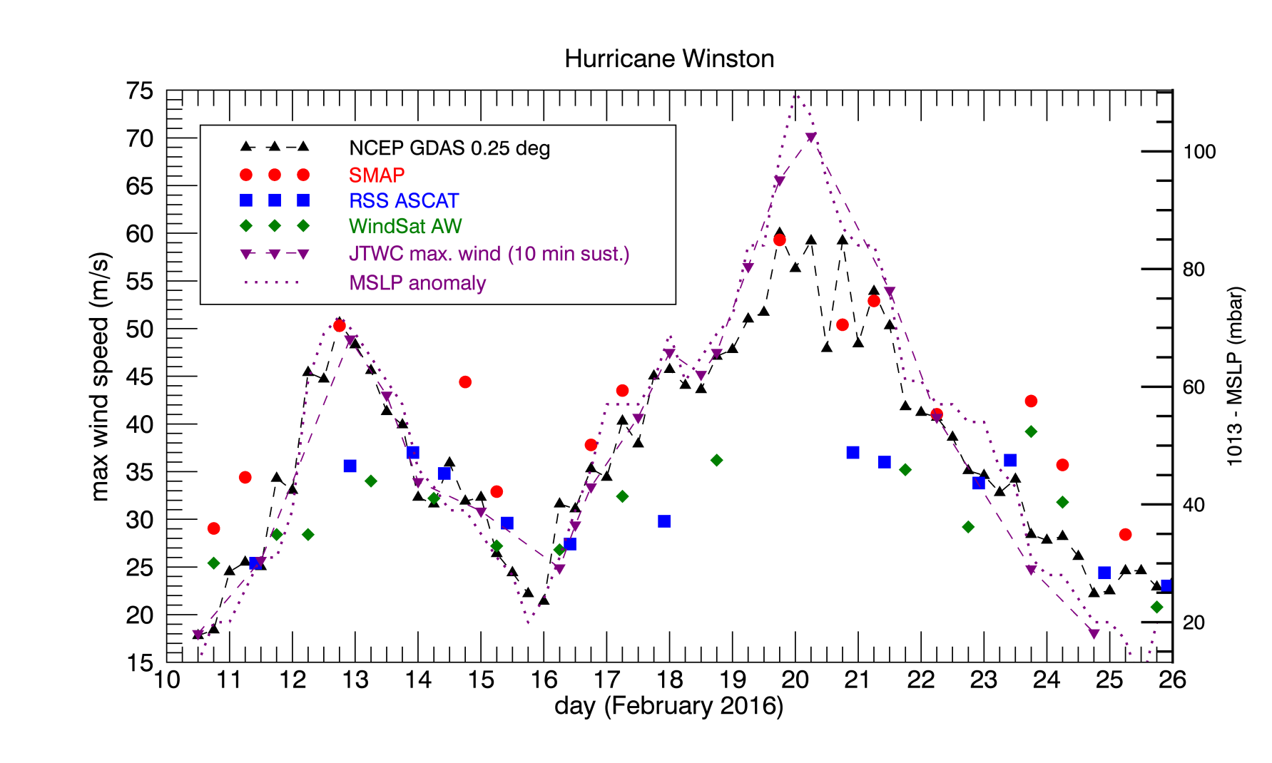
Hurricane Winston 2-Week Time Evolution
SMAP follows MSLP
WSAT and ASCAT saturate
Minimum Sea Level Pressure (MSLP) anomaly is metric for intensity of the storm.
Hurricane Matthew: See presentation by Lucrezia Ricciardulli

Slide 16
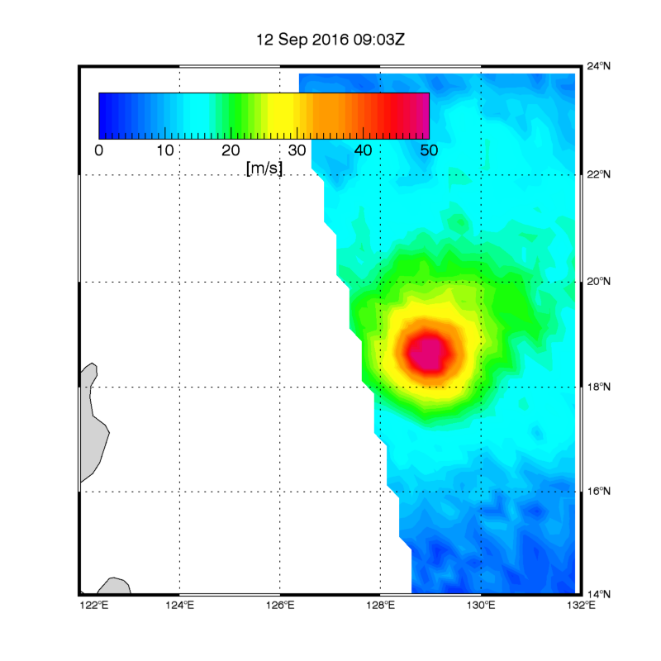
2016 Typhoons Meranti + Malakas
Meranti
Date | 9/12
SMAP W_{max} | 74 m/s
Best Track W_{max} | 70 m/s
MSLP | 907 mbar
WindSat W_{max} | 39 m/s
Malakas
Date | 9/16 | 9/18
SMAP W_{max} | 61 m/s | 43 m/s
Best Track W_{max} | 52 m/s | 41 m/s
MSLP | 937 mbar | 961 mbar
ASCAT W_{max} | 35 m/s | 32 m/s

Slide 17
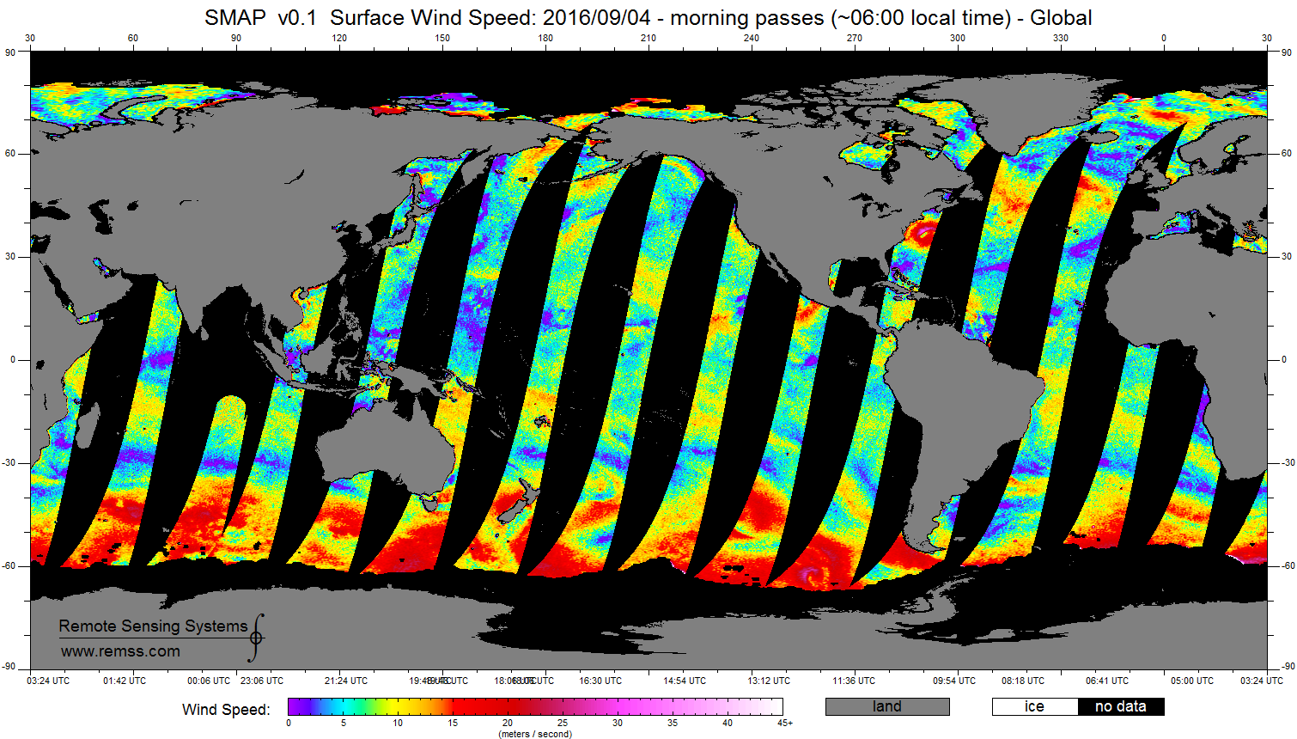
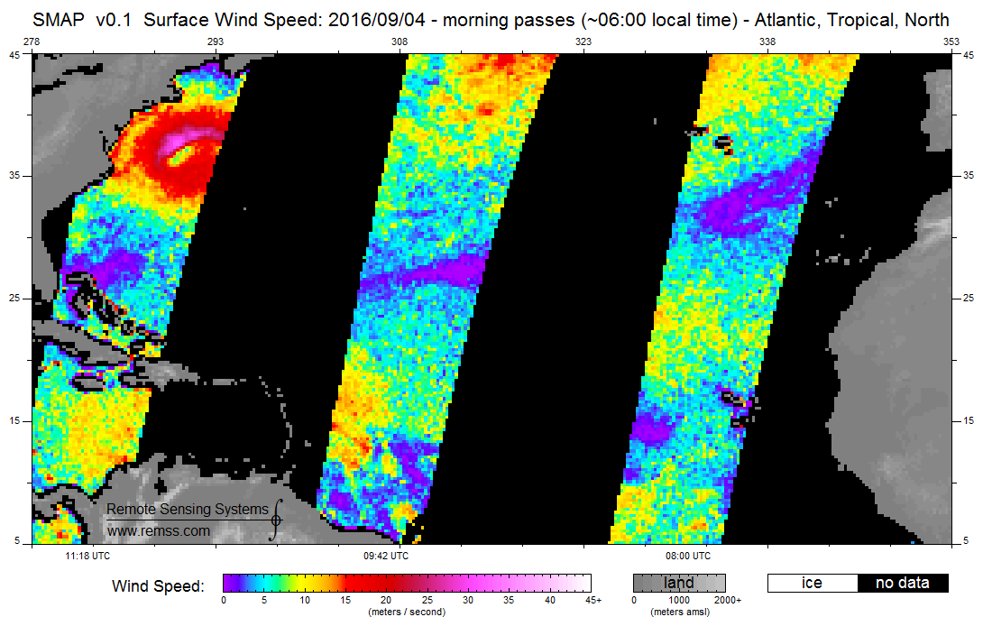
Near Real Time Processing Daily 0.25° maps @RSS Website netCDF4 ftp://ftp.remss.com/smap/wind/
TC Hermine
Sep-04, 2016

Slide 18
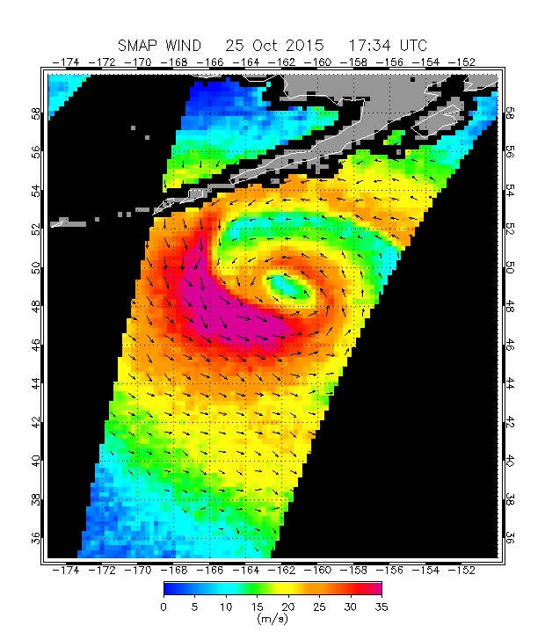
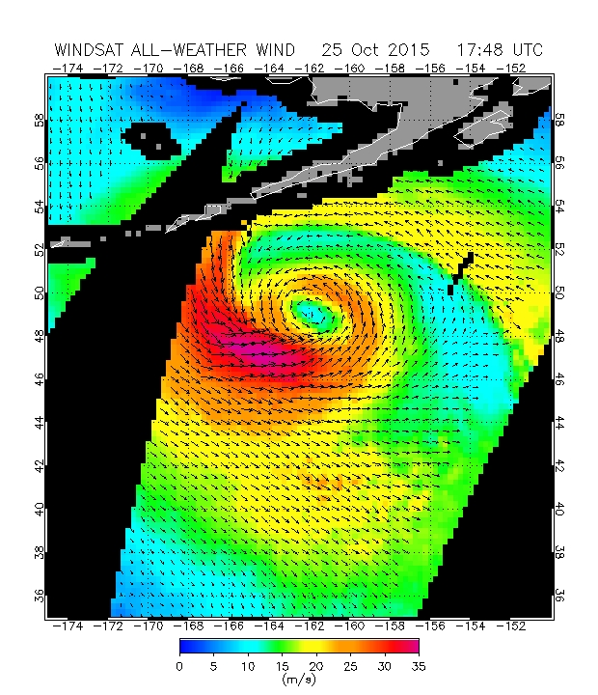
Limited Wind Vector Capabilities Weak polarimetric directional signal > 12 m/s
extra-tropical cyclone
SMAP wind direction retrieval done @ 100 km resolution. Noise reduction.

Slide 19
Summary
The SMAP L-band radiometer has excellent capabilities to measure very strong wind speeds in intense TC
Range: 15 m/s to at least 75 m/s
40 km resolution
SFMR validation: about 10% accuracy
Valuable tool for assessing intensity and size of TC
limited capability to measure wind direction
Key:
Keeps good sensitivity at very high wind speeds
No significant degradation in rain
At high winds it outperforms other spaceborne missions, such as scatterometers (ASCAT, RapidScat) or other spaceborne radiometers (WindSat), whose signals saturate above ~ 35 m/s and which are affected by rain
Data and images available near-real time from RSS
ftp://ftp.remss.com/smap/wind/

Slide 20
Future Work
Potential refinement of high wind L-band GMF
Adjust slope of ΔT_{B}/ΔW
We expect this adjustment to be small
Try to reach consistency with SMOS and V/H-pol radars (Sentinel-1 SAR)
Linear slope of ΔT_{B}/ΔW becomes metric to measure satellite high winds.
L-band radiometer satellite high winds (SMAP, SMOS) can become reference for high wind measurements with other spaceborne instruments:
WindSat "all-weather" wind algorithm
AMSR-2: Two C-band channels (SFMR-like capability to separate out rain)
CYGNSS ?

Slide 21
Backup Slides

Slide 22
Wind Speed Retrieval Correction Tables + Ancillary Fields
Sea Surface Salinity (SSS)
strong dependence at L-band (SSS is prime EDR for SMOS + Aquarius).
need external field: HYCOM, FOAM, WOA, …
Generally accurate enough to be used in SMAP wind speeds.
Inaccurate in large freshwater plumes (Amazon, Congo, …) resulting in inaccurate SMAP wind speeds in those areas.
Sea Surface Temperature (SST)
weak to moderate dependence
need external field: CMC, NOAA OI SST, OSTIA, …
SSS/SST slow varying
can use field from previous day(s) in near-real time processing
Atmospheric profiles
NCEP
very weak dependence. can use climatology or field from previous day(s).
Galaxy/Sun: Fixed tables
No ancillary NWP wind fields are necessary as input to SMAP wind speed retrievals
Notes:
skip

Slide 23
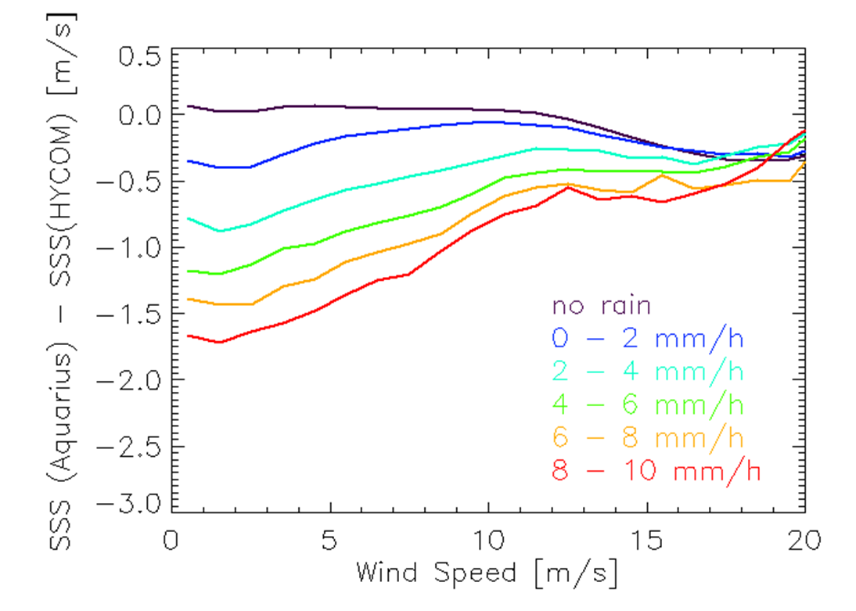
Rain expect little degradation at high winds
Atmospheric attenuation: Very small
At a rain rate of 15 mm/h within the SMAP footprint (which is large!) the T_{B} attenuation is less than 0.30 K ≡0.9 m/s.
Salinity Stratification within upper (5 m) ocean layer
SMAP measures within few cm of surface.
HYCOM model/ARGO drifters refer to ≈ 5 m depth.
At high winds the upper layer is well mixed.
Roughness increase through surface splashing
Very small at high winds.
Low winds
Surface layer stratified
High winds
Surface layer mixed
Aquarius
J. Boutin et. al, BAMS (online), December 2015
Notes:
delta S / delta RR
SMOS :-0.19 psu/(mm/h) for wind speeds 3 – 12 m/s.
Aquarius
-0.17 psu/(mm/h) for wind speed 0 m/s.
-0.13 psu/(mm/h) for wind speed 7 m/s.
-0.07 psu/(mm/h) for wind speed 12 m/s.

Slide 24
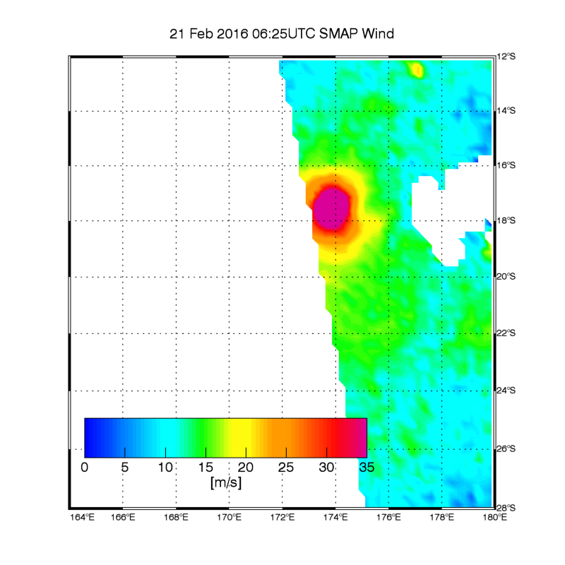
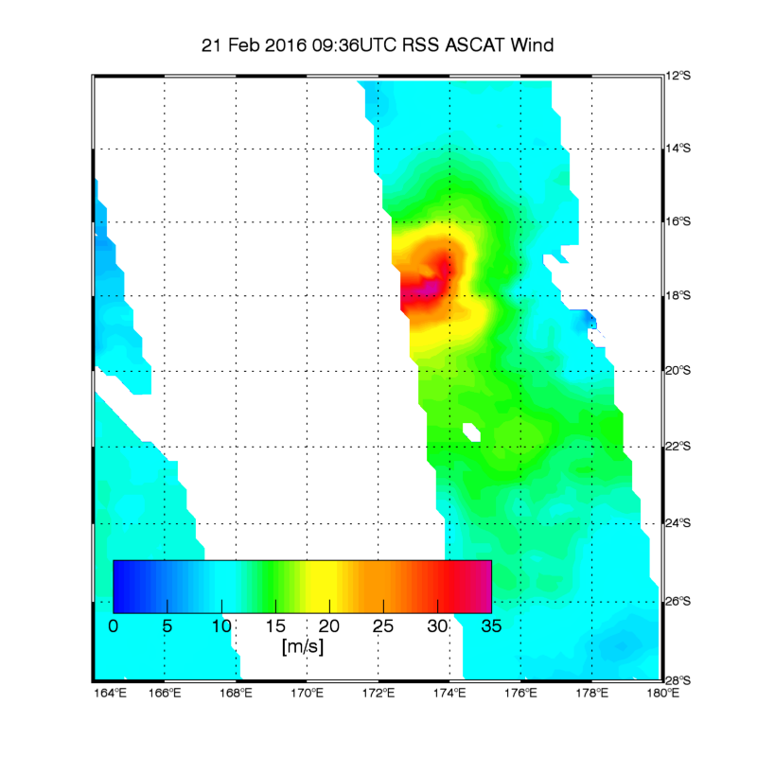
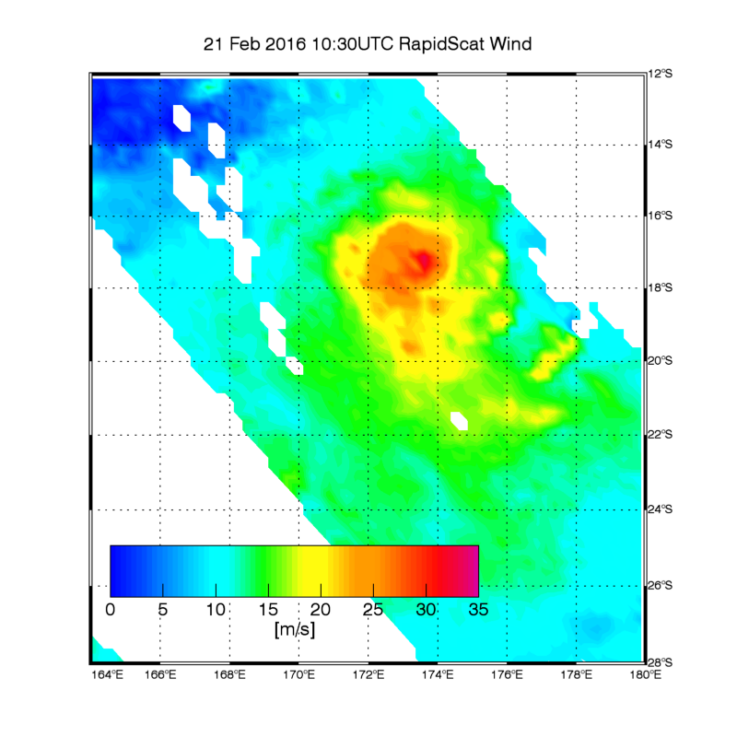
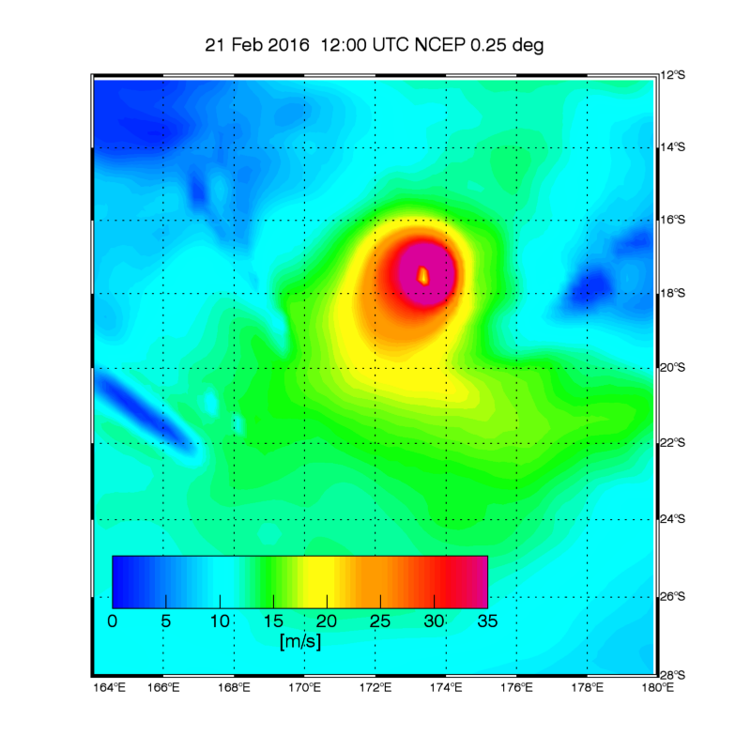
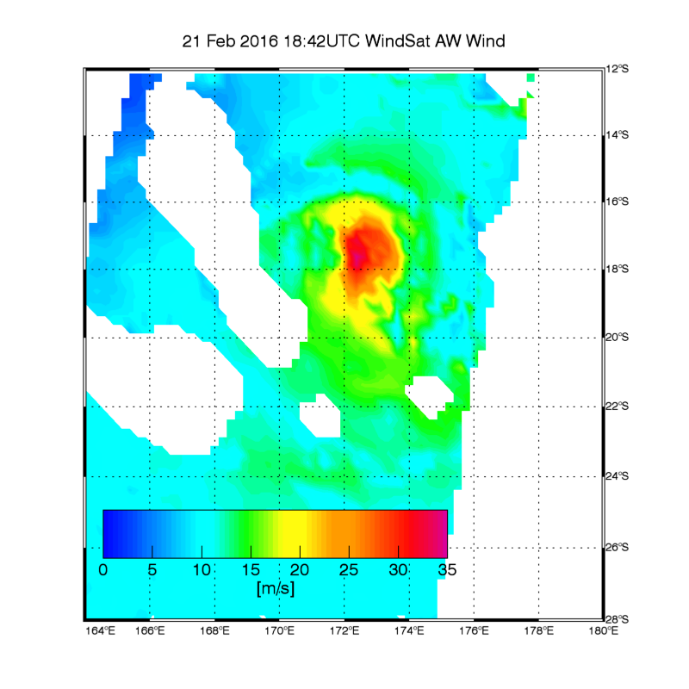
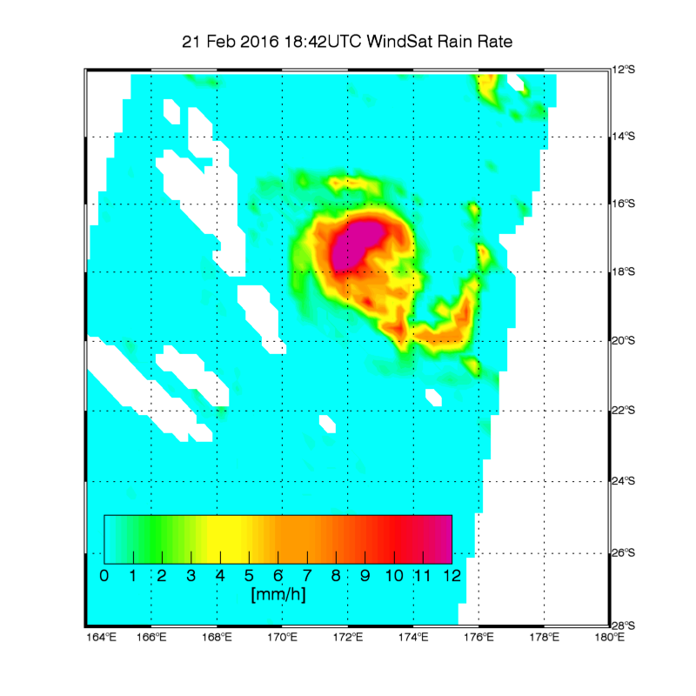
Hurricane Winston
SMAP
ASCAT
RapidScat
NCEP
WindSat AW
WindSat Rain Rate

Slide 25
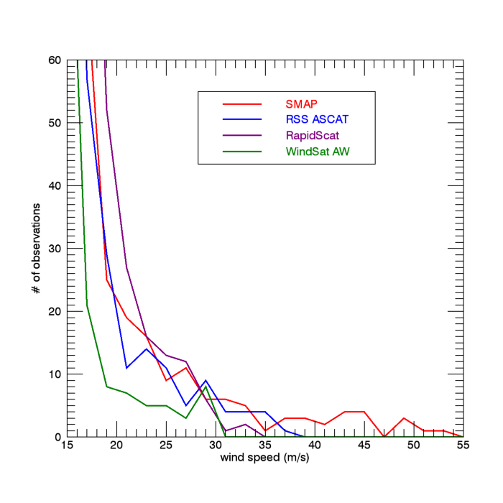
Hurricane Winston Collocated Wind Speed Distribution SMAP – ASCAT – RapidScat – WindSat
 | Max wind in storm | collocated area (km²) W > 30 m/s
SMAP | 53 m/s | 19165
ASCAT | 36 m/s | 7727
RapidScat | 34 m/s | 2872
Best Track 10-min | 54 m/s MSLP: 937 mbar
Only SMAP has W > 36 m/s
Scatterometer (ASCAT, RapidScat) wind signal starts saturating at high winds.
Ku-band scatterometer (RapidScat) affected by rain.
WindSat all-weather algorithm is statistical algorithm. Has not been trained above 40 m/s.
Notes:
skip

Slide 26
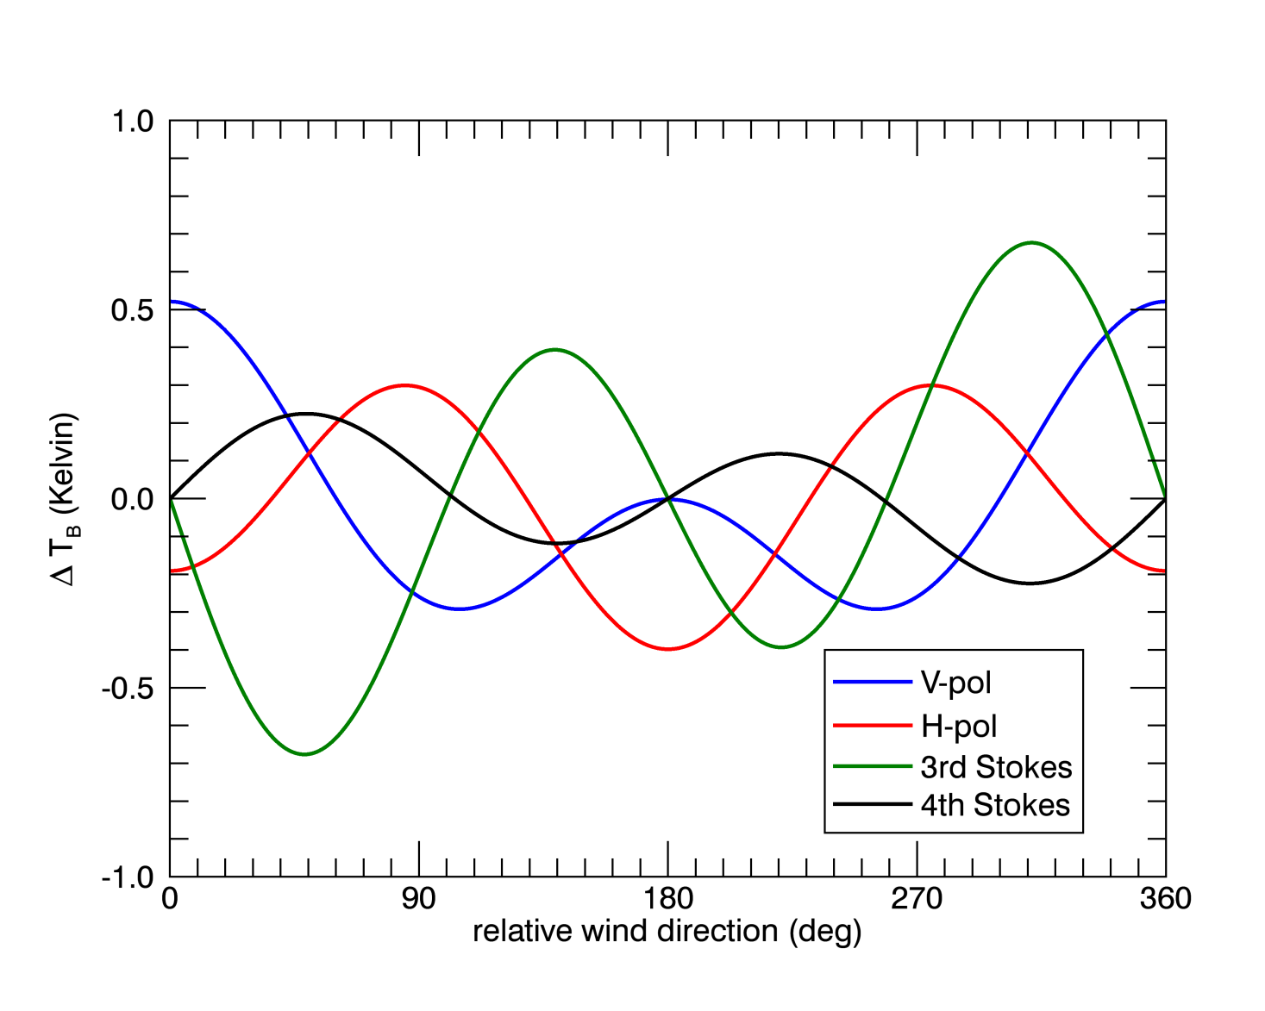
Wind Direction Response Polarimetric Signal
SMAP is fully polarimetric.
Small directional signal.
Wind direction retrieval possible above 12 m/s
1º averaging.
3rd Stokes signal dominated by Faraday Rotation in Earth’s ionosphere.
Use combinations of polarimetric channels that are not affected by Faraday rotation: (V+H), Q²+S₃², S₄ Q=V-H

