Slide 1
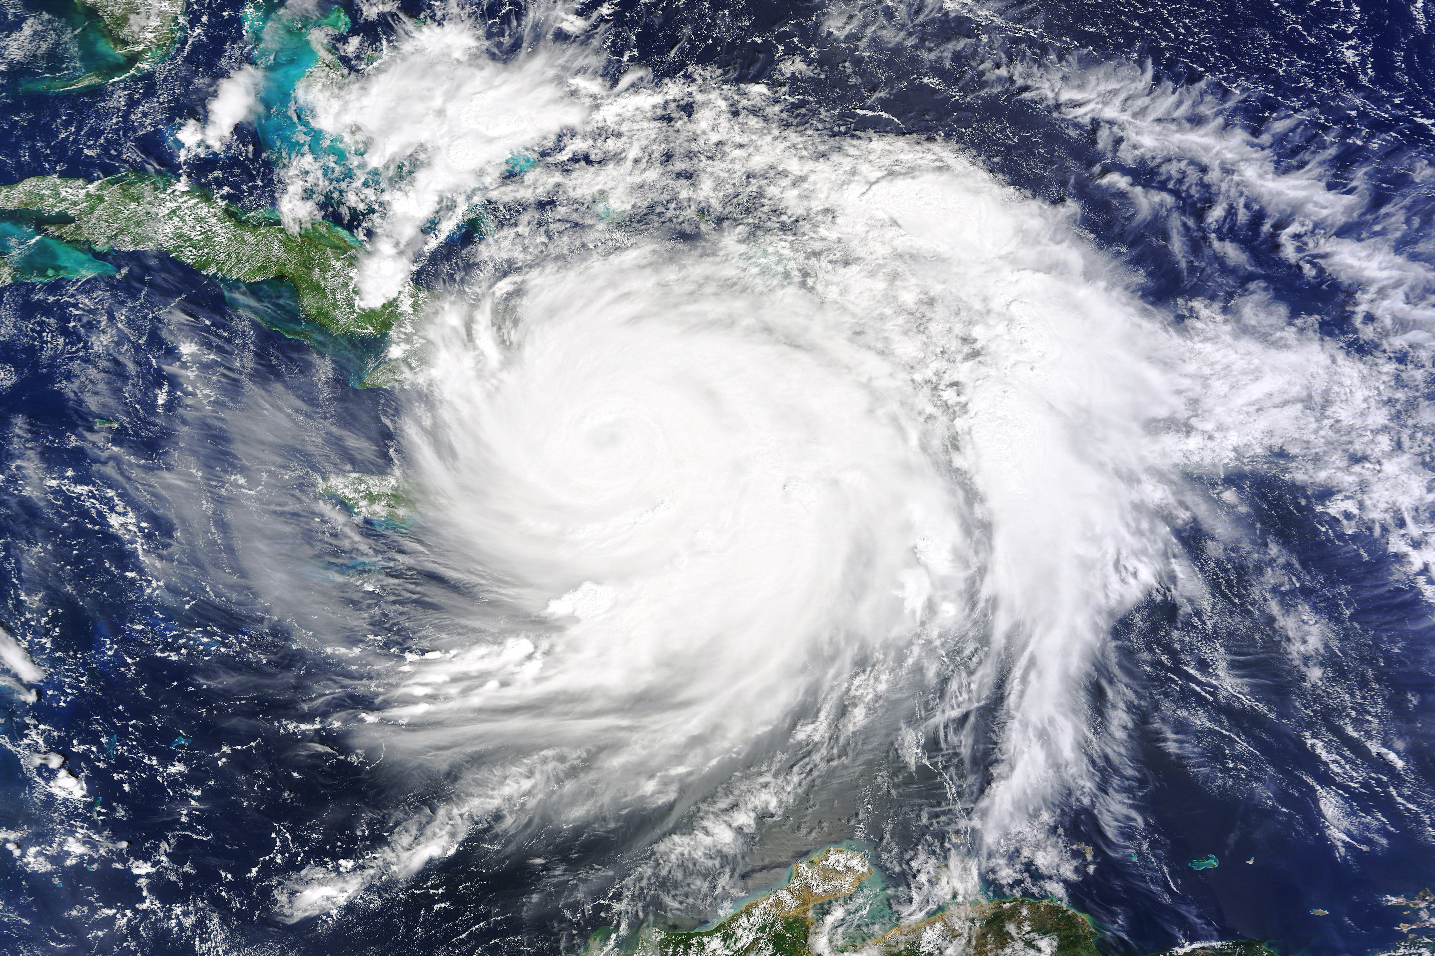
HURRICANE MATTHEW
EXTREME WINDS AND PRECIPITATION FROM SPACE
Lucrezia Ricciardulli, Thomas Meissner, Frank Wentz
Remote Sensing Systems, Santa Rosa, CA, USA
INTERNATIONAL WORKSHOP ON MEASURING
HIGH WIND SPEEDS OVER THE OCEAN
November 2016, UK MET OFFICE, Exeter, UK
Acknowledgements: This work is supported by NASA OVWST

Slide 2
RSS Satellite observations for Hurricane MATTHEW
Sensor | Dataset | Obs. Local Time | Latency
SMAP | Wind speed | 6 am/pm | ~ 6-8 hours
ASCAT | Wind vector | 9:30 am/pm | No NRT, manual processing
WindSat | All-weather Wind vector, Rain, Water Vapor, SST | 6:00 am/pm | 6-12 hours
GMI, AMSR2, SSMIS | Rain rates, WV, SST | Variable | 3-12 hours
MW Radiometers | Blended SST | Variable | 24 hours
Analysis of almost NRT wind and precipitation data from RSS
Comparison with:
- NHC best track data, max 10-min sustained winds (0.88 scaling from 1-min)
- SFMR (from HRD, NOAA flights; US Air-force flights to be done when available)
- NCEP GFS wind fields, 0.25 deg
2

Slide 3
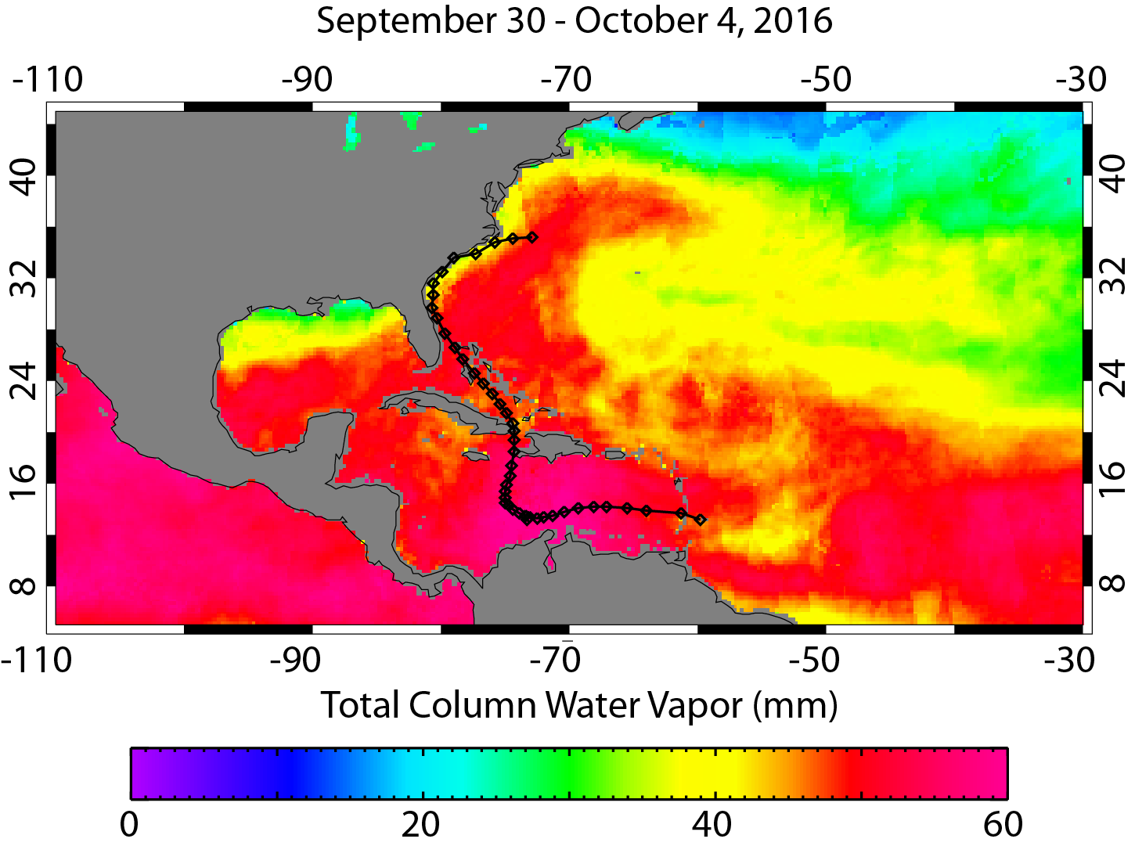
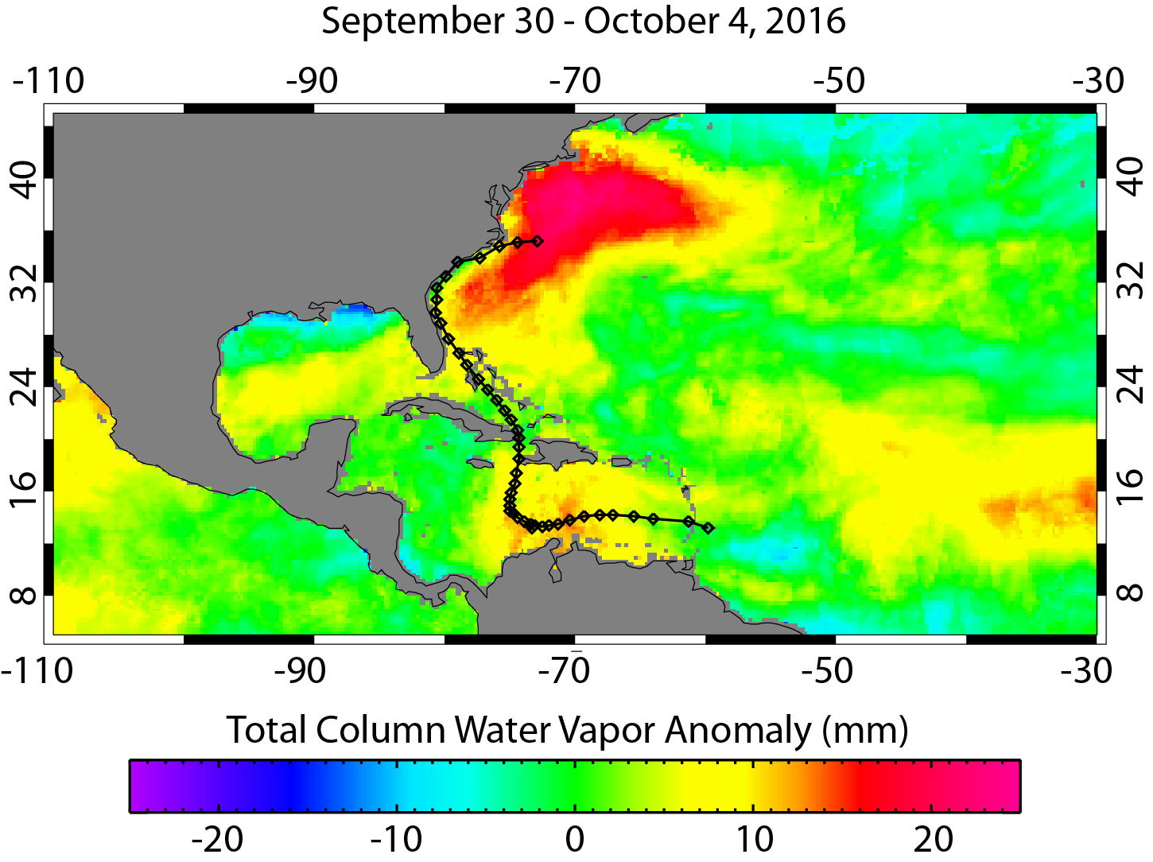
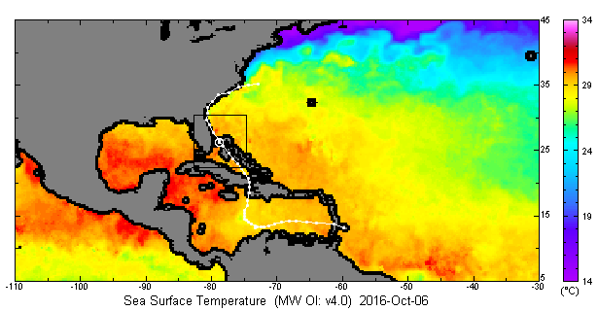
PRECONDITIONING of hurricane Matthew
Very warm SSTs over all tropical Western Atlantic
More moisture → potential for feeding the storm intensity
2. No significant cold wake → missed opportunity for weakening
3. Eyewall travelling just off-shore the US coast for several days → No weakening until landfall on Oct 9
All of this led to a storm that hit Haiti and the US, with Cat. 3-4 winds for more than a week
and continuous wide-spread extreme precipitation
SST
Water Vapor
Water Vapor anomaly
3

Slide 4
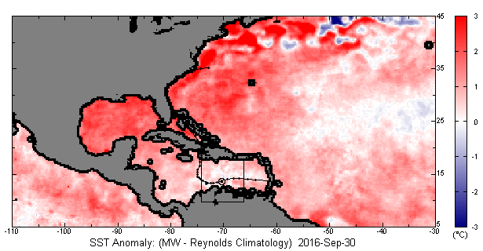
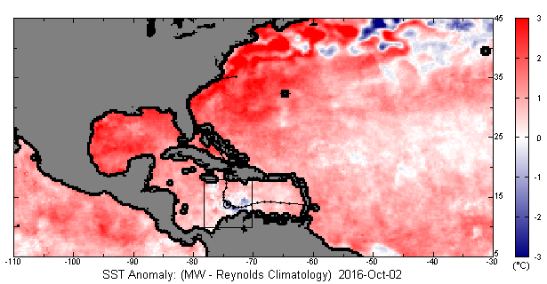
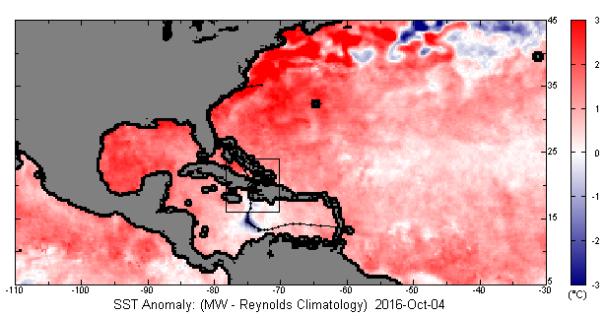
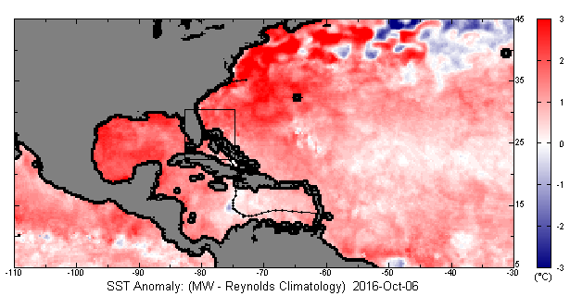
sST anomalies
Very warm SSTs, no significant cold wake
SEP 30
OCT 2
OCT 4
OCT 6
4

Slide 5
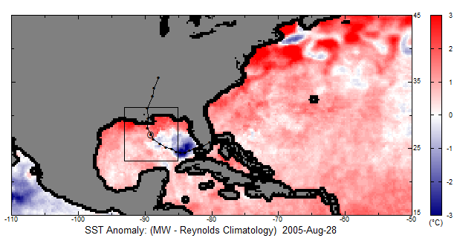
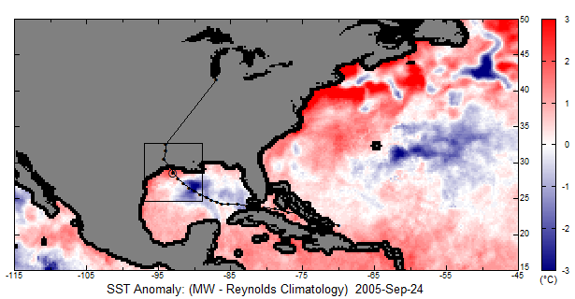
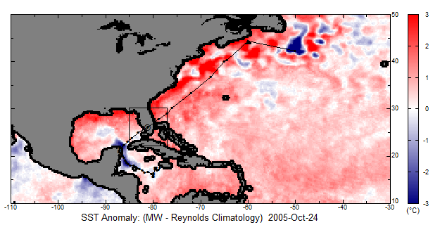
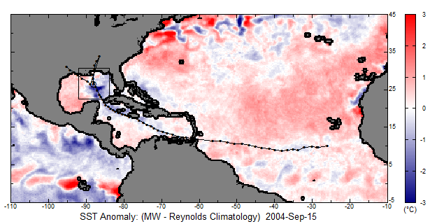
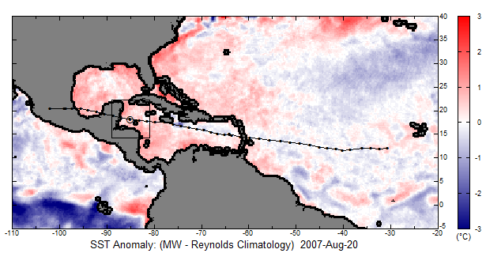
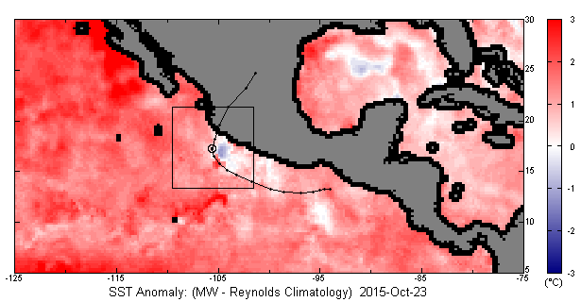
COLD WAKE for OTHER STORMS
Katrina, Aug 28, 2005
Rita, Sep 24, 2005
Wilma, Oct 24, 2005
Ivan, Sep 15, 2004
Dean, Aug 20, 2007
Patricia, Oct 23, 2015
El Nino → Deep thermocline
Very warm SST & No cold wake
Very intense hurricane
Images/data available at http://www.remss.com/storm-watch#storm-archive
5

Slide 6
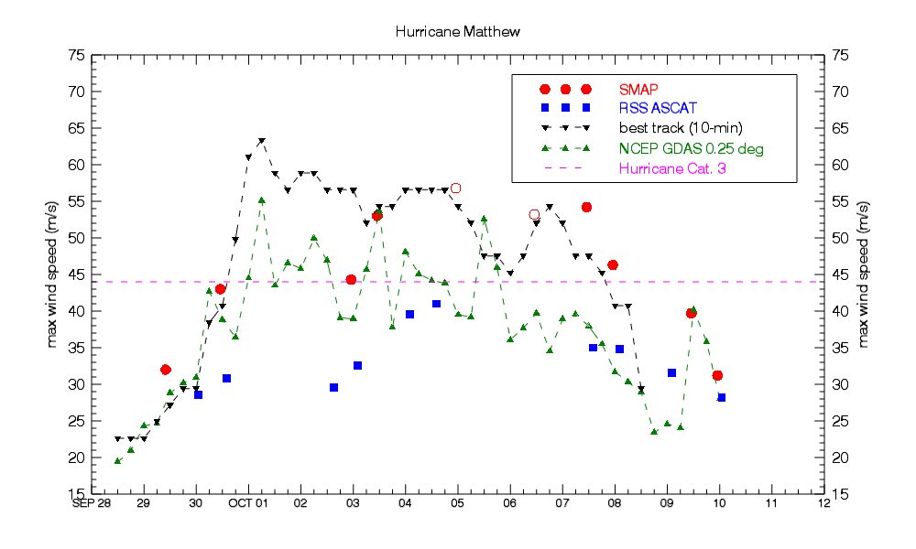
TRACKING MATTHEW’S MAXIMUM WINDS TIMESERIES
Haiti
North Carolina
O Possible land contamination in SMAP
5

Slide 7
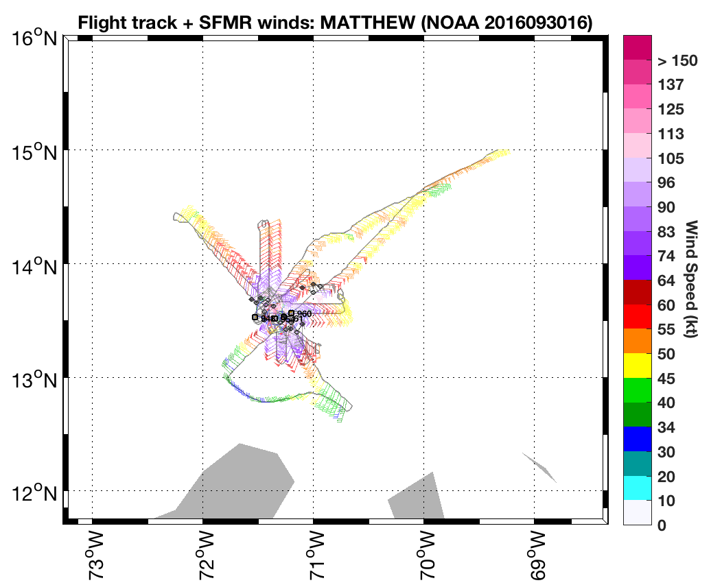
WIND VALIDATION WITH AIRBORNE OBSERVATIONS
What do we use to validate satellite hurricane-force winds?
NOAA flights with SFMR and GPS dropsondes during Matthew available at the NOAA/HRD website
http://www.aoml.noaa.gov/hrd/Storm_pages/matthew2016/sfmr.html
US Air Force flights not yet available.
SFMR surface winds consistent with dropsondes scaled at surface
- Extensive validation dropsondes vs SFMR in Klotz and Uhlhorn (JAOT, 2014)
6

Slide 8
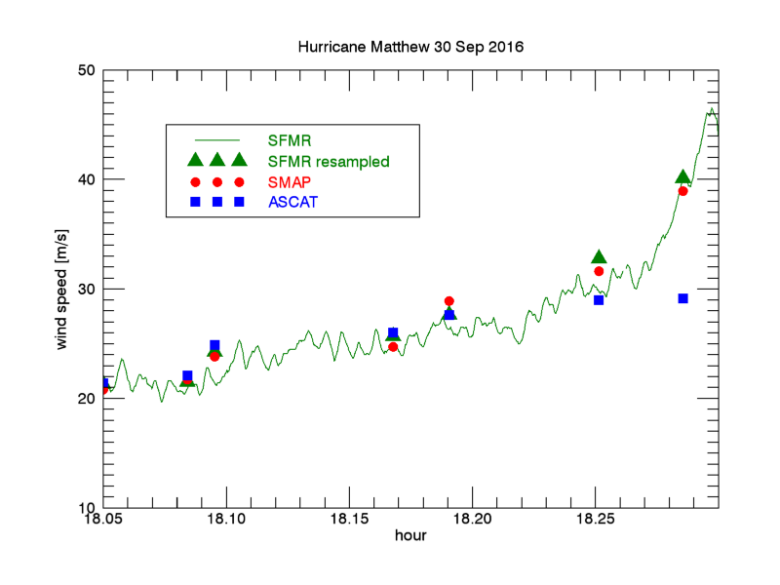
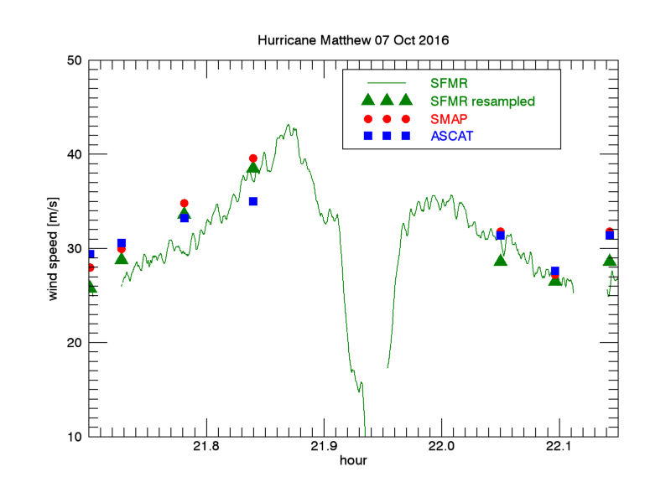
SATELLITE WINDS VS SFMR
Under the assumption that SFMRs accurately measure surface winds,
SMAP Hurricane-force winds are proven to be very realistic.
ASCAT underestimates surface hurricane-force winds → rain, low sensitivity, or scatterometer model function?
7

Slide 9
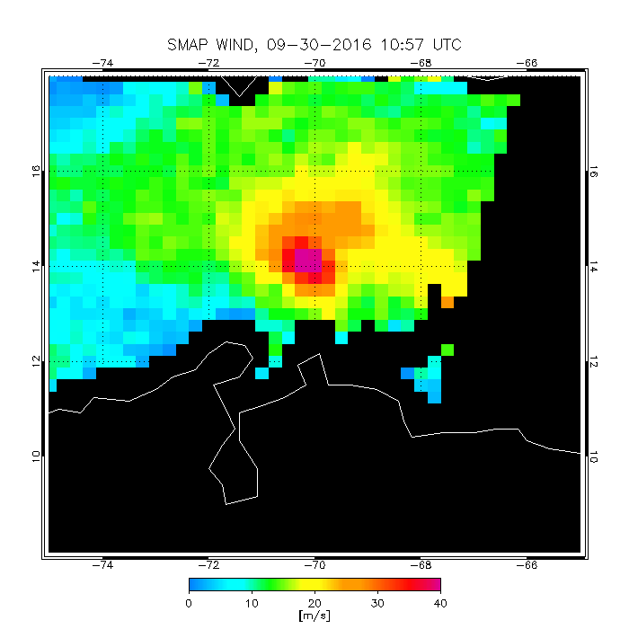
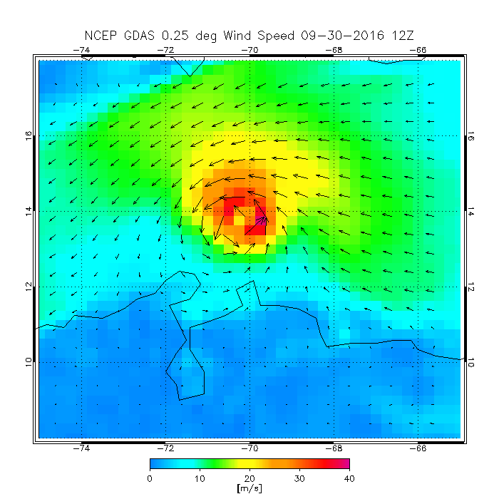
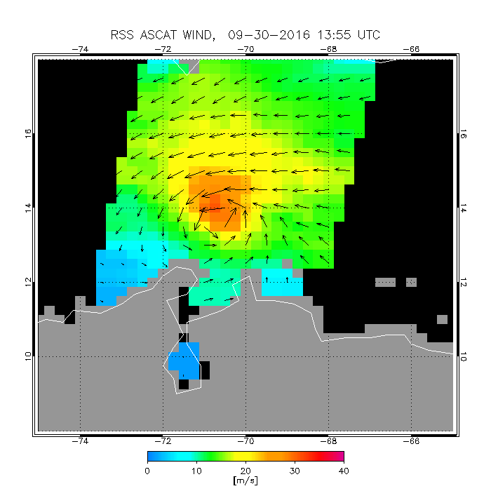
MATTHEW: Satellite surface winds
September 30, AM:
NHC reported Category 3
SMAP Category 2/3
ASCAT too low
SMAP 11 UTC
NCEP 12 UTC
ASCAT 14 UTC
8

Slide 10
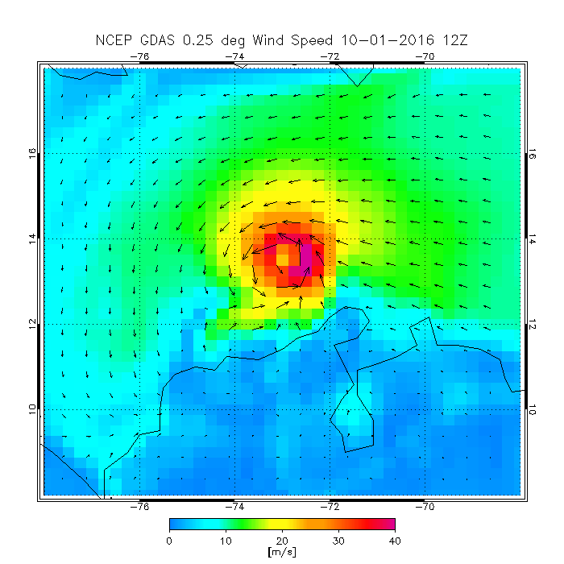
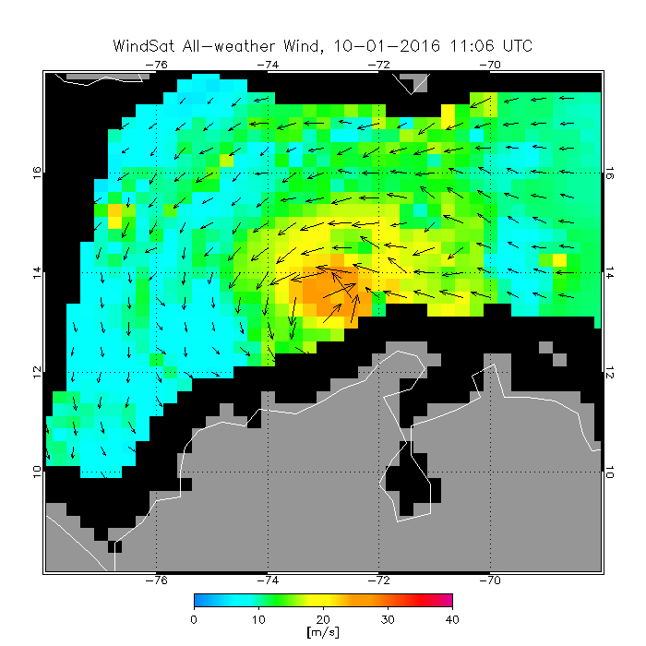
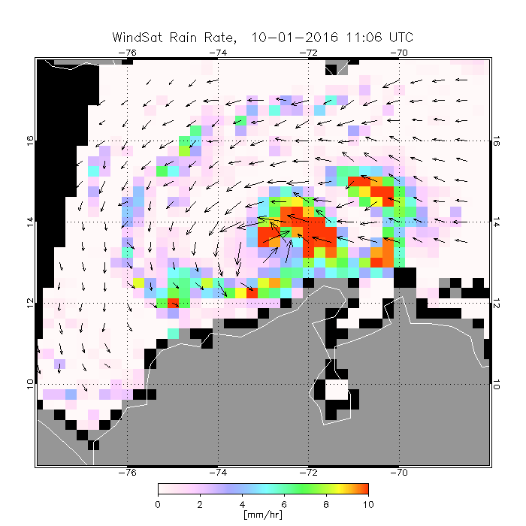
October 1:
NHC reported Category 5
WindSat all-weather winds too low (rain impact)
no SMAP or ASCAT (satellite gaps or partial view)
NCEP GFS
WINDSAT AW WINDS
WINDSAT RAIN
9

Slide 11
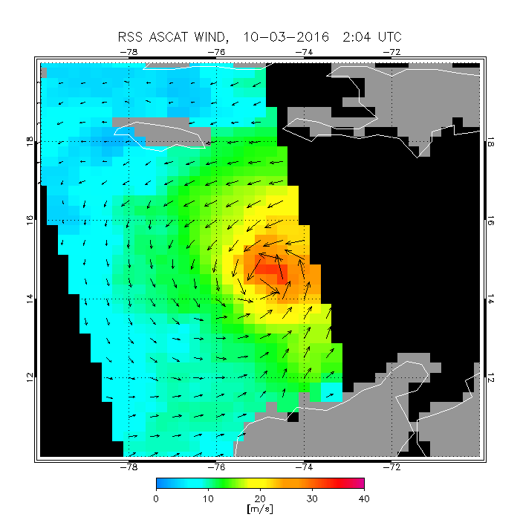
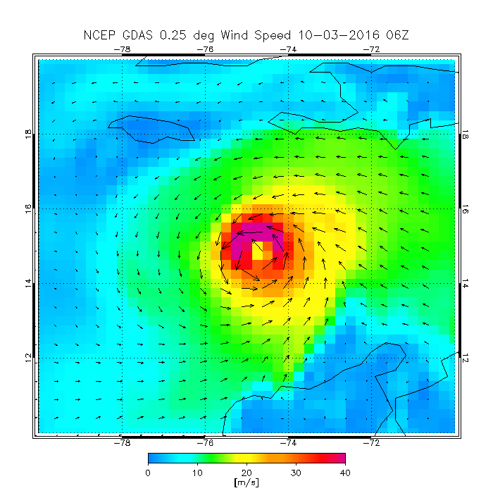
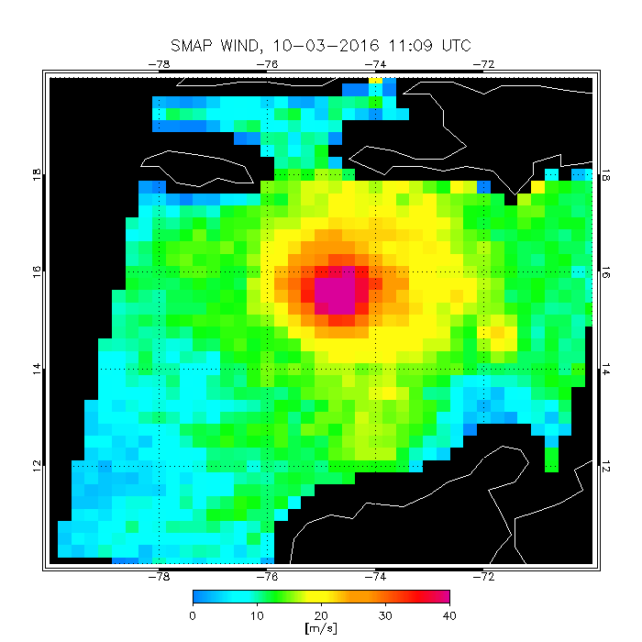
October 3: approaching Haiti
NHC reported Category 4
SMAP Category 4
ASCAT wind speed too low (Category 1) , good wind direction
ASCAT 2 UTC
NCEP 6 UTC
SMAP 11 UTC
10

Slide 12
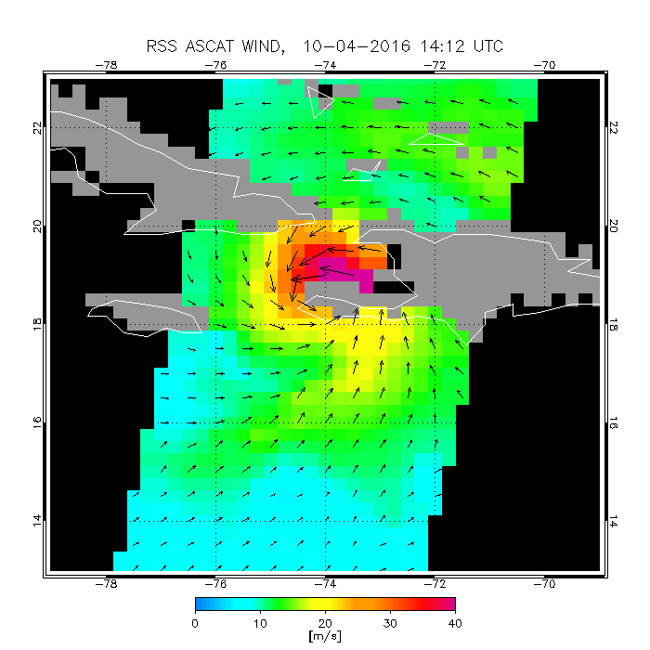
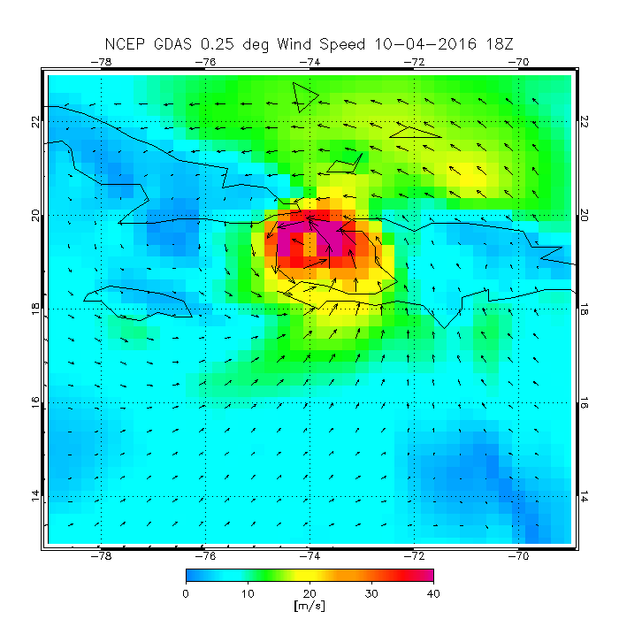
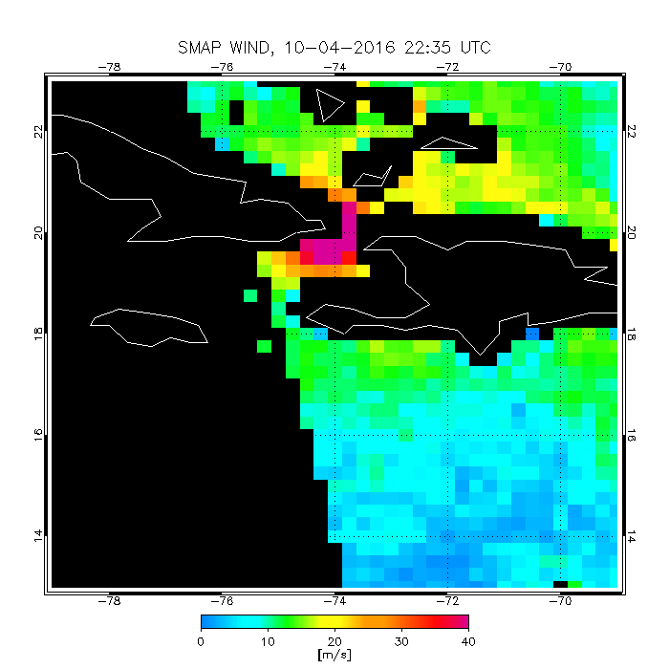
October 4: Haiti landfall
NHC Category 4
SMAP Category 4, but possible land contamination
ASCAT Category 2, good wind direction
ASCAT 14 UTC
NCEP 18 UTC
SMAP 22 UTC
Possible land contamination
11

Slide 13
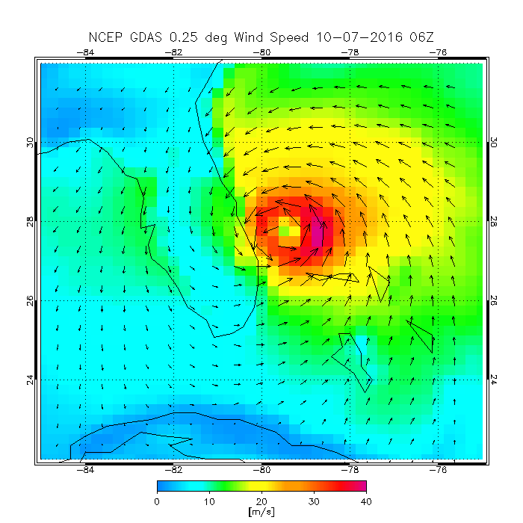
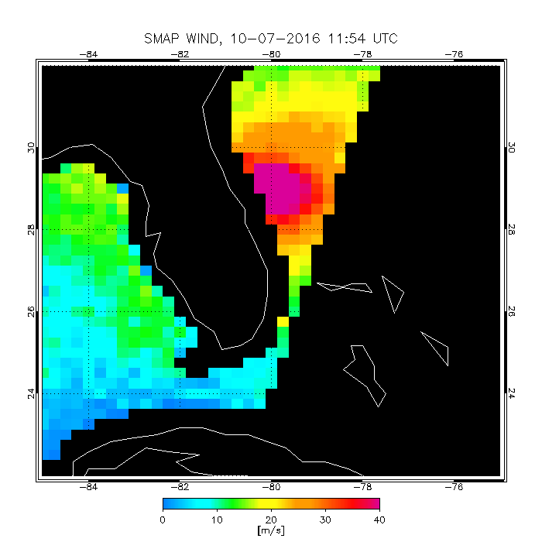
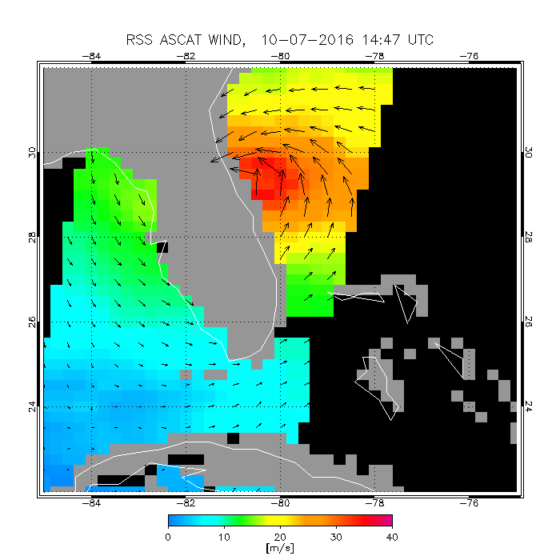
October 7: off Florida
NHC Category 3-4
SMAP Category 3-4
ASCAT Category 1
NCEP 6 UTC
SMAP 12 UTC
ASCAT 14 UTC
12

Slide 14
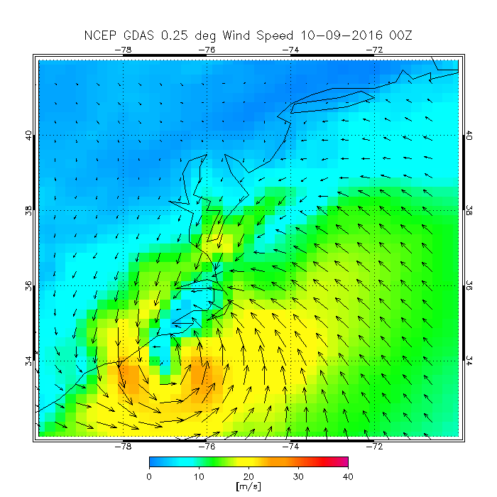
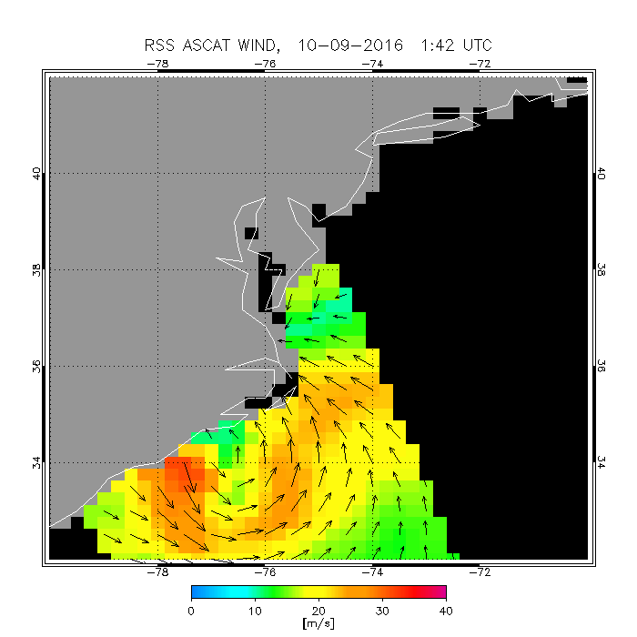
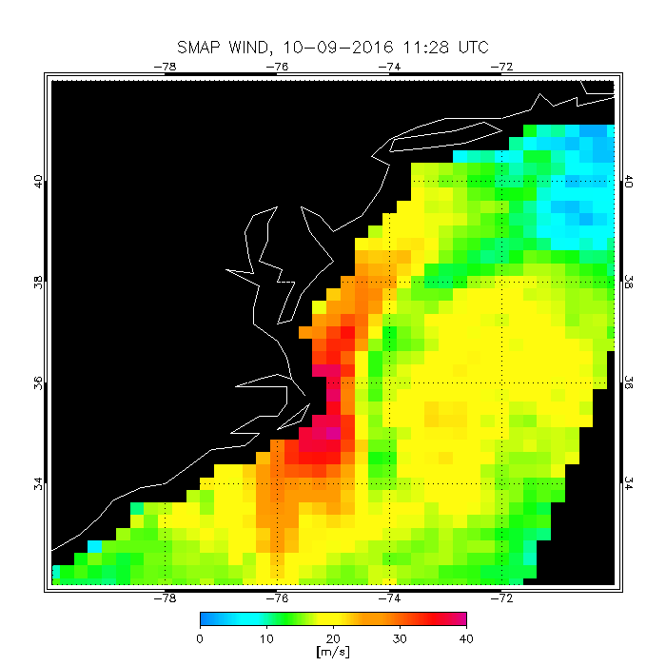
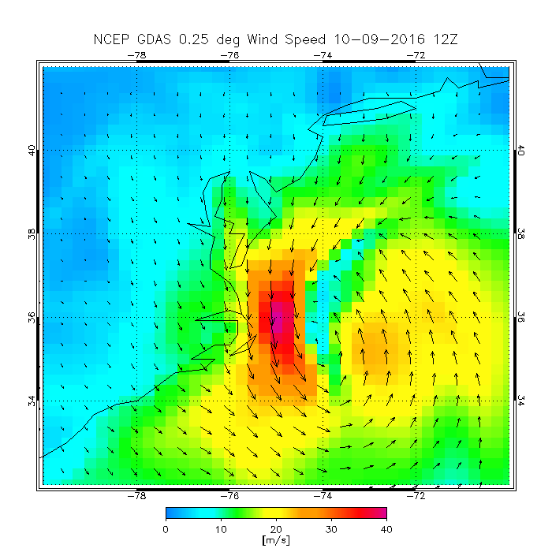
October 9: landfall south Carolina, post-tropical storm
NCEP ~ 40 m/s
SMAP hurricane force winds (max 40 m/s)
ASCAT ~ 32 m/s, but 10 hours earlier, before re-intensification
NCEP 00 UTC
ASCAT 2 UTC
SMAP 12 UTC
NCEP 12 UTC
13

Slide 15
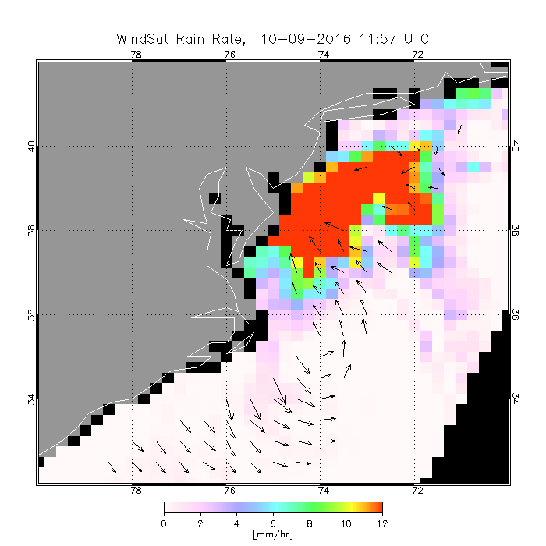
October 9: PRECIPITATION at landfall
Extreme precipitation in area as wide as 300 Km
14

Slide 16
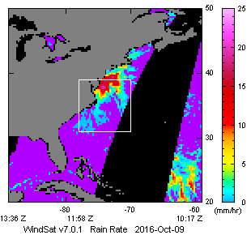
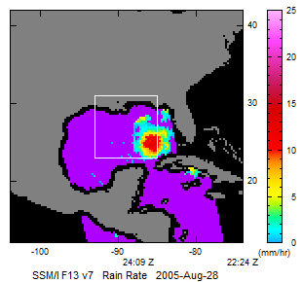
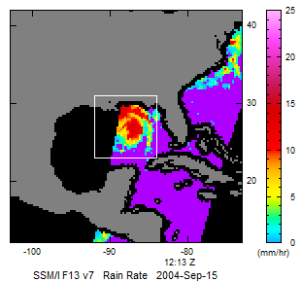
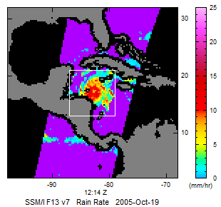
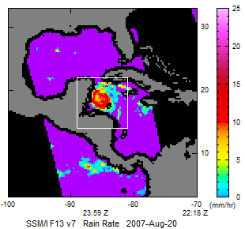
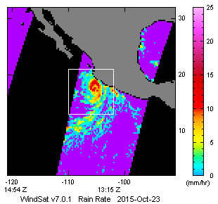
RAIN intensity: comparison to other hurricanes
Matthew, 2016
Katrina, 2005
Rita, 2005
Wilma, 2005
Dean, 2007
Patricia, 2015
15

Slide 17
summary
Review of Satellite MW observations of winds/rain/SST during Matthew
Validation of satellite hurricane-force winds with SFMR (→ dropsondes)
Matthew extreme winds and precipitation fueled by anomalously high SST, high moisture, lack of cold wake, late landfall.
ASCAT correlates to SMAP and NHC best track below 35 m/s,
underestimates hurricane-force winds. Never reached Category 3.
SMAP winds are consistent with SFMR and NHC best track 10-min max winds, through the whole period (Sep 30-Oct 9)
Potential benefit of SMAP in NWP
16

