Slide 1
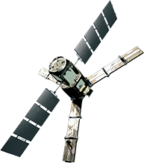
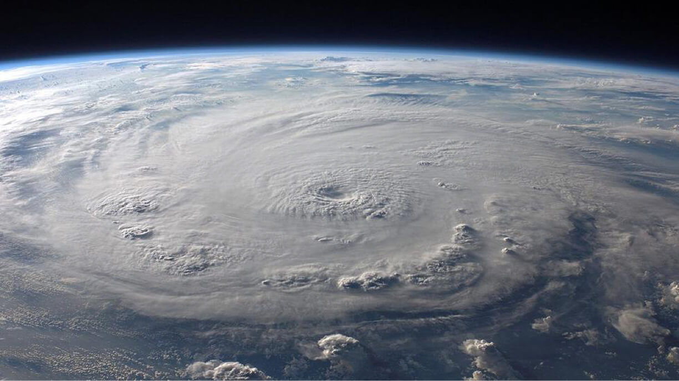

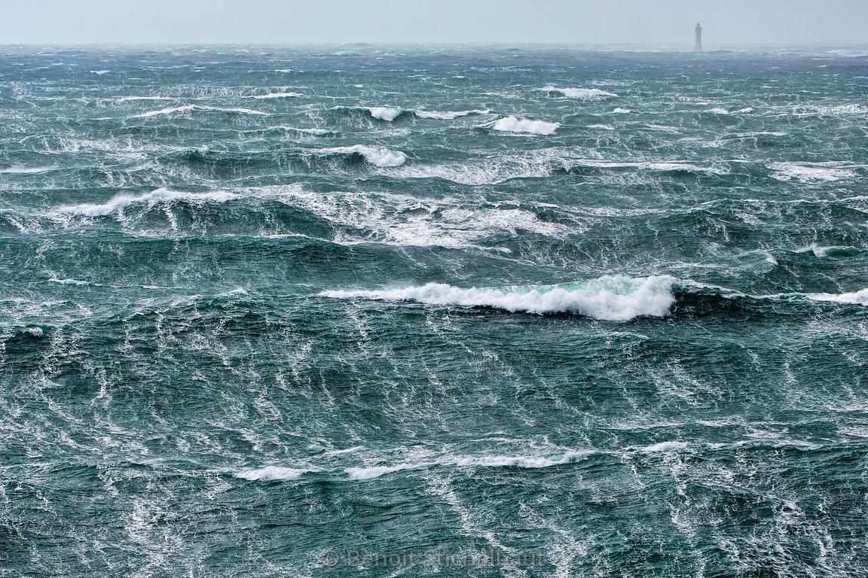
A New Generation
of Space borne Observations of the Ocean in Extreme
Wind Speed conditions
Execter High Wind Workshop
By N. Reul, B. Chapron, E. Zabolotskikh, C.Donlon, A. Mouche, J. Tenerelli, F. Collard, J.F. Piolle, A. Fore, S. Yueh, J. Cotton, P. Francis, Y. Quilfen and V. Kudryavtsev
E. Zabolotskikh, B. Chapron,Y. Quilfen, F. Collard, J. Cotton,
P. Francis, V. Kudryavtsev, J. Tenerelli
UK MetOffice
Exceter 15-17 Nov 2016

Slide 2
Tropical cyclone & Extra-Tropical storm track prediction is steadily improving, while storm intensity prediction has seen little progress in the last quarter century.
=>Important physics are not yet well understood and implemented in tropical cyclone forecast models.
Missing and unresolved physics, especially at the air-sea interface, are among the factors limiting storm predictions.
Detail Information on surface winds under Tropical Cyclones are key to better storm forecasting. However, their measurements from Space with traditional onboard instruments (radars, high-frequency radiometers) is challenging (rain contamination, lost of sensitivity at very high winds,..)
Focus here: study of low-microwave frequency radiometer capabilities (dual C-band from AMSR-2) & new inputs from L-band missions (SMOS, SMAP) for ocean surface remote sensing in extreme conditions

Slide 3
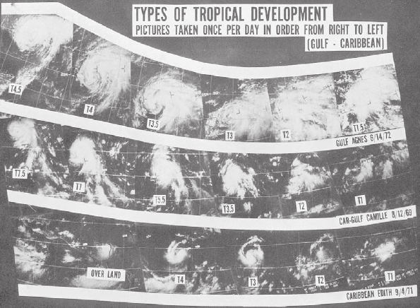
The Advanced Dvorak Technique (ADT)
The Advanced Dvorak Technique (ADT) utilizes longwave-infrared, temperature measurements from geostationary satellites to estimate tropical cyclone (TC) intensity. The ADT is based upon the operational Dvorak Technique developed by Vern Dvorak of NOAA over 30 years ago..
The Dvorak Technique continues to be the standard method for estimating TC intensity where aircraft reconnaissance is not available (all tropical regions outside the North Atlantic and Caribbean Sea), however it has several important limitations and flaws.

Slide 4
Ocean-Atmosphere Interface in very High Wind speed conditions
Whitecaps
Foam streaks

Slide 5
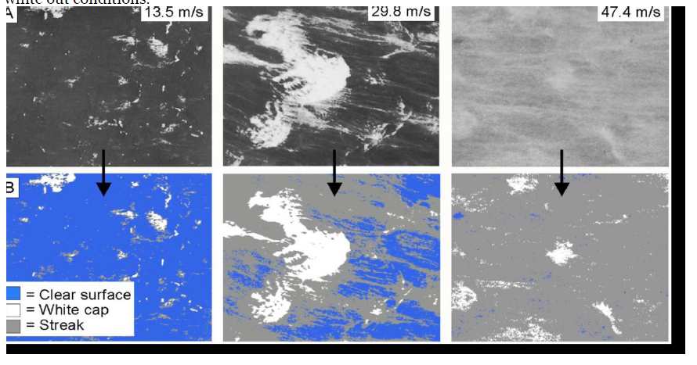
Holthuijsen et al. 2012 investigate these processes using aerial reconnaissance films and GPS drop sondes in hurricanes
Separation of whitecap & streaks coverage

Slide 6
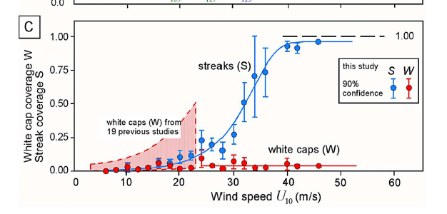
Holthuijsen et al. JGR 2012
Most of the increased surface whitening at & above hurricane force (>33 m/s) is principally
induced by the increased streaks coverage- whitecap coverage is found ~constant above
Hurricane force ~4 %

Slide 7
Sea Surface Observation Capabilities from Space
in
Extreme Wind Conditions

Slide 8
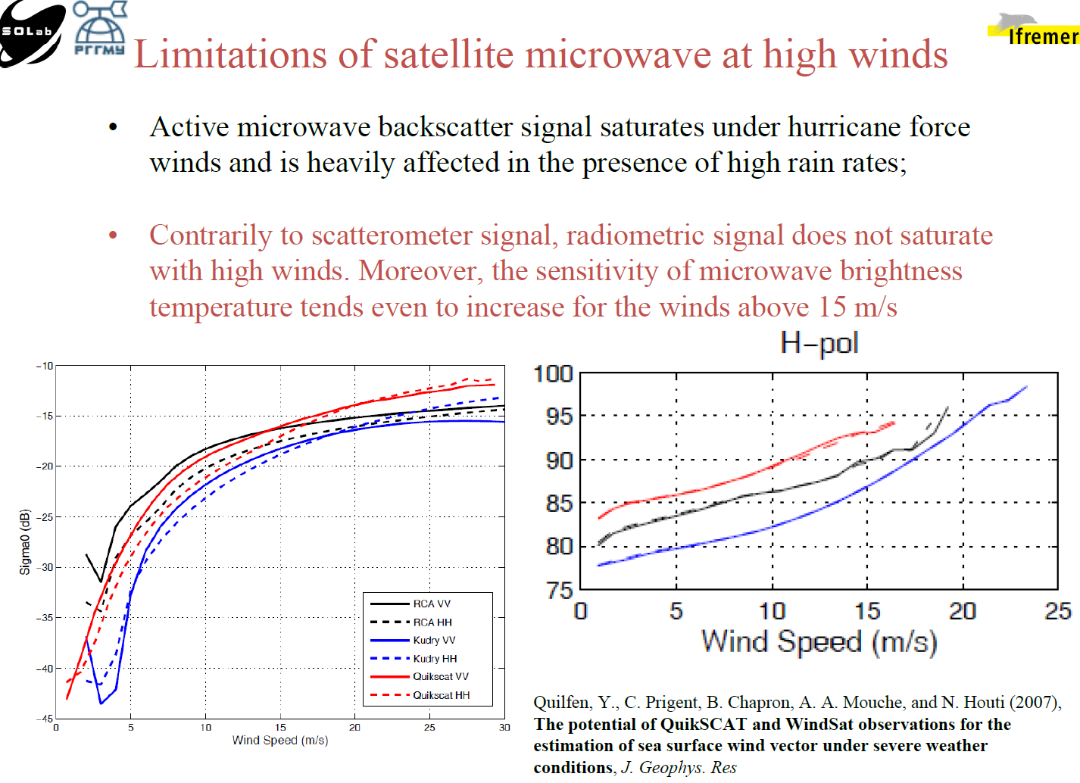
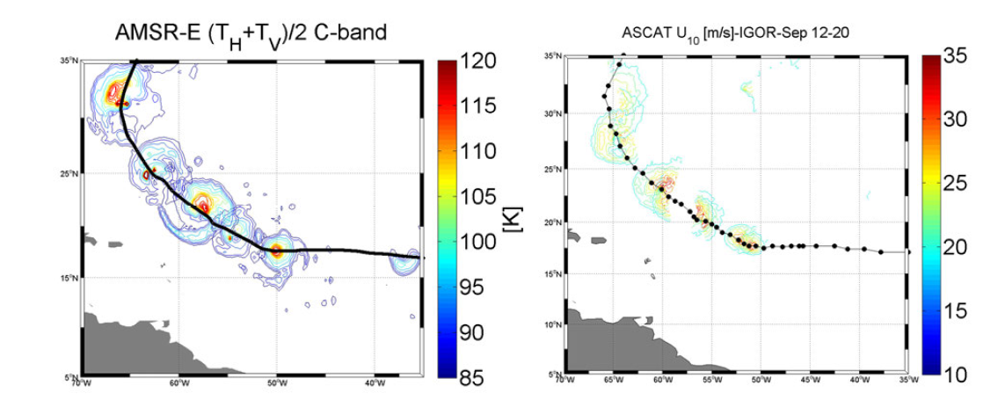
Active microwave C-band backscatter signal in V-pol (Ascat ) saturates under hurricane force (Fernandez et al., 2006)
Lost of sensitivity at high winds due to NRCS saturation
Strong Rain
Impacts

Slide 9
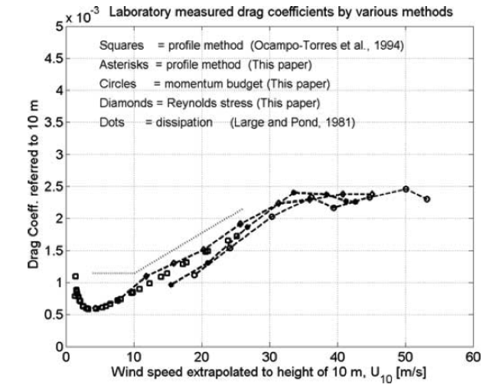

$$τ=ρU_{∗}^{2}=ρC_{D}U_{10}^{2}$$
The aerodynamic roughness of the ocean saturates or even decreases above hurricane force
Donelan, 2004
Powell, 2003
Jarosz, 2007
Small scale scatterers responsible for dual pol NRCS growth as function of winds disappear at high winds, being replaced by mixture of bubbles, foam, streaks and spray layers

Slide 10
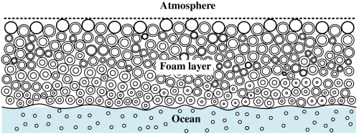

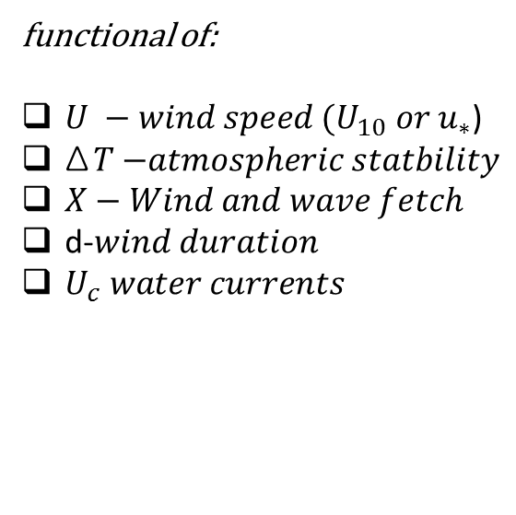

Passive Remote Sensing of Sea at High winds
Emissivity e is function of whitecap coverage
W and thickness
$$e=\left(1−W\right)e_{r}+We_{f}$$
$$T_{B}={eT}_{s}$$
High emissivity of foam layers in
the microwave region
Advantages
Transparent (almost) to the atmosphere
No saturation
Drawbacks
Affected by rain at frequency > 5 GHz
Low spatial resolution of orbiting instruments ~40-50 km
functional of:
$U −wind speed (U_{10} or u_{∗}$)
ΔT $−atmospheric statbility$
$X−Wind and wave fetch$
d-$wind duration$
$U_{c} water currents$

Slide 11
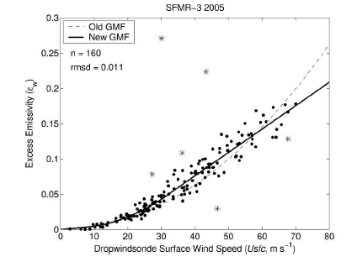

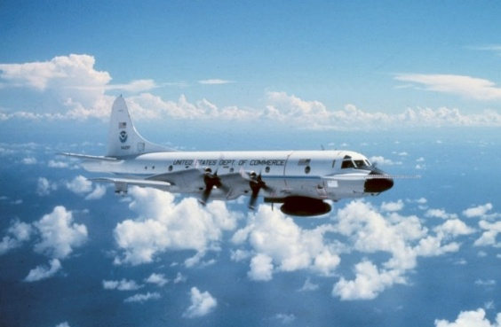
Wind speed retrieval in extreme winds : SFMR
Increase of the microwave ocean emissivity
with wind speed ⬄ surface foam change impacts
Hurricane hunter P-3
This information can be used to retrieve the surface wind speed in Hurricanes:
Principle of the Step Frequency Microwave Radiometer (SFMR) C-band:
=> Use mutli-frequency C-band channels to separate wind from rain effects
NOAA’s primary airborne sensor for measuring Tropical Cyclone surface
wind speeds since 30 year (Ulhorn et al., 2003, 2007).

Slide 12
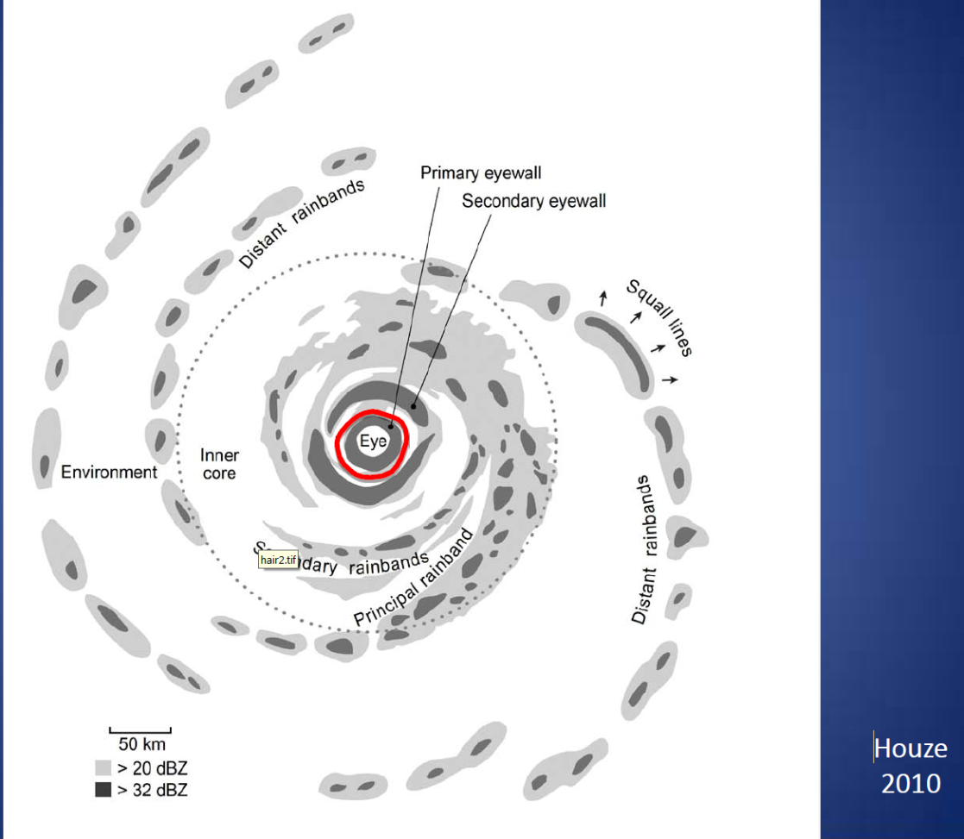
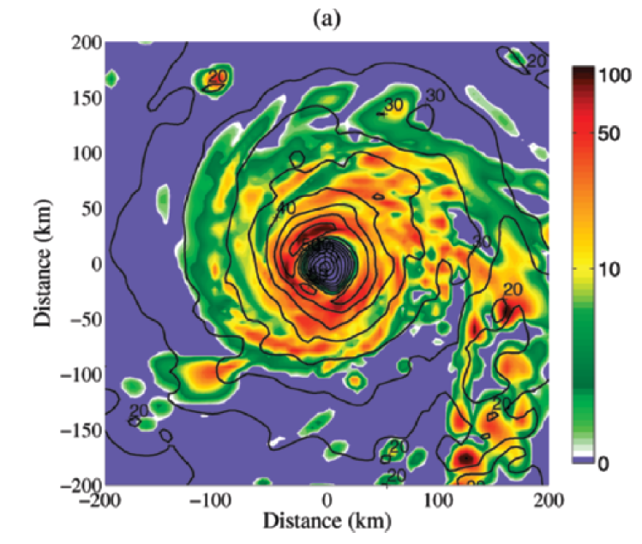
High winds in Hurricanes are very often associated with High rain rates
Rain Anatomy in a hurricane
Rain rate [mm/h]
S.Shen and J. Tenerelli 2007

Slide 13
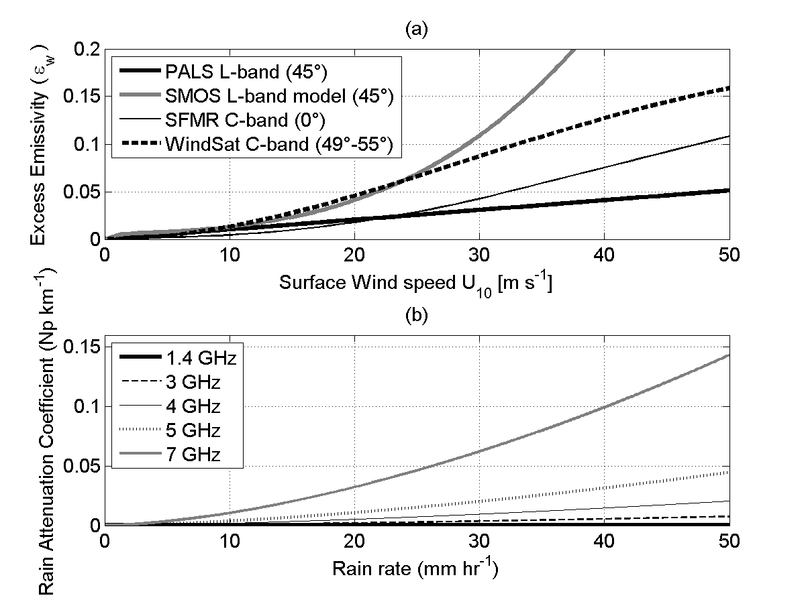
Rain attenuation at C and L-bands
Because of the small ratio of raindrop size to the SMOS electromagnetic wavelength (~21 cm), scattering by rain is almost negligible at L-band, even at the high rain rates experienced in hurricanes.
Rain impact at 1.4 GHz can be approximated entirely by absorption and emission (Rayleigh scattering approximation valid)
Rain attenuation
A factor 100 less
At L band than at 7 Ghz
Generally two order of magnitude smaller at L-band (1.4 GHz) than at C-band (5-7 GHz)

Slide 14
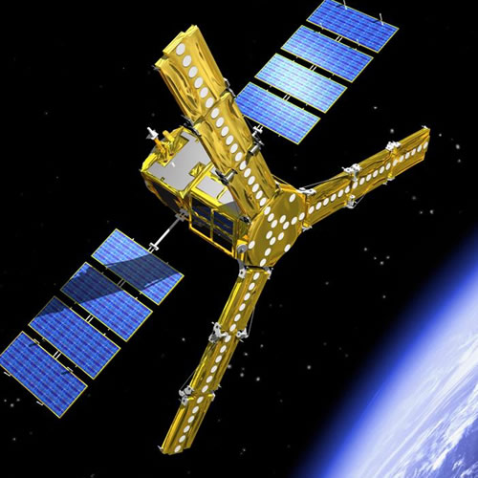
SMOS (Soil Moisture and Ocean Salinity) was launched in November 2009
The SMOS synthetic antenna consists of 69 radiometer elements operating at L-band (frequency ~1.4 GHz, λ=21 cm) and distributed along three equally spaced arms, resulting in a planar Y-shaped structure.
In aperture synthesis radiometers, a TB image is formed through Fourier synthesis from the cross correlations between simultaneous signals obtained from pairs of antenna elements.
Multi-angular images of the brightness temperature are obtained over a large swath width (1200 km), with a spatial resolution varying within the swath from 30 km to about 80 km, and with a revisit time of less than 3 days.

Slide 15
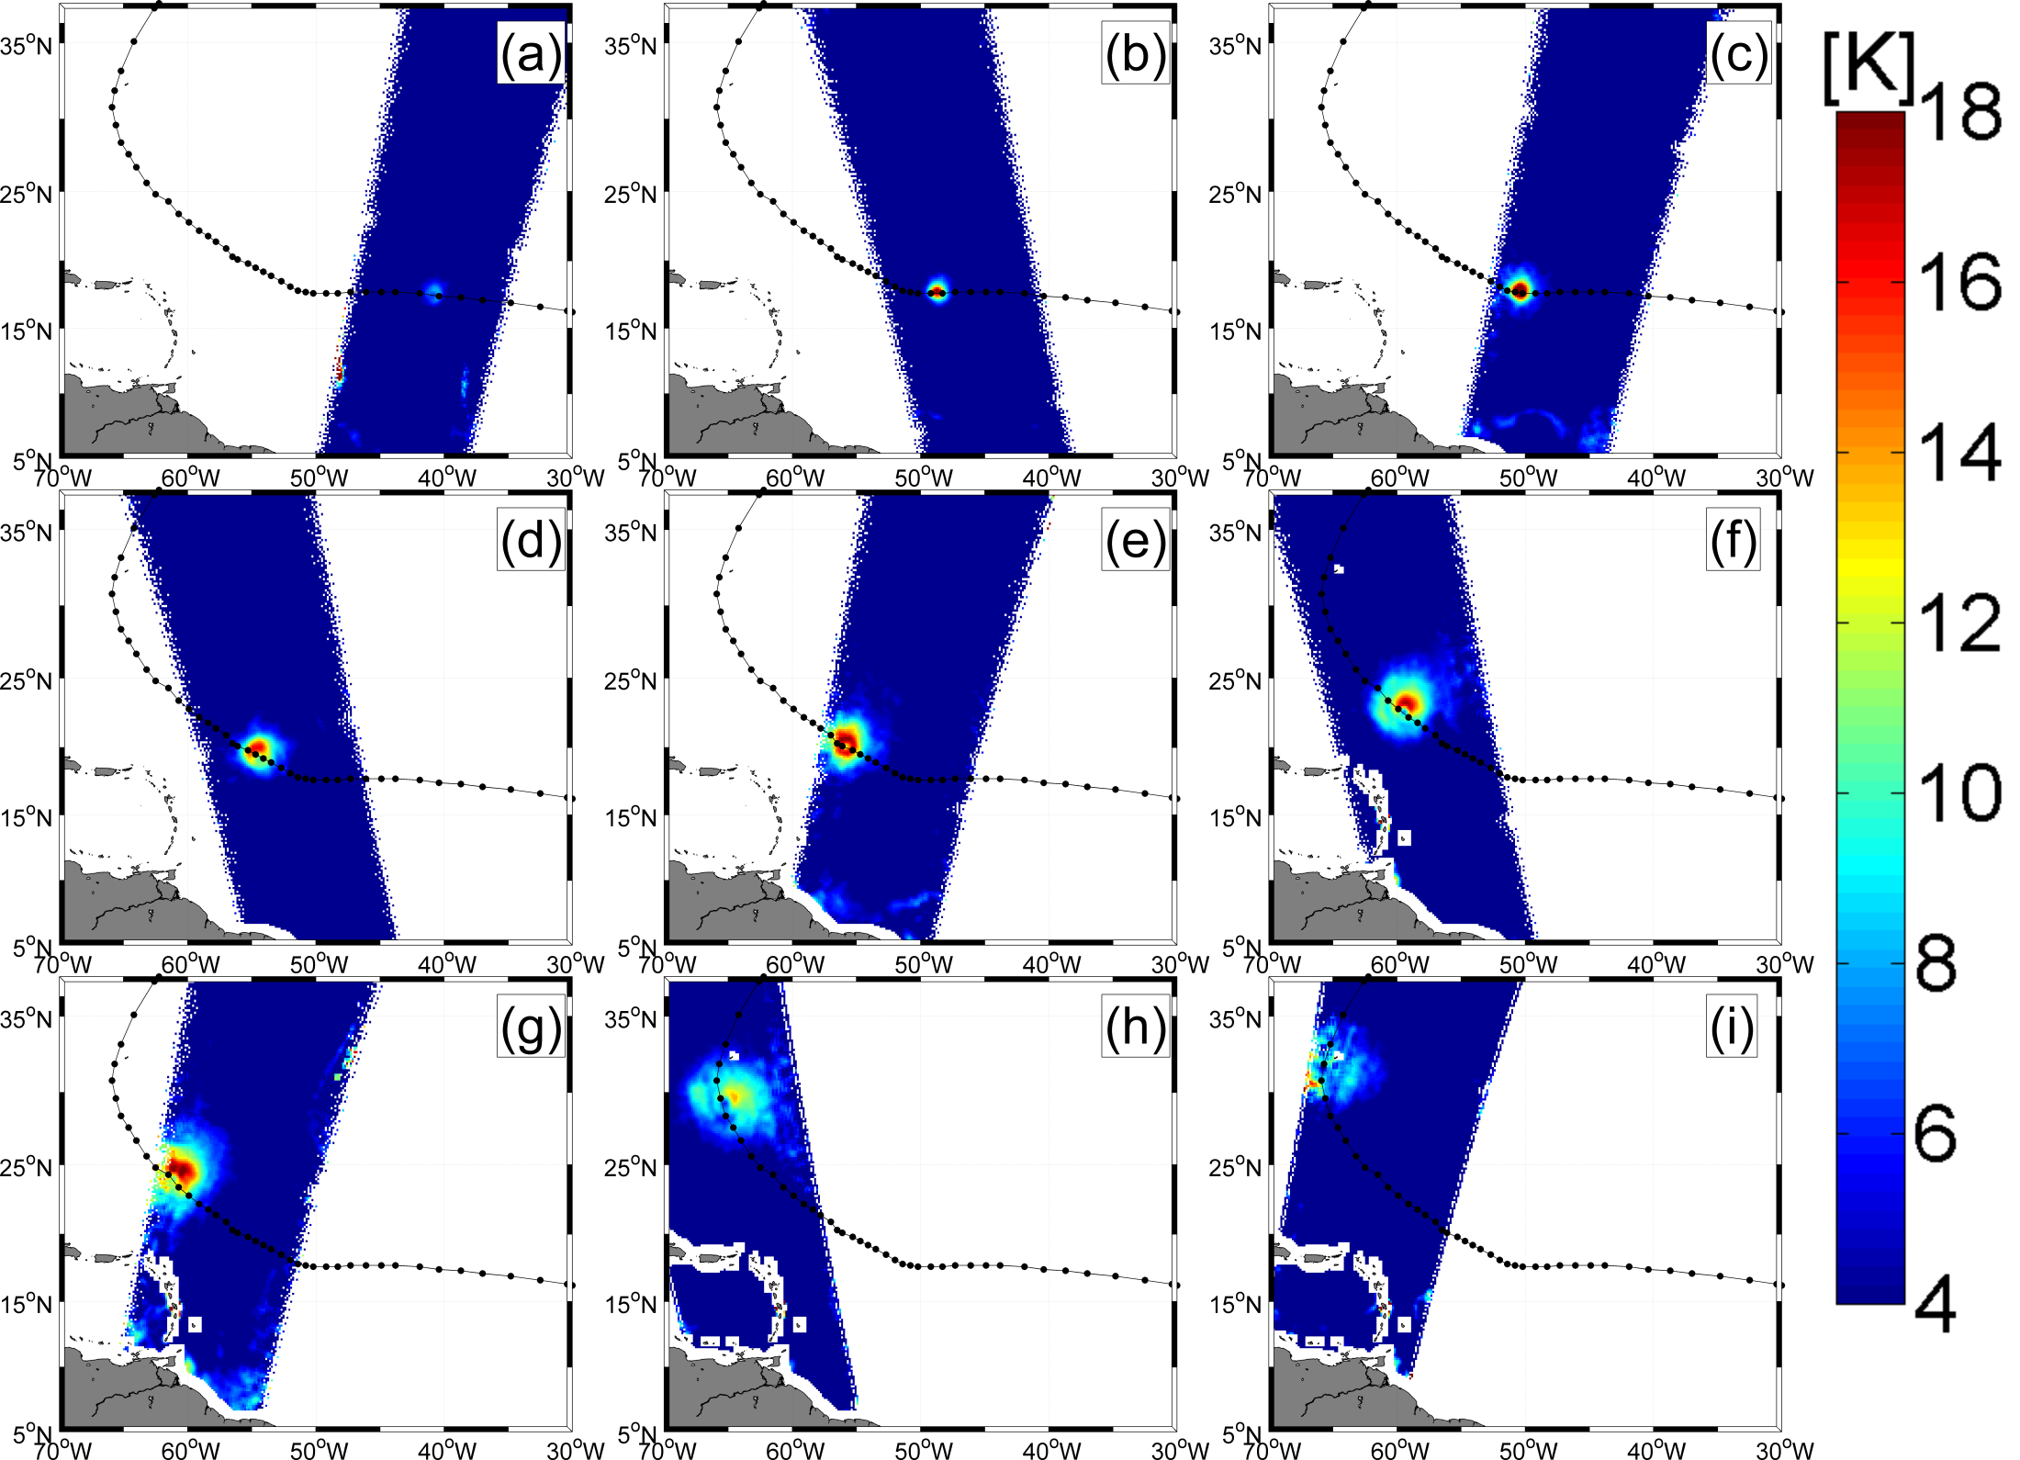
SMOS view of Igor Cat 4 Hurricane Igor 2010

Slide 16
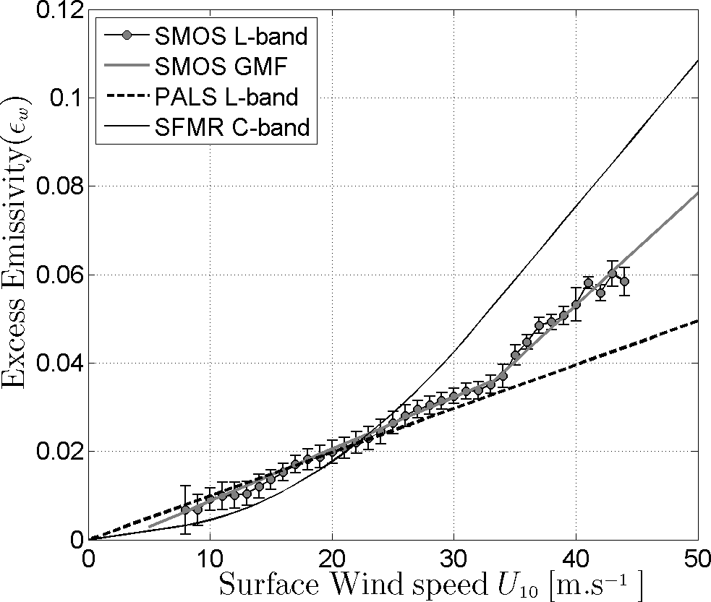
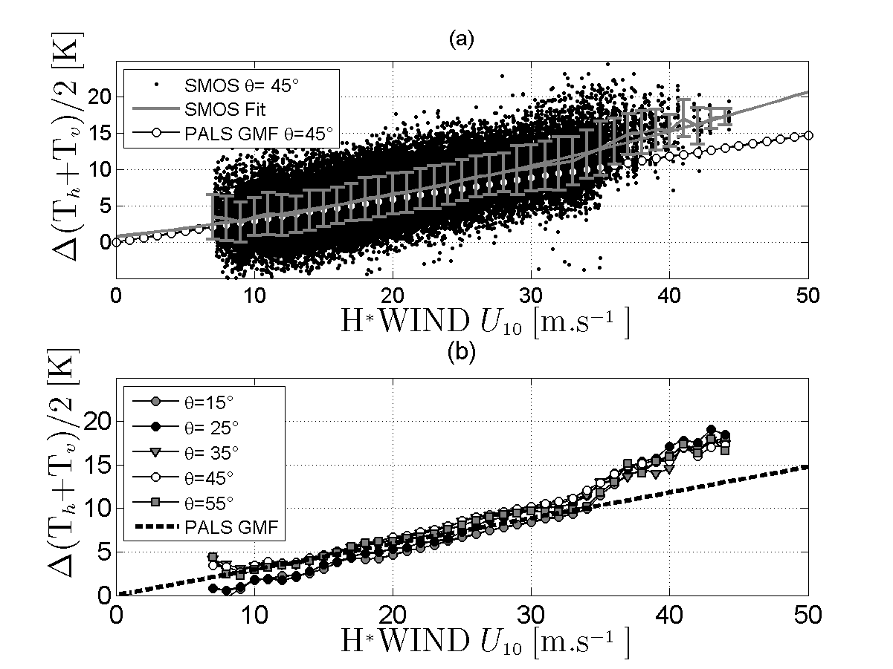
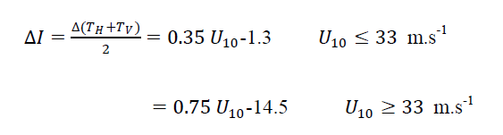
Geophysical Model function: Tb=f(wind speed)
C-band
L-band:
0.7K/m/s
for hurricanes
0.3 k/(m/s)
below
Development of a SMOS wind speed GMF based on Hwind products in IGOR hurricane
Bilinear L-band dependencies with surface wind speed
Reul Nicolas, Tenerelli Joseph, chapron B, Vandemark Doug, Quilfen Y, Kerr Yann (2012). SMOS satellite L-band radiometer: A new capability for ocean surface remote sensing in hurricanes. Journal Of Geophysical Research-oceans, 117

Slide 17
Median values of the surface wind speed Radii evaluated over the four Storm quadrants as function of days at (a) 34 knots, (b) 50 knots and (c) 64 knots. Symbols for the radii from the different wind products are: GFDL model (solid black triangles), H*WIND products (gray squares), SMOS estimated winds (solid white circles) and NHC/ATCF best-track estimates (thick black curves).

Slide 18
SMOS+STORM Evolution ESA-STSE project
Collaboration IFREMER, OceanDataLab & Met Office- (2 years: KO Apr 2014)
Improve high wind speed retrieval algorithms (GMF, rain & wave impacts)
Produce a Global Tropical Cyclone & Extra-Tropical Cyclone storm catalogue &
database from 2010 to now
Comparisons with NWP models & radiometer & scatterometer data
Combine with other observations : AMSR2, WindSat, SMAP, CYGNSS
Evaluate the impact of SMOS High Wind products assimilation on Metoffice forecast
Errors: storm track & intensity forecasts

Slide 19
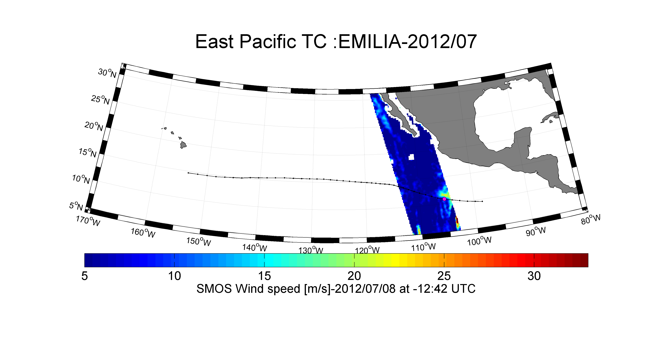
SMOS+STORM Evolution
Detect the useful TC & ETC events in SMOS data: Example of EMILIA
Position of the Storm center at the time of SMOS Aquisition

Slide 20
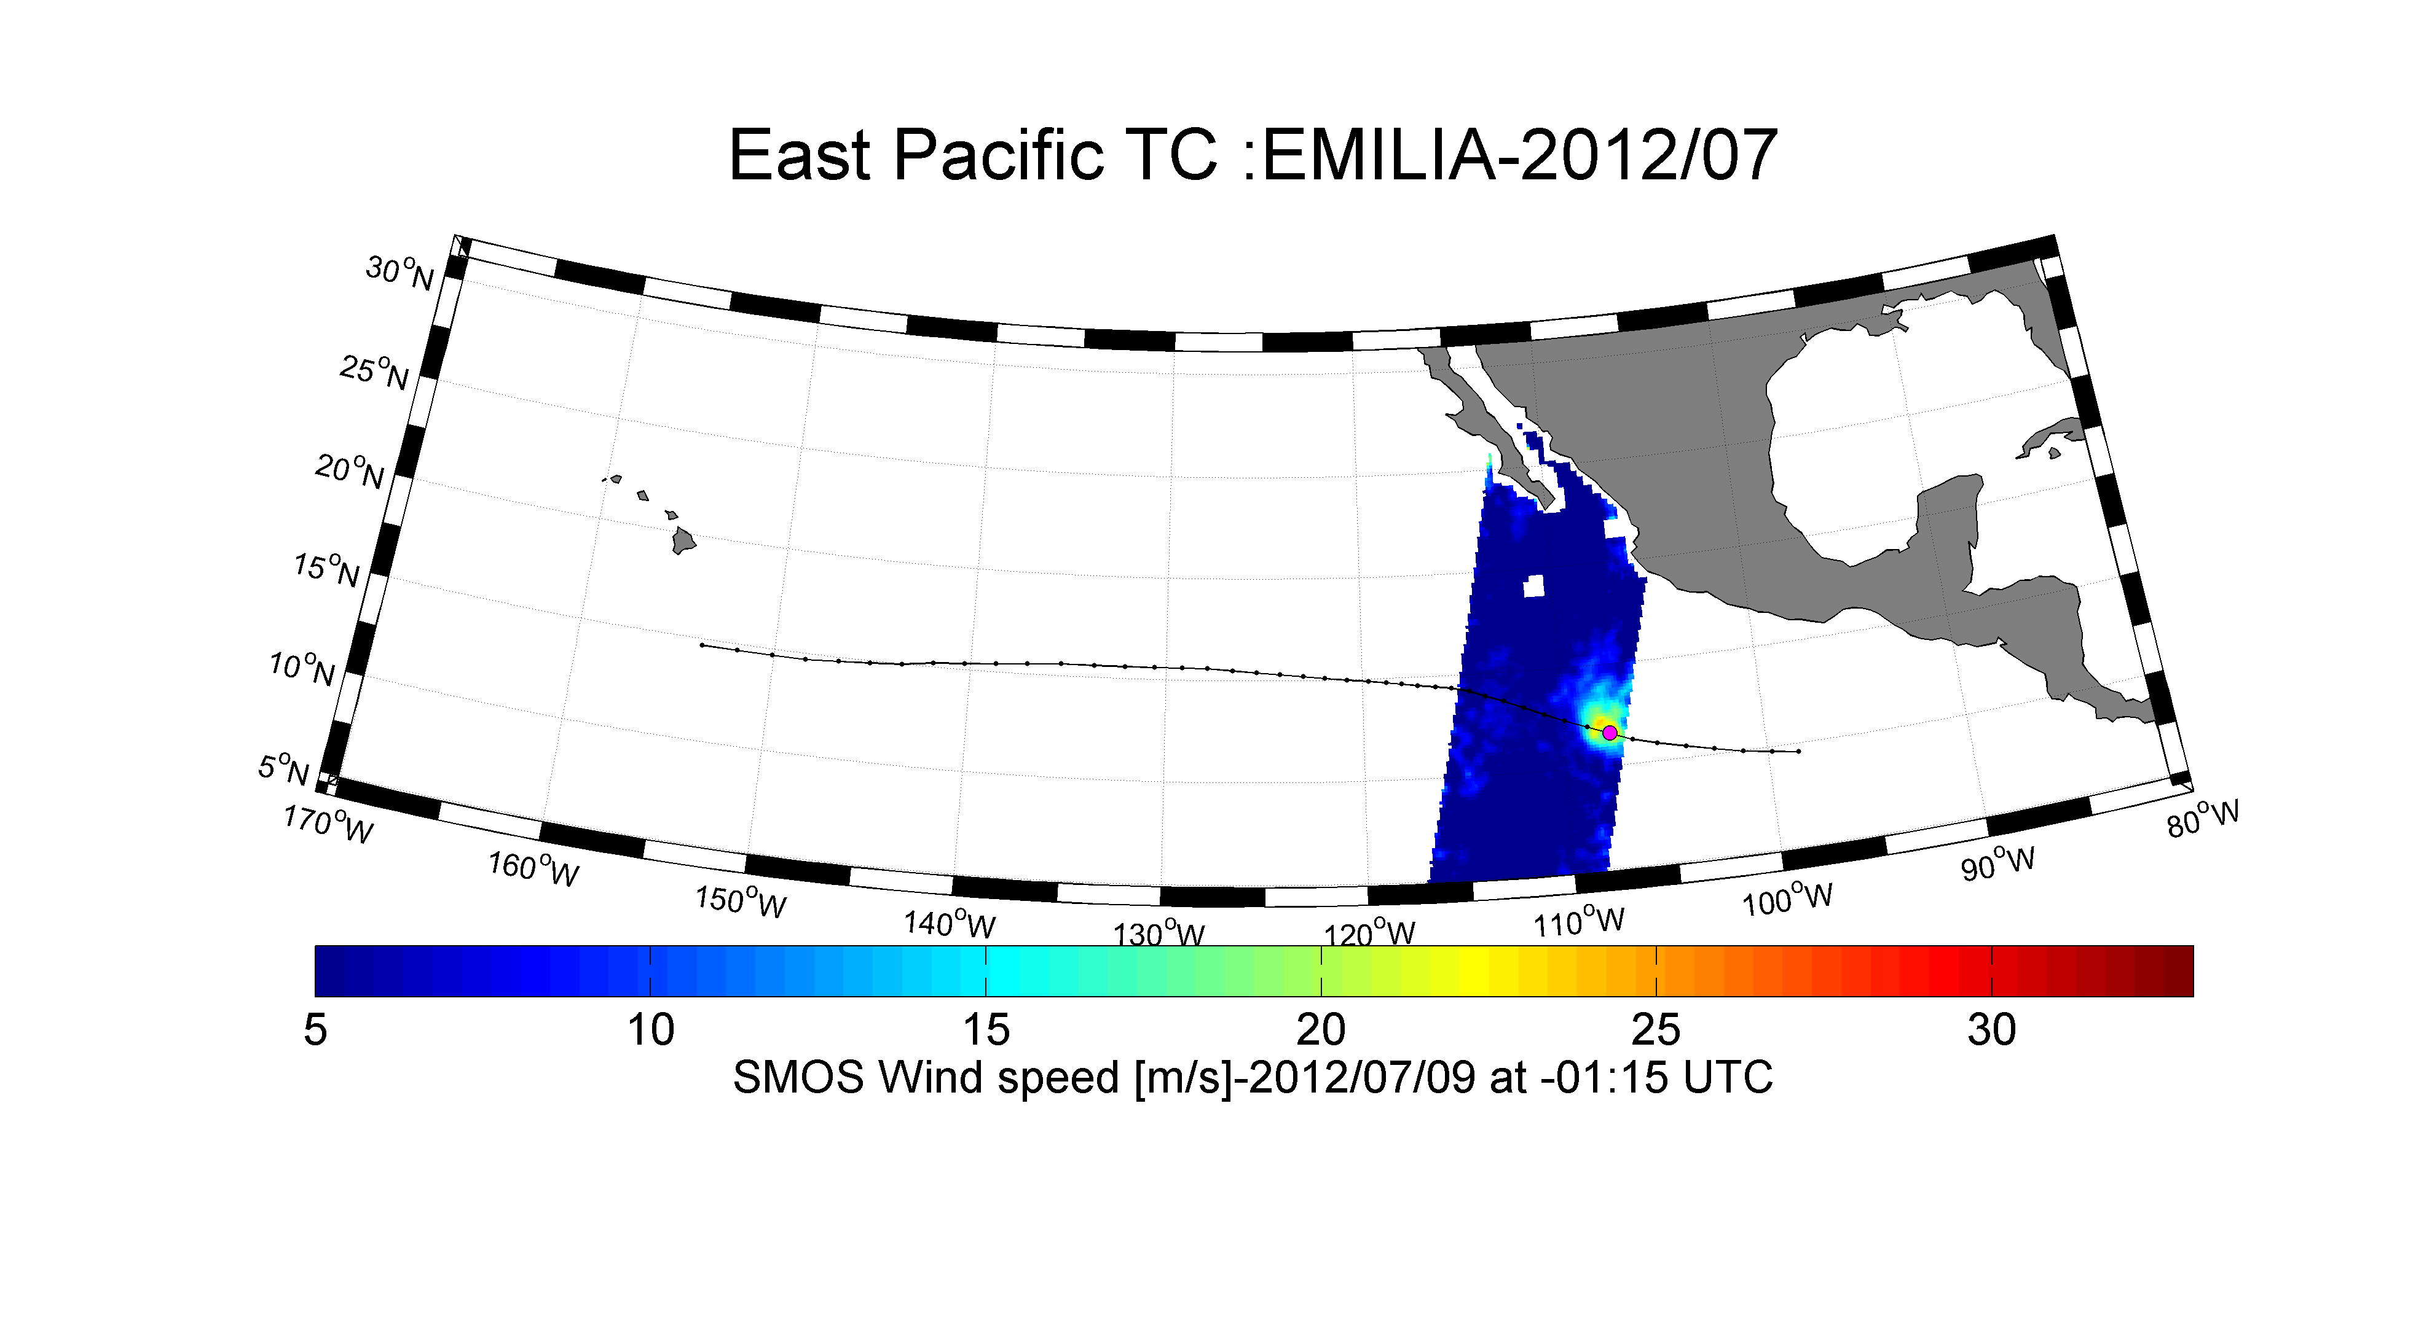
SMOS+STORM Evolution
Tasks 2: Detect the useful TC & ETC events in SMOS data: Example of EMILIA

Slide 21
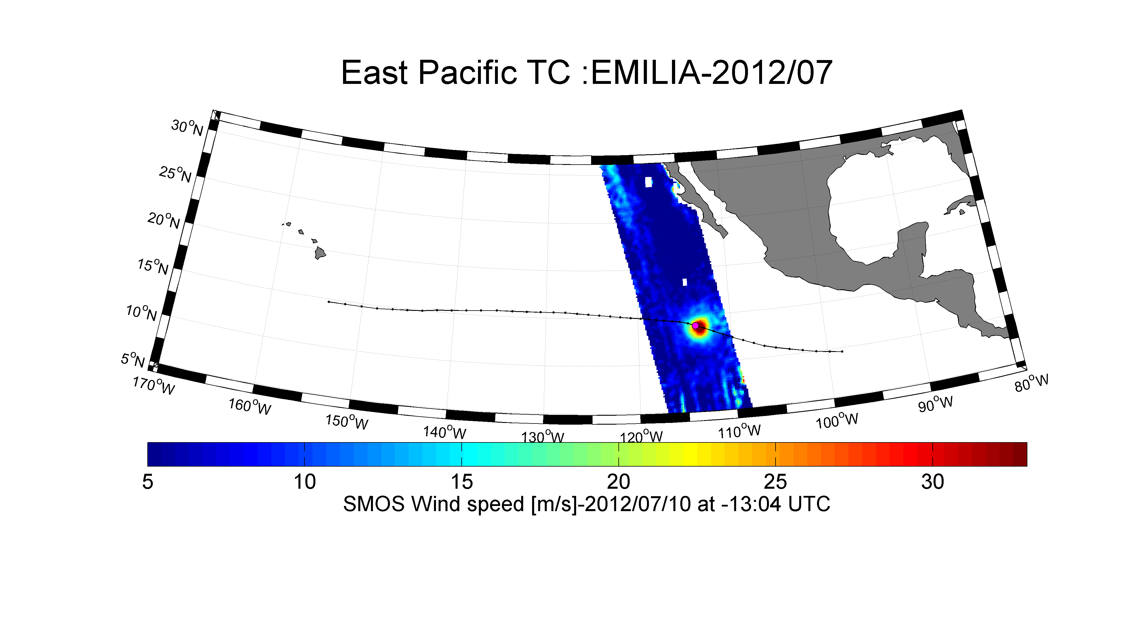
SMOS+STORM Evolution
Tasks 2: Detect the useful TC & ETC events in SMOS data: Example of EMILIA

Slide 22
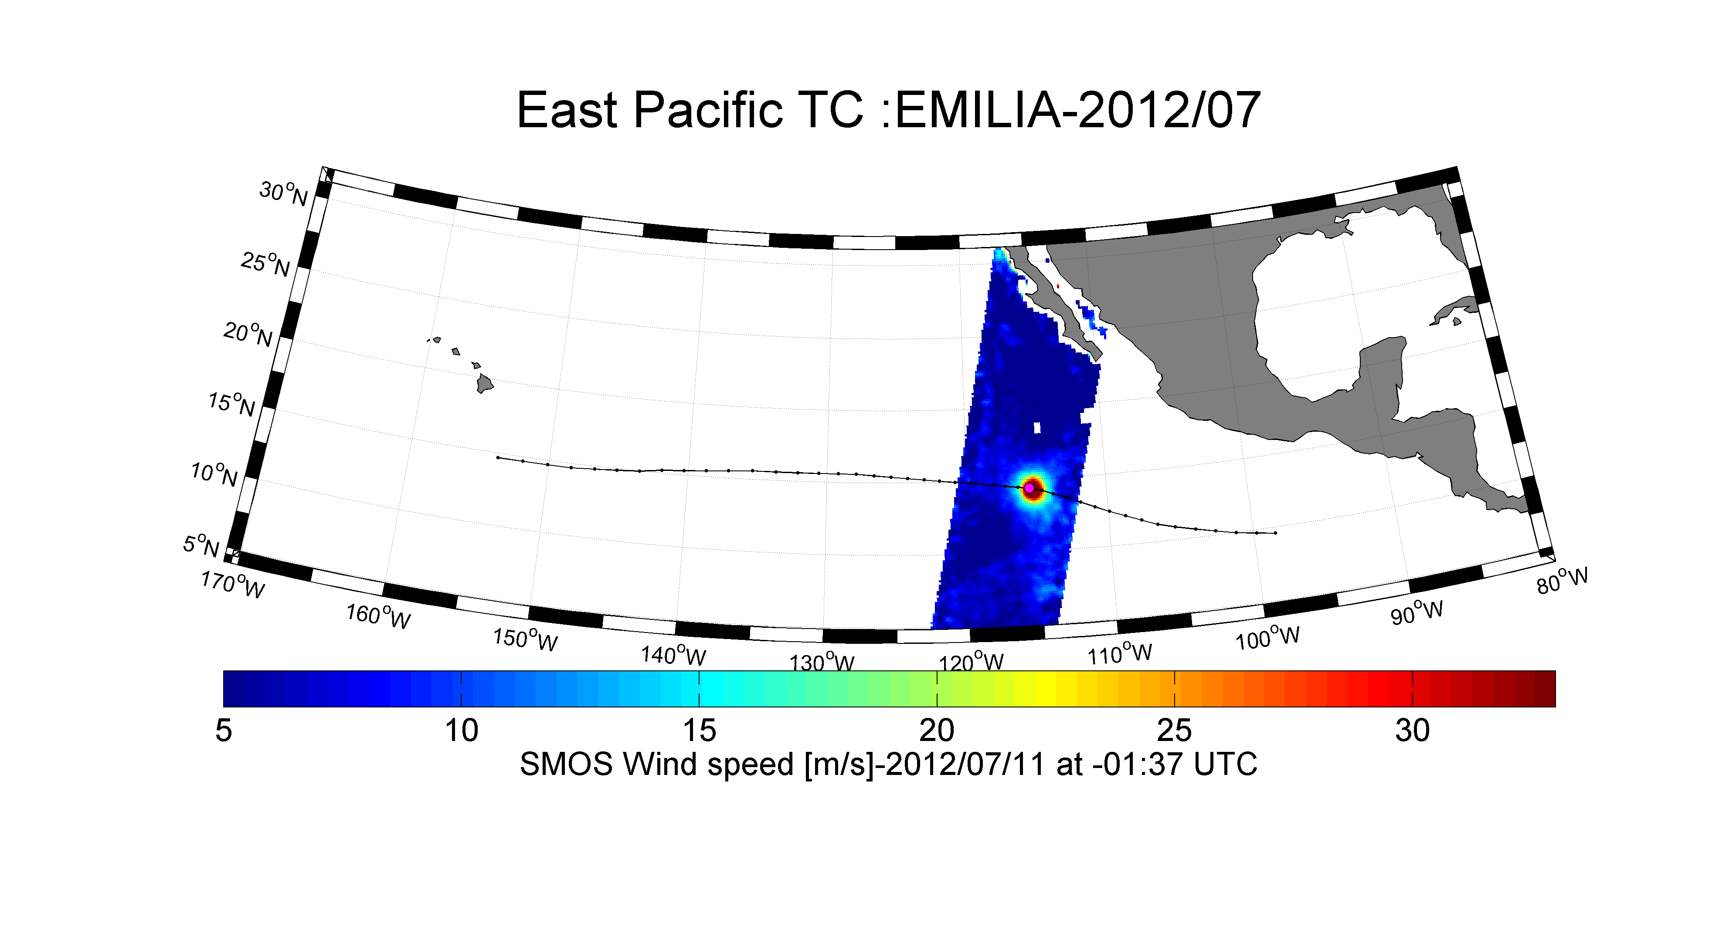
SMOS+STORM Evolution
Tasks 2: Detect the useful TC & ETC events in SMOS data: Example of EMILIA

Slide 23
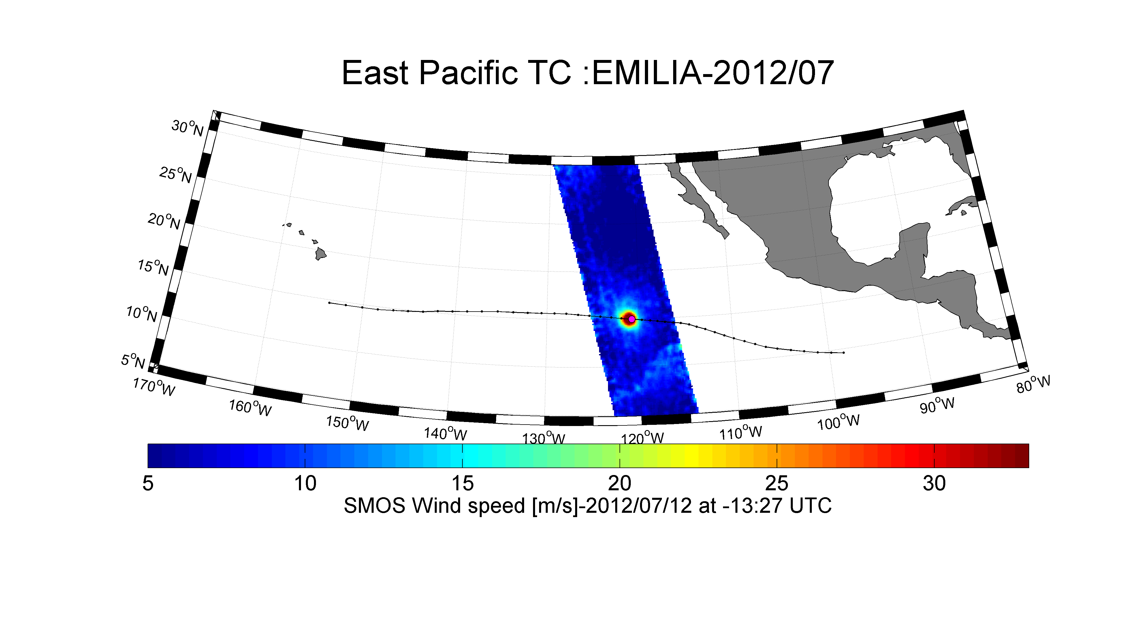
SMOS+STORM Evolution
Tasks 2: Detect the useful TC & ETC events in SMOS data: Example of EMILIA

Slide 24
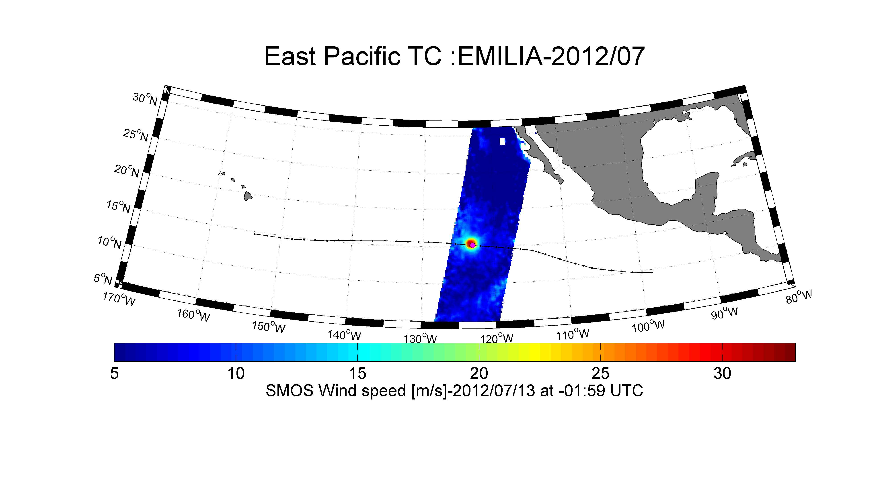
SMOS+STORM Evolution
Tasks 2: Detect the useful TC & ETC events in SMOS data: Example of EMILIA

Slide 25
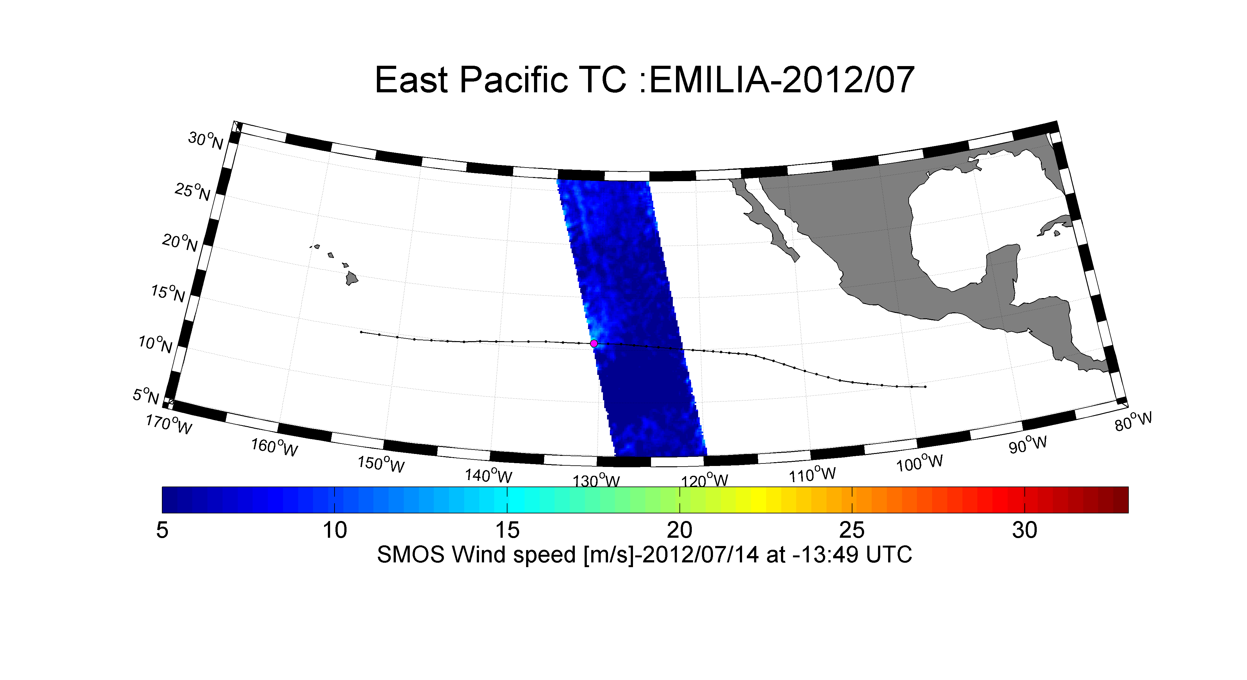
SMOS+STORM Evolution
Tasks 2: Detect the useful TC & ETC events in SMOS data: Example of EMILIA

Slide 26
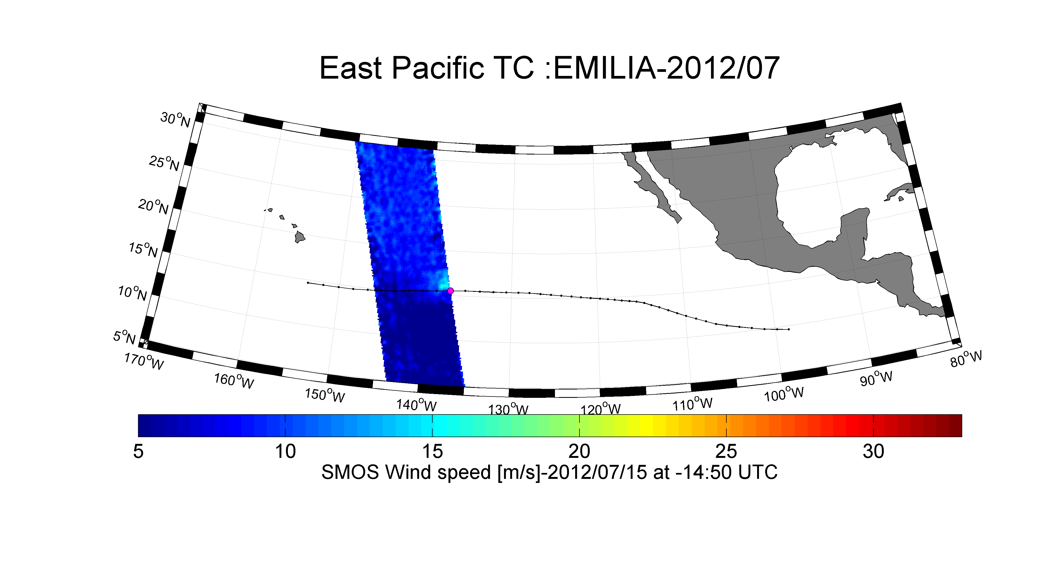
SMOS+STORM Evolution
Tasks 2: Detect the useful TC & ETC events in SMOS data: Example of EMILIA

Slide 27
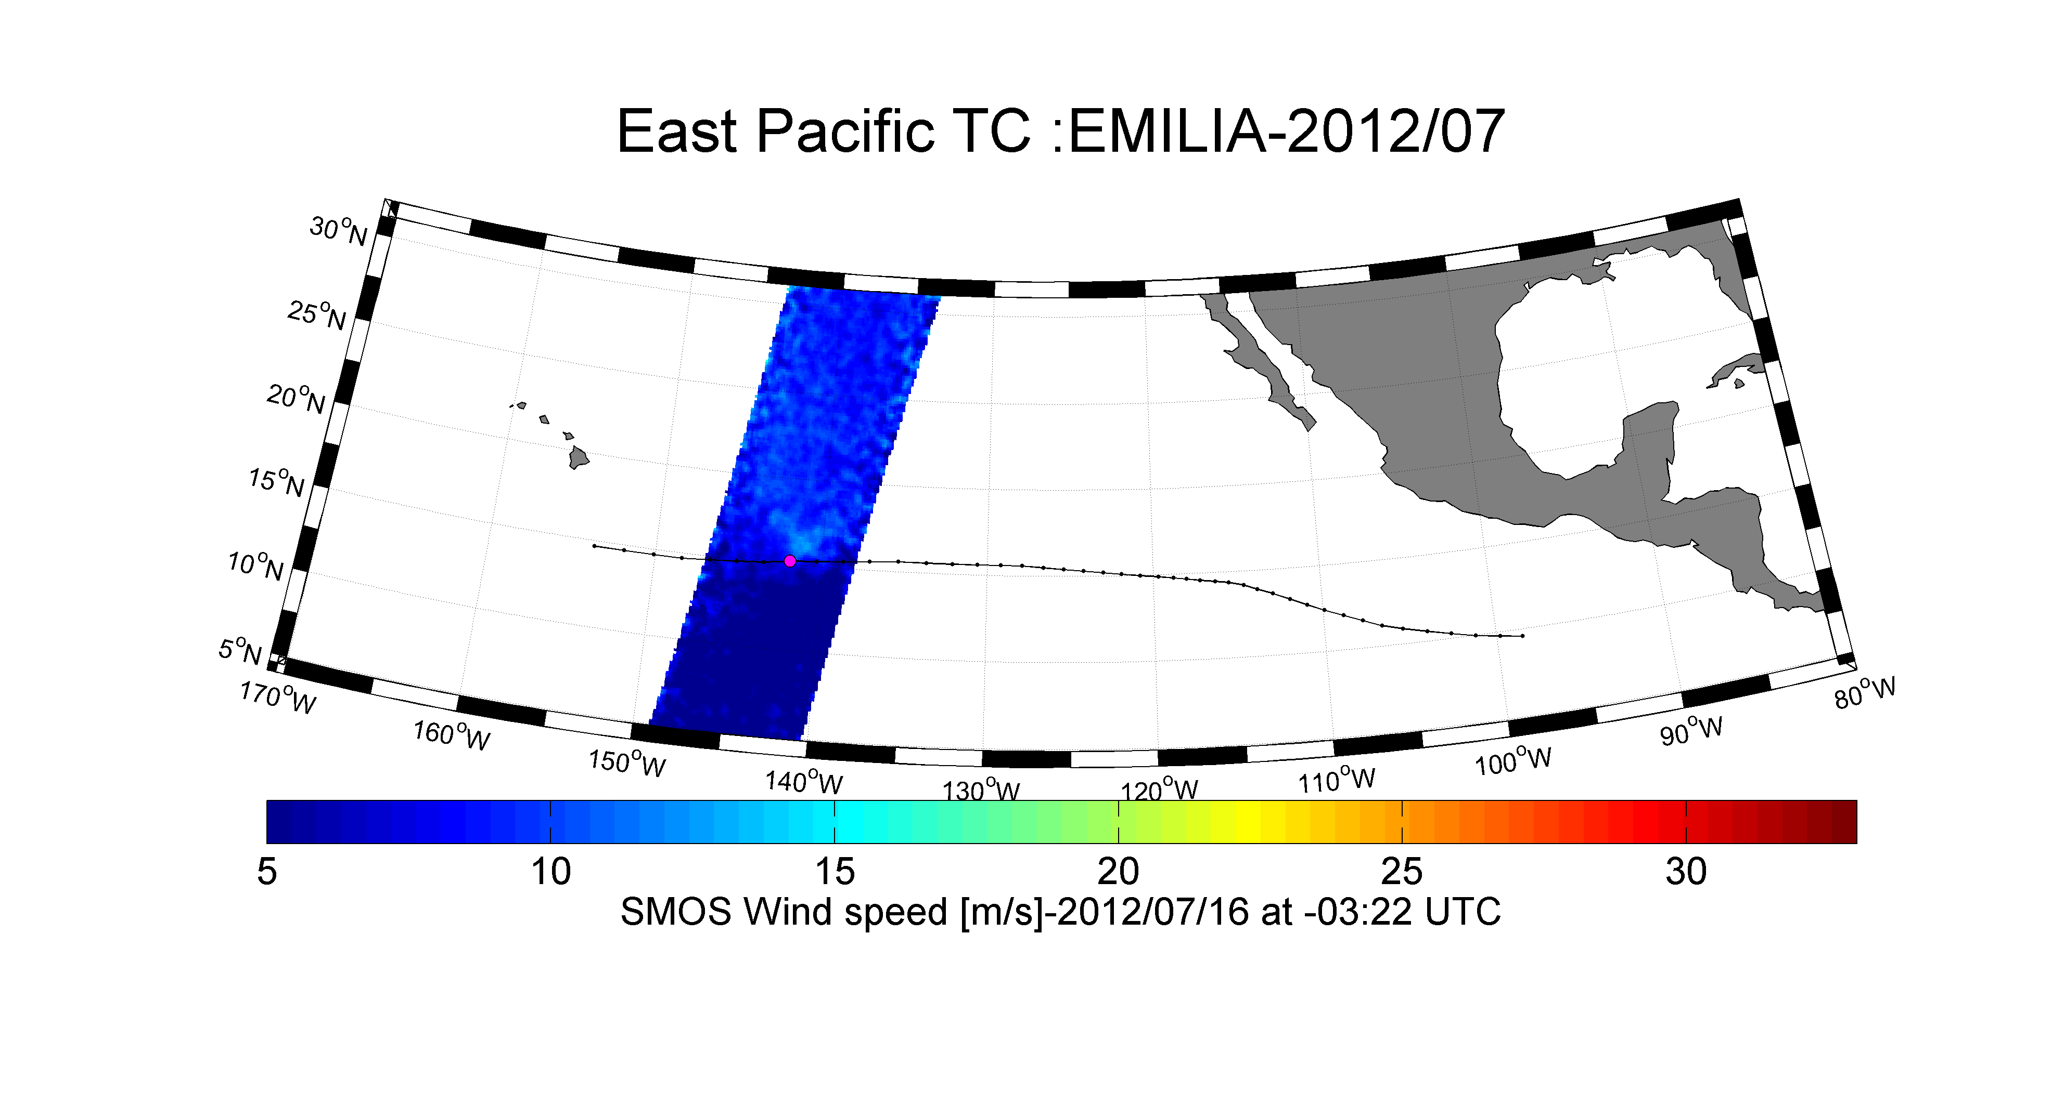
SMOS+STORM Evolution
Tasks 2: Detect the useful TC & ETC events in SMOS data: Example of EMILIA

Slide 28
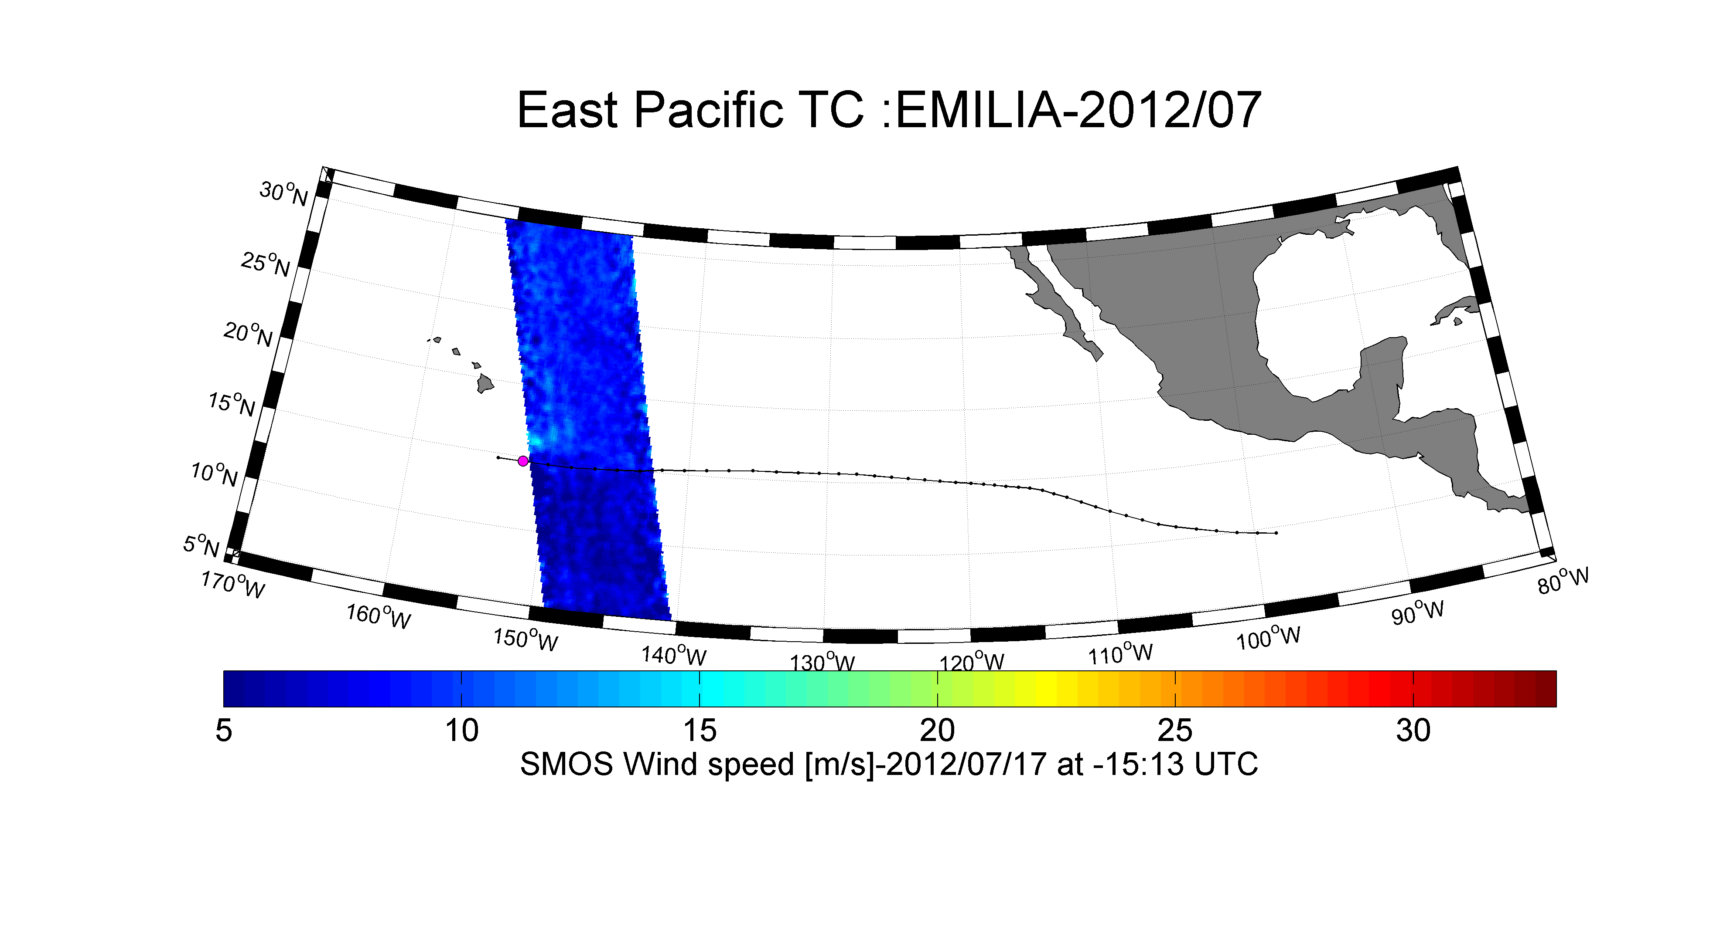
SMOS+STORM Evolution
Tasks 2: Detect the useful TC & ETC events in SMOS data: Example of EMILIA

Slide 29
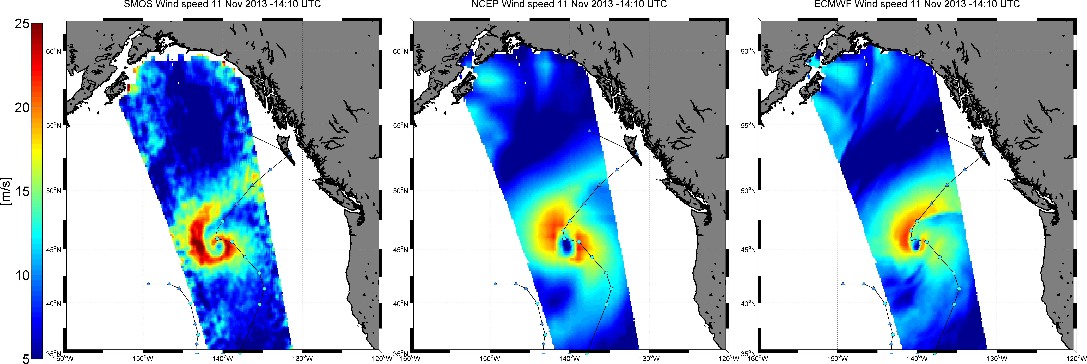
Monitoring Surface Winds with SMOS in Extra-Tropical Cyclones
SMOS
NCEP
ECMWF
SMOS systematically detects higher wind speeds & could help re-phasing the
Storms structures in operational weather forecast models

Slide 30
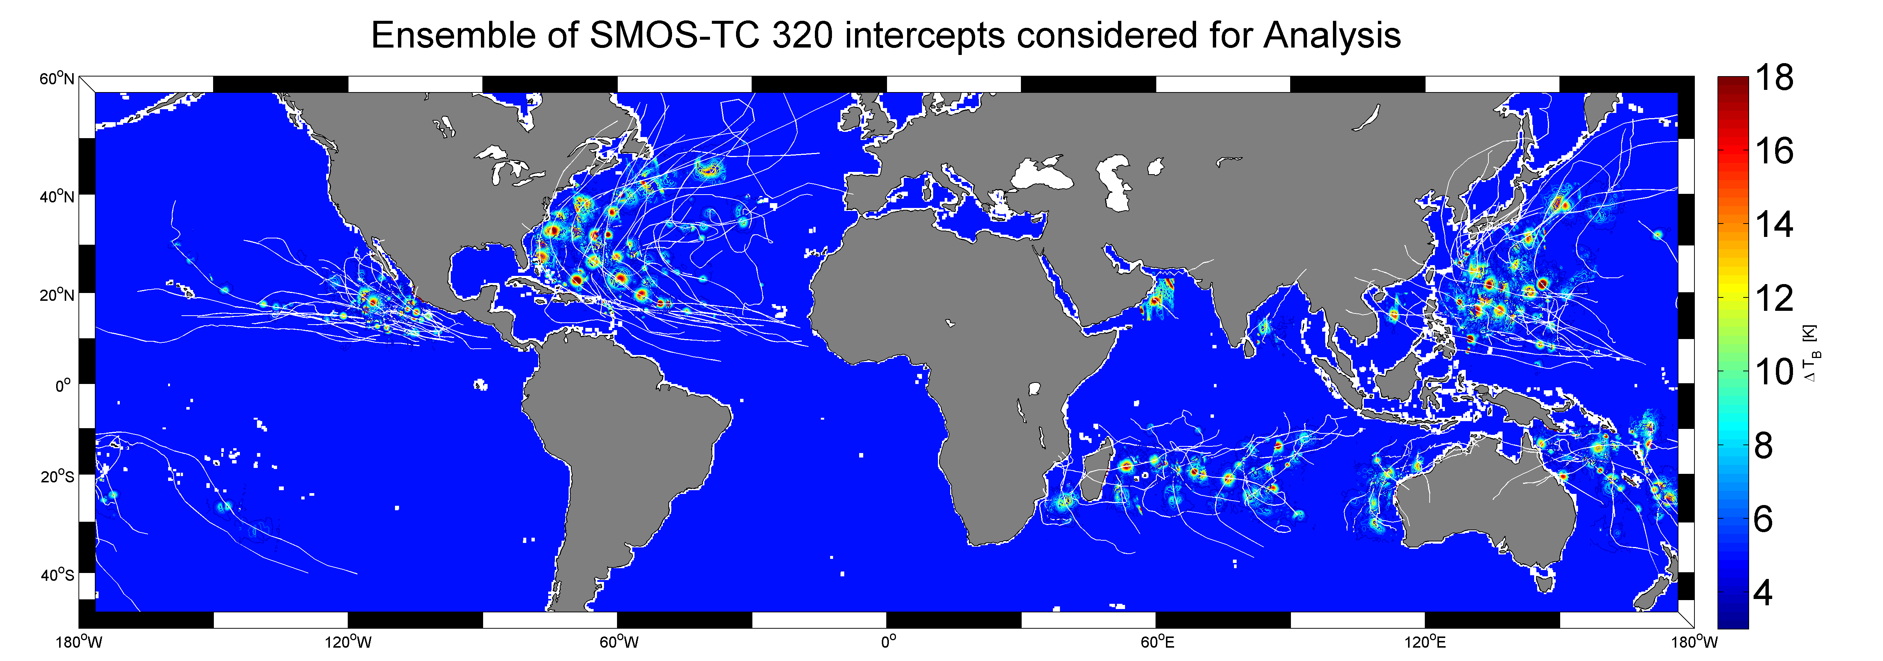
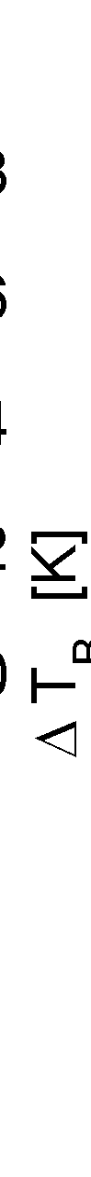
A view at the SMOS-STORM 2010-2015 TC database
A subset of 320 SMOS swath intercepts with TCs over 2010-2015,
free of Radio Frequency Interferences and with pixel distances >150 km from coasts
are selected
Data available at http://www.smosstorm.org/

Slide 31
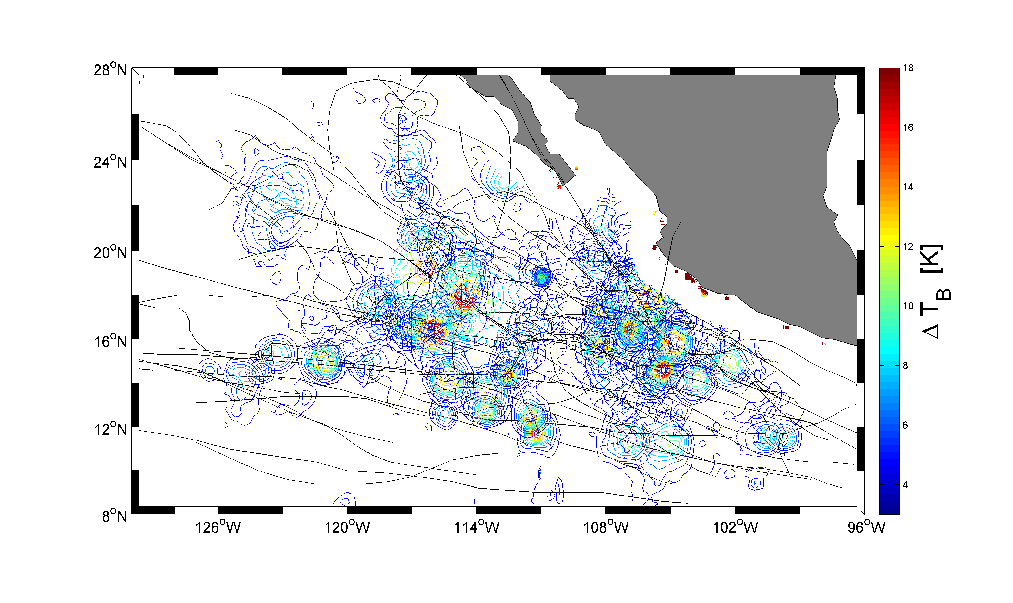
East Pacific SMOS intercepts with 2010-2015 TCs

Slide 32
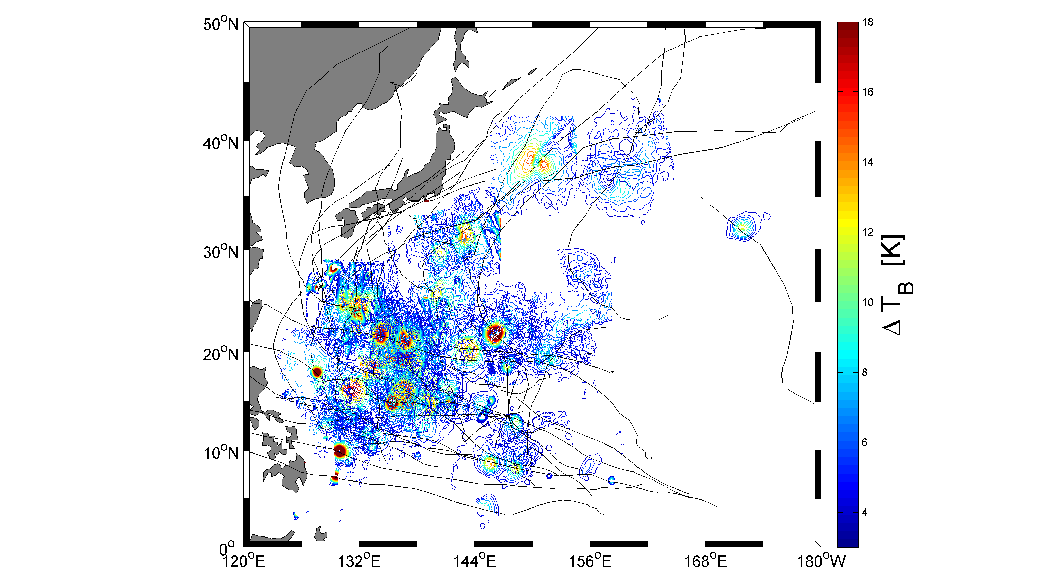
West Pacific SMOS intercepts with 2010-2015’s TCs

Slide 33
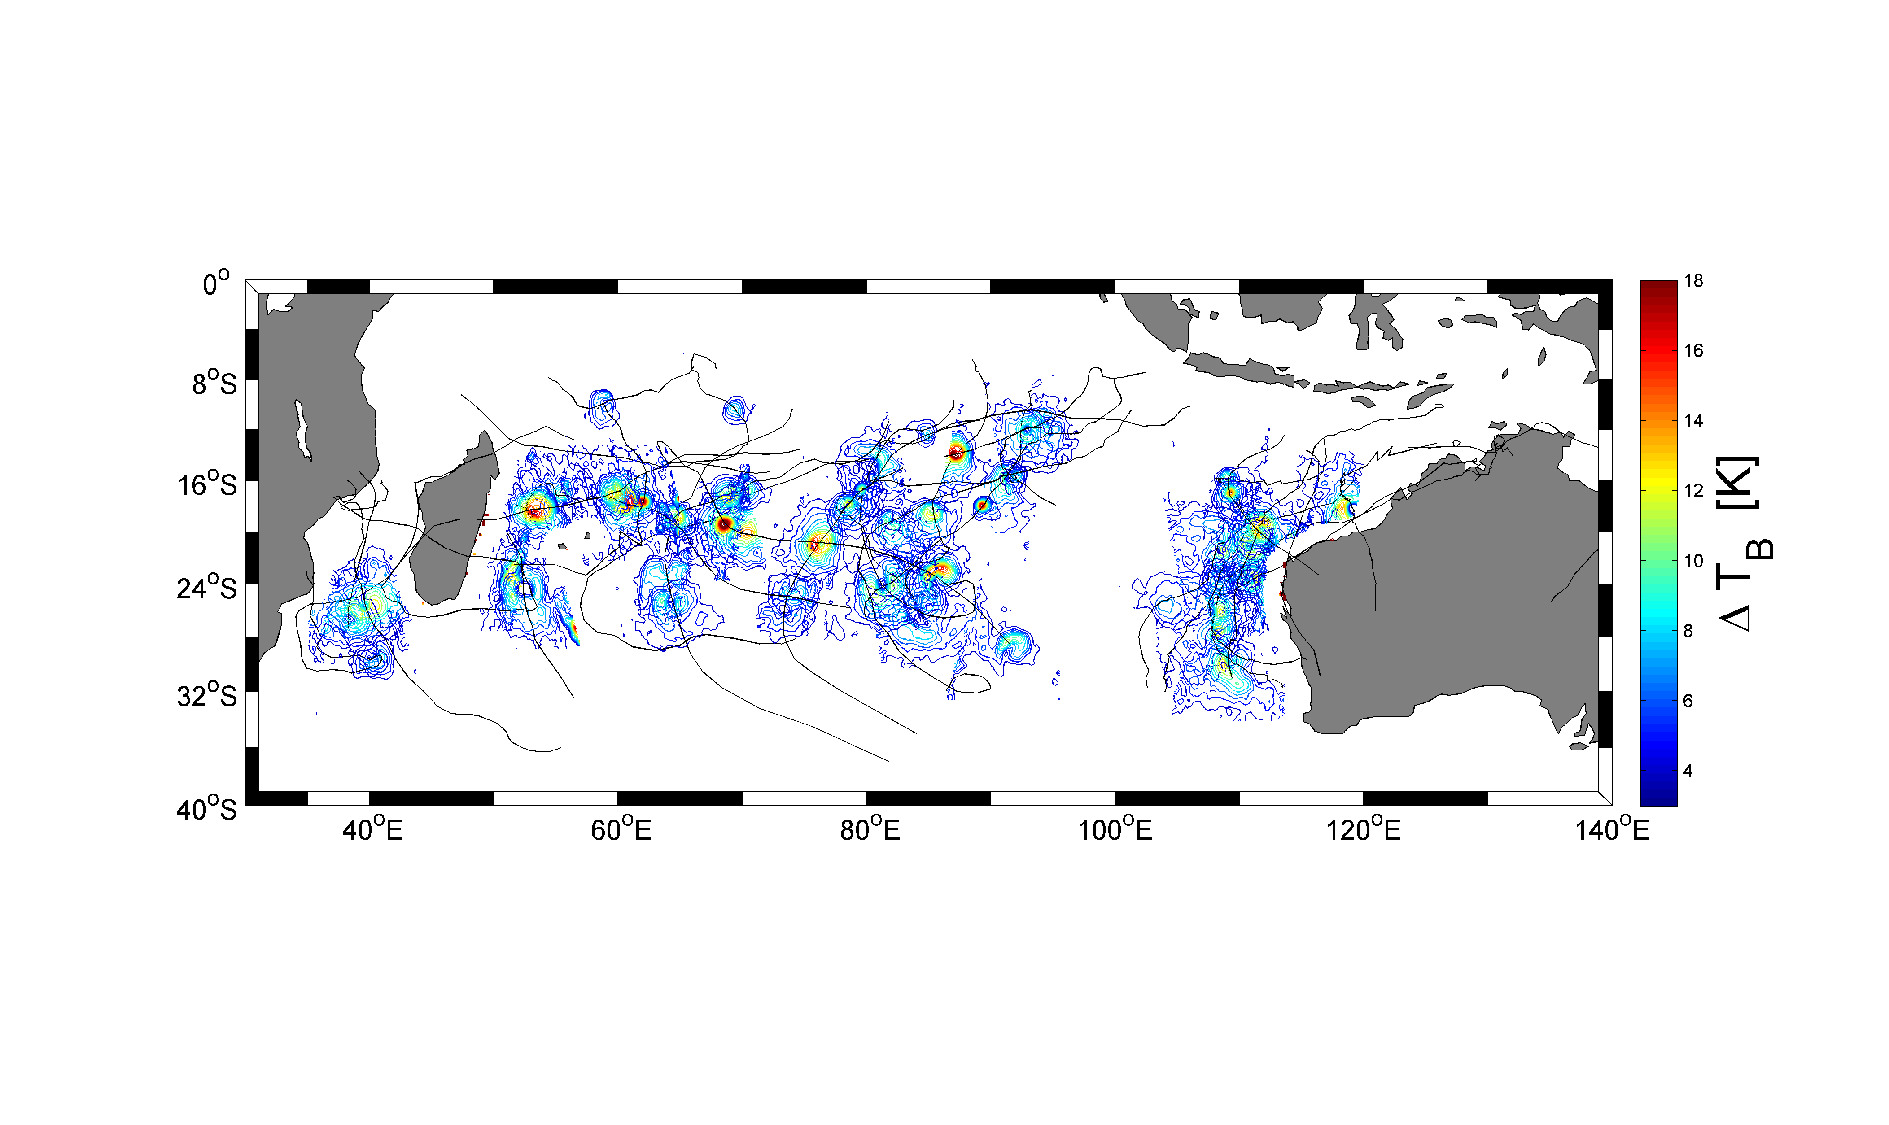
South Indian SMOS intercepts with 2010-2015’s TCs

Slide 34
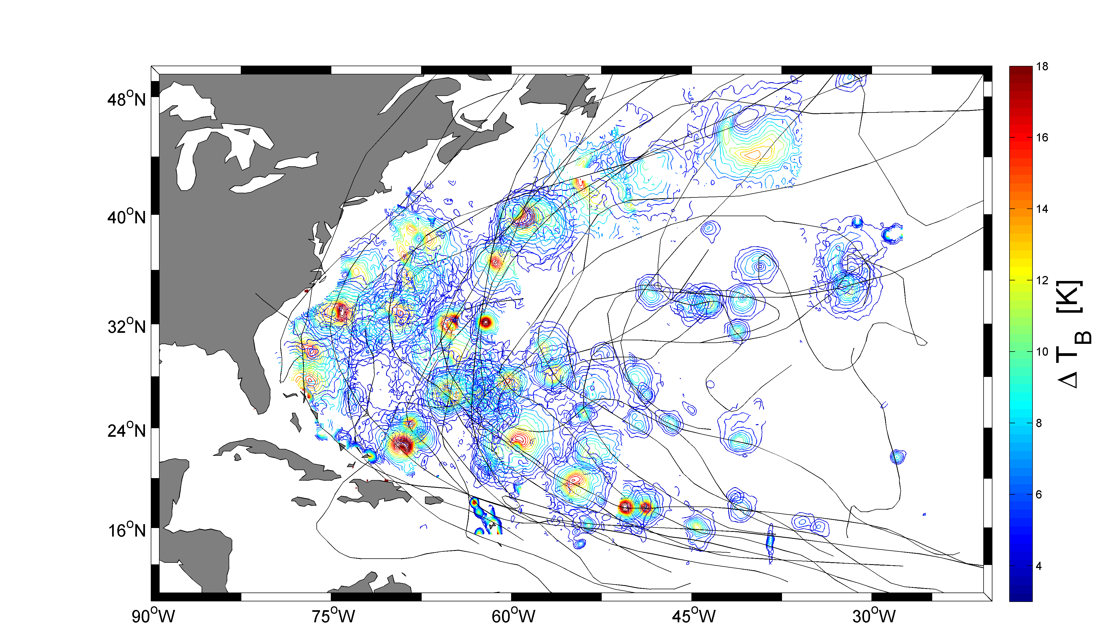
North Atlantic SMOS intercepts 2010-2015 TC

Slide 35
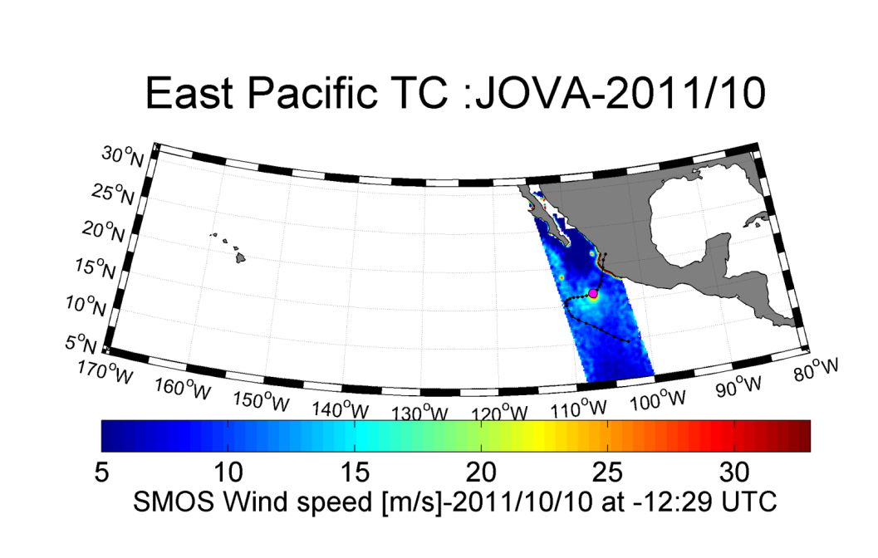
Analysing the GMF more in depth and
TC intensity meter capability of SMOS
For each TC, multi-incidence
Tb contrasts is collected

Slide 36
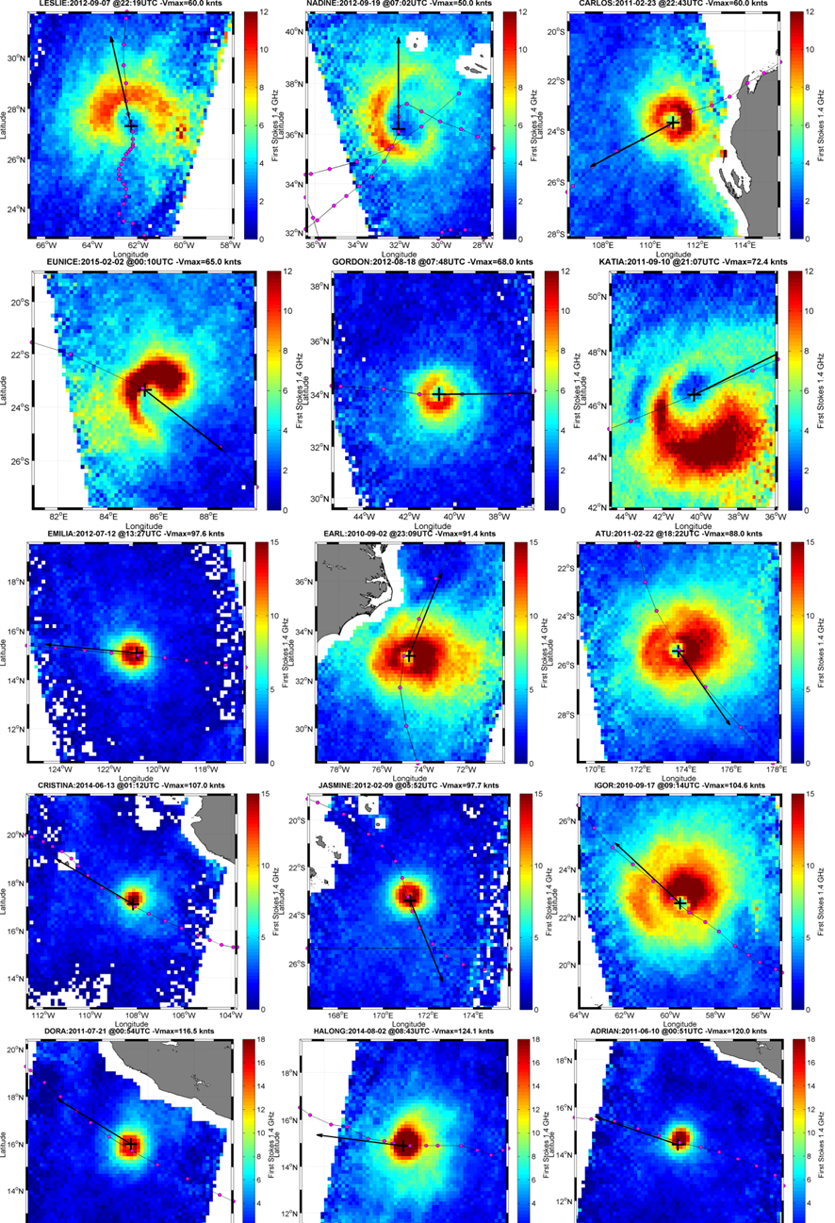
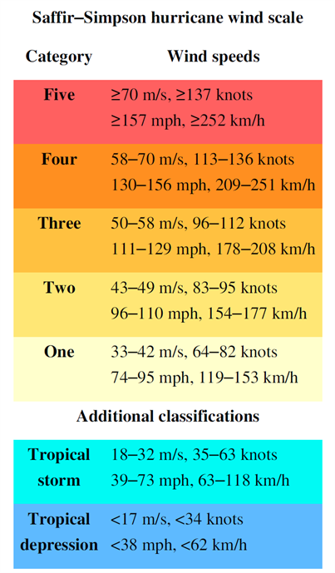
Tropical
Storms
Category 1
Category 2
Category 3
Category 4

Slide 37
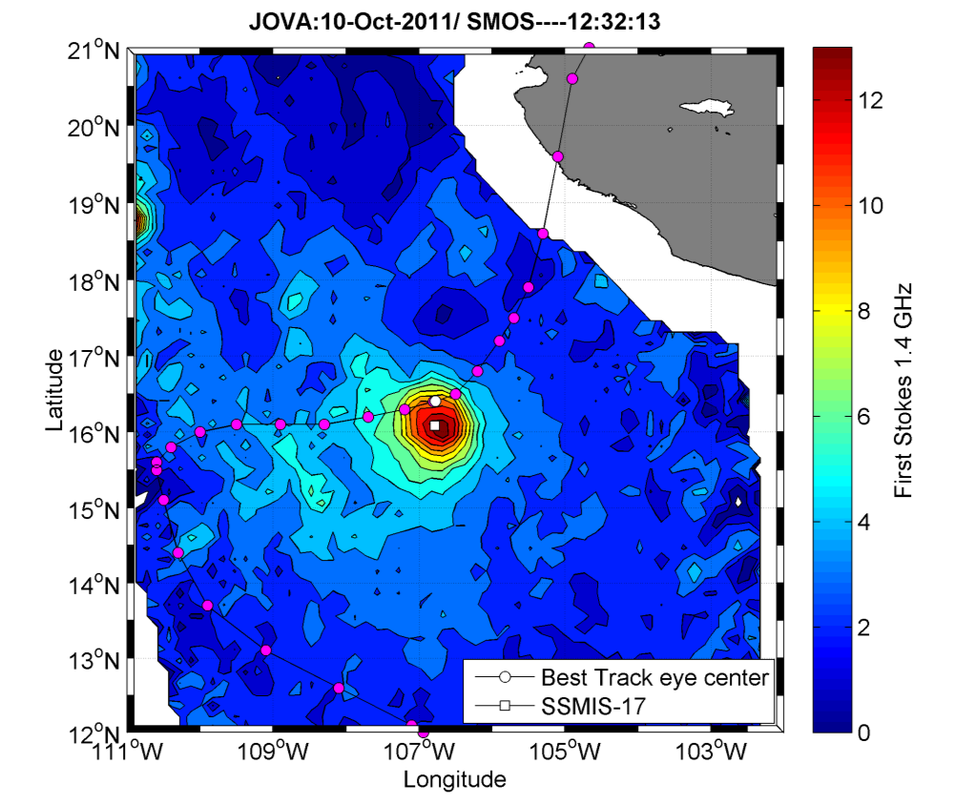
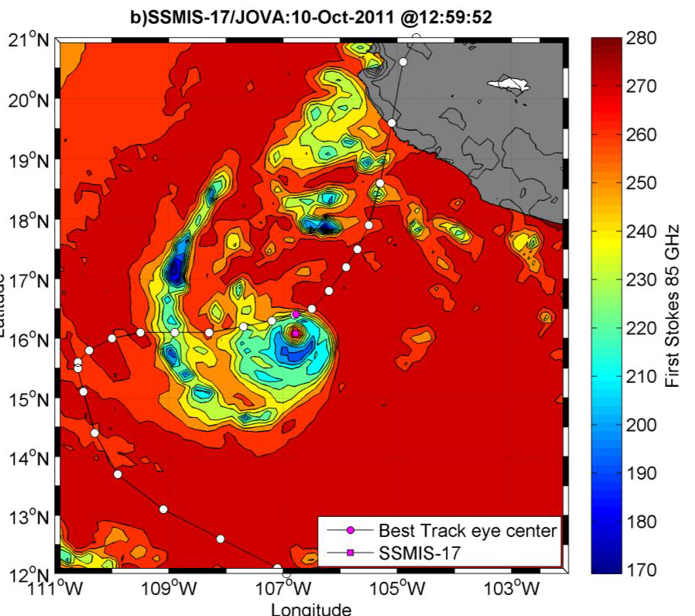
Best track eye position
actual eye position
TC eye position is adjusted using 85 GHz datasets

Slide 38
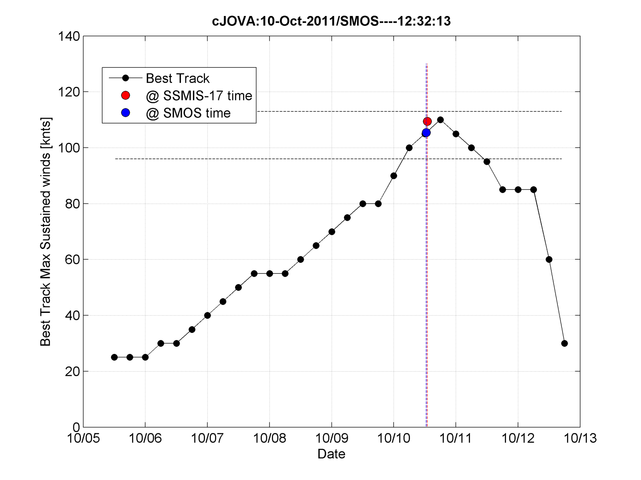
Storm intensity is evaluated using Best track data and used for further classification

Slide 39
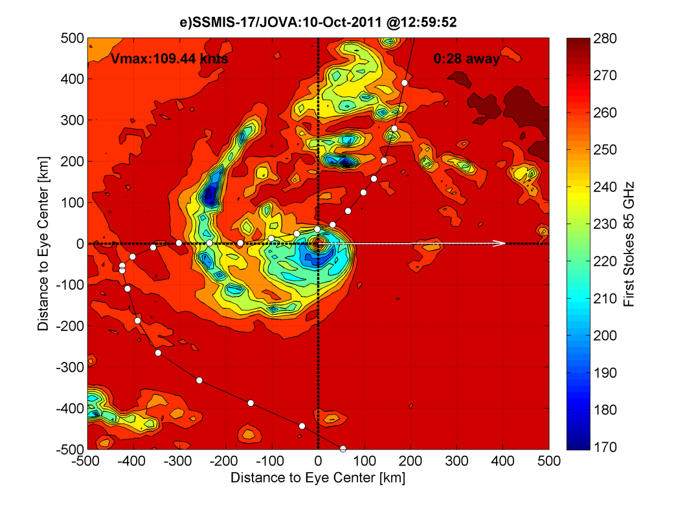
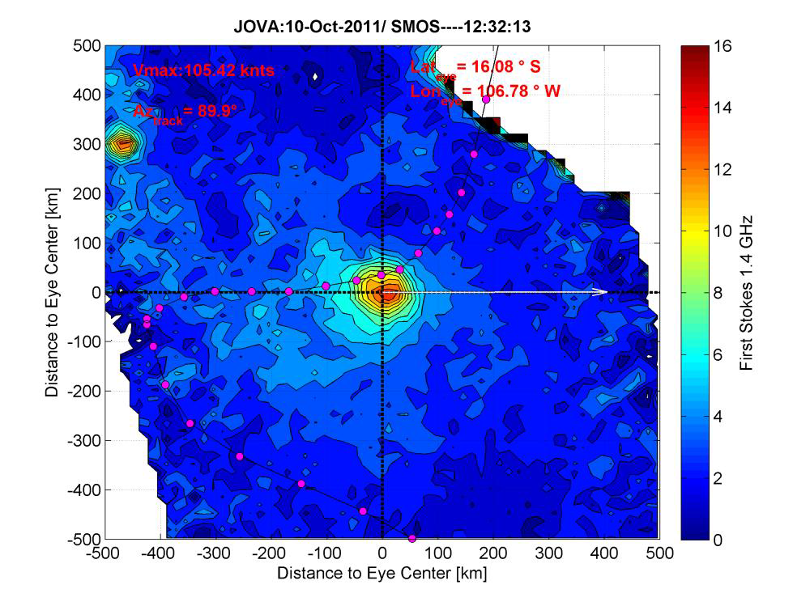
SMOS Tb is recentered on a TC eye-centered frame
and
storm propagation direction is evaluated

Slide 40
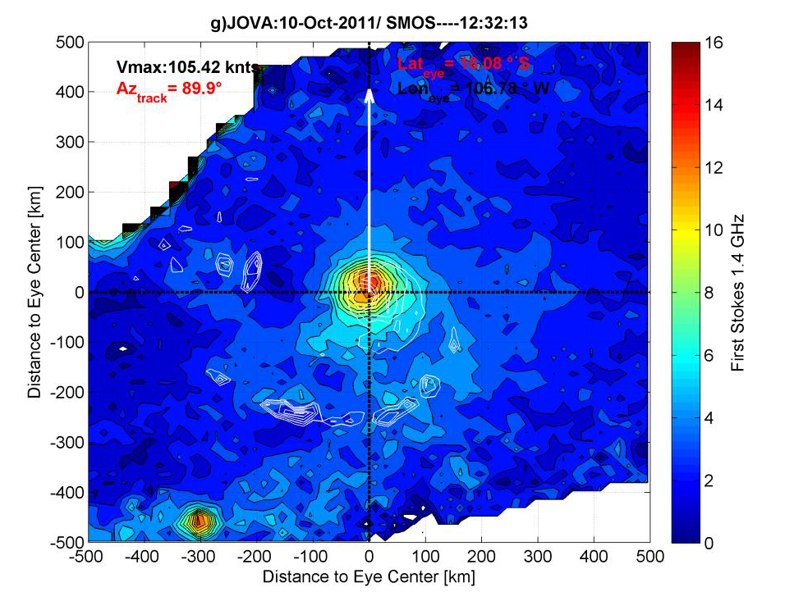
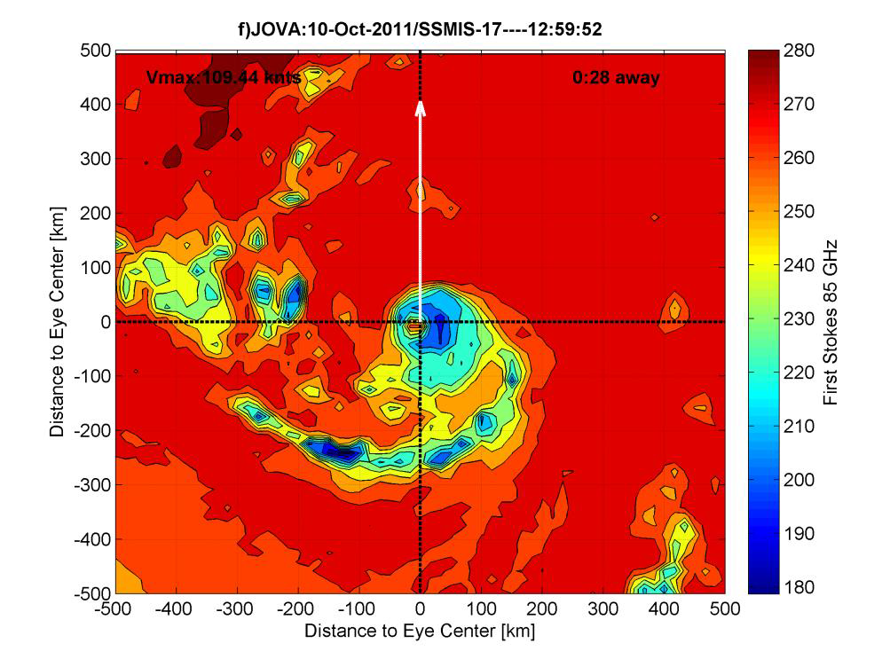
SMOS Tb is rotated to a fix North propagation direction for further Tbs averaging

Slide 41
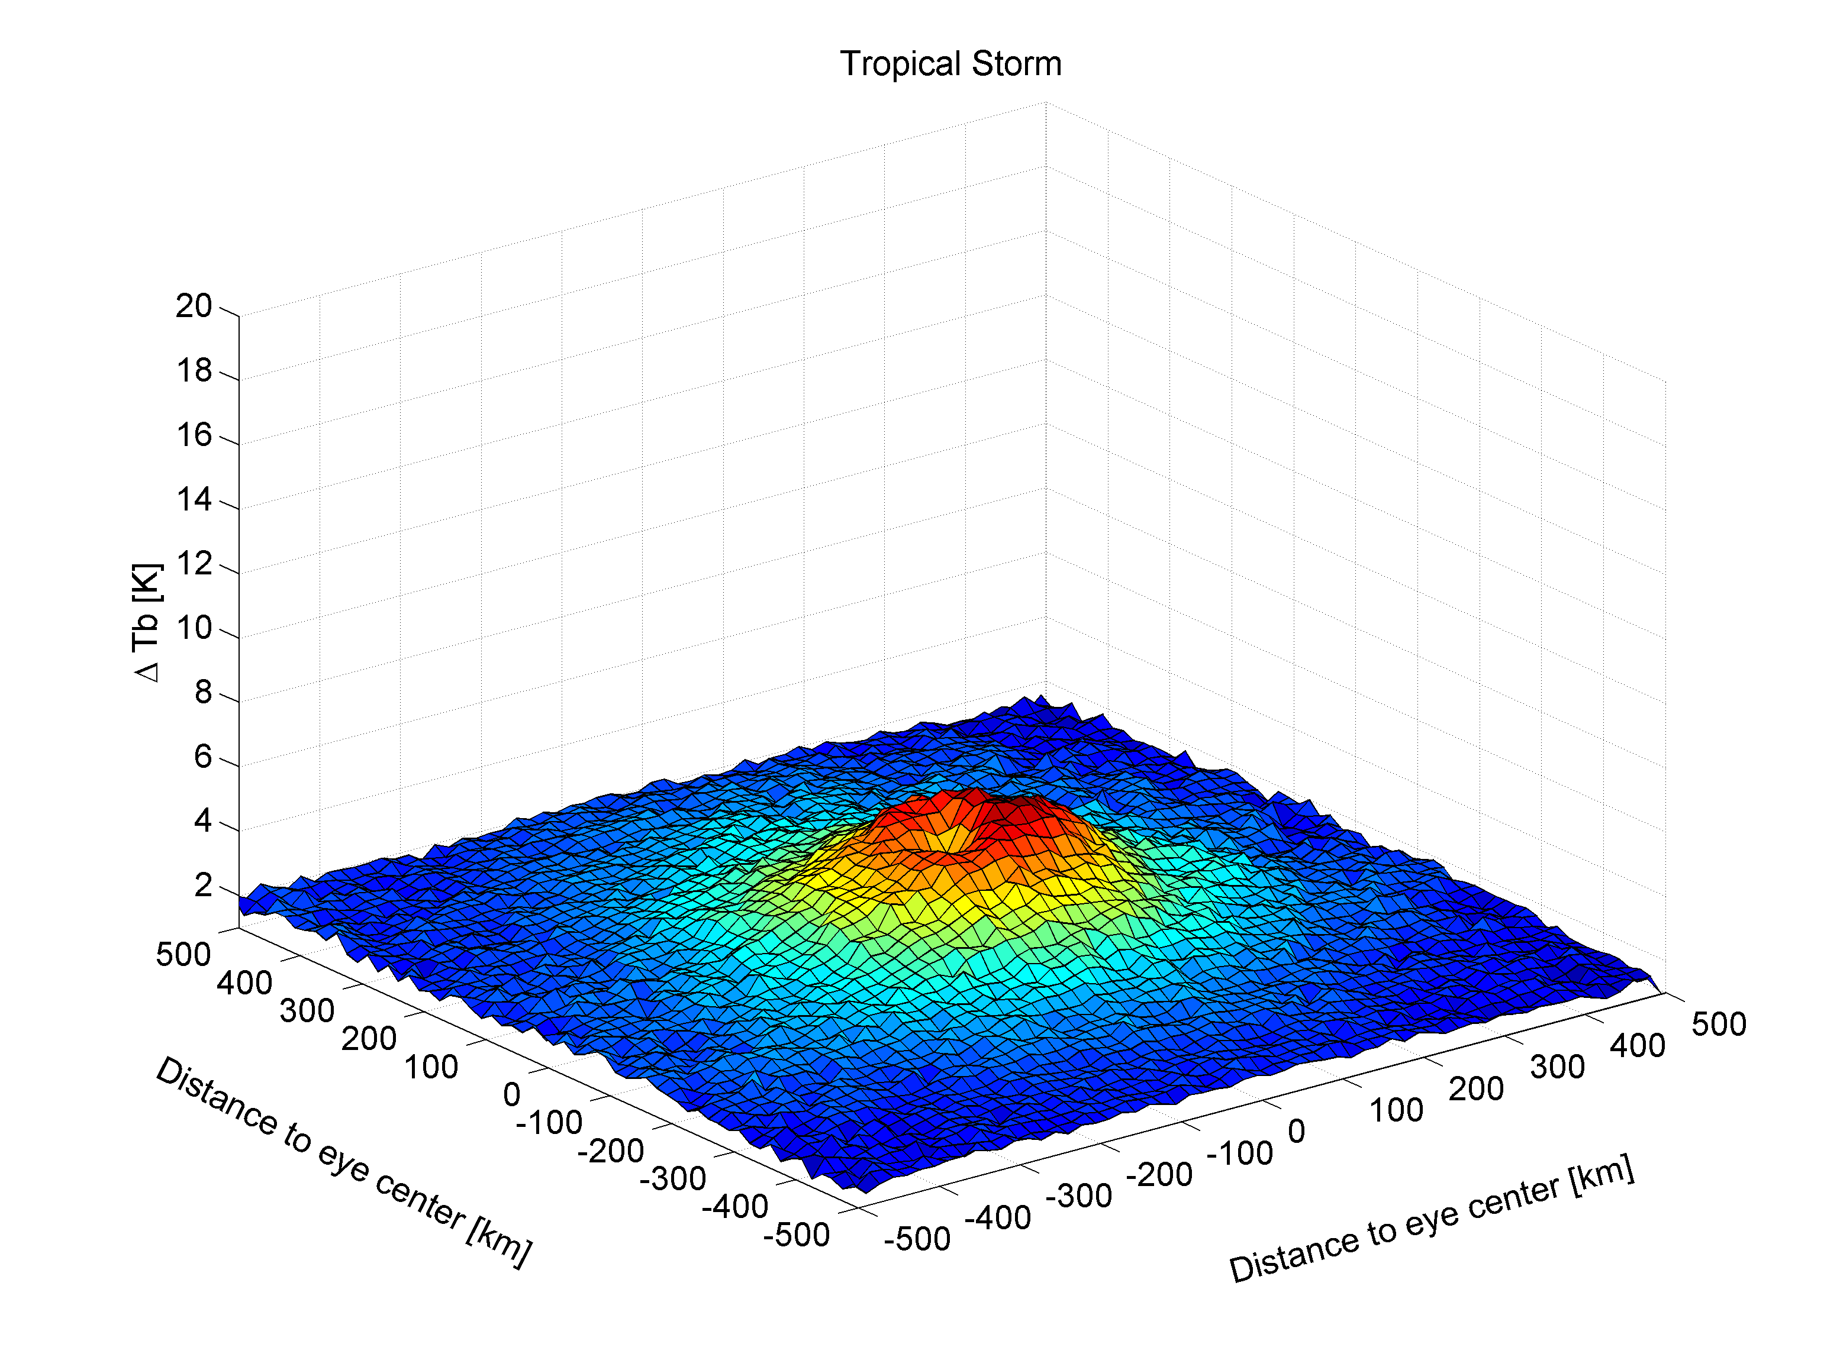
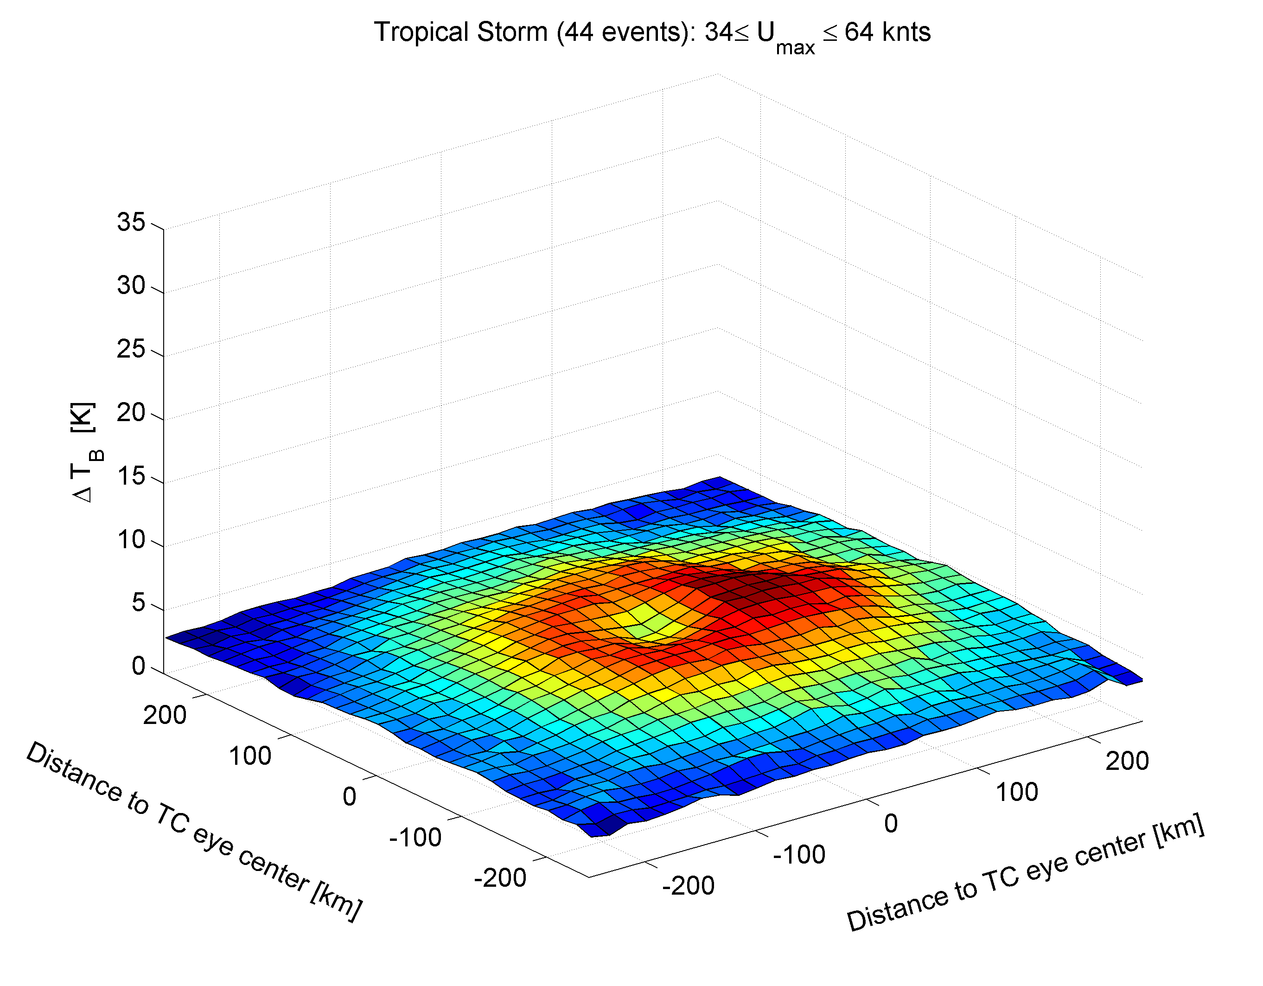
119 events intercepted

Slide 42


86 events intercepted

Slide 43


46 events intercepted

Slide 44


96≤U_{max}≤120 knts
37 events intercepted

Slide 45

27 events intercepted

Slide 46

U_{max≥}135 knts
(3 events intercepted)

Slide 47

Average L-band Tb contrasts as function of storm Intensity & sectors
Systematic right-hand sectors asymetries in Tb as expected in
wind & waves distribution in TCs (extended fetch=>Young, 2003; MacAfee and Bowyer, 2005

Slide 48
SMOS surface Tb data reveal a clear average growth of amplitude with storm intensity
=> Can be used as a Tropical cyclone
intensity meter
SMOS shows sector distribution asymetries with max in RHS Storm quadrants (east)

Slide 49

SMOS STORM SHAKER
New ‘average ’ structural
Information on
tropical cyclones
in terms of radius of high winds
General limits of orbiting scatterometer
Wind speed monitoring capabilities

Slide 50

Derivation of a revised Geophysical Model Function
U=f(Tb) using co-located SFMR wind speed data
64 - SFMR flights were co-localized with SMOS-STORM Tb database over 2010-2014
SFMR data from NOAA:
-C-band Tbs
-retrieved surface wind speed (6 km res)
-retrieved rain rate
-SSS along track (climato)
-SST along track (IR data ?)
SMOS data:
-Multi-incidence Tbs
-retrieved wind speed from SMOS 1st GMF
-SST ostia
-SSS from SMOS data composite of L3 during the week preceeding each storms
NOAA Hurricane hunter P-3

Slide 51


Derivation of a revised GMF: comparisons with SFMR
Ensemble of SFMR tracks &
Wind Speed [knots]
Co-localized SMOS wind Excess Emissivity
Δtime (SMOS-SFMR) < 10 hours

Slide 52

Validation: comparison with NOAA/Hurricane Research Division aircraft data : in moderately strong winds (TS &Cat 1)

Slide 53

Good agreement

Slide 54


Slide 55


Slide 56


Slide 57


Slide 58


Slide 59


Slide 60


Slide 61


Slide 62


Slide 63


Slide 64


Slide 65


Slide 66


Slide 67


Slide 68



Slide 69


Slide 70

Bias!

Slide 71


Bias!

Slide 72



Slide 73

|∆t|<5 hours

Slide 74







Slide 75


Slide 76

30 co-localisations SMOS/HWIND

Slide 77




Slide 78
Preparing New Low Microwave frequency merged surface wind
Products in TCs

Slide 79



Three Low-frequency Microwave radiometers enhancing High Wind Speed ocean Surface monitoring capabilities
SMOS-ESA
Interferometric Radiometer
Frequency: 1.4 GHz L-band
Spatial Resolution: ~43 kms
Swath Width: ~1000 kms
Revisit time Equator: ~3 days
Incidence angles: 10°-60°
Fully polarimetric
Launched Nov 2009
SMAP-NASA
Real Aperture Radiometer
Frequency: 1.4 GHz L-band
Spatial Resolution: ~30 kms
Swath Width: ~1000 kms
Revisit time Equator: ~3 days
Incidence angle: 40°
Fully polarimetric
Launched Jan 2015
AMSR-2-JAXA
Real Aperture Radiometer
Multi Frequency including 6.9 and 7.3 GHz C-band
Spatial Resolution: ~30 kms
Swath Width: ~1450 kms
Revisit time Equator: ~3 days
Incidence angle: 50°
Linear polarizations
Launched may 2012

Slide 80



Towards Merged SMOS-AMSR-2-SMAP High wind products
On 18 May 2012 Japan launched a new passive microwave instrument with the largest in the world diameter of antenna - Advanced Microwave Scanning Radiometer (AMSR2) onboard Global Change Observation Mission – Water satellite (GCOM-W1 “Shizuku”)
Additional channel
Better than AMSR-E
Potential accuracy for SWS retrievals is 1 m/s
Same as AMSR-E

Slide 81
An extreme extreme: the super typhoon Hayan in 2013

Slide 82



Super Typhoon
Maximum sustained Wind
Reaching ~150-170 knots

Slide 83

ASCAT sensing of Hyan on Metop-A & B

Slide 84


Slide 85


Slide 86


Slide 87


Slide 89


Slide 90


Slide 91


Slide 92


Slide 93


Slide 94


Slide 95


Slide 96

Cat 1 on
Saffir-Simpson
scale
Unability of the scatterometer to measure wind speeds above hurricane force (64 knots)

Slide 97

Haiyan Super Typhoon Signature in SMOS data
Figure 1: SMOS retrieved surface wind speed [km/h] along the eye track of super typhoon Haiyan from 4 to 9 Nov 2013.

Slide 98

Haiyan Super Typhoon Signature in SMOS data
Super-
Typhoon
Haiyan
(2013)
ΔTb=41 K !
Cat 4 Hurricane
Igor (2010)
ΔTb=22 K !
Haiyan Typhoon in 2013:
The brightest natural source of L-band radiation ever measured over the oceans
=>an unprecedented natural extreme

Slide 99


Haiyan Super Typhoon Signature in SMOS data
Maximum sustained 1 minute wind speed estimated during Haiyan Typhoon. From SMOS data (black filled dots) compared to Advanced Dvorak Technique (ADT=blue diamond), CIMSS (yellow filled dots), SATCON (red) and Best Track from NHC (cyan).
Surface wind speed deduced from the SMOS estimated excess brightness temperature.
Excellent agreement between SMOS max winds estimates and other traditional
Top of the atmosphere estimates datasets (Dvorak, Best track,..)

Slide 100

SMOS versus AMSR2 SWS in Haiyan
Zabolotskikh E.V., L.M. Mitnik, N. Reul, B. Chapron, (2015). New possibilities for geophysical parameter retrievals opened by GCOM-W1 AMSR2. IEEE Journal of Selected Topics in Applied Earth Observations and Remote Sensing (JSTARS), doi: 10.1109/JSTARS.2015.2416514. IF 2.827
Very Coherent L (SMOS) &
C (AMSR-2) SWS retrievals
5 hours appart
SMOS
AMSR2

Slide 101


Towards Merged SMOS-AMSR-2-SMAP High wind products
Excellent agreement between SMOS+AMSR2 &
Traditional methods of Max wind Estimate (Dvorak)

Slide 102


Slide 103


Slide 104


Slide 105


Slide 106


Slide 107


Slide 108


Slide 109


Slide 110


Slide 111


Slide 112


Slide 113


Slide 114


Slide 115


Slide 116


Slide 117


Slide 118


Signatures of 3 co-evolving 2015 major Hurricanes from 22 Aug to 9 Sep in the East and Central tropical Pacific as seen from SMOS, SMAP and AMSR-2 observations (beyond others)

Slide 119

Time laps of SMOS-SMAP-AMSR-2 winds
A time-series mosaic of surface wind speed measurements from 25 Aug to 8 Sep 2015 over Hurricanes Kilo, Ignacio and Jimena is shown in this animation. Data from three satellite microwave radiometer missions: the ESA L-band SMOS mission, the recently launched NASA L-band SMAP mission and JAXA C-band AMSR-2 mission are combined before your eyes to reveal the track of each Hurricane and the maximum surface wind speed.
32, 26 and 35 intercepts of Jimena, Ignacio and Kilo respectively

Slide 120

Caption: Contours of the domains showing the maxima of surface winds obtained from the combined multiple observations of SMOS, SMAP and AMSR-2 sensors from 22 Aug to 9 Sep 2015 showing the high wind trails over Hurricanes Kilo and Loke (left), Ignacio (center), Jimena (right).

Slide 121




Slide 122

Gain of Wind Speed Sensing capability from Hurricane Cat 1 (64 kt) to Category 2 (95 kts)
Saturation above ~100 kts due to spatial resolution

Slide 123

Radius of Maximum
Winds:
A key TC structural parameter
well retrieved

Slide 124

34-, 50-, and 64-kt wind radii being displayed in blue, cyan, and red, Winds:
Other key TC structural parameters
well retrieved
By SMOS, SMAP
And AMSR-2

Slide 125
Summary
We evidenced clear SMOS brightness temperature signal (∆T_{B}) associated with the passage of Tropical Cyclones
Correlations between L-band Tb increase with TC intensity from Cat 1 to Cat 5 was demonstrated
L-band observations provide a first non-atmosphere corrupted view of the ocean surface in extreme conditions=> wind speed retrieval with ~5m/s accuracy
A complete storm database as been generated for the SMOS mission archive:
TC & ETC 2010-now available at http://www.smosstorm.org/
We have shown that SMOS can allow to retrieve important structural surface wind features within hurricanes such as the radius of wind speed larger than 34, 50 and 64 knots. These are Key parameters to monitor tropical cyclone intensification
Ascat can provide R34, sometimes R50, but not above R64 =>SMOS does

Slide 126
Perspectives
Merged low-frequency radiometer observations in extremes : SMOS+AMSR-2+SMAP +…CYGNSS=> new opportunity to study air-sea interactions in extreme wind conditions: foam & whitecaps properties, ocean response to TC passage, drag coefficient..
SMOS wind speed data assimilation experiments into UK Metoffice forecasts model has been performed to investigate the data impact on:
-storm track & intensity forecasts skills (see James Cotton’s talk)

Slide 127

Towards Merged SMOS-AMSR2-SMAP High wind products

