Slide 1
International Workshop on Measuring High Wnd Speeds over the Ocean
Met Officee, Exeter, UK, 15-17 November 2016
The NASA CYGNSS Satellite Constellation Tropical Cyclone Mission
Maria Paola Clarizia and Chris Ruf
University of Michigan, Ann Arbor, MI USA

Slide 2
CYGNSS Mission Overview
The Cyclone Global Navigation Satellite System (CYGNSS) is the first NASA Earth Venture Mission
CYGNSS consists of 8 microsatellites, each with a 4-channel GPS bi-static radar receiver
Mission lead/Science Ops (University of Michigan)
Spacecraft/Integration/Mission Ops (Southwest Research Institute)
The driving science objective is rapid sampling of ocean surface winds in the inner core of tropical cyclones
CYGNSS uses a new measurement technique and a new satellite mission architecture
Measure the distortion of GPS signals scattered from the ocean surface to determine ocean surface roughness and wind speed
Use small satellites so many can be flown to improve sampling

Slide 3
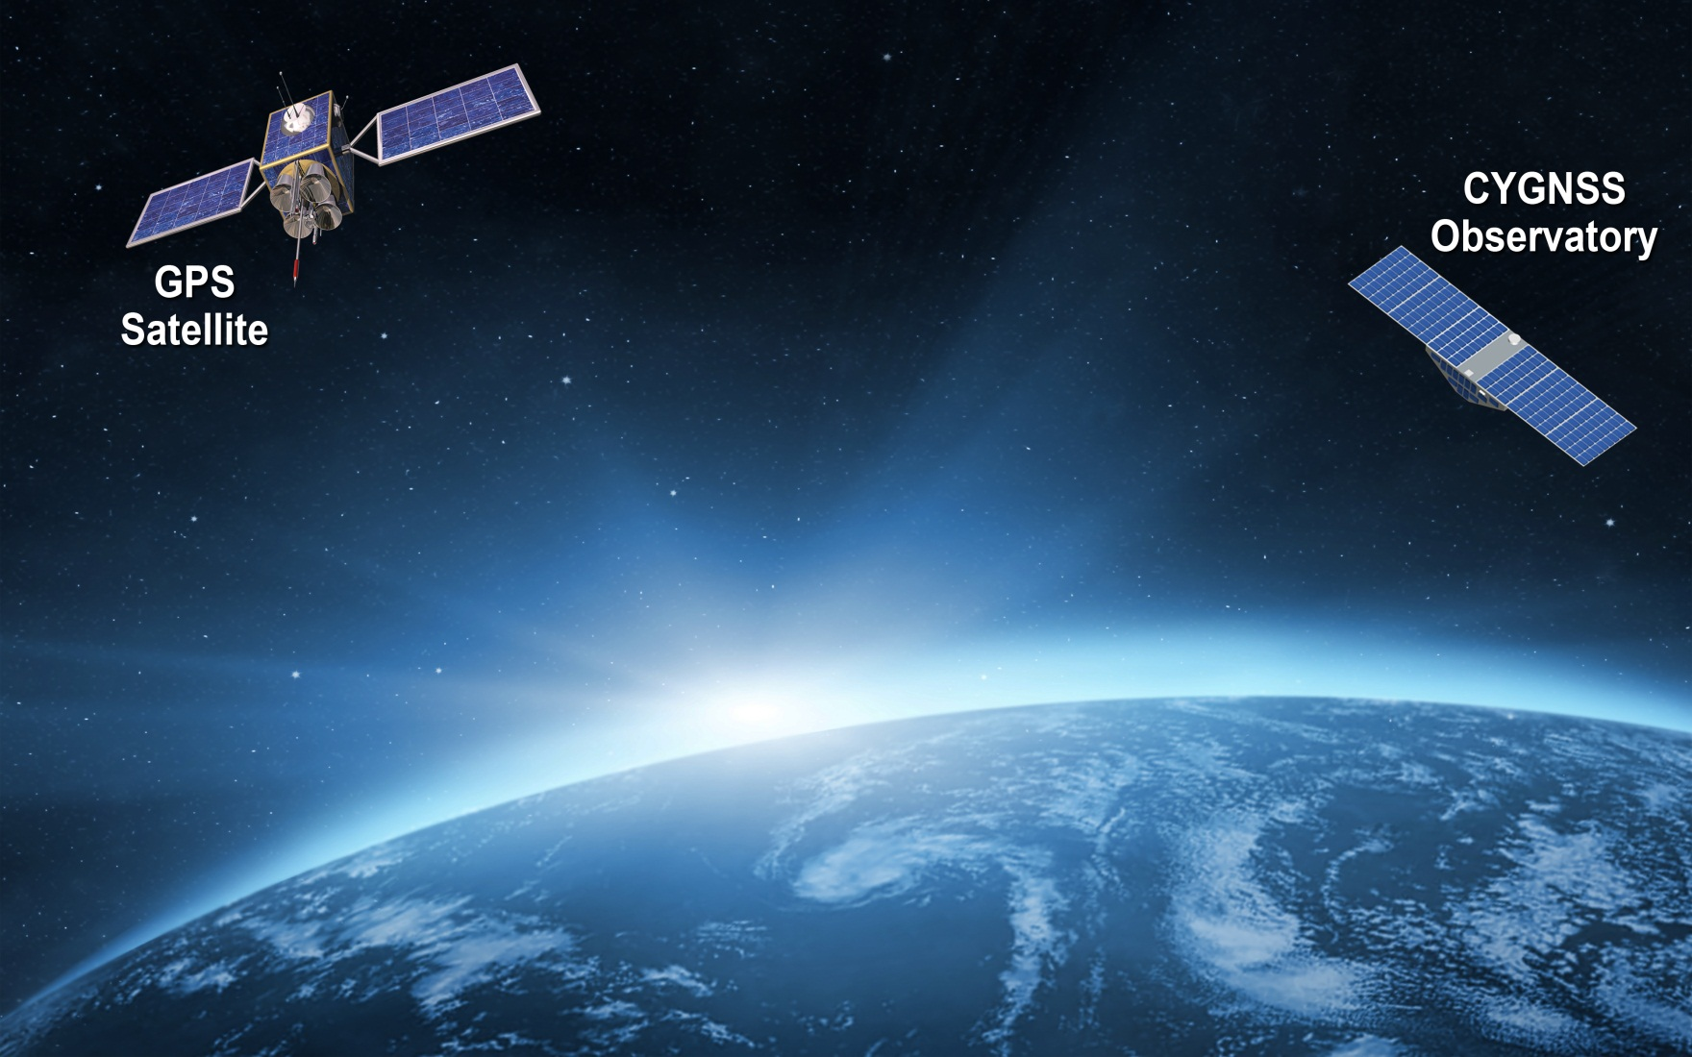
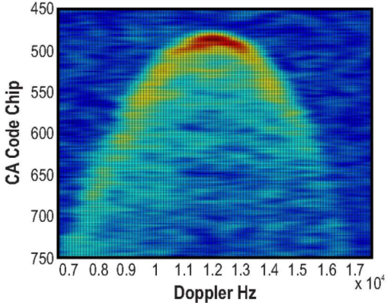
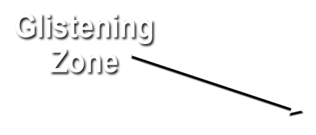
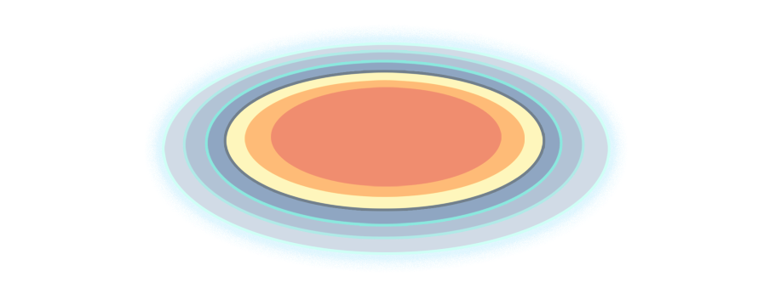
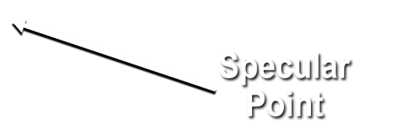
Notes:
Bi-static scattering geometry with GPS direct signal proving reference and quasi-specular forward scattered signal containing ocean surface roughness information
Animation illustrates – propagation and scattering geometries – GNSS bi-static scatterometry
quasi-specular forward scattered signal from the ocean surface -- received by nadir ant array
Ideal reflected signal (perfect ocean surface) -- mirror image of direct
scattered signal contains detailed information about surface roughness statistics
Glistening zone broadens from perfect surface to broad area given increase in surface wind speed.
Use example of Sun reflection while flying on airplane overwater to conference
direct GPS signal -- coherent reference for the coded GPS transmit signal – received by zenith ant
Inset: Image produced from data by the UK-DMC-1 demonstration spaceborne mission shows scattering cross-section
Two coordinates of the image:
Variable lag correlation (signal delay)
Doppler shift
The DDM enable the spatial distribution of the GPS signal surface scattering cross section to be resolved
Measurement of the ocean surface roughness and near-surface wind speed is possible from two properties of the DDM
The scattering cross-section can be related to surface roughness which corresponds to near surface wind speed
Wind speed can also be estimated from the shape of the scattering arc (the red and yellow regions)
The arc represents the departure of the actual bi-static scattering from the purely specular case that would correspond to a perfectly flat ocean surface

Slide 4
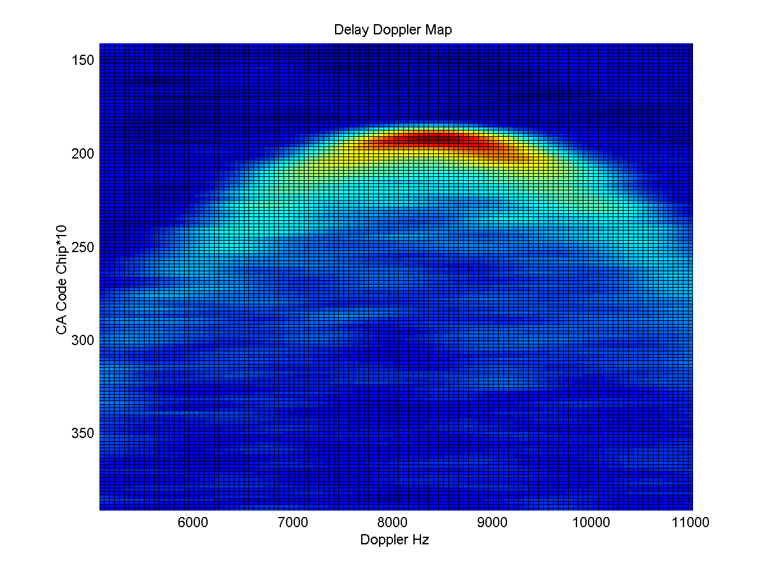
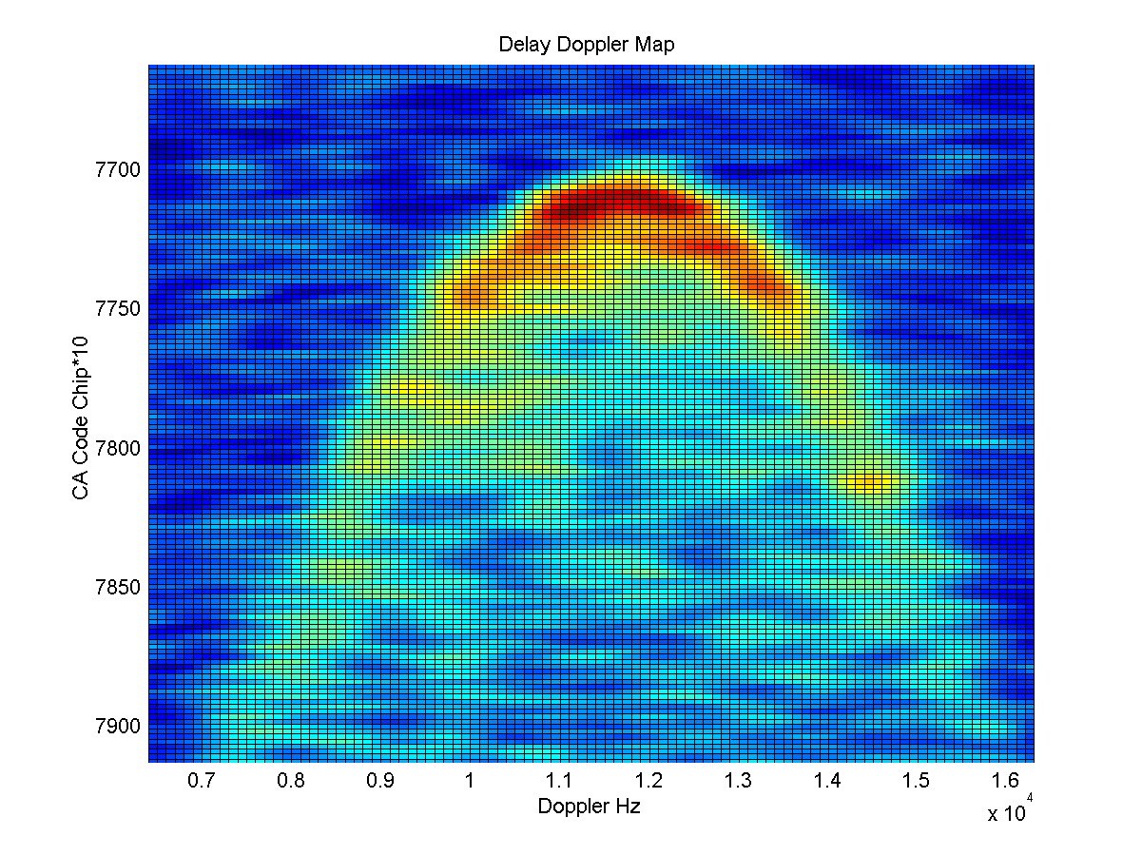
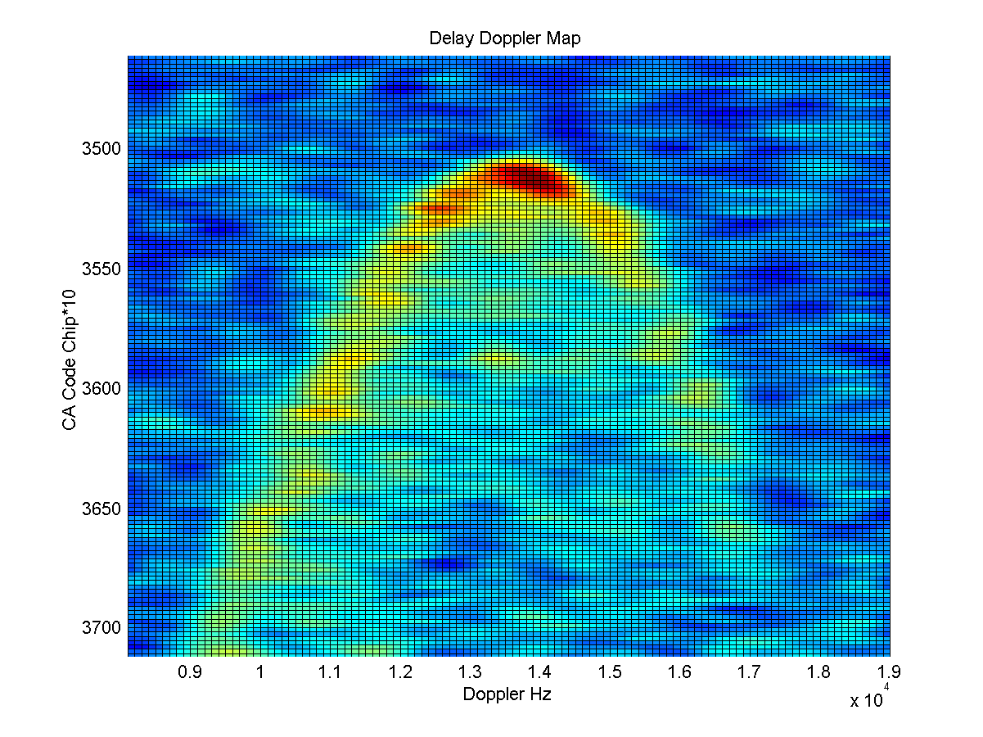
Spaceborne Empirical Demonstration of Ocean Wind Speed Retrievals by GNSS-R
GNSS-R instrument (early version of CYGNSS science payload) deployed on UK-DMC-1 mission, launch 2003
Winds ~ 2 m/s
Winds 7 m/s
Winds 10 m/s

Slide 5
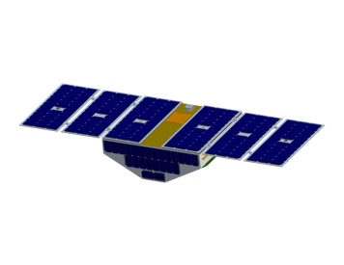
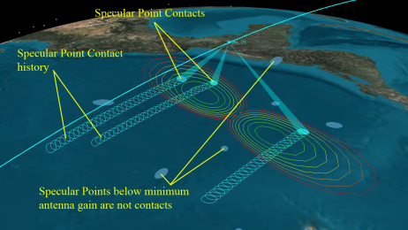
CYGNSS Specular Point Contacts and Spatial Sampling

Slide 6
CYGNSS Spatial Sampling
90 min (one orbit) coverage showing all specular reflection contacts by each of 8 s/c
24 hr coverage provides nearly gap free spatial sampling within +/- 35 deg orbit inclination

Slide 7
Level 1 Baseline Mission Science Requirement
Sci Rqmt # | Requirement | Verification Approach
1 | 3 m/s to 70 m/s at 5 km x 5 km resolution | Simulation/Analysis/Test
2 | Operation in presence of rain | Analysis
3a | 10% retrieval uncertainty for winds > 20 m/s | Simulation/Analysis/Test
3b | 2 m/s retrieval uncertainty for winds < 20 m/s | Simulation/Analysis/Test
3c | Spatial Resolution of 25 km x 25 km or better | Simulation/Analysis
4a | 100% duty cycle during science operations | Analysis/Test
4b | Mean temporal resolution less than 12 hours | Simulation/Analysis
4c | 24 hour spatial sampling covering 70% or more of the cyclone historical track | Simulation/Analysis
5 | Calibrate and validate CYGNSS data in individual wind speed bins above and below 20 m/s | Simulation/Test
6 | Support operational hurricane forecast community | Demonstration

Slide 8
Level 0-1 Data Products
Level 0 (Raw data telemetered to ground)
DDM in units of counts proportional to total measured power (scattered radar signal + instrument noise)
Level 1 (DDM Calibration)
L1Aa DDM of received power
L1B DDM of bistatic radar scattering cross section

Slide 9
Level 2 Data Products
Level 2 (Wind Speed)
Spatially averaged wind speed over a 25x25 km² region centered on the specular point
Uncertainty in the retrieved wind speed depending on the location of the specular point in the nadir science antenna beam
Level 2 (Mean Square Slope)
Spatially averaged mean square slope of the ocean surface over a 25x25 km² region centered on the specular point

Slide 10
Level 3 Data Products
Level 3 (Gridded Wind Speed)
L2 retrieved wind speed is produced in the spacecraft time & space coordinates
Re-grid L2 wind speed to a uniform 0.25 deg lat/lon grid with 3 hr time increment
Level 3 (Gridded Mean Square Slope)
Re-grid L2 MSS to a uniform 0.25 deg lat/lon grid with 3 hr time increment

Slide 11
Level 4 Data Products
Level 4 Integrated Kinetic Energy
3 hr reporting intervals
<5% RMS error
Level 4 Vmax
3 hr reporting intervals
<4 m/s RMS error
Level 4 Rmax, R-34, R50, R66 (significant wind radii)
3 hr reporting intervals
Level 4 gridded surface wind vector analysis field
9 km grid spacing, cycled Hybrid Data Assimilation
HWRF analysis fields with and without CYGNSS
Evaluations of impact of assimilating CYGNSS data
Produced for limited number of Atlantic hurricanes

Slide 12
CYGNSS Mission Status
Phases A/B/C complete
Define requirements (A), Preliminary flight segment design (B), Critical flight segment design (C)
Currently in Phase D
8 observatories integrated with launch vehicle
Mission Operations Center online at SwRI in Boulder, CO
Science Operations Center online at UM in Ann Arbor
Launch window opens at 08:00 EST on 12 Dec 2016
L-1011 aircraft takes off from Cape Canaveral
Pegasus dropped over mid-Atlantic, launched into 510 km circular orbit at 35º inclination
Begin deployment of 8 Observatories at ~L+12 min
Phase E (science operations) to begin at L+60 days

Slide 13
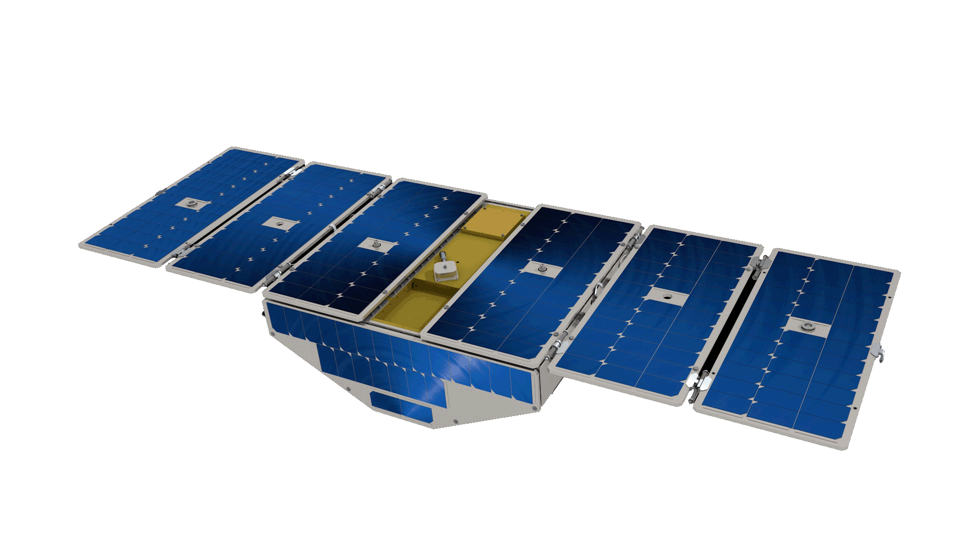
CYGNSS Observatory
Power: 38.3 W; Mass: 24.8 kg

Slide 14
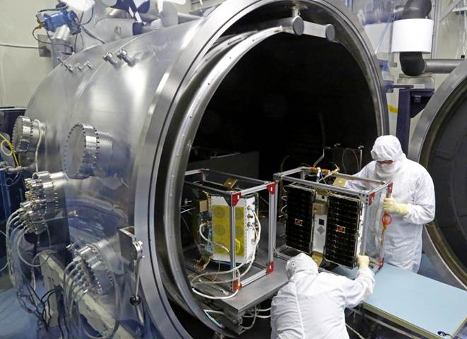
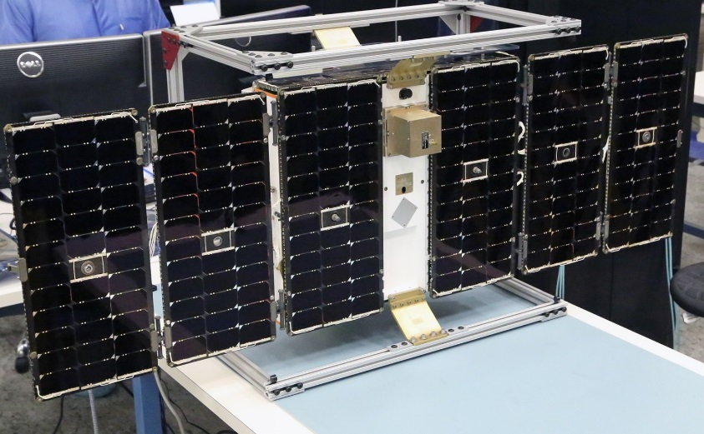
Assembly, Integration & Test
Observatory Mass PropertiesTest
Thermal/Vacuum Test
Solar Array Deployment Test

Slide 15
Vibration Testing of Complete Flight Segment

Slide 16
Pegasus Installed on L-1011 Aircraft

Slide 17
Observatory Separation (at L + 12 min)

