Slide 1
Major Issues Associated with Impacts and Remotely Sensed Observations of High Wind Speeds
Mark A. Bourassa
Dept. of Earth, Ocean and Atmospheric Science, and
Center for Ocean-Atmosphere Prediction Studies, and Geophysical Fluid Dynamics Institute
Florida State University
Tallahassee, FL
With input from many people, including Jim Edson, Heather Holbach, Jason Keefer, and Lucia Pineau-Guillouand
Thanks to ESA and NASA OVWST for travel support.

Slide 2
Motivation
The International Ocean Vector Winds Science Team (IOVWST) annual meeting in May 2015 had two working groups request high winds workshops
Climate working group and Stress working group
Many earlier workshops demonstrated need for more accurate high winds
Considerable improvements have been made toward intercalibration of L2 scatterometer products.
Progress has been made in understanding and interpreting the scatterometer responses for typical wind speeds (3 to 15ms⁻¹),
High winds (> 17ms⁻¹ in general) diverge slightly
Extreme winds (>30ms⁻¹) are much more of a concern
Observations indicate different behavior between Tropical and extratropical cyclones for U₁₀>20ms⁻¹
Physical insights into the key processes would be very beneficial to the flux modeling and ocean modeling communities, as well to improved intercalibration
Improvements in intercalibration might lead to society benefits

Slide 3
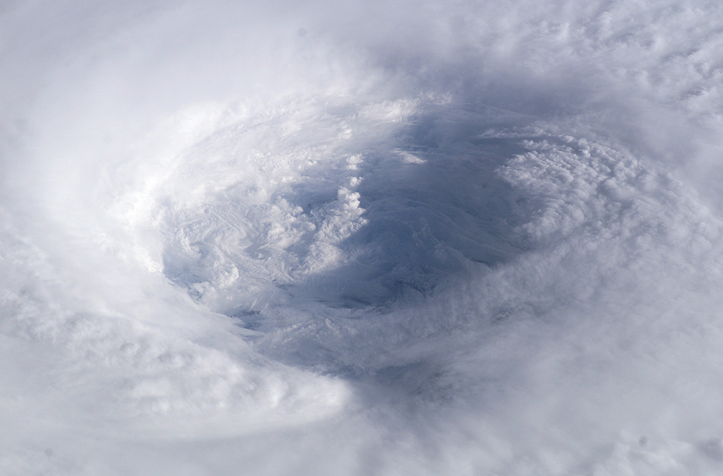
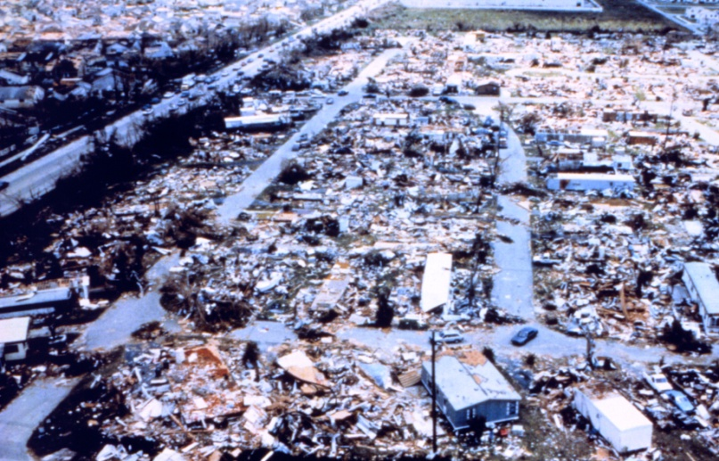
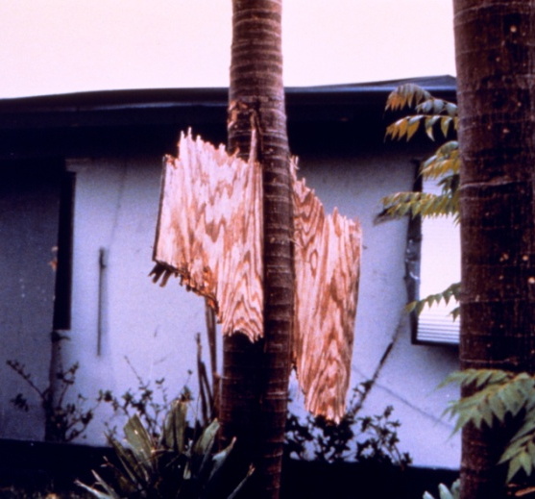
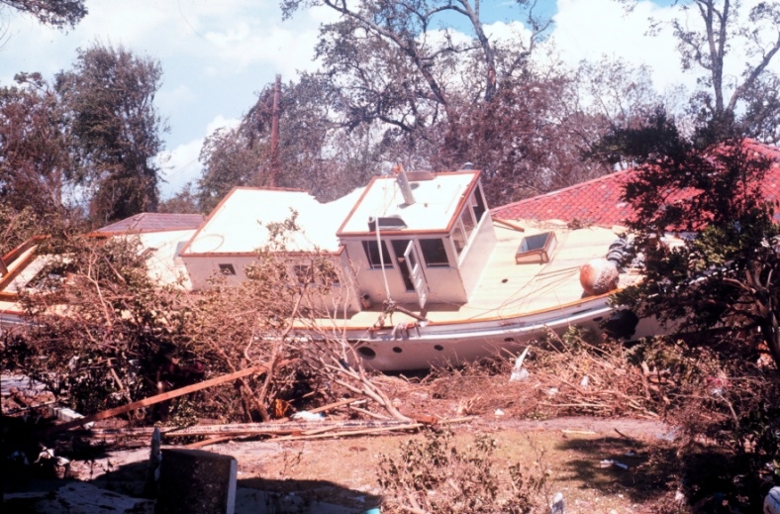
Examples

Slide 4
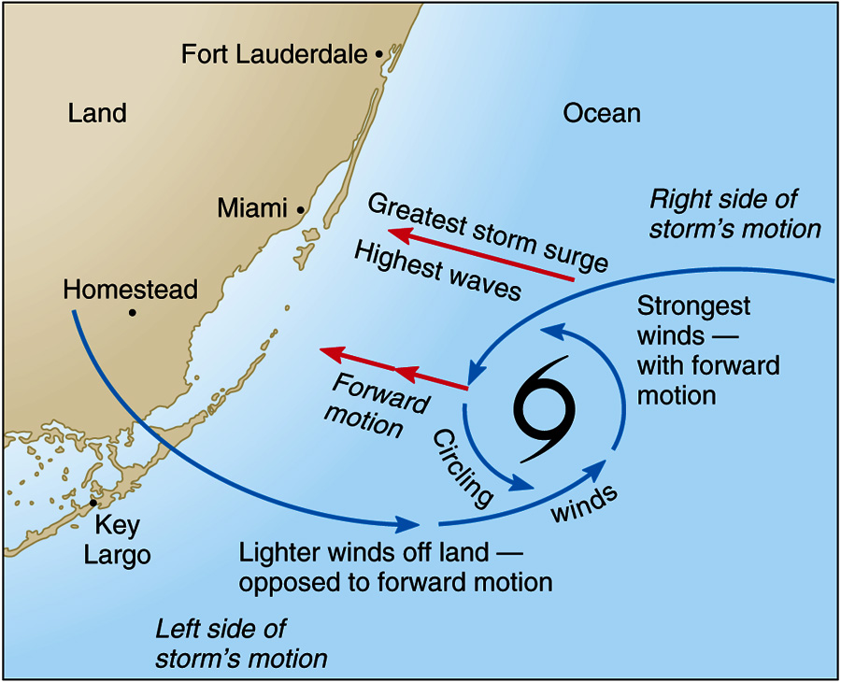
Hurricane Weather at Landfall
If a storm is translating (the center is changing it’s position on the globe), then the winds on the side to the right of the direction of travel are likely to be the greatest, and the winds to the left are likely to be the weakest.
Drag on land can further reduce the winds on side with inflow from over land.
For considering the storm surge, recall that Ekman transport of water is to the right of the wind direction.

Slide 5
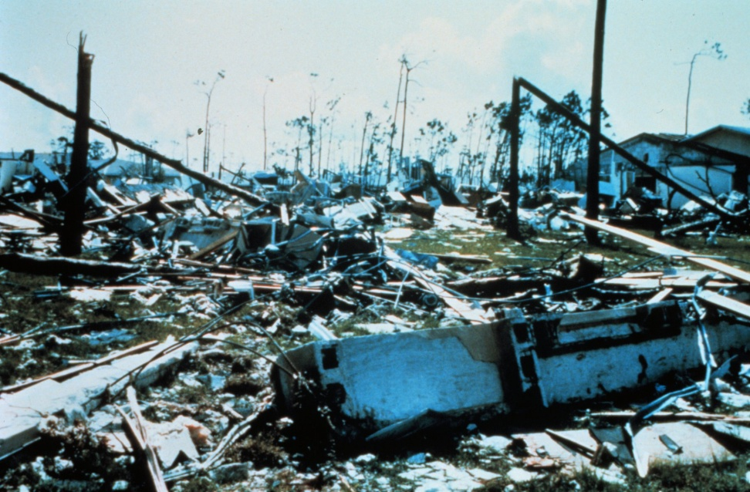
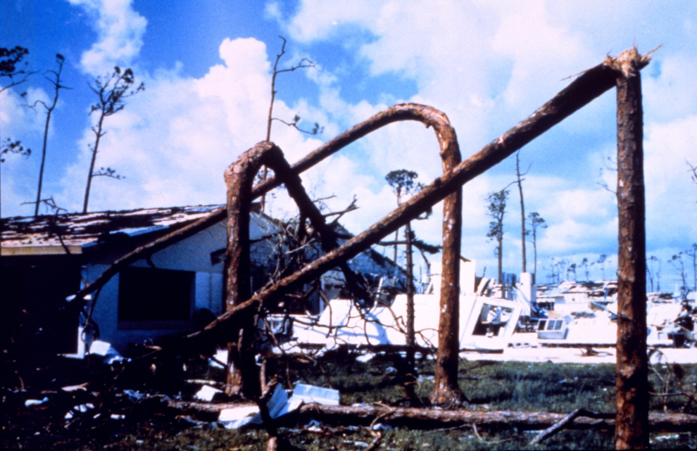
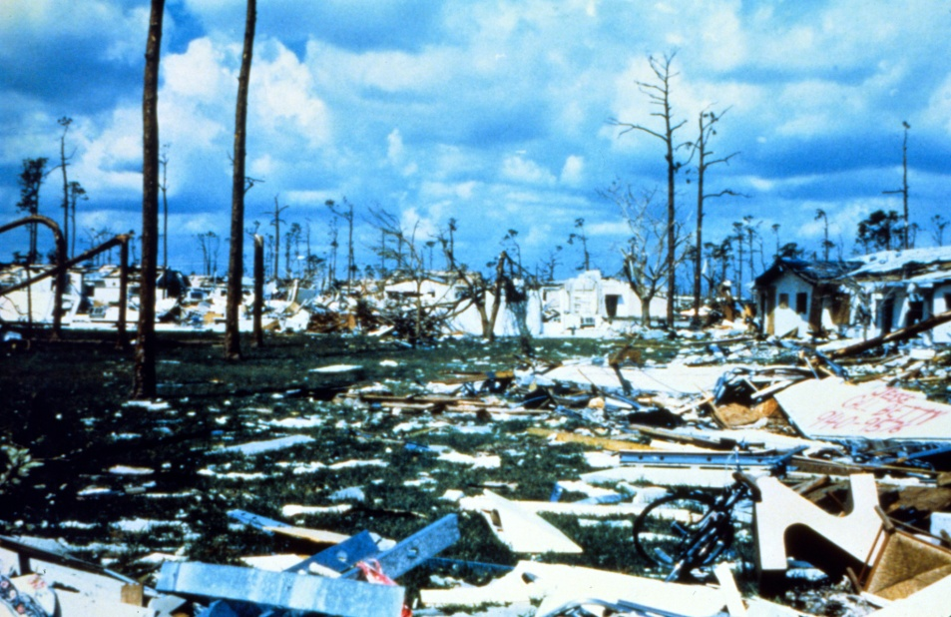
Wind Damage
Hurricane Andrew - A ground view of the devastation in Pinewoods Villa
http://www.photolib.noaa.gov/historic/nws/

Slide 6
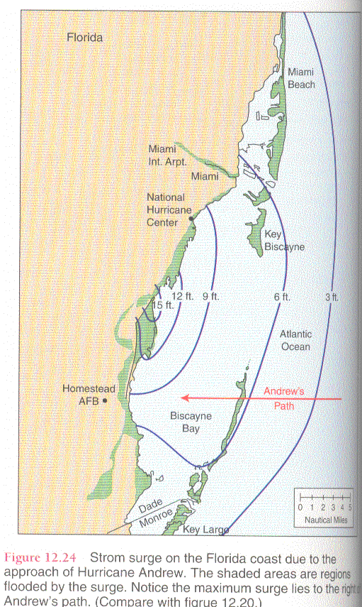
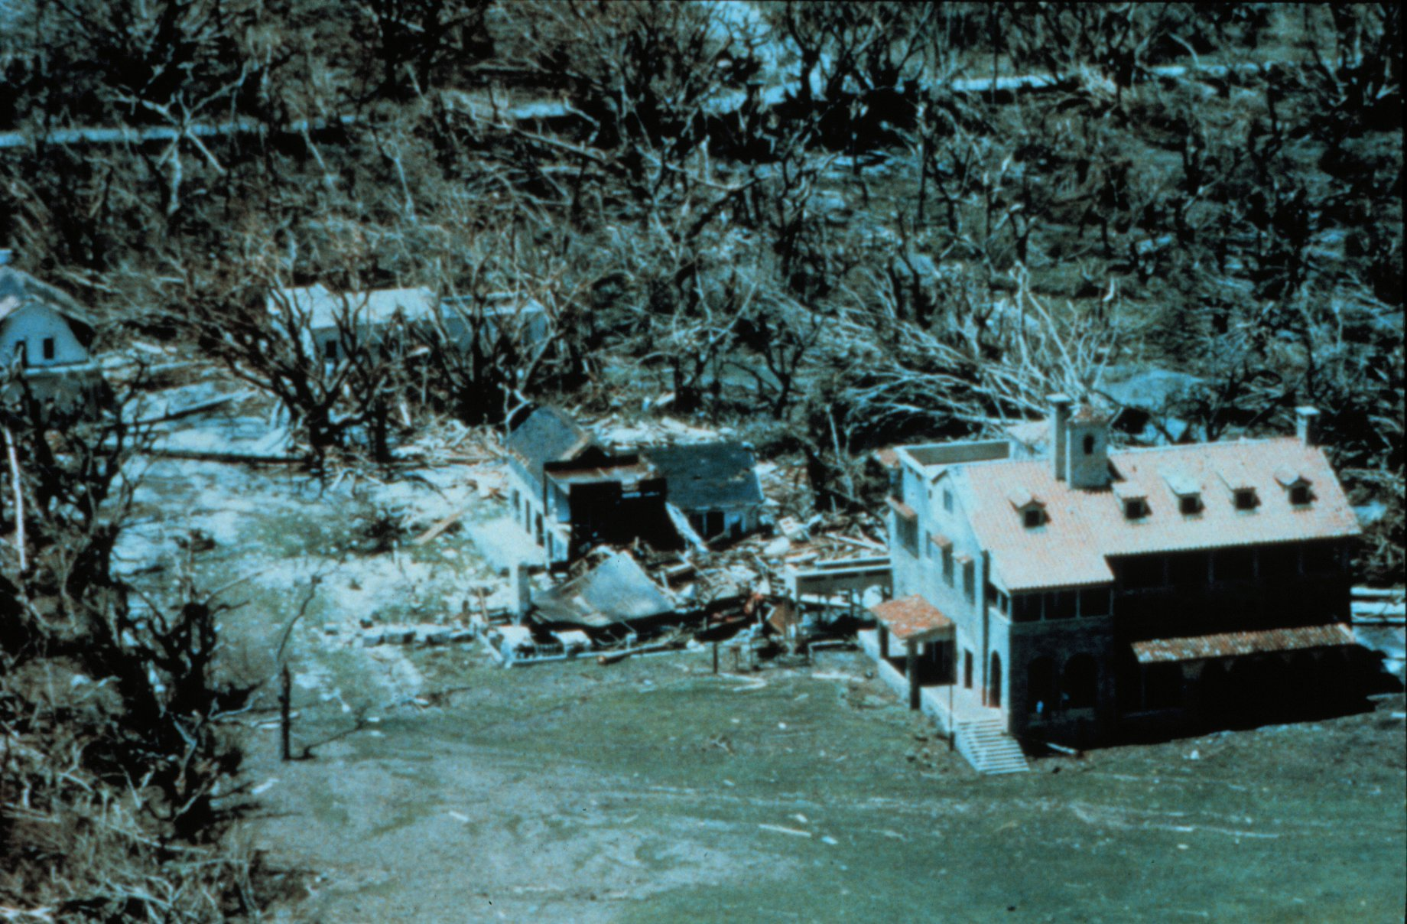
Storm Surge for Andrew
Left: forecast storm surge.
Above: Buildings on the Deering Estate Still-water marks from storm surge measured at 16.5 feet Image ID: wea00529, Historic NWS Collection http://www.photolib.noaa.gov/historic/nws/wea00529.htm

Slide 7
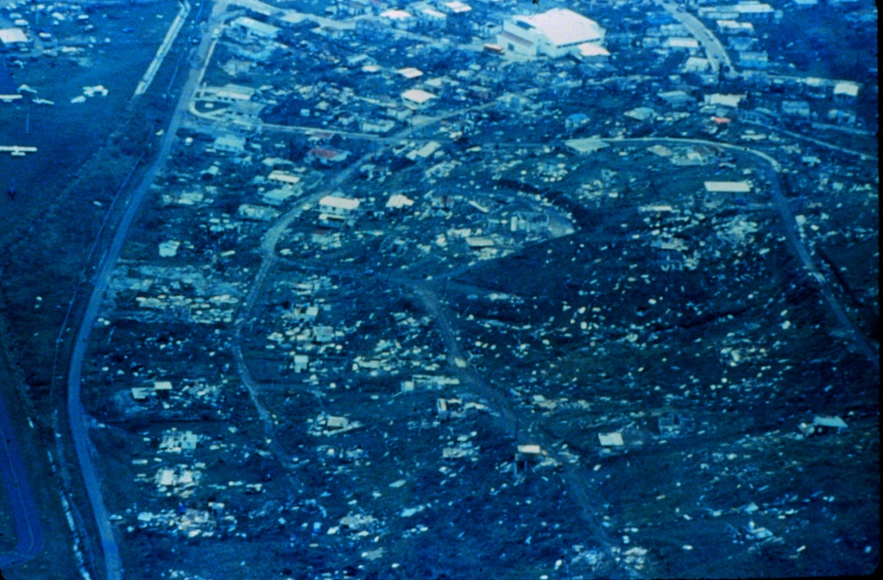
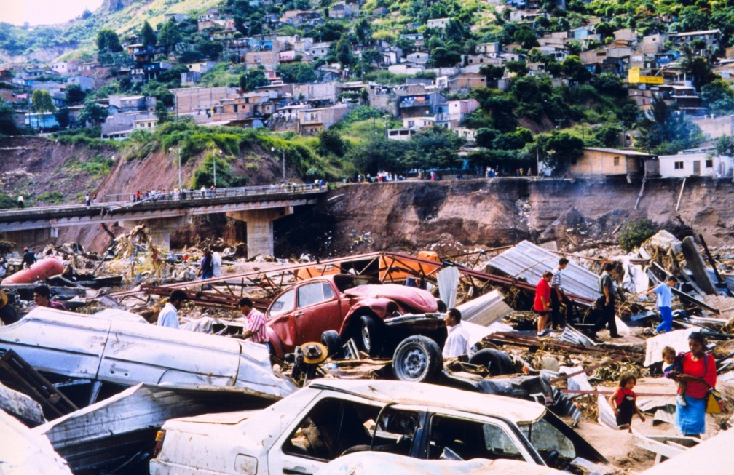
Devastation
Severe housing damage near the airport on Culebra Hurricane Hugo http://www.photolib.noaa.gov/historic/nws/wea00461.htm
Flood damage along the Choluteca River caused by Hurricane Mitch. Over 9,000 deaths and 9,000 missing were attributed to Mitch making it the second most deadly hurricane in history ranking only below a 1780 hurricane in the Lesser Antilles. http://www.photolib.noaa.gov/historic/nws/wea02450.htm

Slide 8
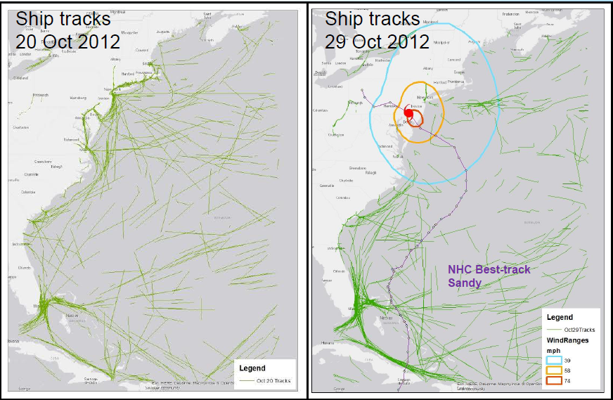
Ship Movement
Normal
Hurricane Sandy
Graphic from Joe Sienkeiwicz,
Lt. Joselph Phillips and Ashley Miller
Before and during Hurricane Sandy; (25ms-1 is a rough threshold for avoidance

Slide 9
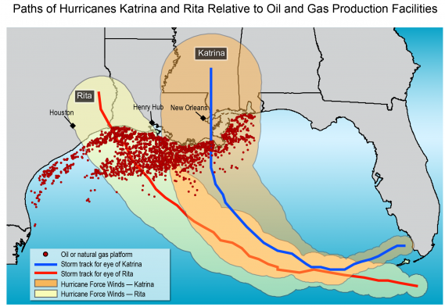
US Oil Production in the Gulf of Mexico
Soruce: Climate Change Impacts in the United States: The Third National Climate Assessment

Slide 10
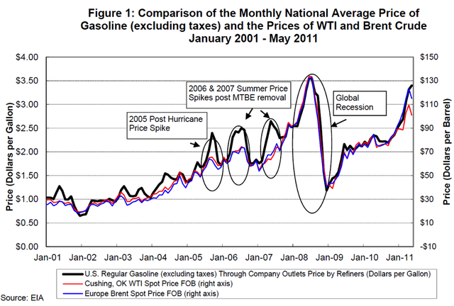
U.S. Cost of Oil Impacted by Hurricanes

Slide 11
High Wind Speeds from Ships
We are working on two high wind speed data sets.
US Research vessels with winds >20 ms⁻¹
http://coaps.fsu.edu/RVSMDC/html/highwind.shtml
We discovered an QC/QA code (e.g., ship in port)
Hold off downloading this data set until next week
Volunteer observing ships with winds >20 ms⁻¹
Being processed
Will likely be at the same site

Slide 12
Outline of Calibration Issues
Remotely sensed estimates of winds depend on stress
Very high wind environments make extrapolations of air/sea coupling from lower wind speed physics questionable
We know that stress is sensitive to surface currents and wave characteristics, at most wind speeds this can be finessed .
Large sampling differences as a function of wind speed can result in a systematic bias (underestimate) in speed unless accounted for
A typical assumption is that the wind stress does not change with height within the lower boundary-layer (and above the wave layer) – not true for high winds
It is also observed that rain in hurricanes reduces the surface roughness, which is closely related to stress and hence causes errors in remotely sensed winds

Slide 13
Observations of Stress Rather than Wind
Remotely sensed estimates of winds depend on observations that are sensitive to surface stress (a measure of vertical wind shear) rather than wind speed.
Lines represent different values of air/sea differences in temperature.
SST – Air temperature
Positive is unstable stratification
Negative is stable stratification
Stability is proportional to the ratio of production of turbulent kinetic energy buoyant due to buoyancy and mechanical shear.
For high wind speeds shear dominates and the drag coefficient and stress as less dependent on buoyancy.
Calibration is adjust to neutral equivalent winds to avoid ambiguity
Unstable stratification
Drag Coefficient, C_{D10} (unitless)
0.0 0.5 1.0 1.5 2.0
Stable stratification
0 5 10 15 20 25
Wind Speed, U₁₀ (ms⁻¹)
Graphic from Smith (1988)

Slide 14
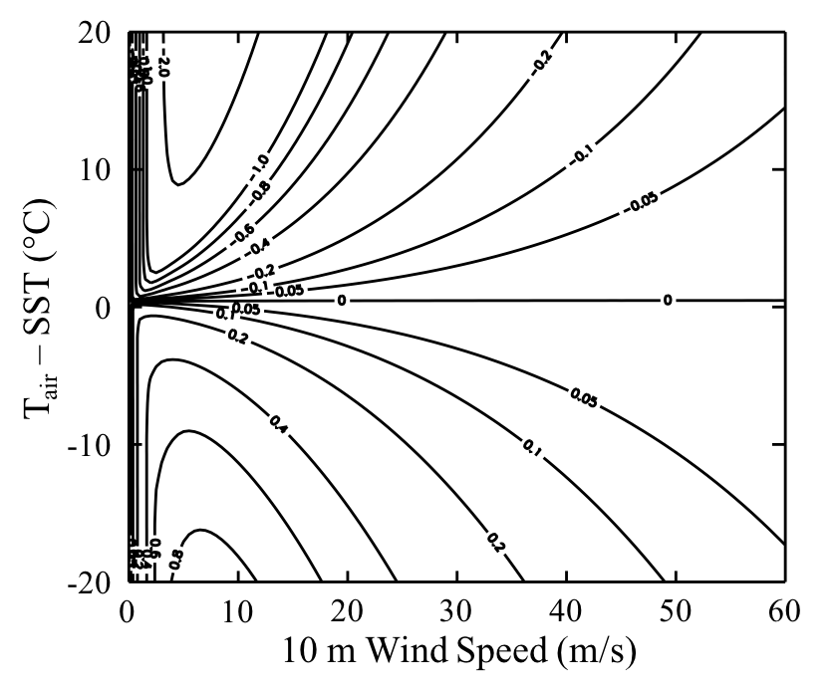
Impact of Stability on Wind Speed
Plot of the differences between U₁₀ and U_{10EN}
U_{10EN} – U₁₀
Units of ms⁻¹
Danger – physics are extrapolated from conditions below 20 ms⁻¹
Impact of stability appears to be a very minor issue for hurricane force winds!
This statement will be qualified later in this talk.

Slide 15
Extrapolation from Lower Wind Speeds
Very high wind speed conditions likely cause changes in the environment that make extrapolations of air/sea coupling from lower wind speed physics questionable,
and hence make calibration and interpretation of observations more challenging
At very high wind speeds, the short wind-waves to which scatterometers respond are ripped away
The response may still be from short water waves, but they are formed by a different physical mechanism
ECMWF drag coefficient are over estimated.
Smaller wind speeds are needed to get the stress right
COARE4.0 flux algorimth shows this problem (Jim Edson)
Preliminary comparison to winds from oil rigs (Lucia Pineau-Guillou)
The change in air/sea coupling mechanism seems to occur at lower wind speeds in hurricanes (~22 m/s) than in mid-latitude storms (>28m/s)

Slide 16
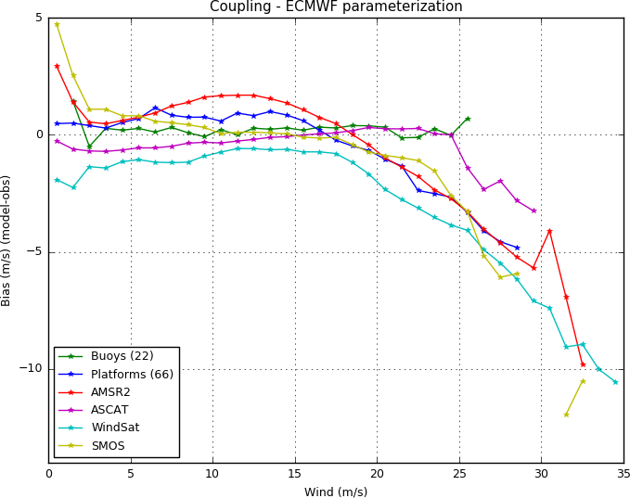
ASCAT and Buoys are Different
Different does not mean bad
ASCAT is very well calibrated to buoys
But buoys are questionable (likely biased) at high wind speeds.
If the wave height is similar to the anemometer height, then waves change the physics and reduce the wind speed
Jim Edson
Graphic from Lucia Pineau-Guillou

Slide 17
Comparison of Drag Coefficients
ECMWF drag coefficient is similar to COARE4.0 for most wind speeds
But is too large for high winds
If ECMWF stress is good, then wind speeds must be too low
XX Add example from Jim Edson
Graphic from Jim Edson

Slide 18
Dependence on Waves and Currents
We know that stress is sensitive to surface currents and wave characteristics.
Currents are usually assumed to be small; the influence of waves is far from clear.
Several examination of SFMR retrievals suggest that wave can change brightness temperatures by several K (Hwang 2016; Holbach 2016)
Hwang, P. A., 2016: Fetch- and duration-limited nature of surface wave growth inside tropical cyclones: With applications to air-sea exchange and remote sensing. J. Phys. Oceanogr., 46, 41-56, doi:10.1175/JPO-D-15- 0173.1.
Holbach, 2016: Ph.D. Dissertation, FSU
Currents typically cause common estimates of drag coefficient to be over estimated (reduced vertical wind shear is ignored), requiring a higher drag coefficient to match the observed stress.
If currents are an issue for high winds (which seems certain), then remotely sensed winds will tend to be overestimated

Slide 19
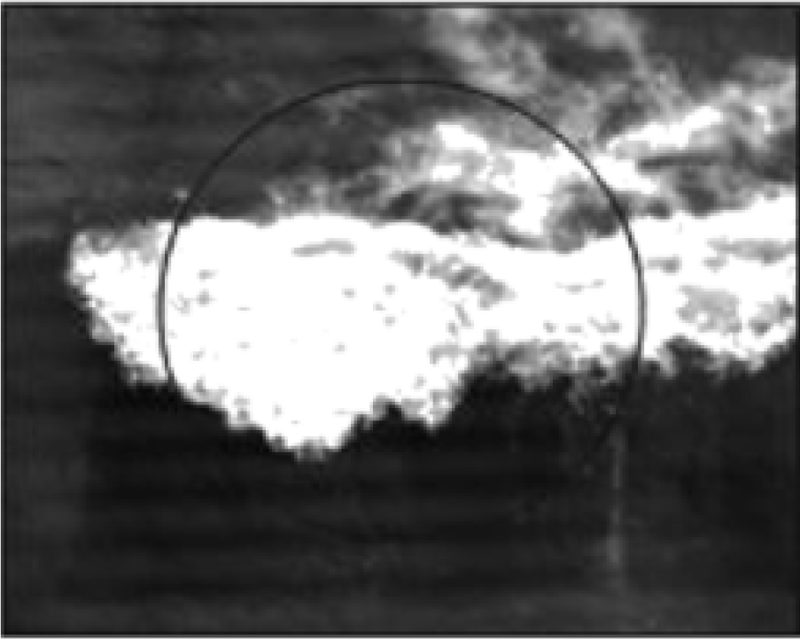
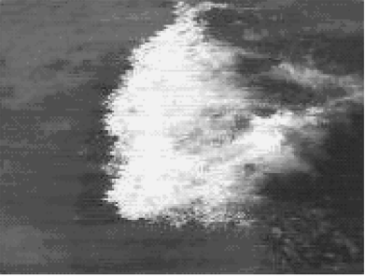
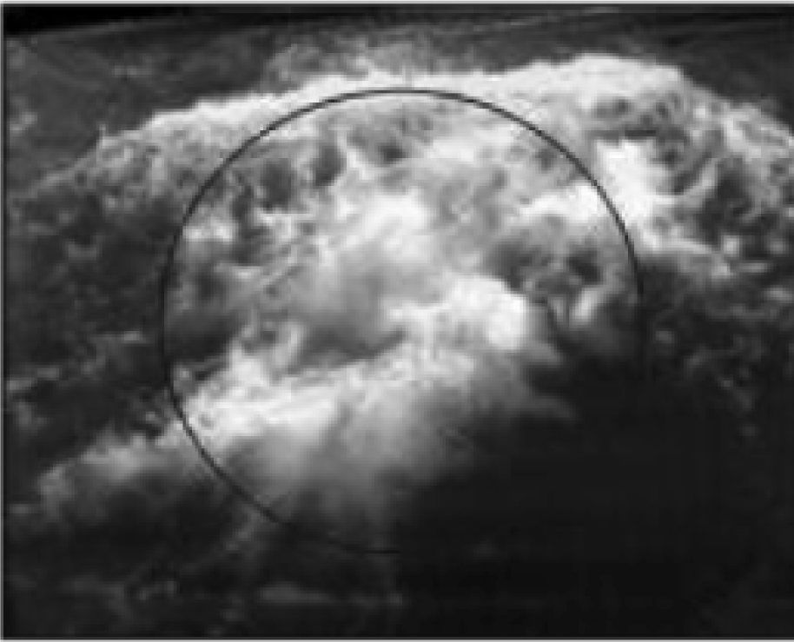
Whitecap and Foam Distribution
Front of Wave
Side of Wave
Back of Wave
Source: Padmanabhan et al. 2006
53° Incidence
We often assume that wind and waves (on average) move in the same direction
If they move in different directions the stress (arguably) increases
Therefore the amount of white capping increases
Preliminary results of SFMR observations (at 25° incidence angle) suggest rather large changes in excess brightness temperature (perhaps 4K)
Related problems will exist for scatterometry, and for L-band radiometry

Slide 20
Impacts of Sampling and Uncertainty
Large sampling differences as a function of wind speed can result in a systematic bias in speed unless accounted for
For high winds this causes an underestimation
The opposite error happens at very low wind speed, where there are no real wind speeds below 0 ms⁻¹ and plenty just above that wind speed
This is an extreme case, and a similar issue for wind speeds in strong hurricanes is less severe – but how much less?
The following example is based on the comparison of scatterometer wind speeds to visual estimates from ships
Li Keqiai, 2016, MS Thesis, FSU

Slide 21
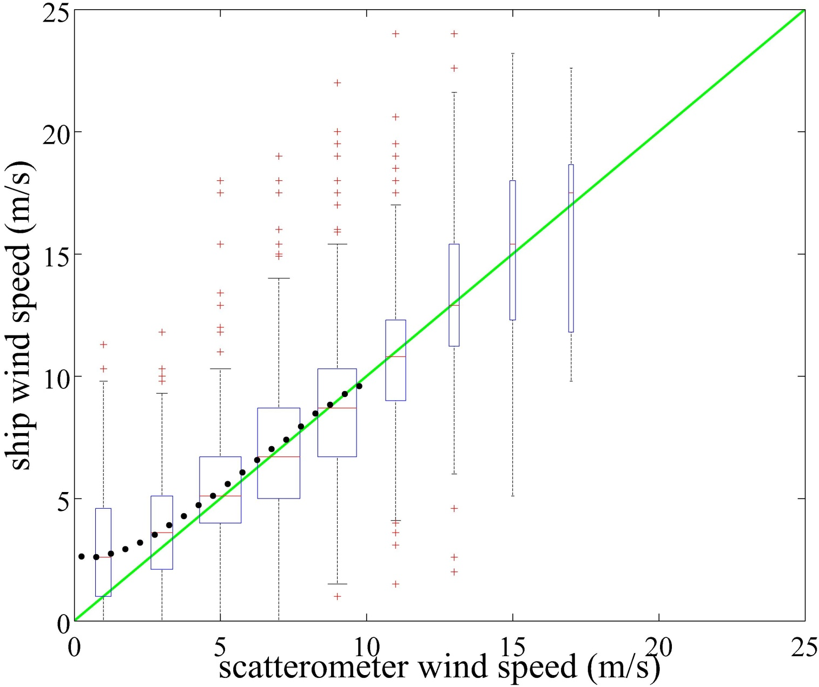
Apparent Bias in Visual Estimates
Visual winds and scatterometer equivalent neutral winds seem to a good match
Except for low wind speeds

Slide 22
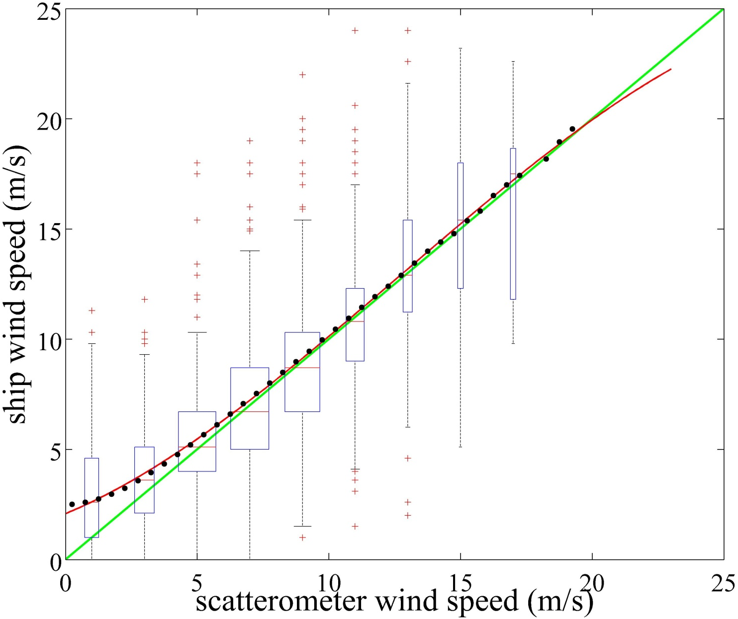
Purely Due to Large Noise and Sampling
Simply adding noise to scatterometer winds almost exactly mimics the apparent bias
red line
3.1 ms⁻¹ noise for visual winds
Probably similar or smaller than uncertainty in hurricane wind speeds
Scatterometer Winds Plus Visual Wind-like noise (ms⁻¹)

Slide 23
Trends in Wind Speeds
There has been a great interest in how the frequency of high winds is changing with time
Global trends are different when observed by different instruments
This is in part because regional trends are different, and different instruments sample different regions
Sampling, similar to the problem shown in the last slide, but for high winds impacts the assessment of high percentile winds
The impact of sampling will be shown in a comparison of sampling from SSM/I constellation, QuikSCAT sampling for T/P and JASON1
To simplify interpretation, all sampling applied to ERA-Int winds
Within ±3 hours of the ERA-Int winds
This approach reduces calibration-related problems
It is imperfect because these data are assimilated in ERA-Int
However, calibration is a minor issue in comparison to sampling
Sampling will be shown to be critical.

Slide 24
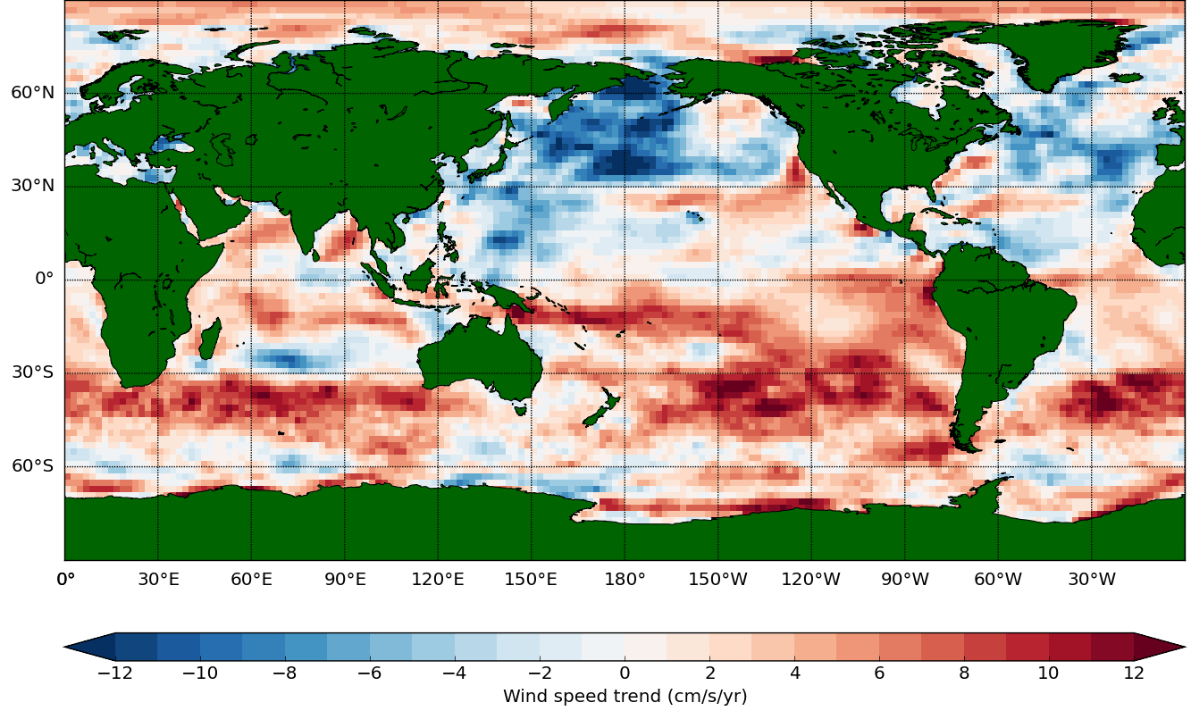
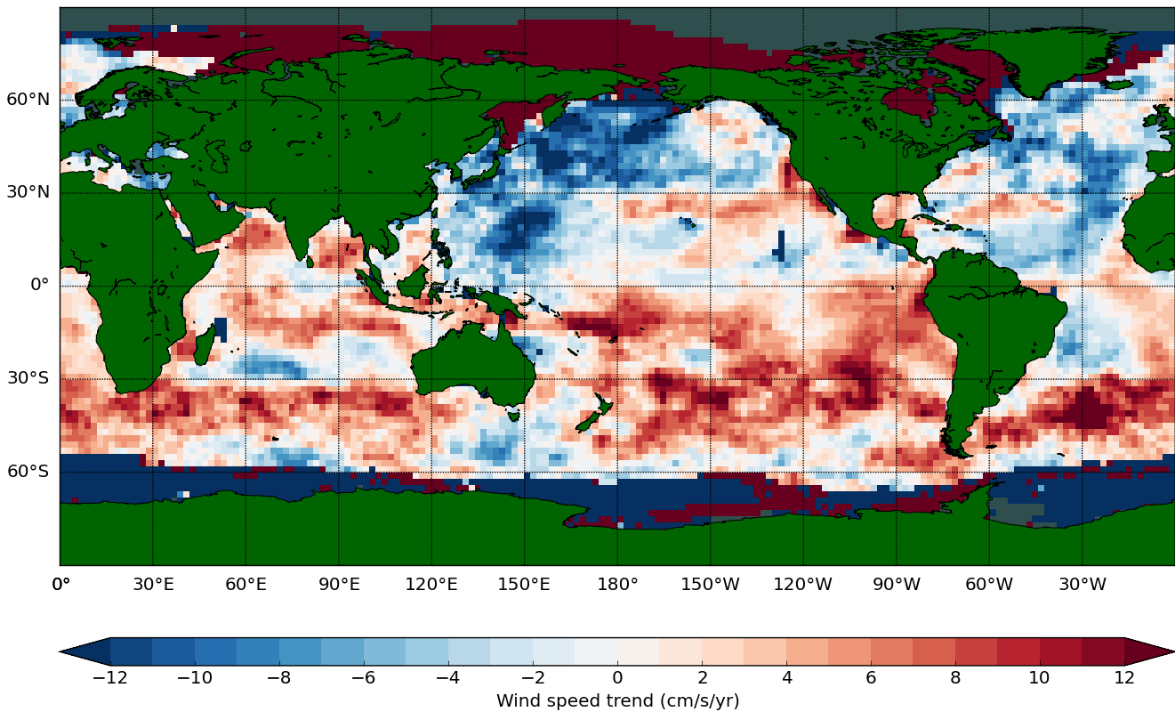
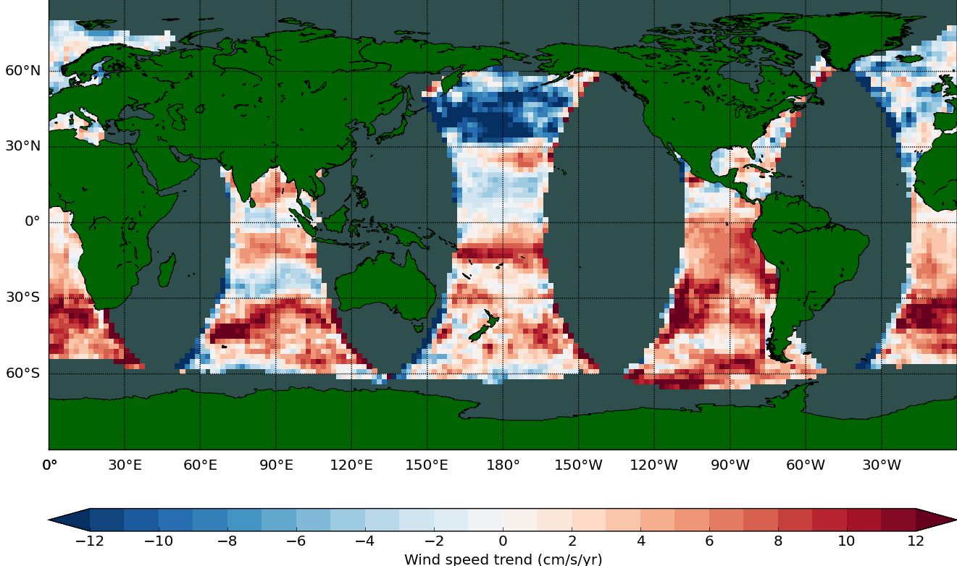
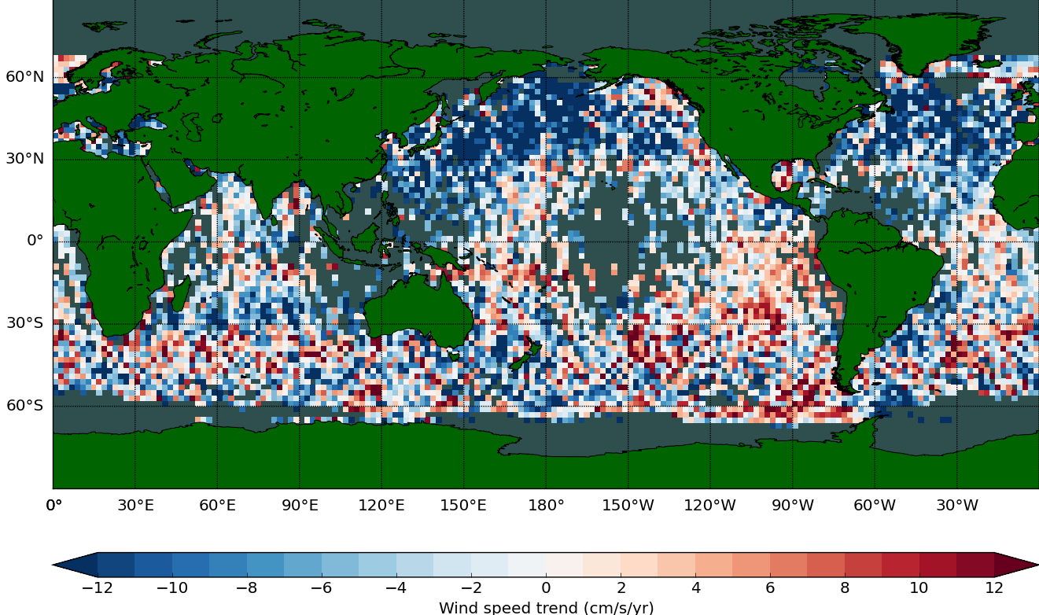
Trend in 90th Percentile winds calculated over 9 years in the QuikSCAT lifetime (1999–2009)
ERA-Int
SSM/I
QuikSCAT
T/P + JASON1
Graphics courtesy of Jason Keefer

Slide 25
The Log-Wind Profile Assumption
A typical assumption is that the wind stress does not change with height within the lower boundary-layer (and above the wave layer).
This assumption is equivalent to assuming that there are no sources or sinks of momentum in that layer
Large amount of spray and spume act as a sink of atmospheric momentum, and also enhances the surface drift.
Rain can also transfer momentum from aloft to lower heights.
If our observations of stress are used to calibration the physics then
Aircraft in situ observations of stress are not going to be well suited unless the aircraft is flown dangerously low
This is not a good option for observations!!!
This is a very rough environment for surface observations of stress!
Evaporation from droplets might also change the stability and cause the near surface boundary-layer to differ from the boundary-layer above the spray layer

Slide 26
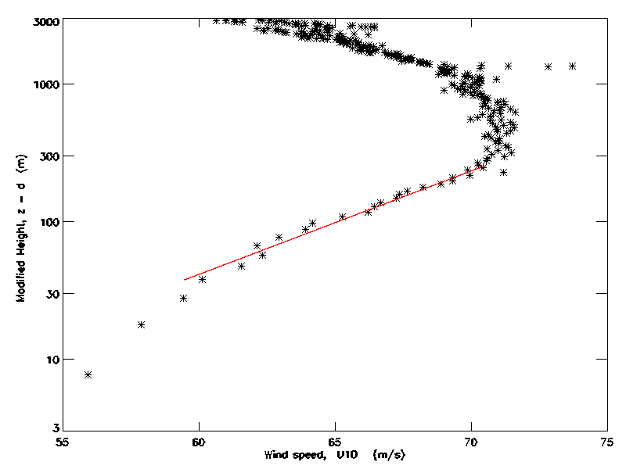
Example Profile
Profile of dropsondes from cat 4 case in Powell et al. (2003)
Shows the log-wind profile extends up to 300m height
500m in other cases.
Log-profile does not fit near the surface
u∗ = 2.3ms⁻¹
U(z) α log(z – d )
Log profile
}
Not a log profile
Data provided by Mark Powell via Kerry Emanuel
55 60 65 70 75
Wind Speed, U₁₀ (ms⁻¹)

Slide 27
Impacts of Rain on Physics and Sampling
It is also observed that rain in hurricanes reduces the surface roughness, which is closely related to stress and hence causes errors in remotely sensed winds
Rain and spray presumably change the relationship between surface observations and winds at a reference height (e.g., the traditional 10 meters).
Large rain rates adversely impacts the quality of observations (even at C-band) making using such data in calibration very dangerous
Unfortunately extreme winds are often associate with rain
L-band is much less sensitive to falling rain, but will still be impacted by the moving surface.
Footprint size and beam filling (sampling a homogeneous environment) will be a big issue in calibration.
High resolution should help, as long as the footprint samples the enough surface to provide homogeneous samples
Note stress is supported by shorter scale waves (modified by longer scale)

Slide 28
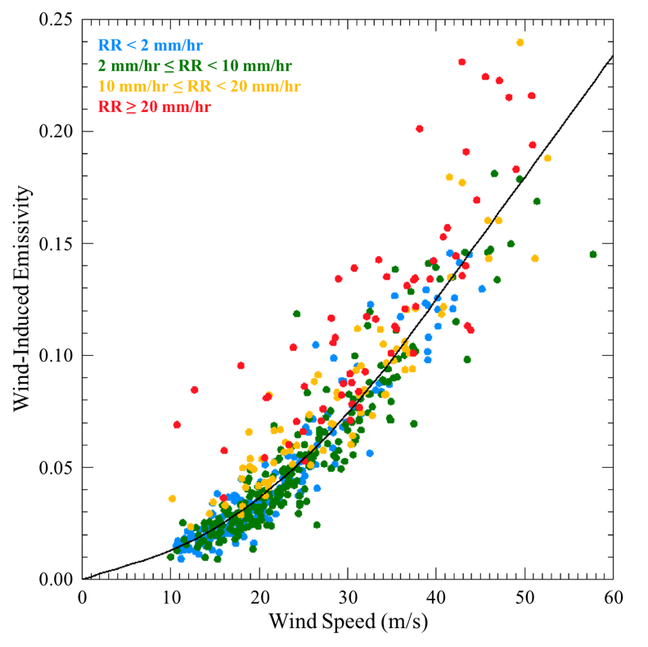
Impacts of Rain on SFMR Retreivals
Modeled Wind Induced Emissivity as a function of wind speed
Colored by rain rate
Graphic from Holbach (2016)

Slide 29
Remarks
Measurements based on near surface observations are more related to the surface than winds or stresses aloft. We need a better understanding of the physical changes with height
The sampling of near near-surface winds is highly biased towards hurricanes (thanks to the efforts of the NHC)
Consequently, dropsondes and Mark Powell’s HWIND product are used for tuning remotely sensed wind
HWIND is pretty reliable away from the storm core and the outer bounds of the storm (Dinapoli et al. 2012)
Winds from oil rigs might be an alternative
Remote sensing
The physics of air/sea coupling changes between 20 m/s and 30 m/s
Appears to change at lower wind speeds for hurricanes than for extrtatropical storms
Suggests that changes in temperature or surface tension could be important

Slide 30
Conclusions
We need higher resolution winds
Reduces beam filling problems
Can make measurements nearer to rain
Can make measurements nearer to land
Can better resolve gradients
While longer-wave instruments can see through rain, rain can modify the surface and hence confuse the interpretation of the measurements
Cross calibration across instruments and QA assessments on a standard cross instrument scale are both needed to bring high winds to the broader community
Sea state clearly impacts measurements
This is a noticeable problem within 30 to 50km of the center of a hurricane
Suggest that data from outside this region be used for validation and intercalibration (higher winds will come with time)
Southern Ocean storms will be very different than hurricanes
We need additional sea state observations
If we are sensitive to stress rather than wind, then we need a much better understanding of the how wind and stress are coupled in very high wind speed events
Sampling is critically important for applications

Slide 31
Major Issues Associated with Impacts and Remotely Sensed Observations of High Wind Speeds
Mark A. Bourassa
Dept. of Earth, Ocean and Atmospheric Science, and
Center for Ocean-Atmosphere Prediction Studies, and Geophysical Fluid Dynamics Institute
Florida State University
Tallahassee, FL
With input from many people, including Jim Edson, Heather Holbach, Jason Keefer, Lucia Pineau-Guillouand many others
Thanks to ESA and NASA OVWST for travel support.

