Slide 1

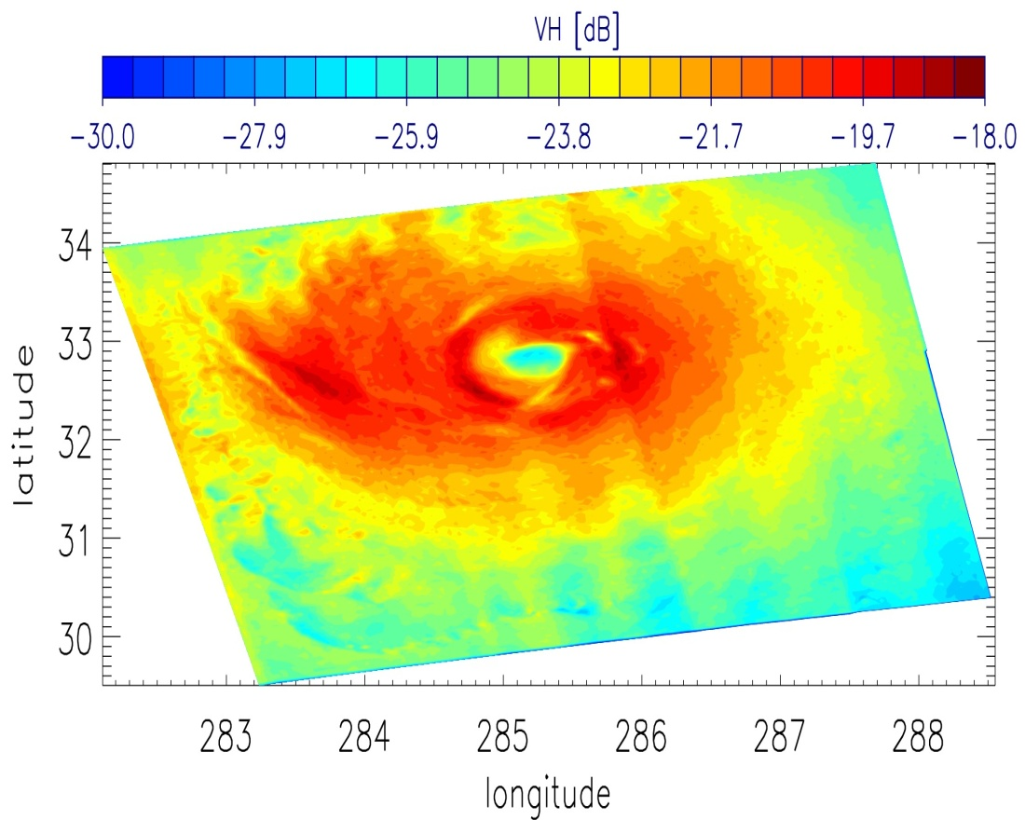
Retrieving Extreme wind speeds using C-band instruments
Gerd-Jan van Zadelhoff, Ad Stoffelen, P. Vachon, J. Wolfe, J. Horstmann, M. Belmonte Rivas, F. Fois
van Zadelhoff et al. (amt-7-437-2014)

Slide 2

MetOP Second Generation
The MetOP-SG series will be launched in 2020+
One instrument on board is a vertical co-polarization (VV) C-band scatterometer (SCA), similar to ASCAT.
An innovation on ASCAT-SG is the inclusion of cross-polarization (VH) channels on the scatterometer mid beams to retrieve extreme winds.
The goal of the present work was to provide a scientific background to assist in the decision-making process on including the VH channels to the ASCAT-SG instrument.
We present a cross-polarization Geophysical model function (VH-GMF) based on RadarSAT2 SAR data.

Slide 3
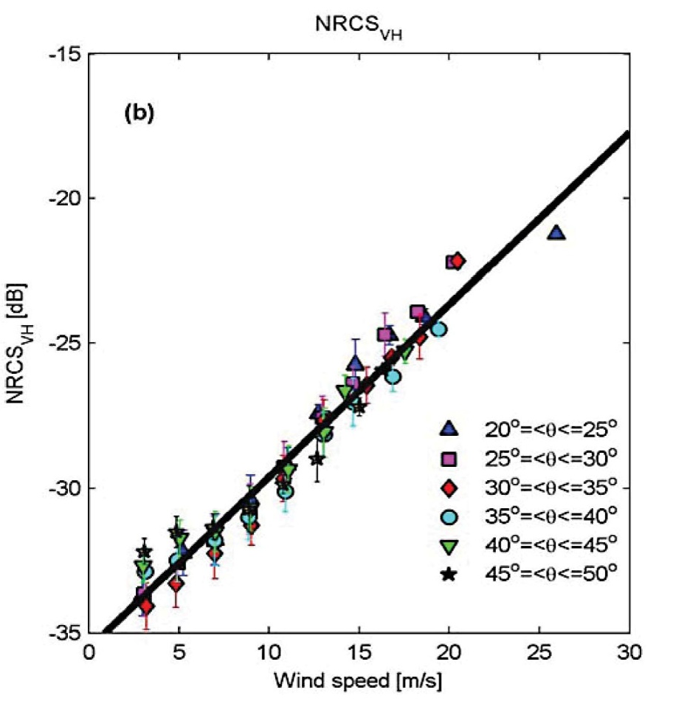
Zhang et al. 2011
Wind speed vs. cross polarization
Vachon et al.(2011) & Zhang et al. (2011) used RadarSat-2 SAR data, collocated with in situ buoy measurements to check for wind dependence
The VH signals (up to ~20 m/s) appear linear in dB
No clear incidence and azimuth angle dependence are apparent in their data.
In this work we look into the VH dependence at higher wind speeds (>20m/s)

Slide 4
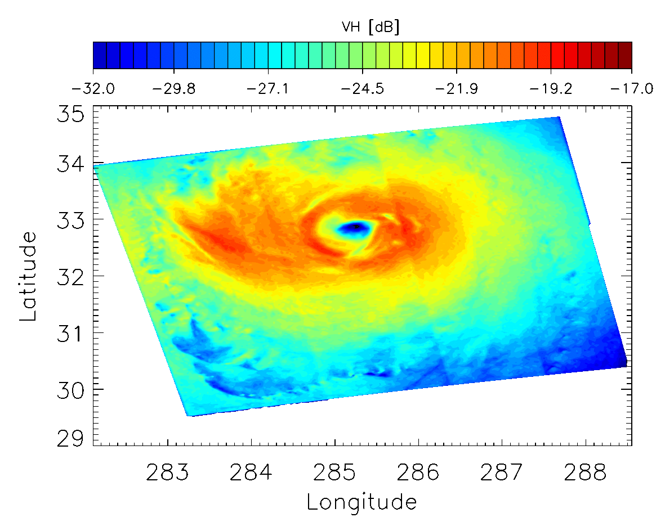
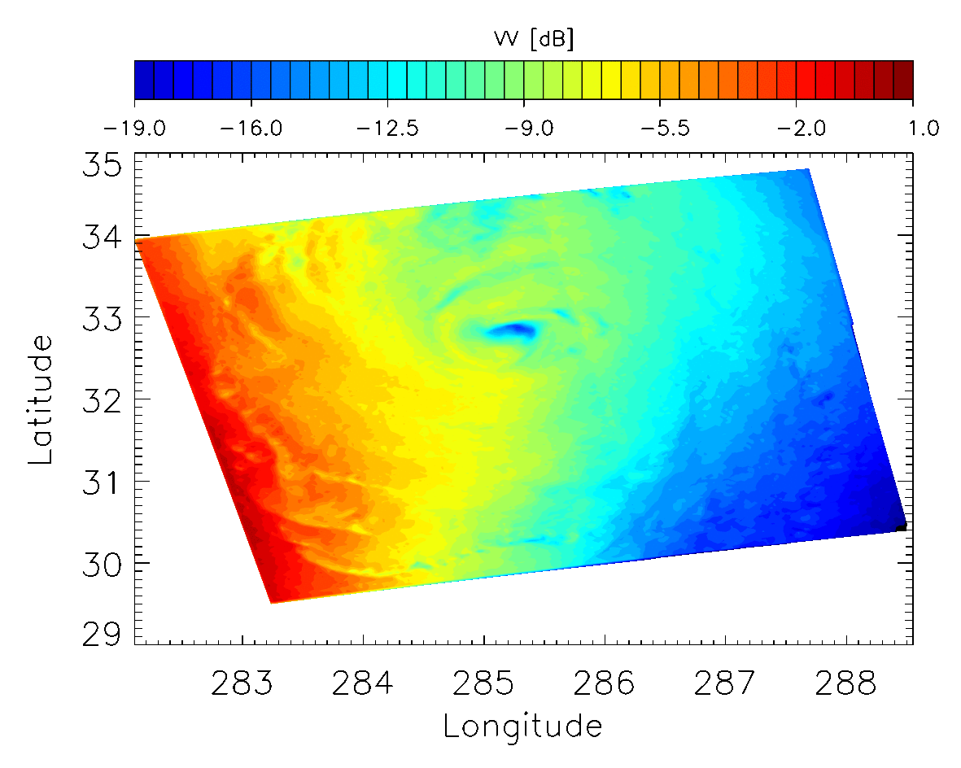
Hurricane images RadarSat-2
19 images of 13 different Hurricanes (2008-2011)
The VH band shows a sharp defined ‘eye’, no apparent incidence angle or rotation angle dependence.
Hurricane Earl [September 02 2010, 22:59:20]

Slide 5
Evaluating VH signals using wind speed information
Two eye-position corrected velocity sources have been used in this research to create a VH-GMF:
  SFMR velocities from
  NOAA Hurricane flights
  ECMWF forecasts:+3,6, ..
NB: HWIND was tested, but
explained least variance among
all others: SFMR, ECMWF and
RadarSat VH
The NOAA best track maximum wind speed estimates are subsequently used to validate the main results.
VV, HH and VH

Slide 6
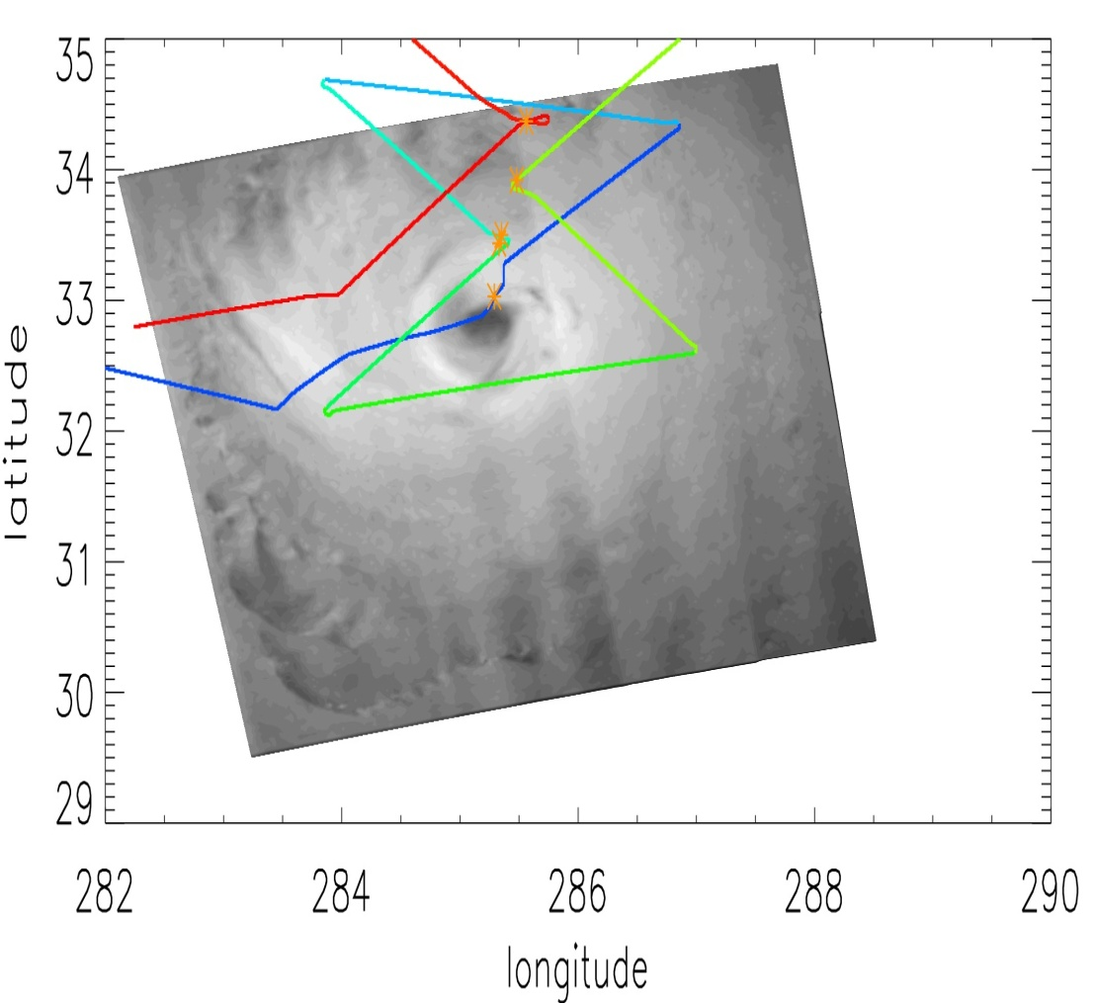
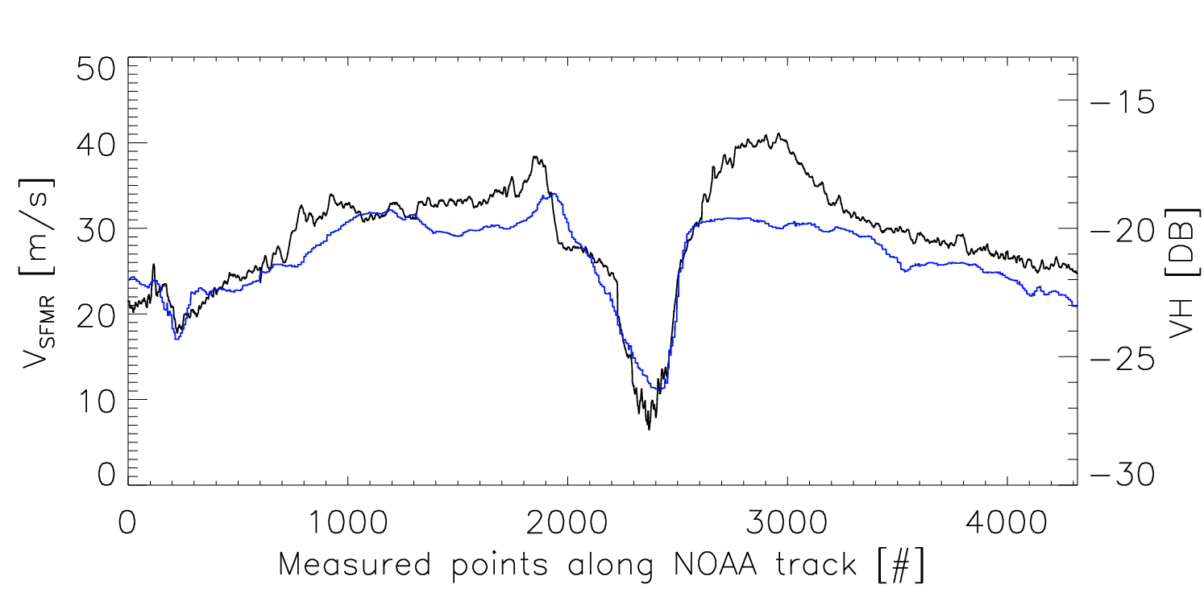
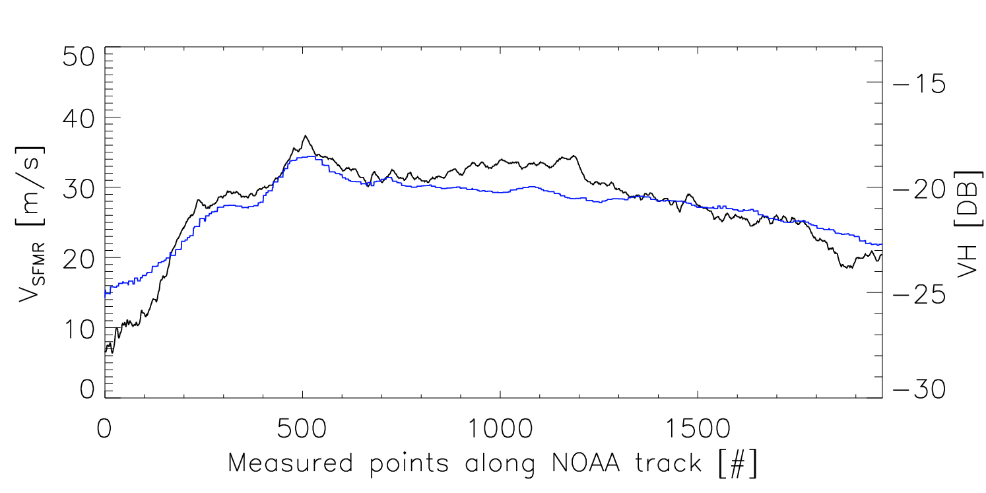
Collocation and comparison of SFMR & RadarSAT-2
Not all Hurricanes have collocated SFMR data (18 legs; 8 hurricanes)
Separate each NOAA flight in separate flight legs
Collocate each leg separately with RADARSAT-2 image

Slide 7
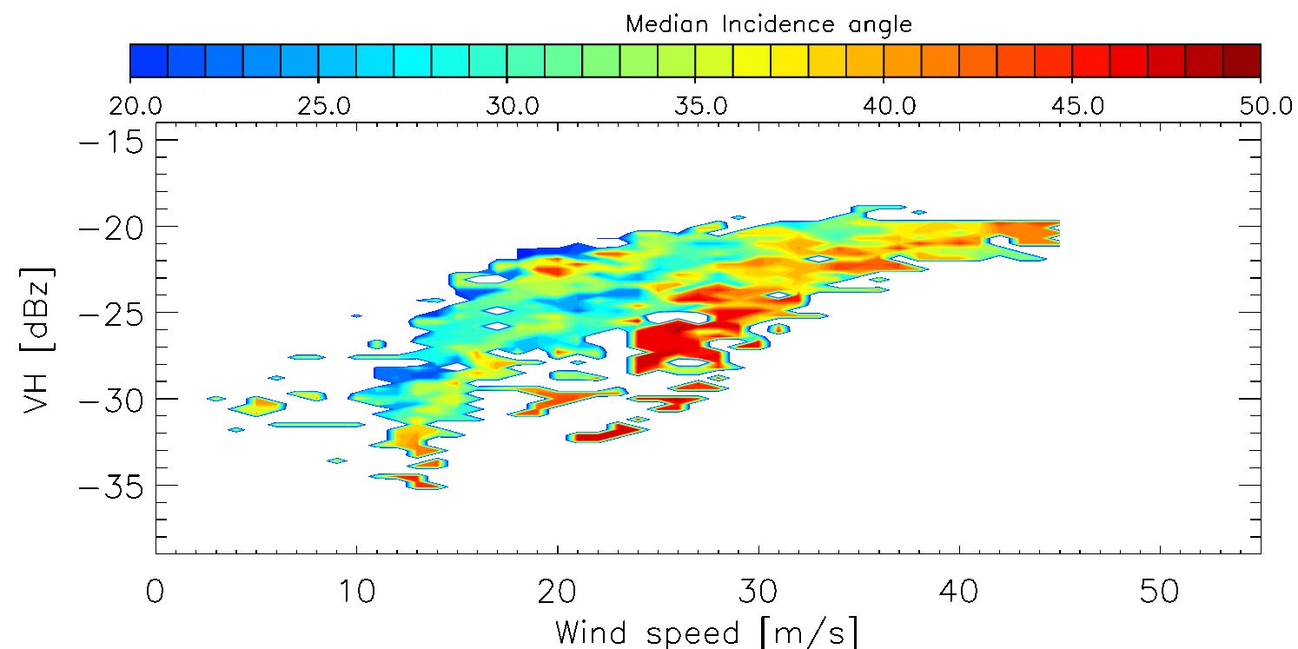
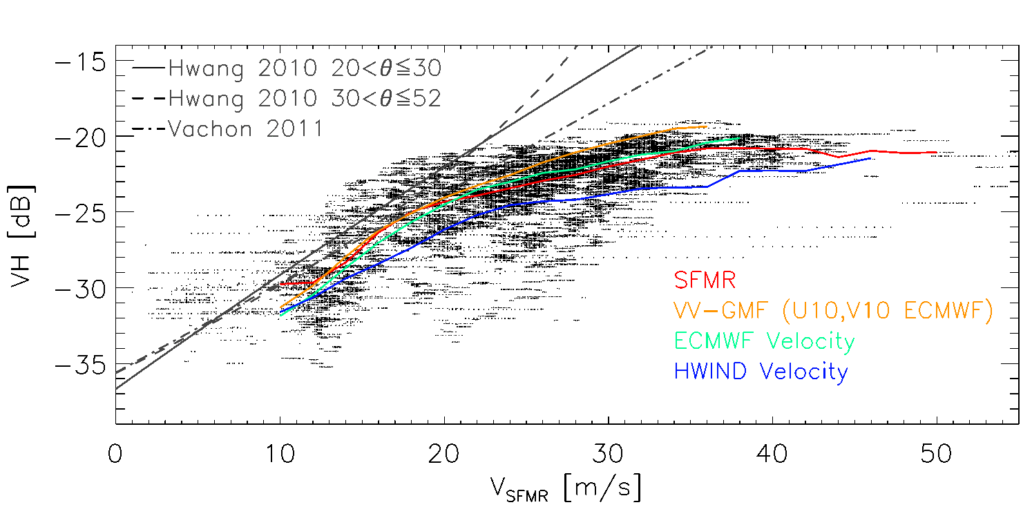
Combining all available SFMR data
There seems to be a incidence angle dependence in the SFMR data (blue 20º → red 48º)
More comparison data is required → ECMWF wind speeds are used for this

Slide 8
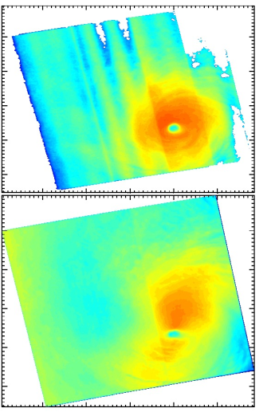
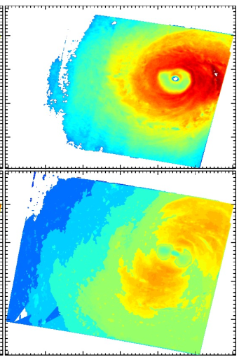
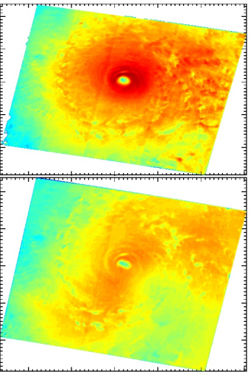
Wind direction dependence
Correct both the VH and VV signals for their incidence angle dependence and check for a wind direction pattern
VH
VV

Slide 9
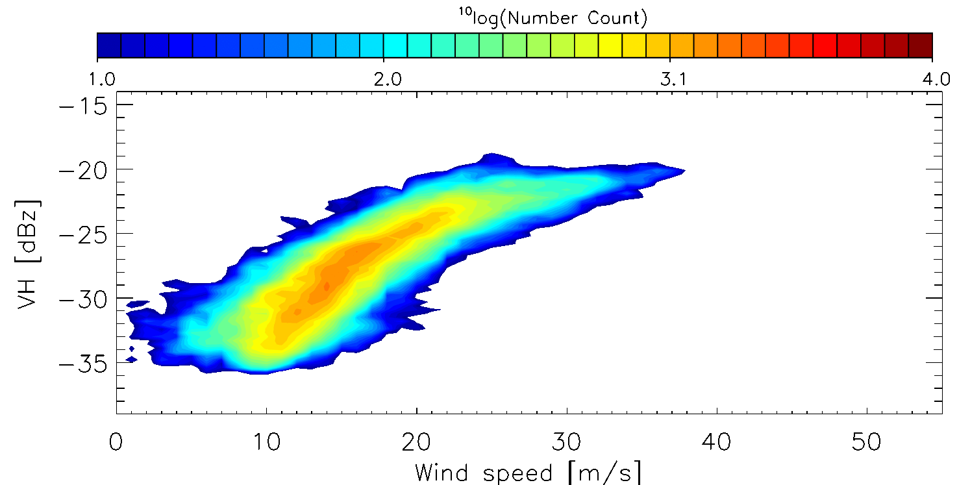
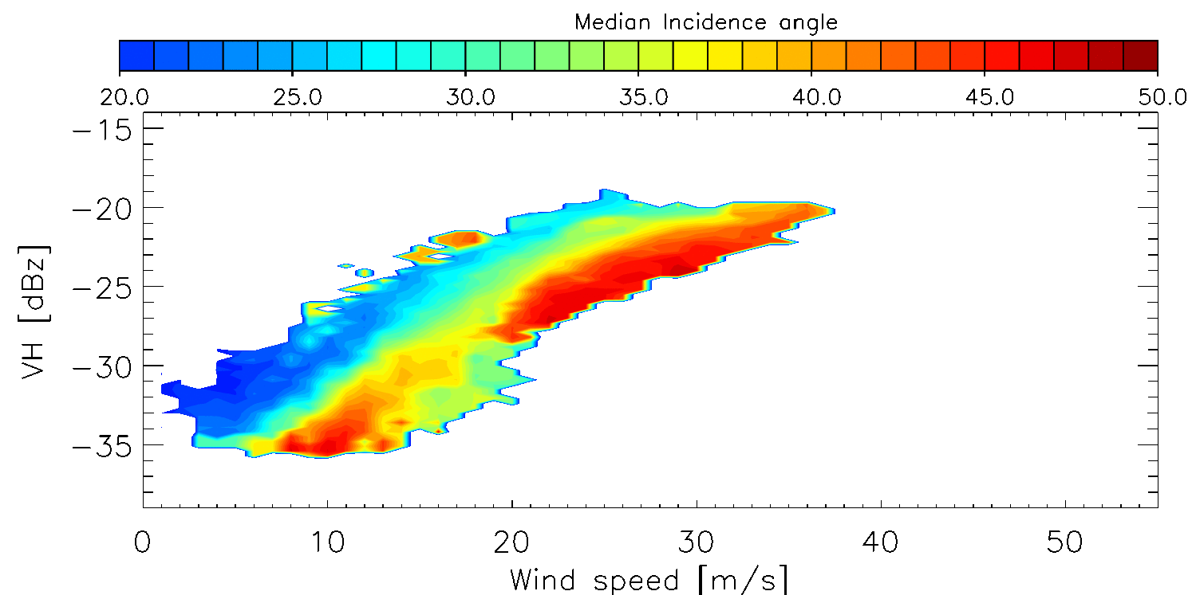
Collocation with ECMWF forecasts
A total of 19 RADARSAT-2 dual polarized SAR images (VV and VH) were acquired between 2008 and 2011.
The combined distribution is well structured (relatively small width; corr. 0.85) but shows a (weak) incidence angle dependence

Slide 10
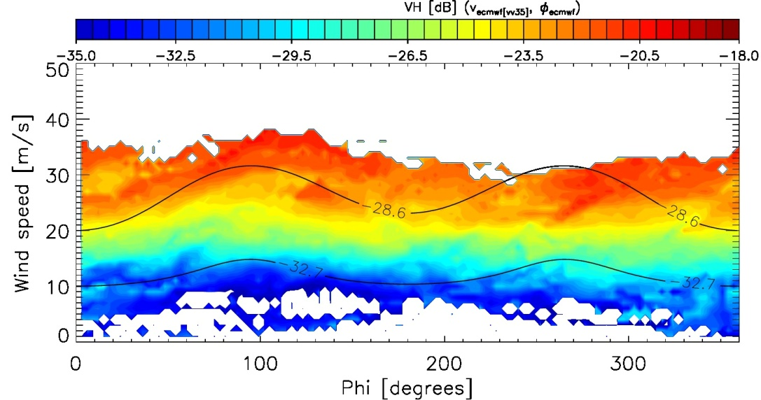
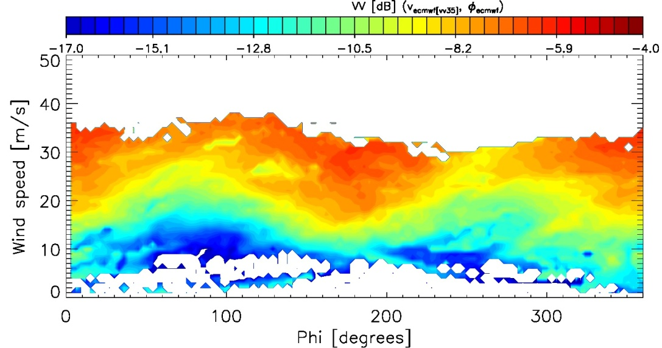
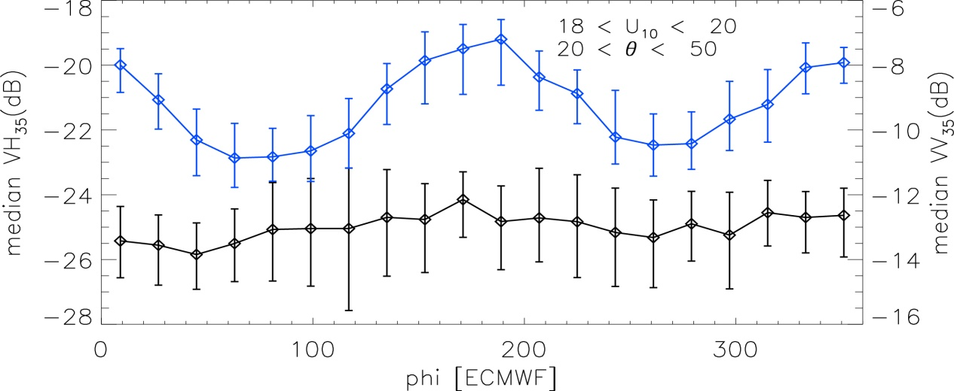
Wind direction dependence
VH
VV
Cross polarization signals show no wind direction dependence

Slide 11
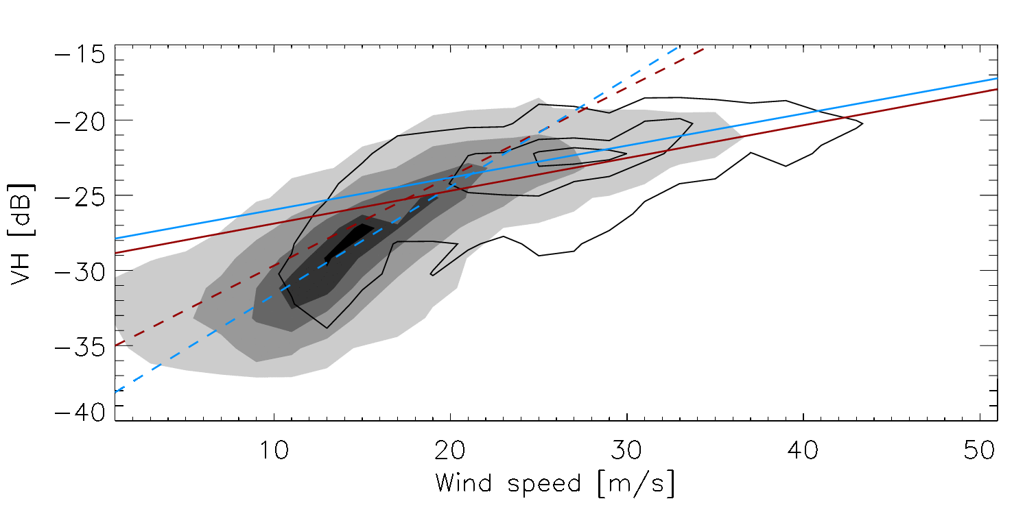
Creating a VH-GMF
SFMR-VH and ECMWF-VH distributions look very similar
There is a change in slope around 20m/s
SFMR
ECMWF
VH-GMF:

Slide 12
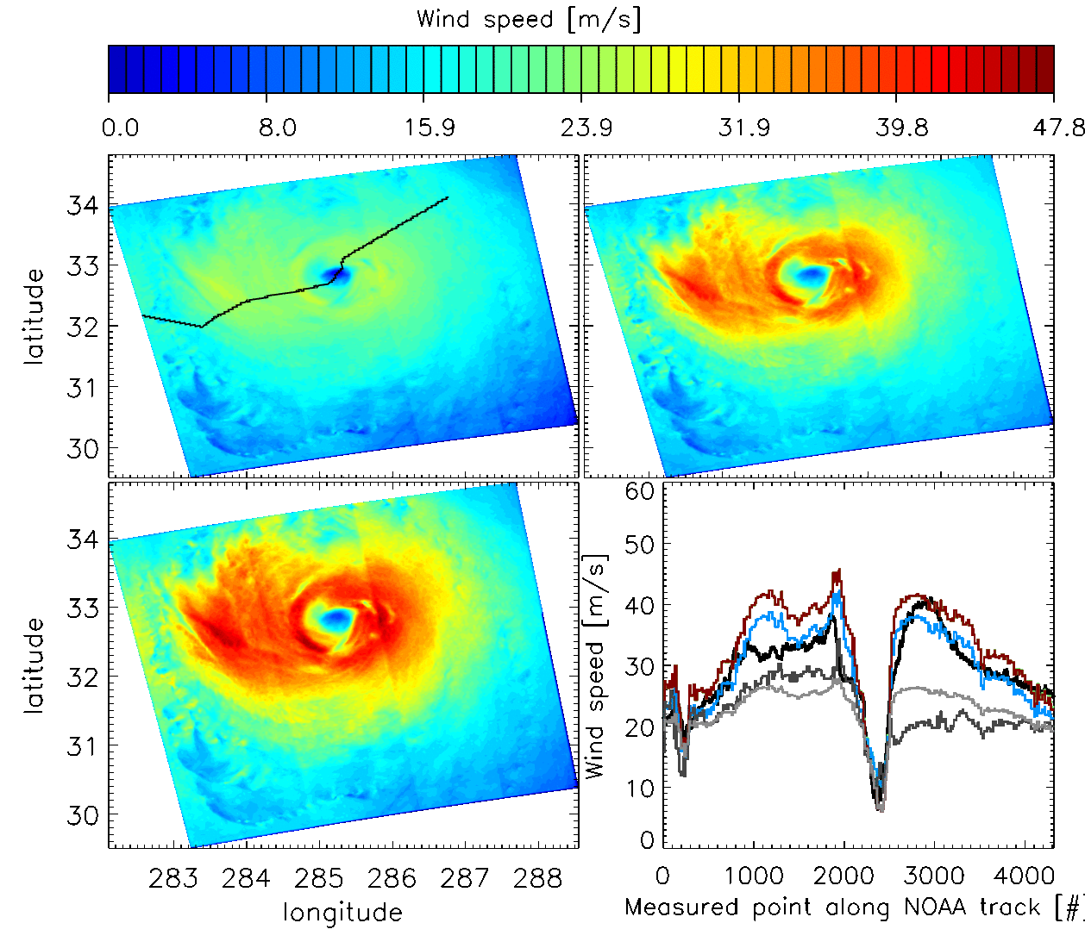
Calibrating U₁₀ in Hurricanes ?
Vachon 2011
ECMWF
SFMR track
Vachon + SFMR
VH-GMF
ECMWF
Vachon
VV-GMF

Slide 13
Calibrating U₁₀ in Hurricanes ?
VH-GMF
ECMWF
SFMR
Vachon
VV-GMF

Slide 14
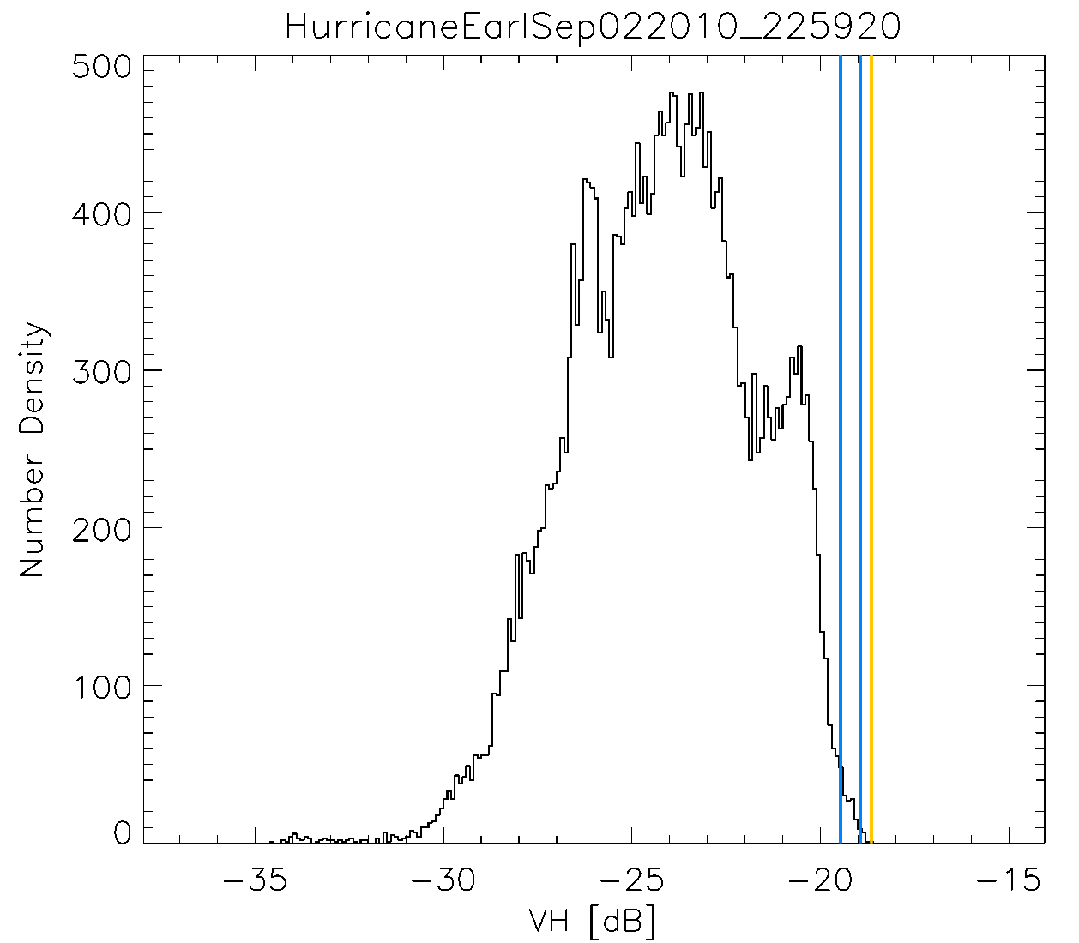
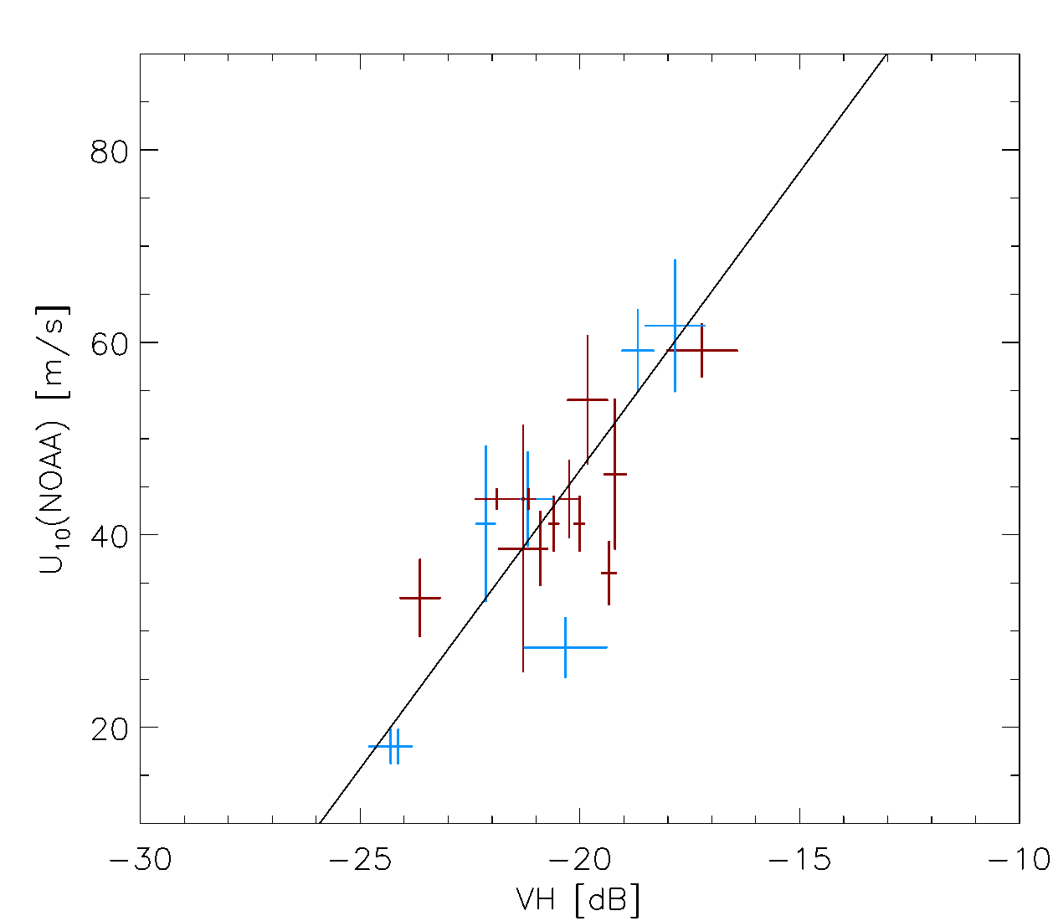
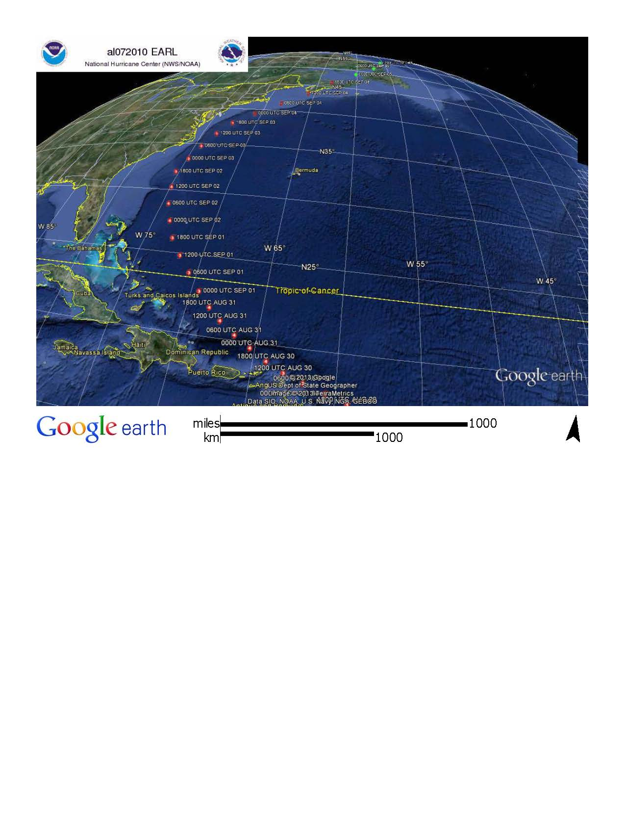
Comparing the NOAA best track estimate (max. 1-minute sustained surface wind speed) versus the averaged VH-signals of the 0.995 and 0.9995 percentile values.
+12 hours
-12 hours

Slide 15
Comparing the NOAA best track estimate (max. 1-minute sustained surface wind speed) versus the averaged VH-signals of the 0.995 and 0.9995 percentile values.
Cross polarization data can be used to retrieve the ‘near real time’ Maximum wind speed.
Cross polarization data appears not to saturate up to ~60m/s wind speeds

Slide 16
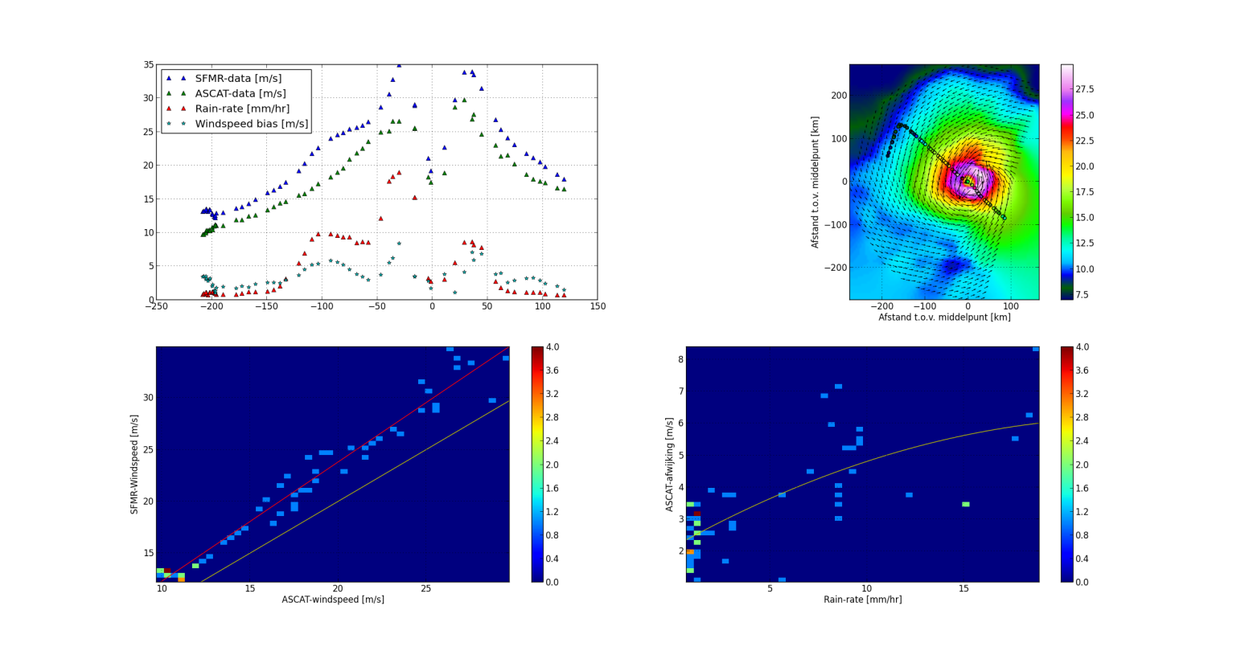
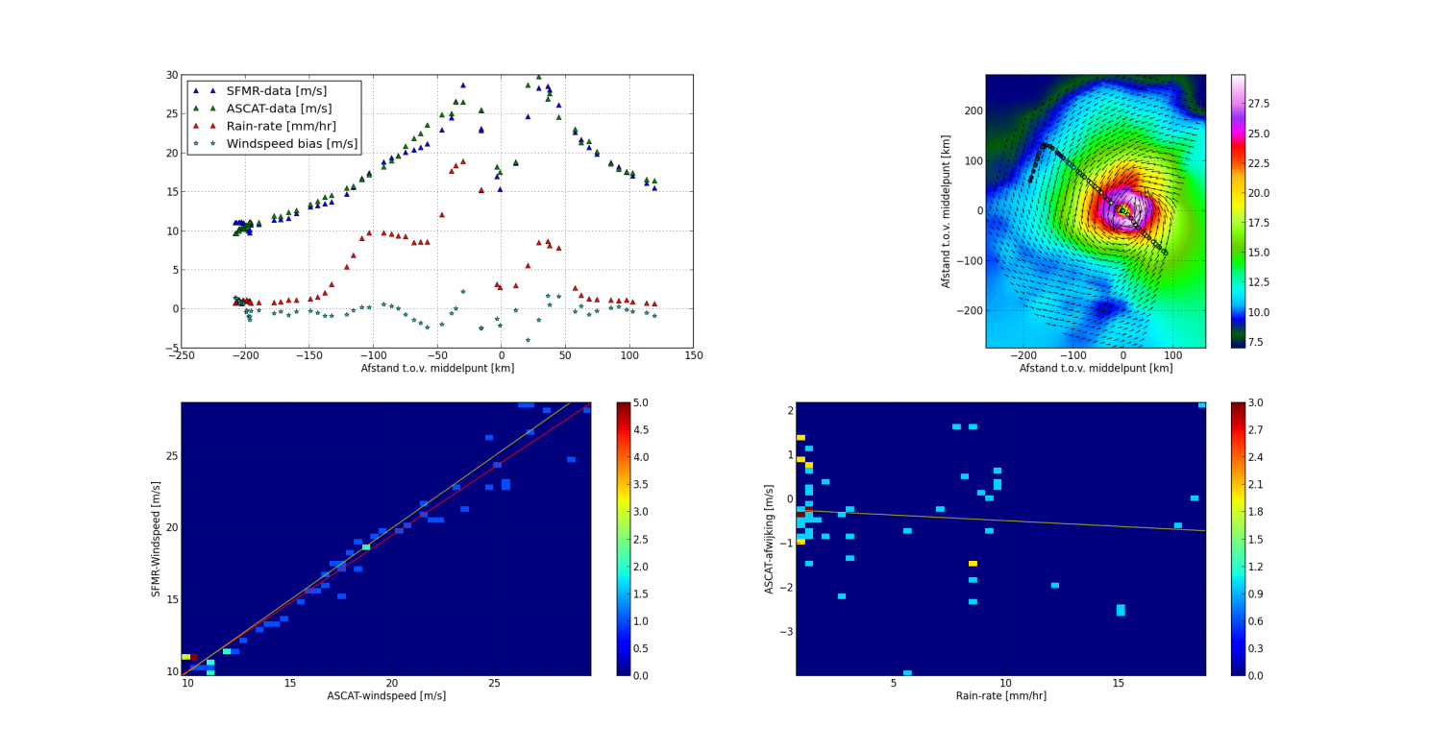
SFMR?
CMOD5n winds are lower than SFMR (VV pol)
CMOD5 winds are equal to buoy winds for 15 to 20 m/s; which to trust?
SFMR winds go up when it rains; NOAA is recalibrating

Slide 17

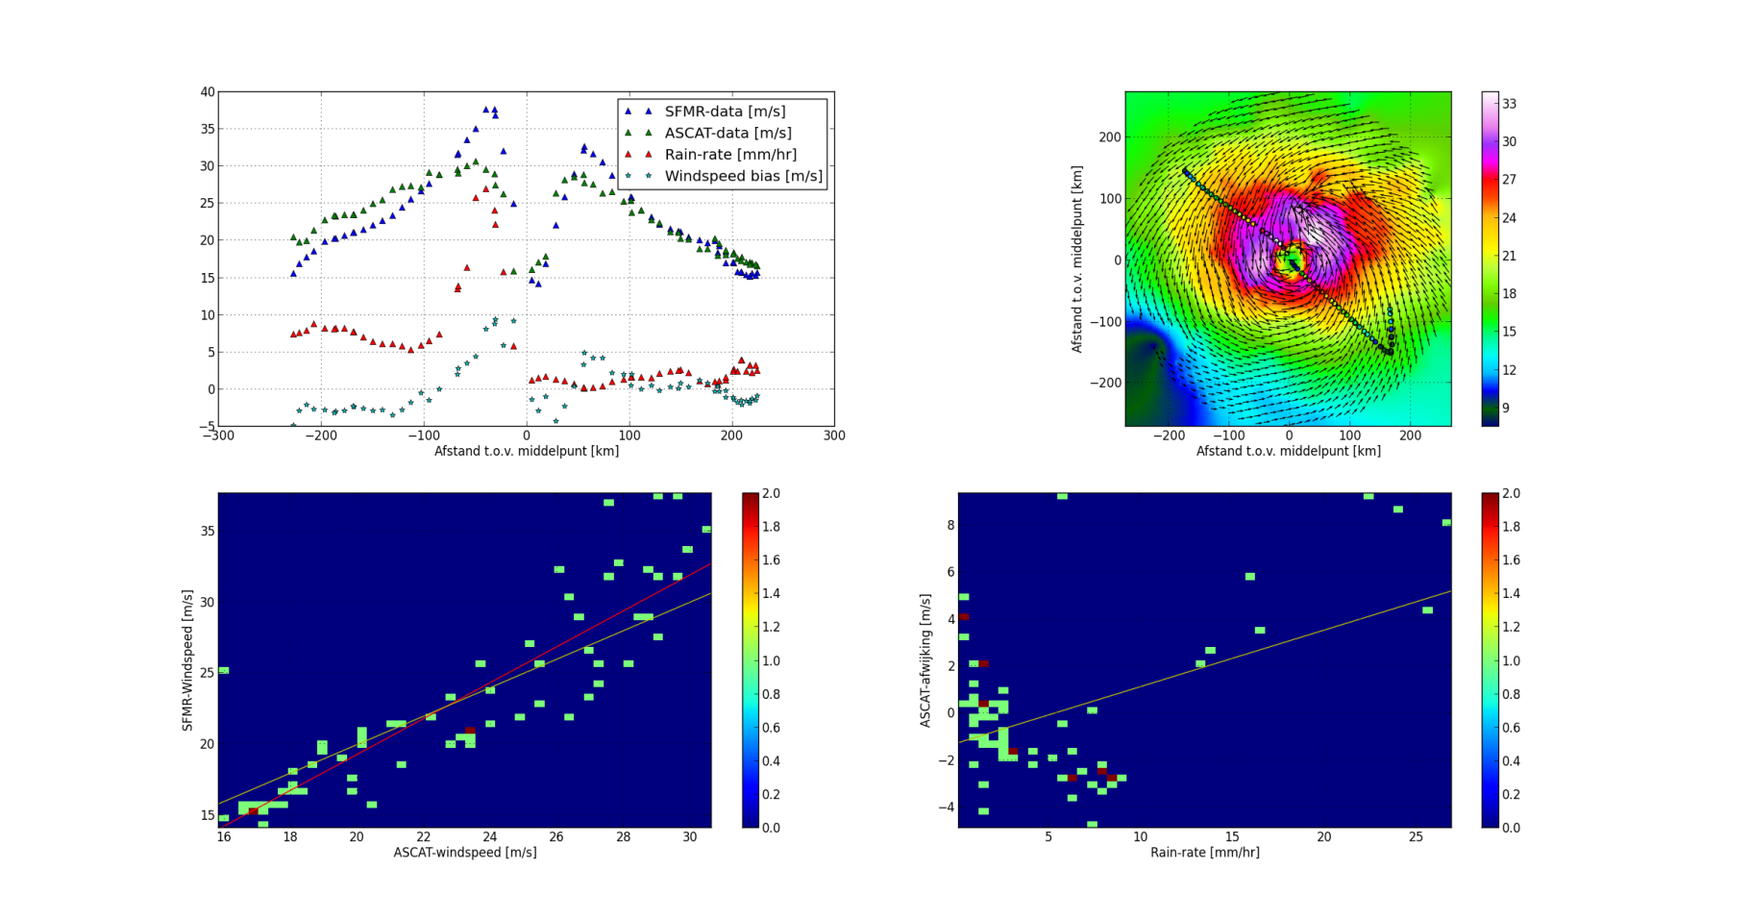
SFMR?
Wind speed bias and rain rate appear correlated

Slide 18
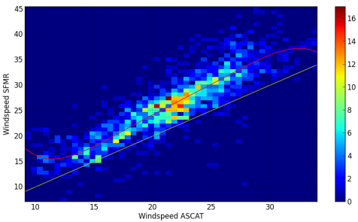
ASCAT and SMOS scales
y (x) regressed
30 40 50 60 70
30 40 50

Slide 19
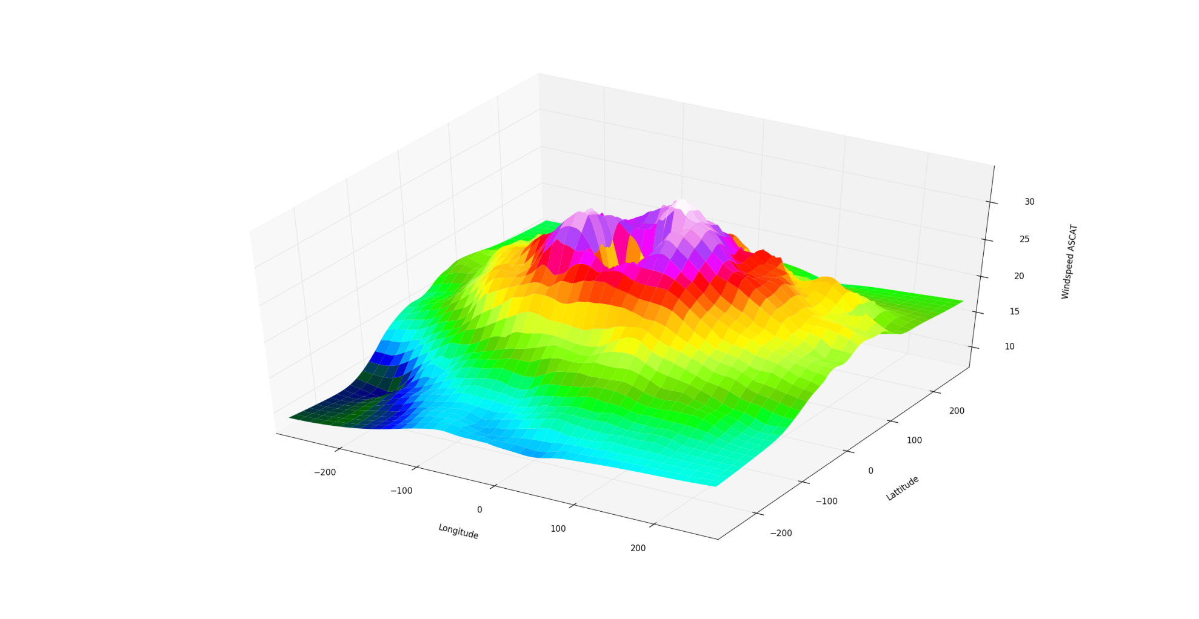
ASCAT eye wall

Slide 20
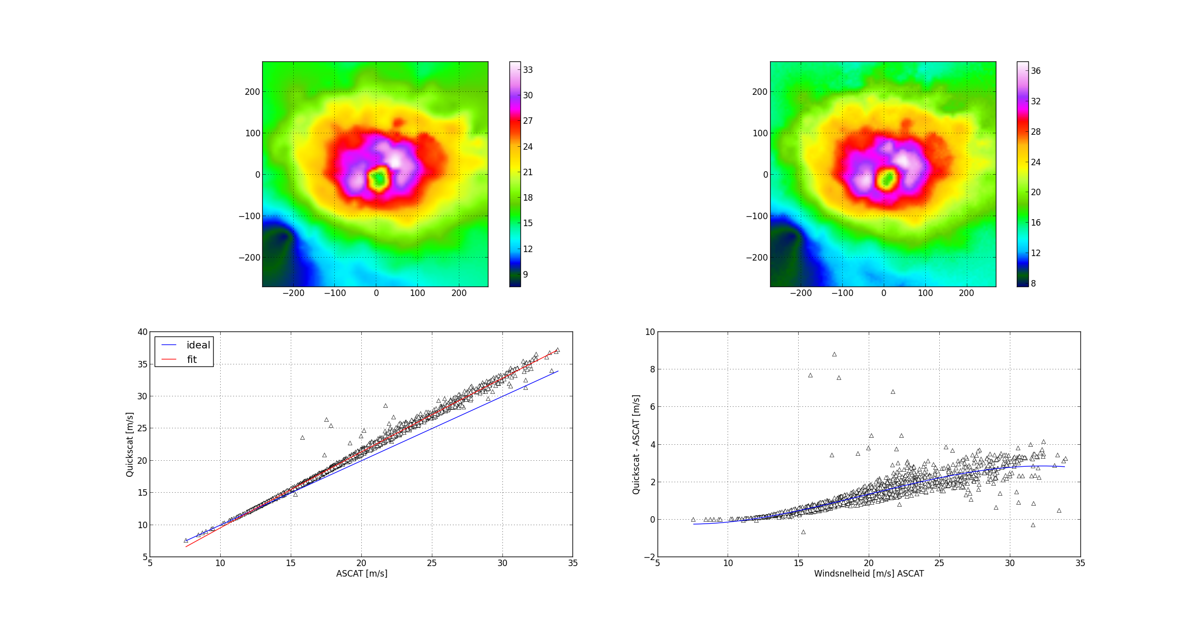
ASCAT – QuikScat
Corrected at KNMI

Slide 21
Conclusions
An additional cross polarization (VH) channel on ASCAT-SG will retrieve wind speeds up to at least 45 m/s (based on available SFMR data)
The VH wind speed dependence shows a different relationship in the low&strong wind speed regime(U₁₀<20m/s) compared to the strong&severe wind speed regime(U₁₀>20m/s)
The VH signals show a modest incidence angle dependence and negligible wind direction dependence in the VH signals
There is a strong correlation between the highest VH measurements within a hurricane SAR image and the one-minute maximum sustained wind speeds from the NOAA best track product up to 60 m/s. This correlation can be described by a linear relationship and can be used for TC guidance
An operational satellite with a VH channel will be able to retrieve in near real time the one-minute maximum sustained wind speed from a hurricane or typhoon, and an assessment of the spatial wind speed distribution
Both VH and extreme wind measurements need more attention in calibration at appropriate spatial resolution

Slide 22
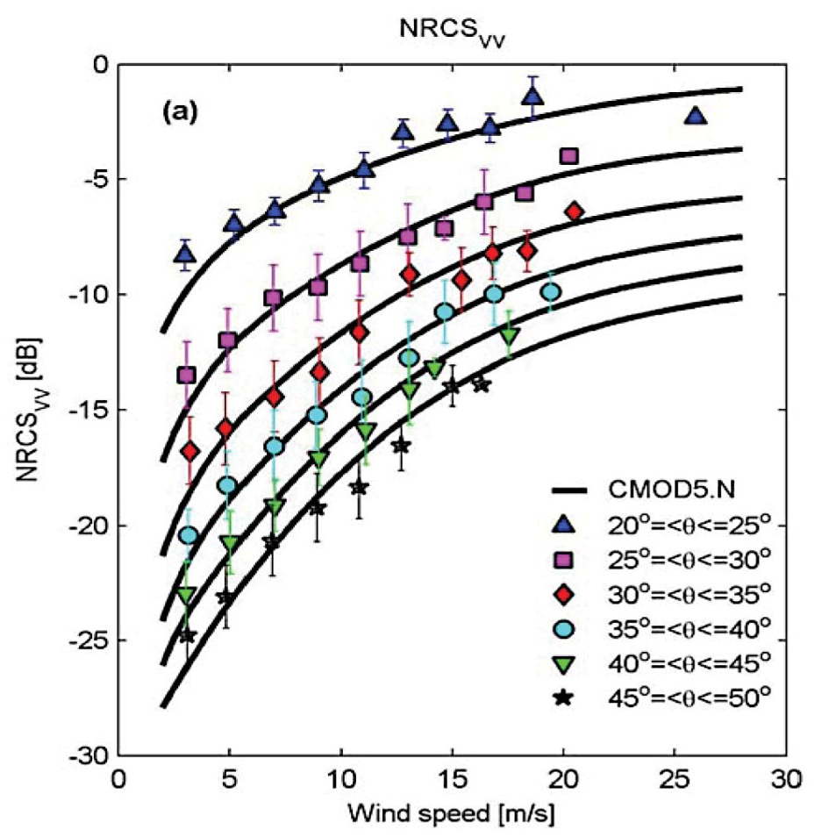
Scatterometers & wind speed
Scatterometers measure the radar backscatter from the ocean
The return depends on the roughness of the ocean and the incidence angle
The roughness of the ocean can be directly related to the (10 meter equivalent-neutral) wind speed
The backscatter is strongly dependent on the wind direction (upwind >> crosswind)
The signal saturates at about 40m/s
Zhang et al. 2011
www.knmi.nl/scatterometer/cmod5

