Slide 1
Validation of Strong Ocean Surface Wind Speeds
Zorana Jelenak, Paul S Chang, Joe Sapp, Faozi Said and Seubson Soisuvarn
NOAA/NESDIS/STAR
Joe Sienkievicz NOAA/NWS/OPC
Michael Brennan NOAA/NWS/NHC
Zorana.Jelenak@noaa.gov

Slide 2
Objective
SFMR reprocessing project
High Wind Observations in Operations – NOAA Experience
  Detection and Validation and Use in Operations

Slide 3
2015 High Winds Workshop Coclusions
High winds workshop held December 2015 at the National Hurricane Center in Miami, FL
  Over arching objective to explore/discuss scatterometer extreme OSVW (> 30 m/s)
    What do we know, what don’t we know, and where do we go from here
    A conclusion reach was that:
      SFMR was determined to be a core “in situ” source of high wind data for use as validation or GMF development
      However, the SFMR dataset is not consistent (residual calibration errors) amongst the various SFMR instruments being observed
    Issue
      Each SFMR has residual calibration errors
        Due to biases due to reflections and emissions from external items (i.e., instrument pod structure, aircraft structure)., uncertainty of the antenna physical temperature,e tc.
  SFMR Reprocessing Project
    These calibrations issues result in errors in the wind speed and rain rate retrieval whose magnitude varies as a function of wind speed and rain rateCharacterize the residual SFMR calibrations issues and consistently reprocess the SFMR dataset (which includes data from multiple SFMR instruments).
      Utilize GPS dropsonde and IWRAP data from hurricane and winter storm flights (span a larger dynamic range of air temperatures and sea state conditions

Slide 4
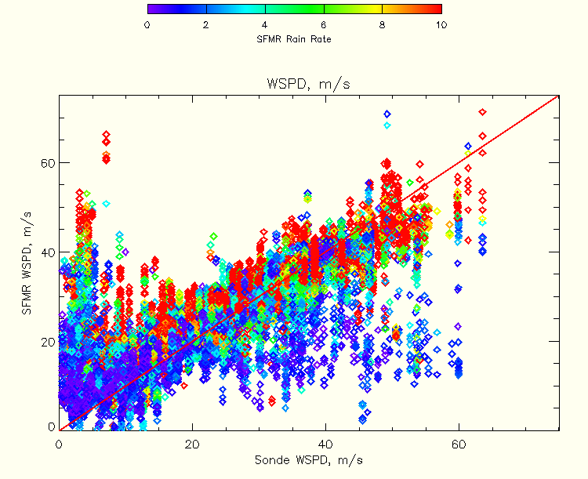
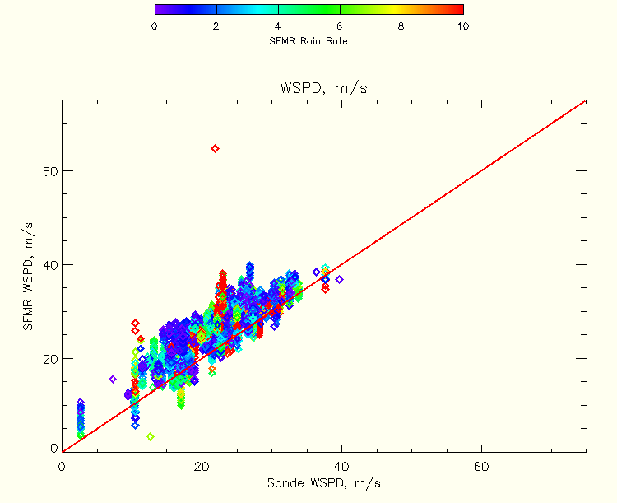
Uncorrected SFMR vs Sondes
2007-2015

Slide 5
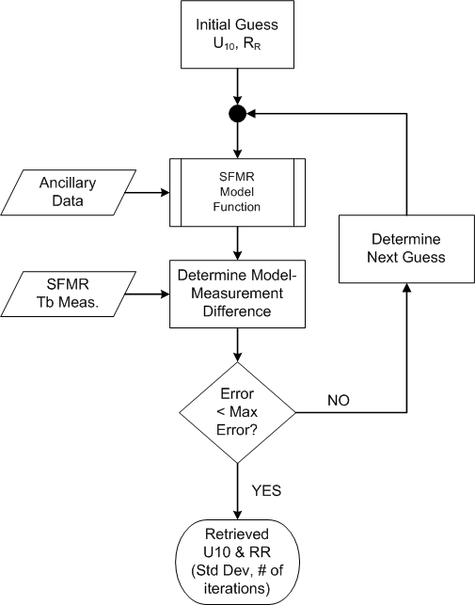
STAR SFMR Retrievals
Determine initial / next guess (U₁₀ & RR)
Calculate T_{b} using SFMR GMF
Determine difference between measured and modeled T_{b}
If model and measurements agree within a specified threshold, retrieval complete. If not, determine next guess and repeat.

Slide 6
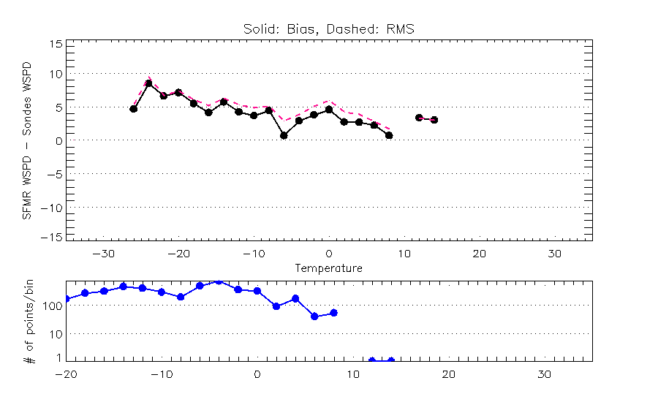
SFMR WSPD Error vs Ambient Temperature

Slide 7
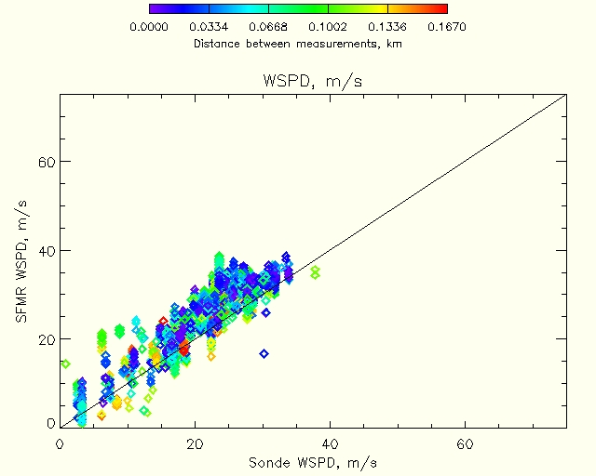

Slide 8
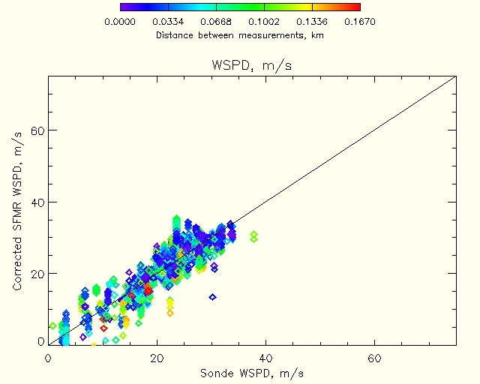

Slide 9
SFMR Bias vs Rain Rate

Slide 10
SFMR vs Spaceborn Scatterometers
Winter Measurements
Original

Slide 12
SFMR Reprocessing Project
Reprocessed SFMR data from 2006-2015
Data is available however it is still not quality controled
Contact: Joe.Sapp@noaa.gov

Slide 13
High Wind Measurements Calibration, Validation and Operational Impact

Slide 14
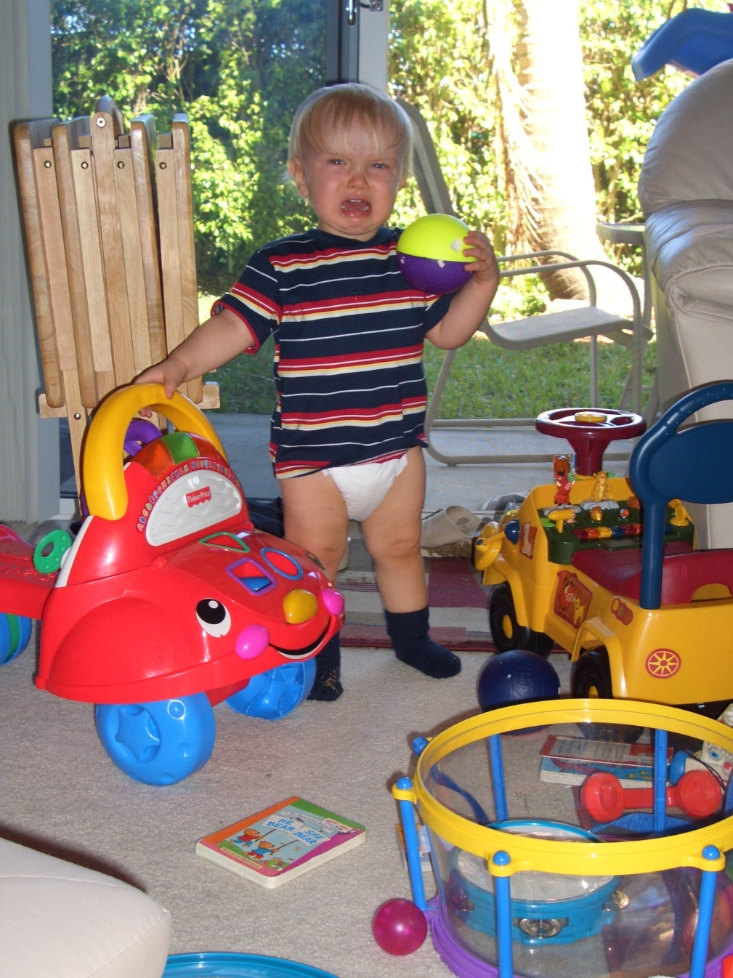
Motivation
“…As with many of these types of things, the training investment has been slim to none when the data are first made available. Initiatives/technologies like this always seem to be on the internet first and then some day they shows up in our Work Stations. Then when we get it, only some use it. We see that data can be useful but also that it has problems and we have no knowledge to sort through them…”
Picture courtesy of Dr R. Knabb

Slide 15




Ocean Winds Team Transitioning Machine
Data access and display
Operations
R2O
O2R
Research
New Research
Training
O2R
New
Operations
R2O
Data access and display

Slide 16
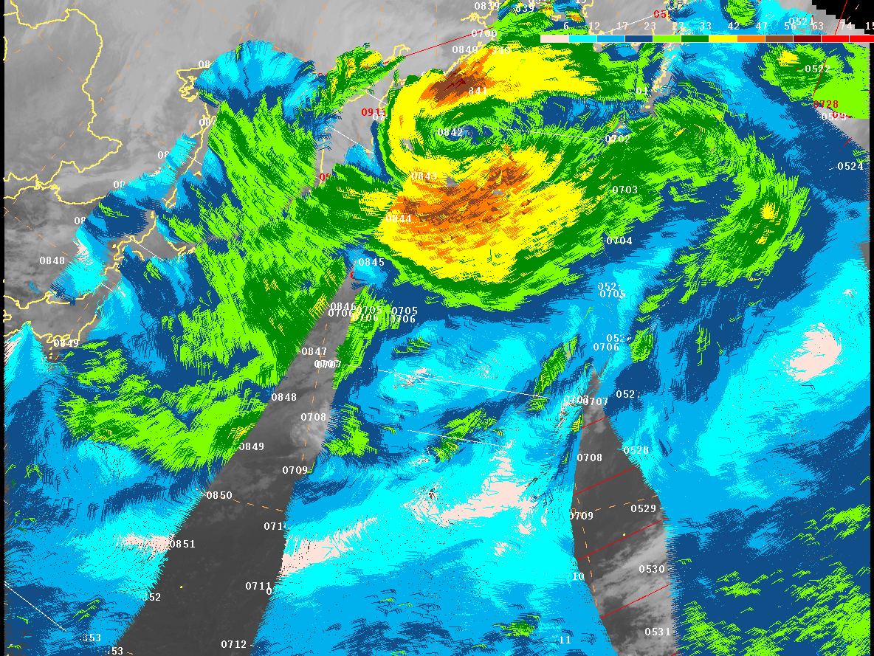


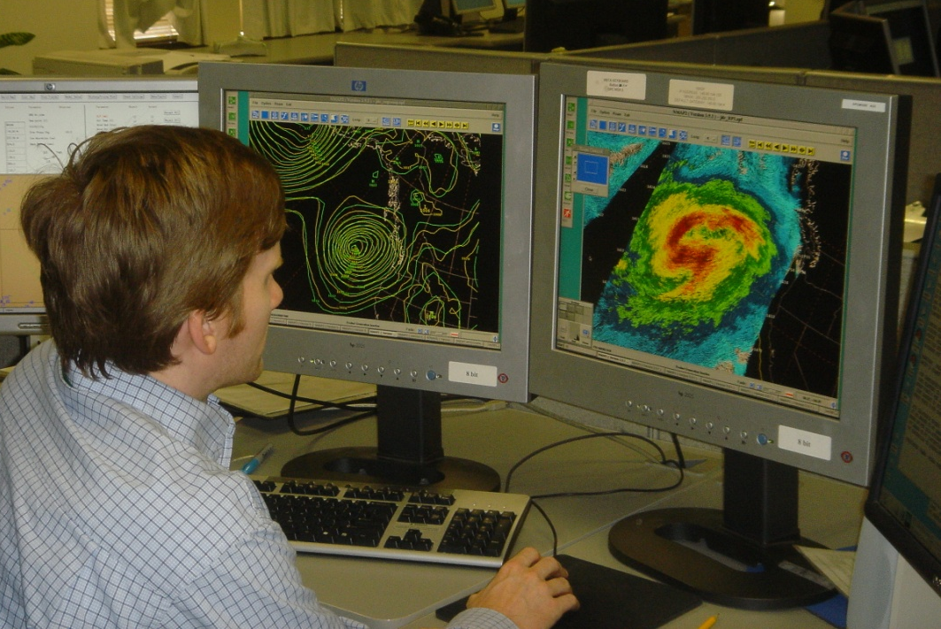
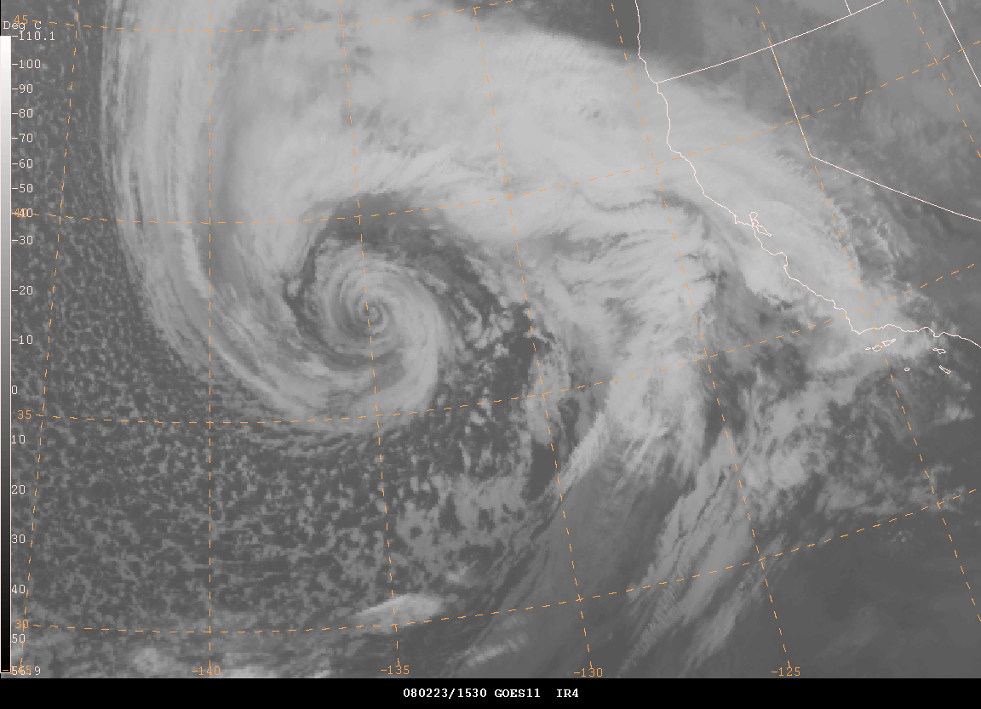
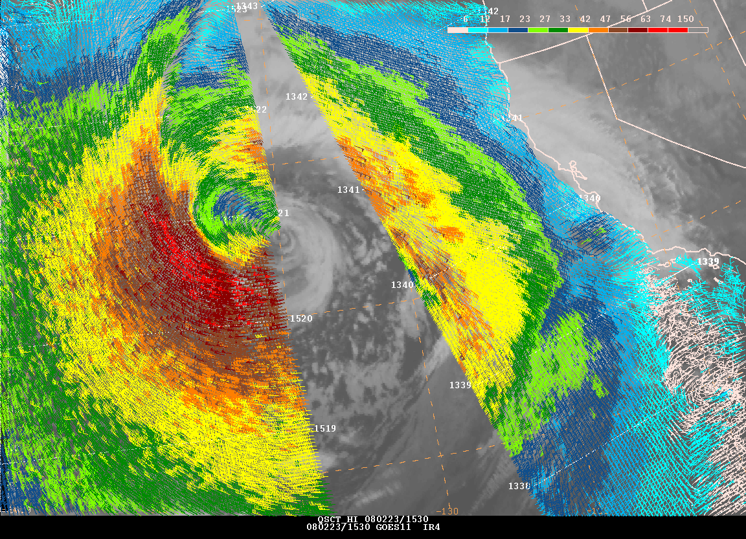
Use of Scatterometer Data at NWS Marine Weather Forecasting Offices and Centers
QuikSCAT
Marine wind warnings
  Issue, continue, terminate
Identify weather features
  Lows, highs, fronts
    Intensity
    Trends
Short term marine forecasts
  Aerial coverage of winds
Real-time Verification
  Comparison to NWP analyses
    Feature intensity
OSVW of particular interest for extratropical cyclone (ETC) forecasting and warnings

Slide 17
The Use of Scatterometer Data in OPC Operations
Hurricane Force Events Detected from Dec 2000
Detection increased with:
  Forecaster familiarity
  Data availability
  Improved resolution
  Improved algorithm
WARNING
CATEGORIES
Pre- QSCAT
1. GALE 34-47 kt
2. STORM >48
QSCAT ERA
1. GALE 34-47 kt
2. STORM 48 -63 kt
3. HURCN FORCE
> 64 kt
Improved wind
algorithm and
rain flag Oct 06
12.5 km QuikSCAT
available May 04
25 km QuikSCAT
Available in N-AWIPS
Oct 01
Hurricane Force
Wind Warning
Initiated Dec 00
Totals
A-289
P-269
558
QuikSCAT
Launch
Jun 99
The quality, consistency and coverage of QuikSCAT OSVW data significantly impacted the marine weather warning and forecasting

Slide 18
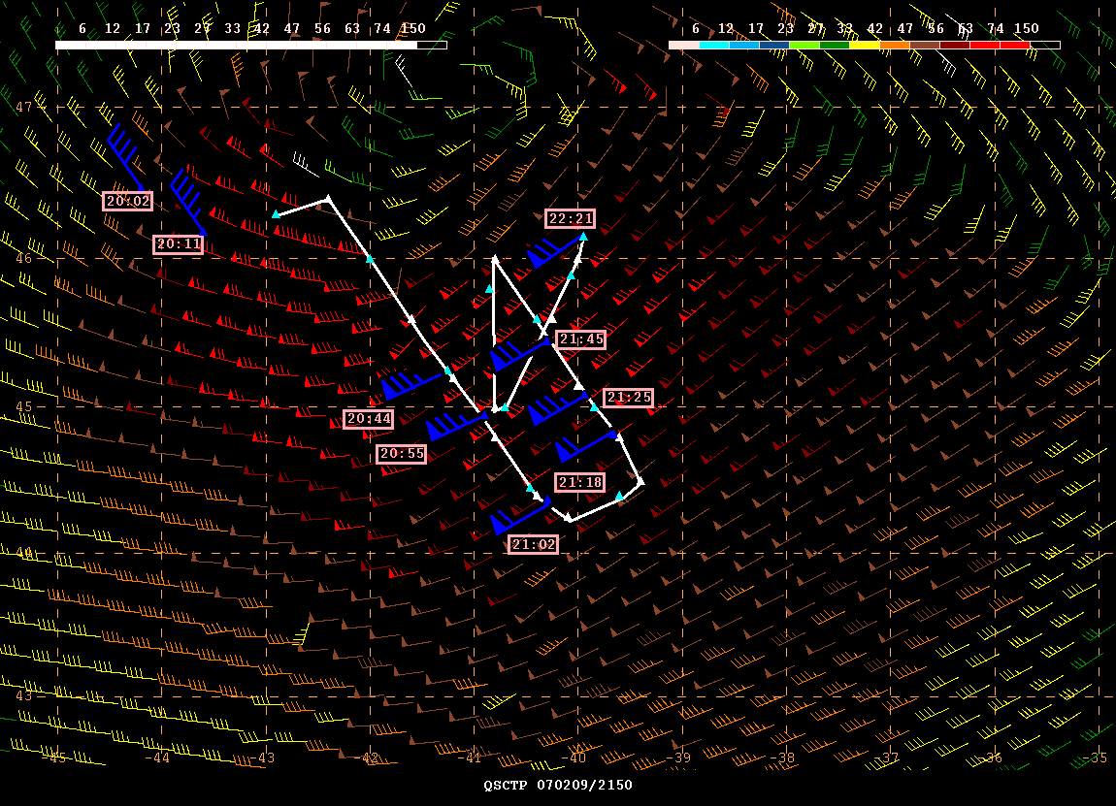

NOAA High Wind Speed QuikSCAT Validation Campaign
Wind Speed (Knots)
February, 9th 2007
Coincident QuikSCAT and Aircraft Wind Measurement reveal HF winds in extratropical storm in North Atlantic
HF warning category – added Dec 2000
Consistency – allowed OPC to focus
Understanding - Climatology
- Predictability
Notes:
Before QuikSCAT, rarely observed hurricane force extratropical cyclones. With QuikSCAT, started issuing hurricane force wind warnings.

Slide 19
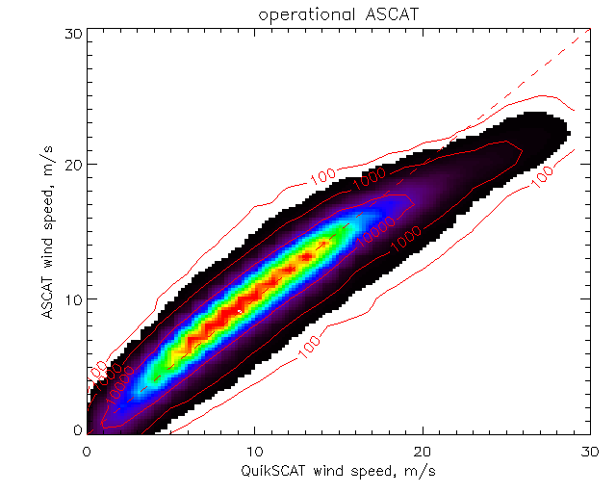
Detection of Hurricane Force Winds Within Extratropical Cyclones by Different Observation Systems
QuikSCAT observations are no longer available since November 23, 2009
ASCAT underestimates high wind speeds in comparison to QuikSCAT
  Hurricane force wind detection from ASCAT is very rare
Hurricane Force Observations
Oct’07 ~ May’08
Operational
212
188
Can ASCAT high wind speed retrievals be improved?
38
3
19

Slide 20
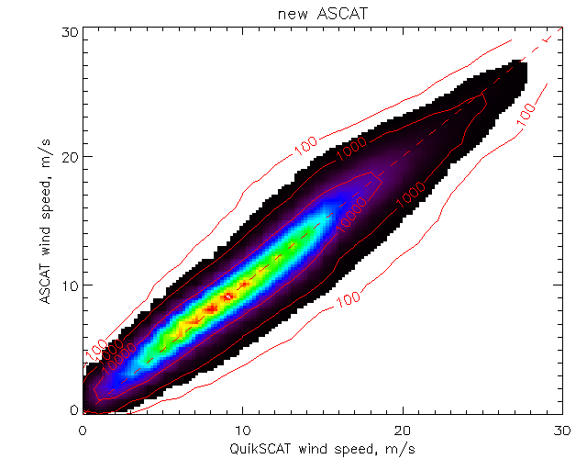
Hurricane Force Observations
( Oct’07 ~ May’08 )
A new ASCAT GMF has been developed to improve the high wind retrievals:
  Better detection of HF cyclones compared to operational ASCAT data product
  High winds compare better to QuikSCAT retrievals (but still biased low)
  QC flag needs tuning
New
212
188
3
39
38
19

Slide 21
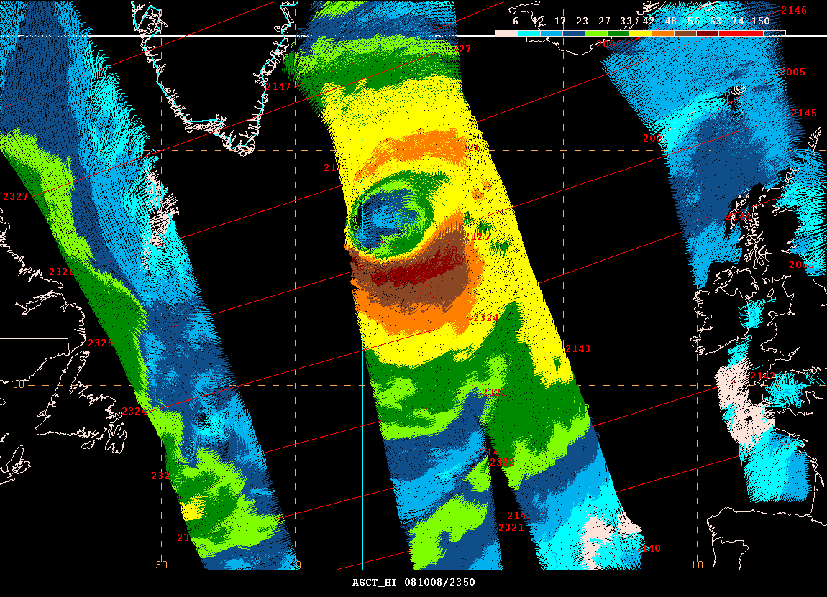
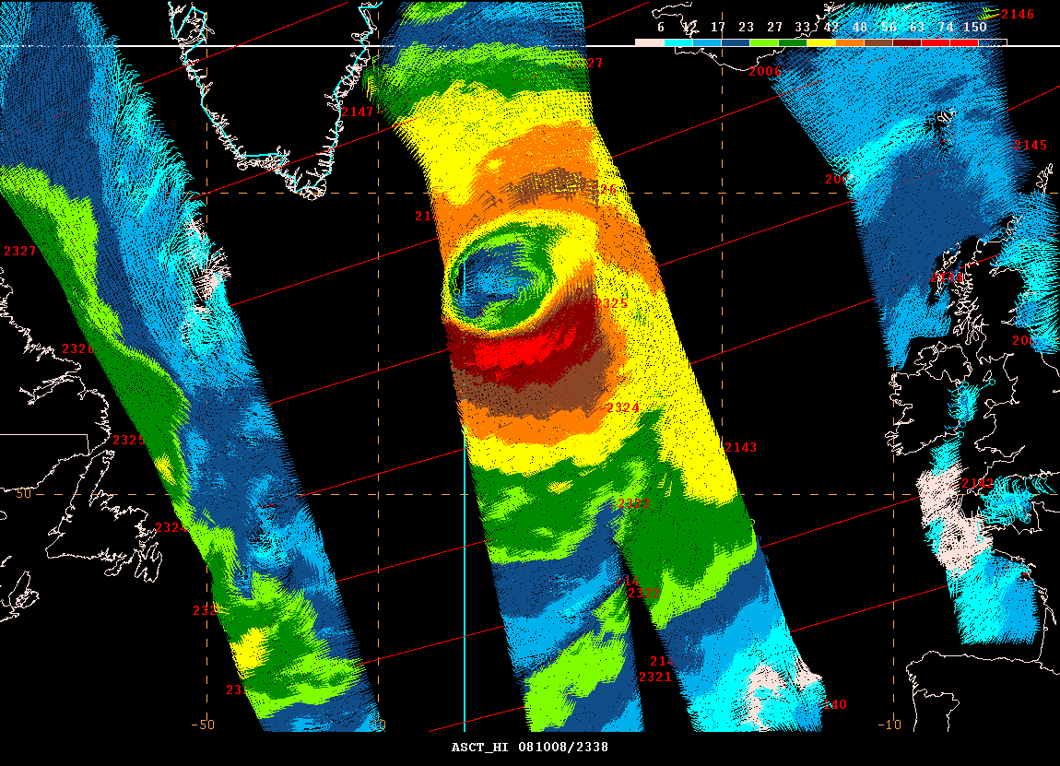
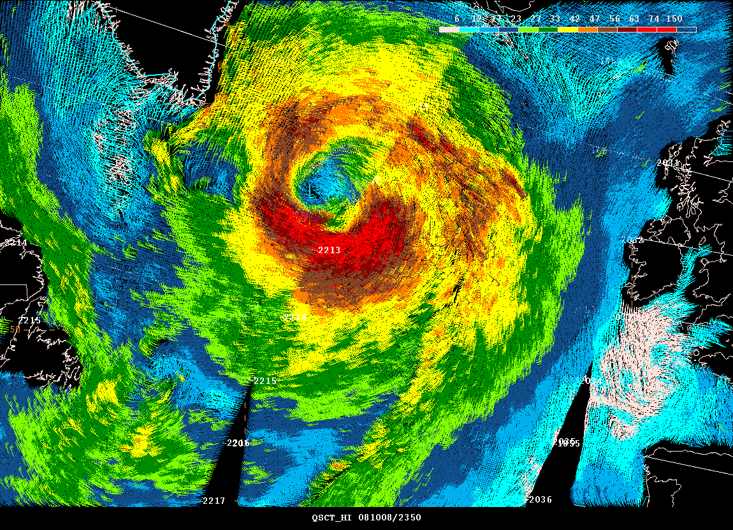
North Atlantic Extratropical Storm Example
ASCAT- Old GMF
ASCAT – New GMF
Operational ASCAT wind product detects STORM force wind. One wind warning category lower than the actual winds.
QuikSCAT & New ASCAT wind products detects HF wind.
QuikSCAT

Slide 22
NRT Hurricane Force Extratropical Cyclone Detections
Continued after QuikSCAT Ceased Operations
QuikSCAT Era
Post QuikSCAT

Slide 23
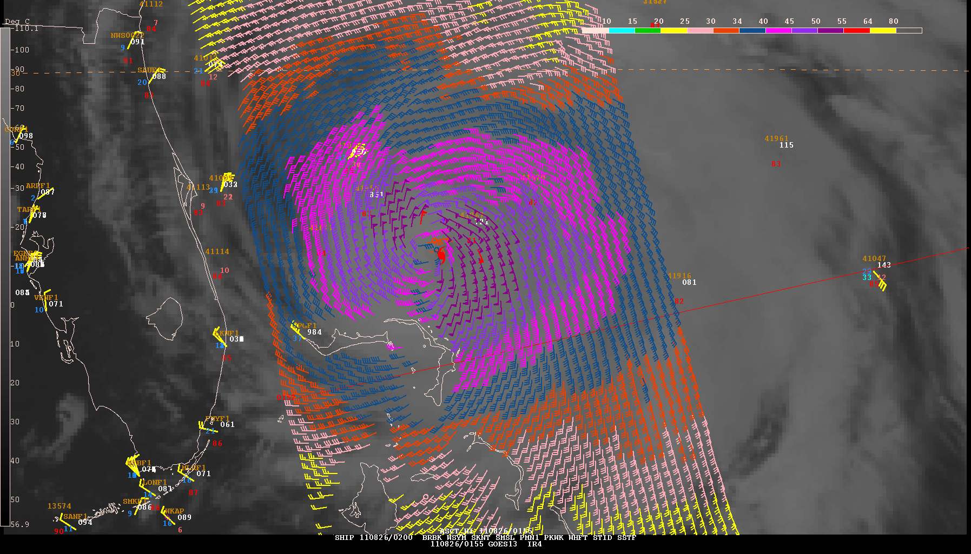
New ASCAT GMF Impact in TC Wind Field Analysis
Hurricane Irene
0152 UTC 26 August 2011
Old GMF

Slide 24
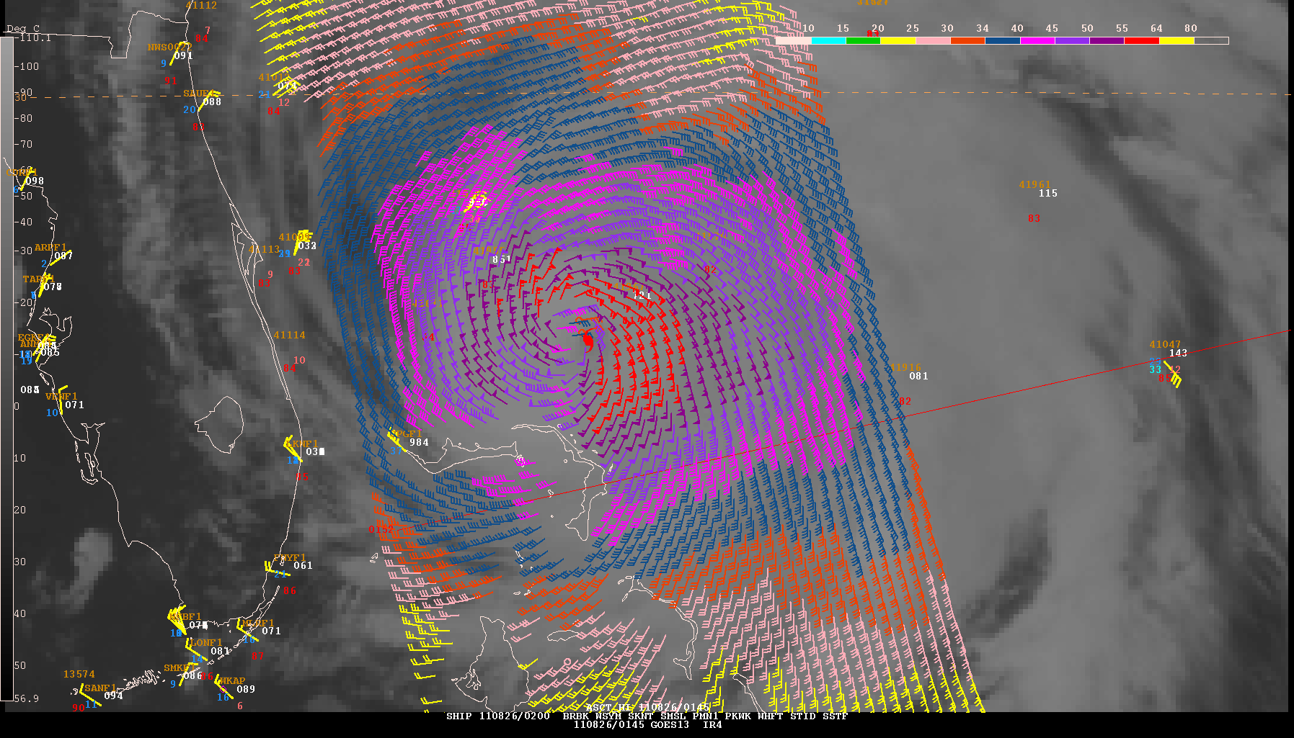
New ASCAT GMF Impact in TC Wind Field Analysis
Hurricane Irene
0152 UTC 26 August 2011
Analyzed wind radii from all sources
(including aircraft)
50 KT.......110NE 100SE 50SW 75NW.
34 KT.......250NE 200SE 125SW 160NW
ASCAT wind radii (new GMF)
50 KT.......90NE 105SE 60SW 70NW.
34 KT.......170NE 205SE 135SW 175NW.
New GMF
Old GMF
New ASCAT GMF has compared favorably to 34 and 50 kt wind radii estimates from aircraft data in some cases

Slide 25
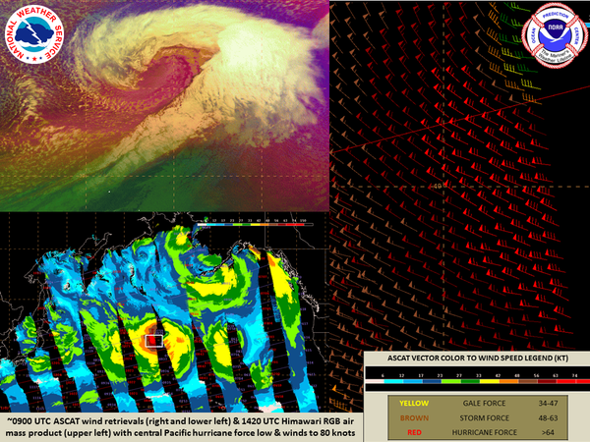
1420 UTC Himawari RGB image w/Pacific hurricane force low, ~09Z ASCAT wind retrievals w/80 knots SW of low

Slide 26
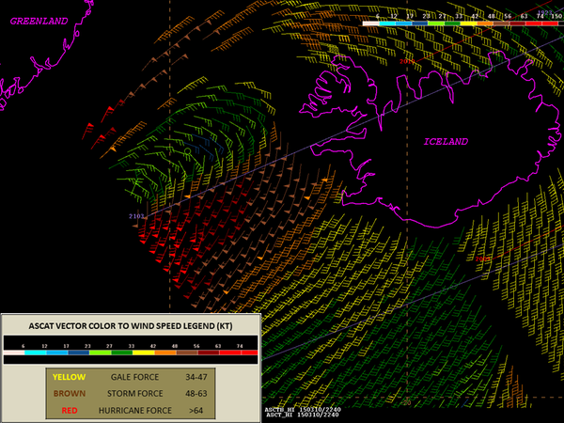
21Z ASCAT wind retrievals confirm hurricane force winds up to 75 knots W of Iceland w/ powerful North Atlantic low

Slide 27
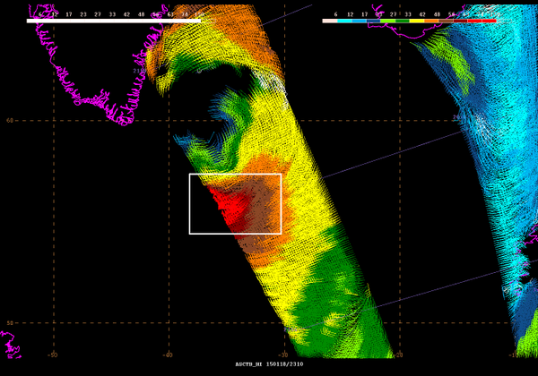
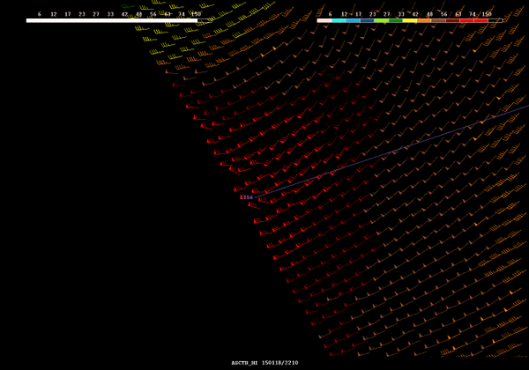
Last night's 21Z ASCAT data w/impressive swath of hurricane force winds (in red) up to 80kt SE of Greenland

Slide 28
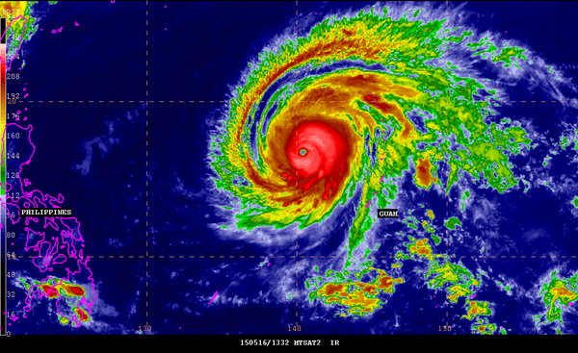
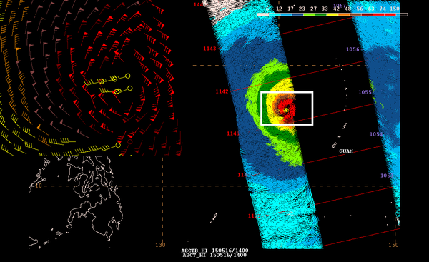
1332 UTC IR image of Super Typhoon Dolphin, 1142 UTC ASCAT wind retrievals w/ up to 90 knots near center

Slide 29
Wind Field Structure Observations within Mature ETC’s

Slide 30
Extratropical Storm Life Cycles
(adapted from Shapiro – Keyser Cyclone Model)
(SECLUSION)
HURRICANE FORCE WINDS
Notes:
A research project was held off the U.S. Atlantic Coast in the late 1980’s to study meteorological bombs. Developing storms were studied with many instruments including aircraft measurements. As a result of the research the above evolution of an ocean storm was suggested. Isobars and fronts are shown in the top. The evolution of the wind field is shown across the bottom. The evolution from open wave to mature “seclusion” can occur on the order of a day or two. The Portland Gale followed this evolution with the steamer Portland remaining to the north of the storm center in strong NE winds.

Slide 31
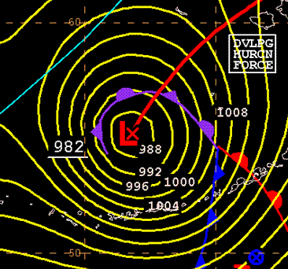
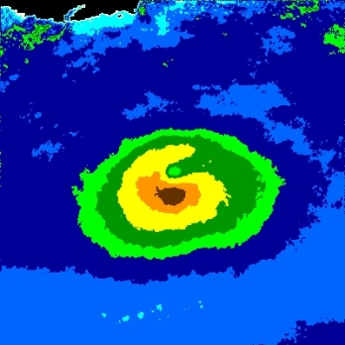
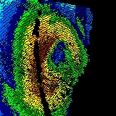
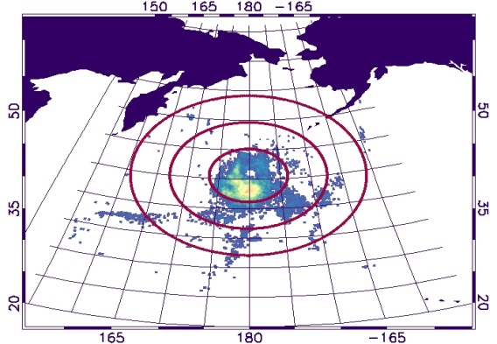
Storm track file
Read HF Cyclone Info.
Extract Science QS 12.5km Data
&
Perform QC
(land, ice, coast, rain) flags
Generate Mean Wind Fields
5000km
5000km
Estimate speed & Angle
(Heading Vector)
North
Mean motion
5000km
5000km
Storm motion
Generate Frequency of HF Occurrence per grid fields
East

Slide 32
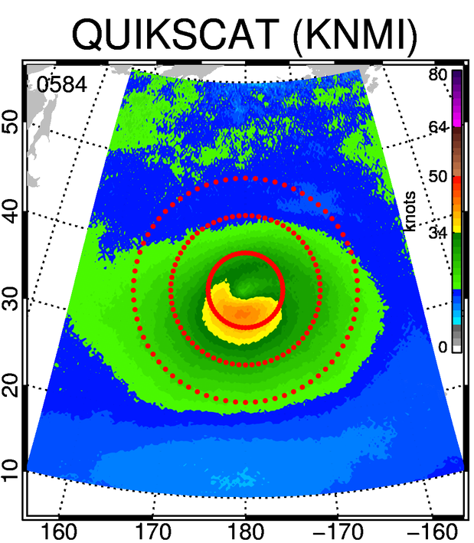
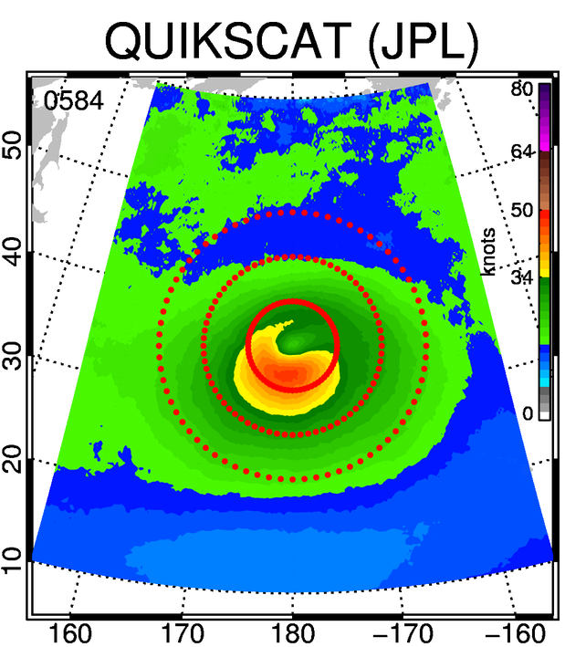
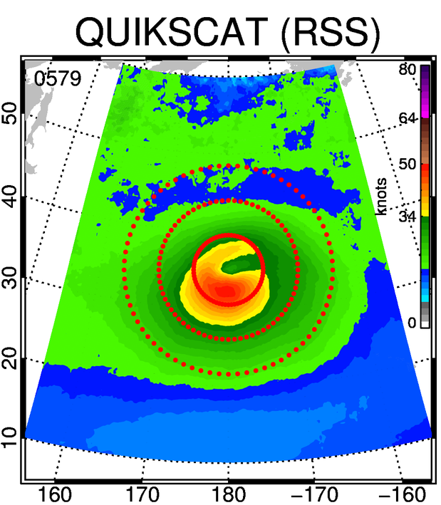
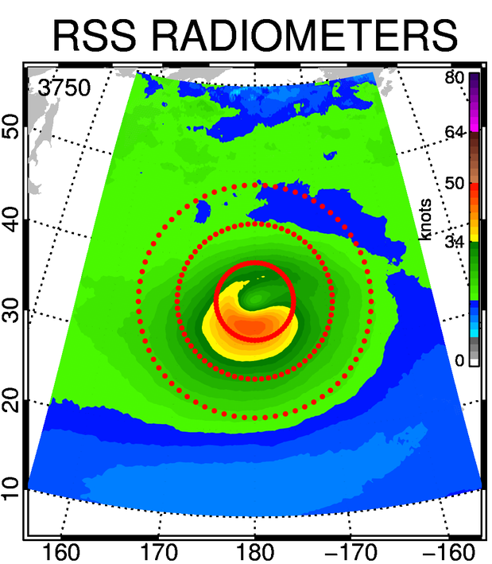
North Pacific Storms
QuikSCAT Products Comparison
2001-2009

Slide 33
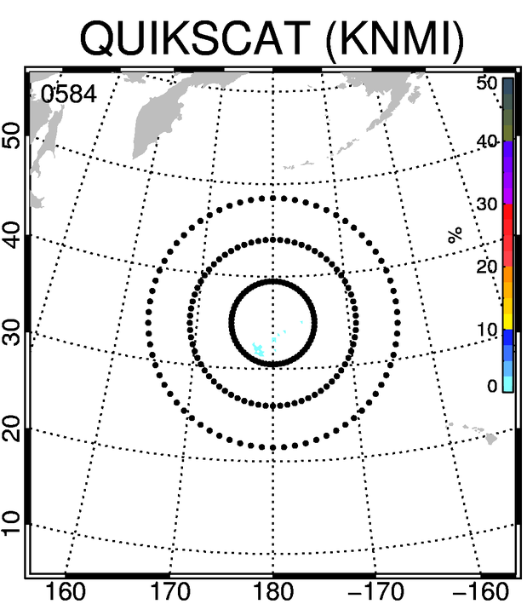
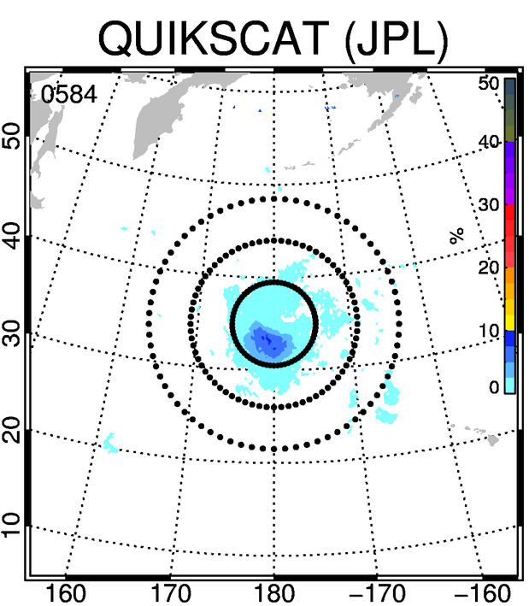
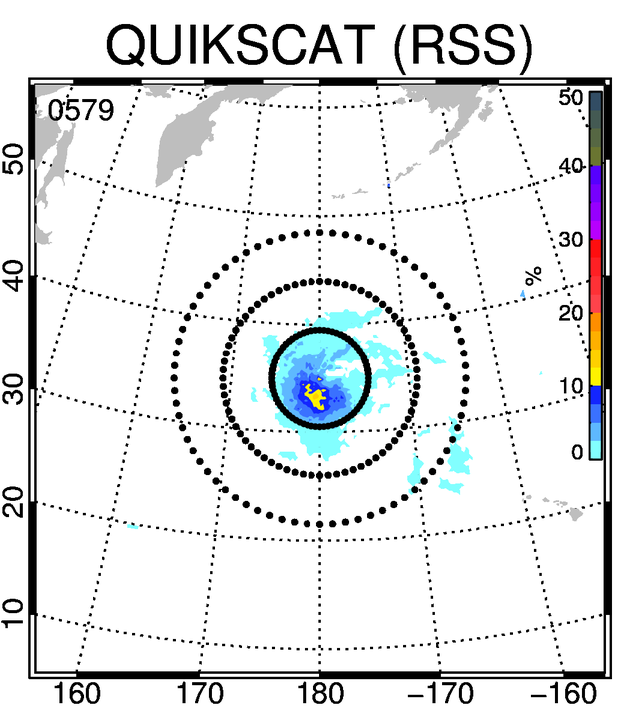
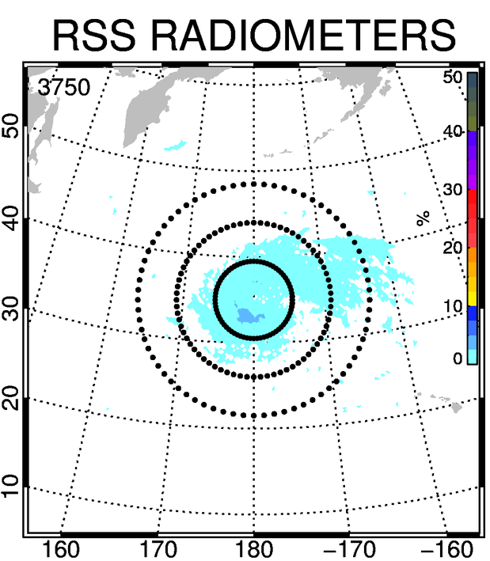
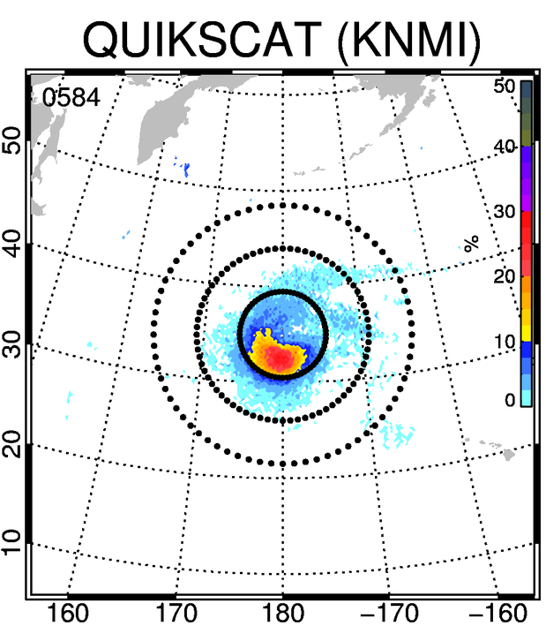
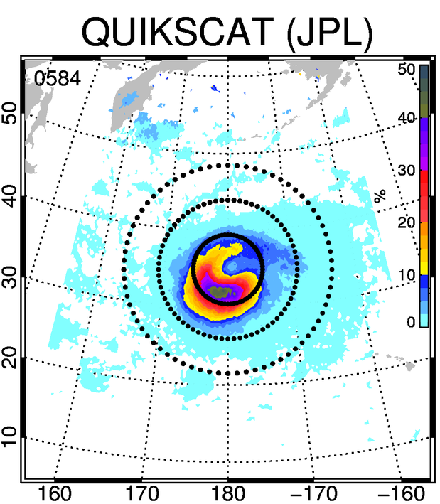
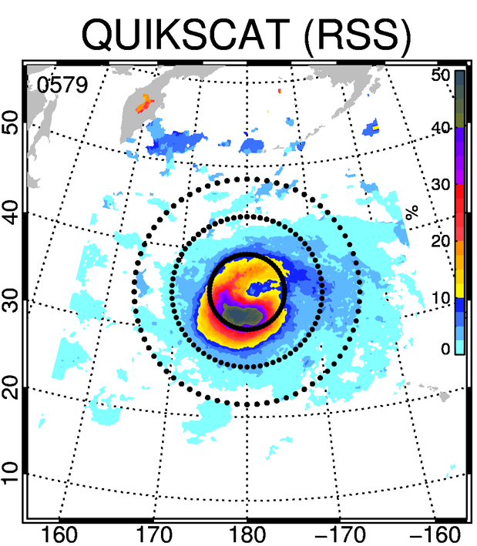
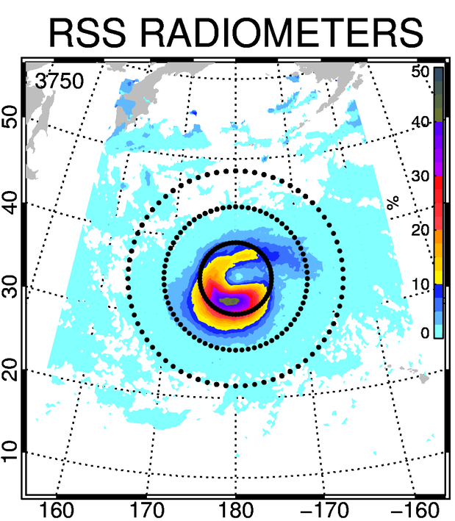
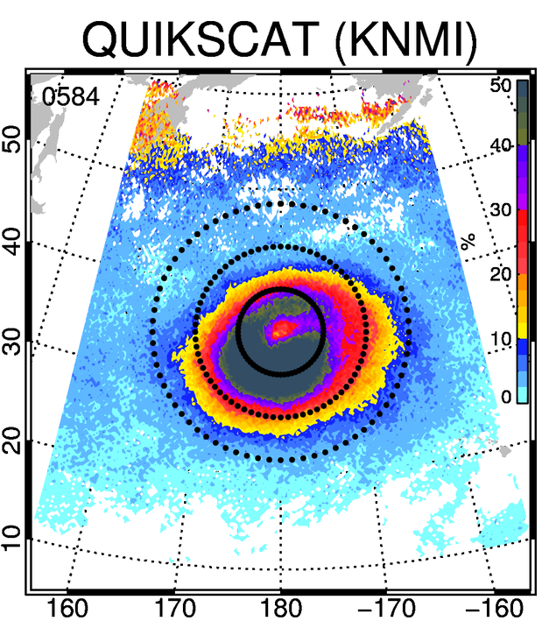
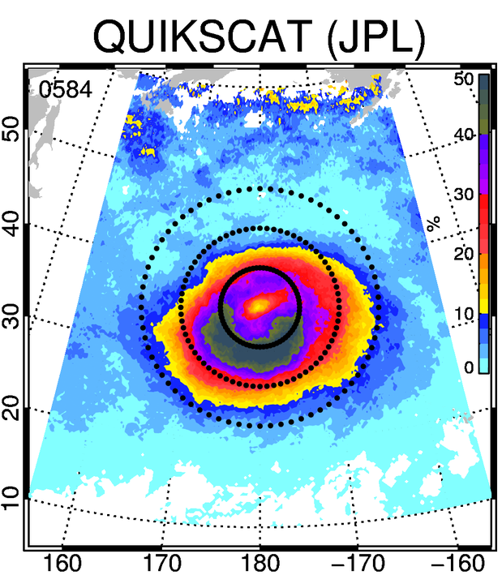
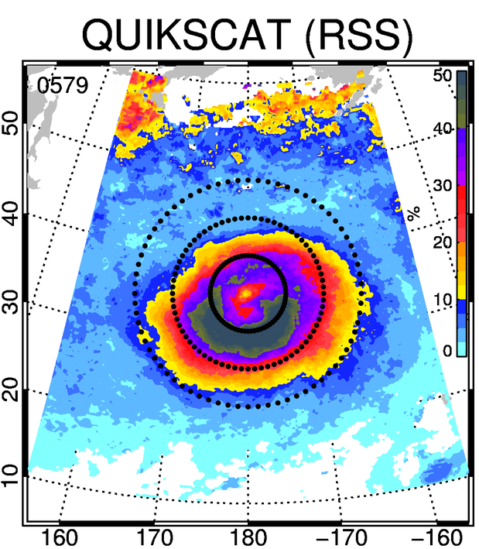
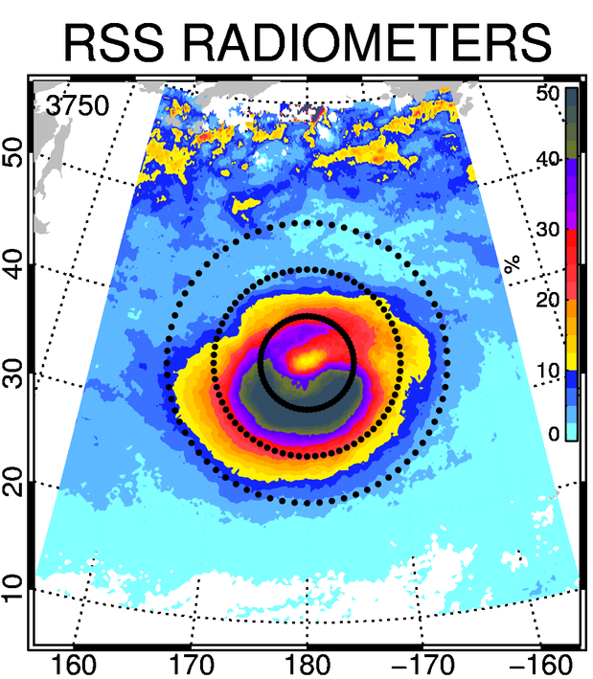
Frequency of Hurricane Force Winds
Frequency of Storm Force Winds
Frequency of Gale Force Winds

Slide 34
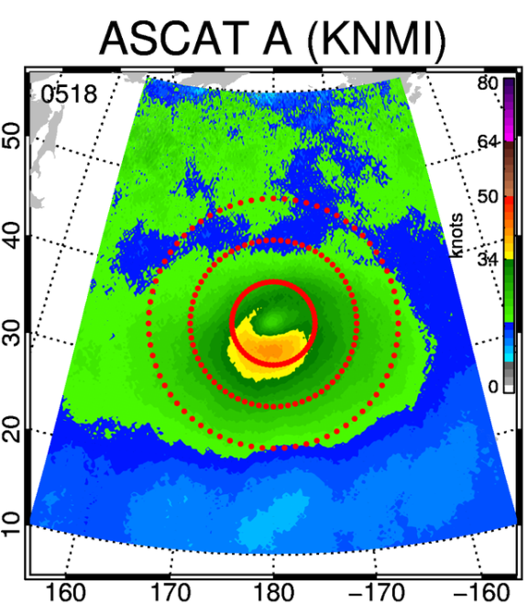
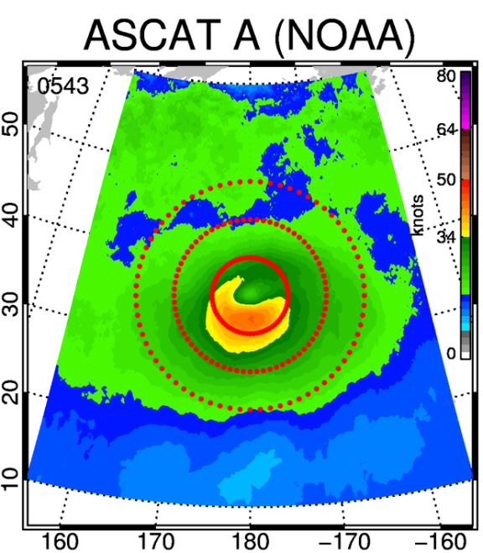
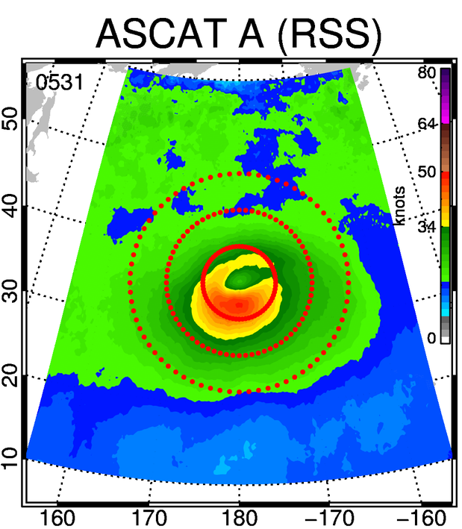
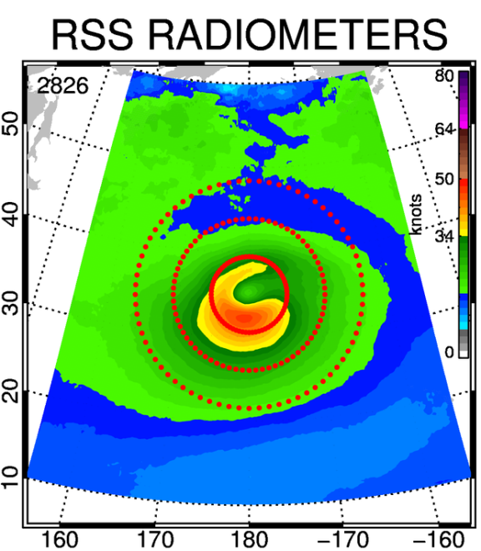
North Pacific Storms
ASCAT-A Products Comparison
2007-2015

Slide 35
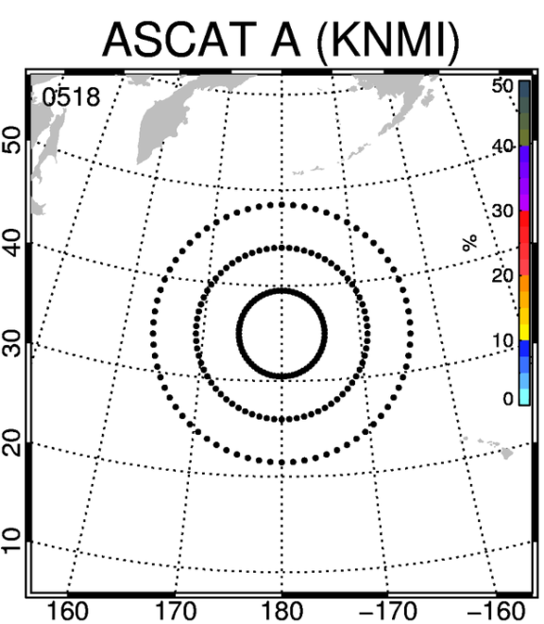











Frequency of Hurricane Force Winds
Frequency of Storm Force Winds
Frequency of Gale Force Winds

Slide 36
KNMI, NOAA and RSS ASCAT
High Winds Case Study
Extratropical Storm Feb 1st, 2010 NOAA P3 Flight

Slide 37

UNCORRECTED SFMR WINDS

Slide 38


Slide 39


Slide 40


Slide 41

KNMI
100km
40kts

Slide 42

NOAA
40km
50kts
120km
40kts

Slide 43

RSS
KNMI
(CMOD5.n)
100km
40kts
RSS
200km
40kts
NOAA
(CMOD5.h)
120km
40kts

Slide 44
NOAA
40km
50kts
RSS
130km
50kts

Slide 45





Heavy Weather Avoidance
Courtesy of Joseph Sienkiewicz NOAA/NWS/OPC

Slide 46
Summary
Collaboration vs Competition
  Radiometers have higher sensitivity to high winds than scatterometers
    Doesn’t mean scatterometter measurements are redundant at high winds
  There is intermediate wind regime where all instruments should have comparable sensitivity (20-35m/s)
  Radiometers have lower sensitivity to low winds than scatterometers
    Doesn’t mean radiometer measurements are redundant at low winds
Validation approaches
  Statistical and application driven
To transition data from research to operations training is a key

Slide 47

Wants vs Needs
Thank You!
Picture courtesy of Dr R. Knabb

Slide 48

Use Of Scatterometer Data at National Hurricane Center 2000-2014
ASCAT-A
QSCAT Failure
OSCAT
ASCAT-B
OSCAT Failure

Slide 49
The Impact of QuikSCAT
“QuikSCAT has been instrumental in forecasting coastal jets. We didn't know they were out there before QuikSCAT.”
“QuikSCAT has been absolutely vital for understanding the structure of tropical cyclones.”
“QuikSCAT is our bread and butter!”
“Because of QuikSCAT, our ability to assess current conditions has never been better and our warnings never more accurate.”

Slide 50
WindSat Experience
Colaboration vs Competition

