Slide 1
Sea State Influence on SFMR Wind Speed Retrievals in Tropical Cyclones
Heather Holbach^{1,2,3}, Mark Bourassa¹, and Brad Klotz³
¹ Florida State University, ²NGI, ³NOAA/AOML/HRD
International High Winds Workshop
Exeter, UK
November 16, 2016
We acknowledge Mark Powell, Frank Marks, and the pilots and crew at NOAA AOC. Research supported by NASA JPL (036683), NOAA (031132) and NGI.

Slide 2
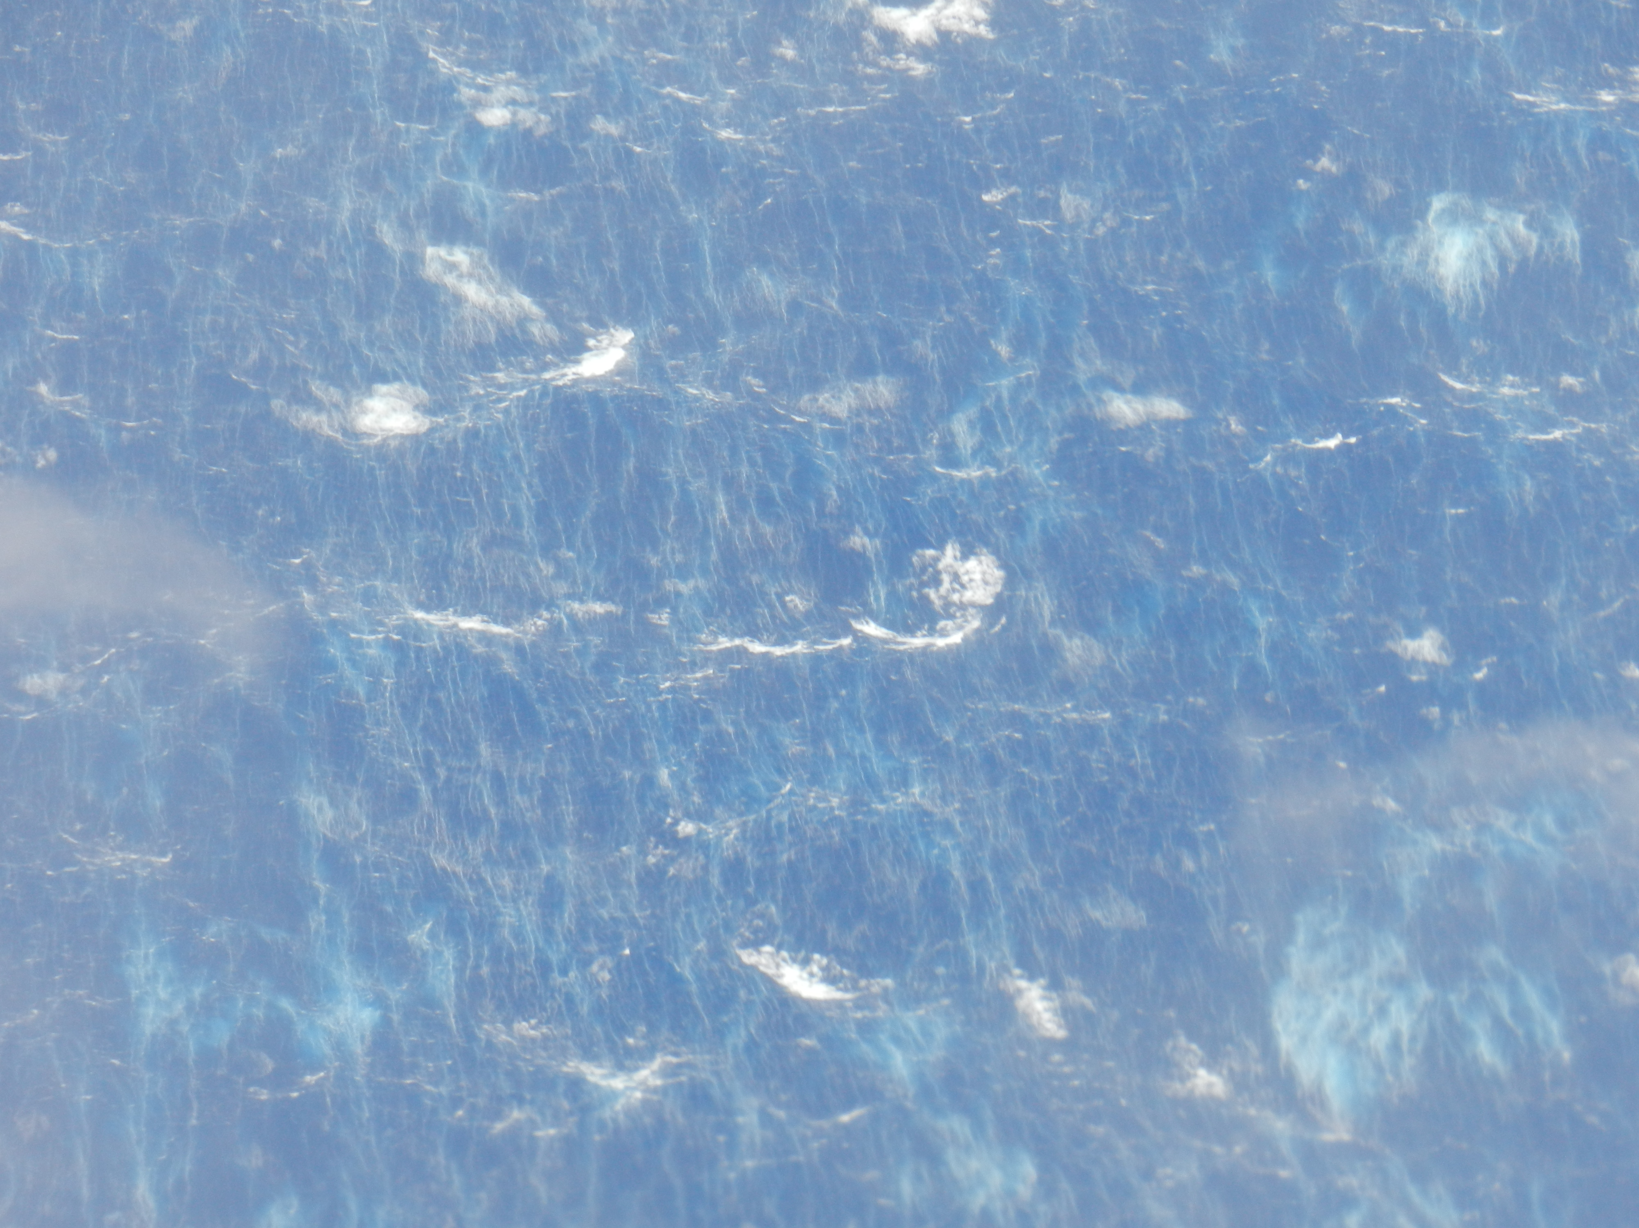
SFMR Wind Speed Retrieval
Successful retrievals rely on understanding the relationship between ocean surface brightness temperature and wind speed
Many other factors can influence the ocean surface brightness temperature besides wind speed
Sea state
Viewing angle
Wind direction
Sea surface temperature

Slide 3
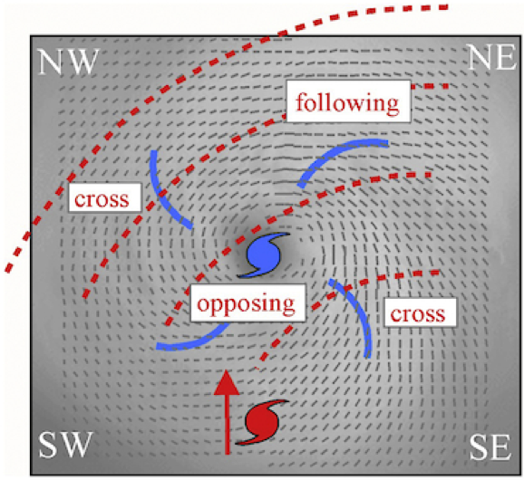
Hurricane Wave Characteristics
Swell:
More dominant in inner core (Wright et al. 2001, Hwang 2016)
Cross swell (wrt wind direction) reduces white capping (Goddijn-Murphy et al. 2011) and limits wave breaking (Holthuijsen et al. 2012)
Fig. 3 Holthuijsen et al. (2012)

Slide 4
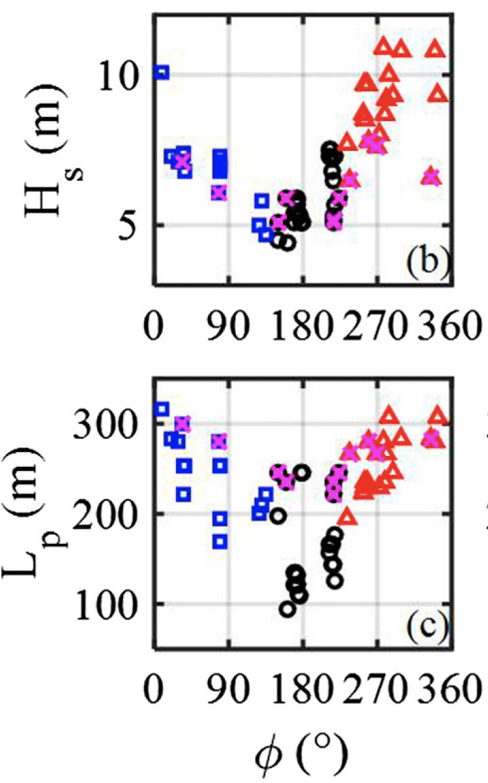
Hurricane Wave Characteristics
Left
Back
Right
Inside 30km
from center
Wind waves:
More dominant in outer region (Wright et al. 2001, Hwang 2016)
Hwang (2016):
Tallest in front-right sector
Longest wavelength in front-right and front-left sectors
Smallest (height) and shortest wavelength in rear sector
Steepest waves in front-right or rear sector.
X
Fig 2 Hwang (2016)

Slide 5
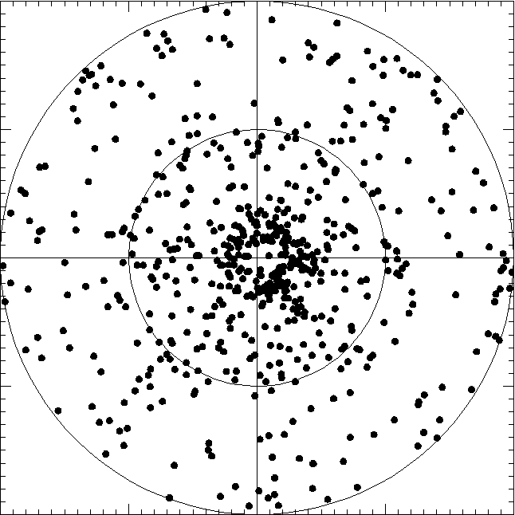
Methodology
Storm Motion
Level flight data collocated with a dropsonde in a hurricane between 2010 and 2015
$ε_{w}=ε−ε_{0}−ε_{atm}−ε_{cos}$ where$ε=\frac{T_{B}}{T}$
Wind-induced emissivity is calculated by subtracting smooth surface emissivity, the atmospheric, and cosmic emissivity
Wind-induced emissivity difference is 4.74 GHz SFMR – model fit from Klotz and Uhlhorn (2014)
200
Azimuth Angle
100
Along Storm Track Distance (km)
0
-100
-200
-200
-100
0
100
200
Cross Storm Track Distance (km)

Slide 6
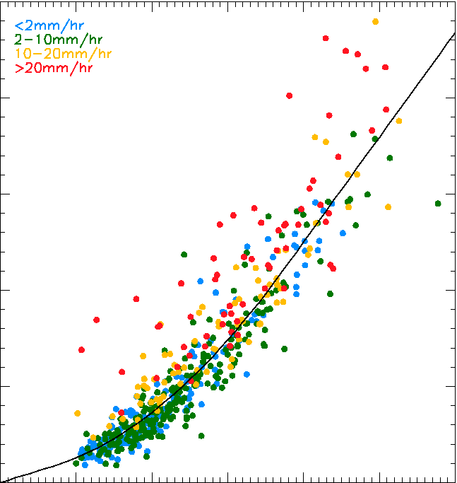
Wind-Induced Emissivity vs. Wind Speed
0.25
422 collocation pairs with rain rate less than 10 mm/hr
At 20 m/s, 0.005 change in wind-induced emissivity results in 1.6 m/s wind speed change
At 40 m/s, 0.005 change in wind-induced emissivity results in 0.9 m/s wind speed change
RR < 2 mm/hr
2 mm/hr ≤ RR < 10 mm/hr
10 mm/hr ≤ RR < 20 mm/hr
RR ≥ 20 mm/hr
Model Fit
0.20
0.15
Wind-Induced Emissivity
0.10
0.05
0.00
0
10
20
30
40
50
60
Wind Speed (m/s)

Slide 7
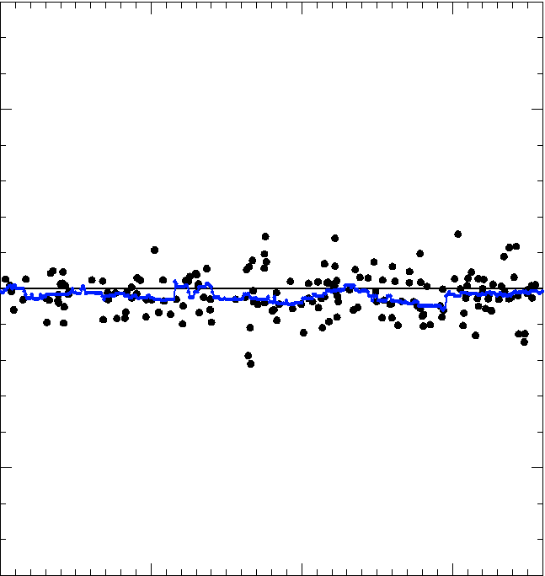
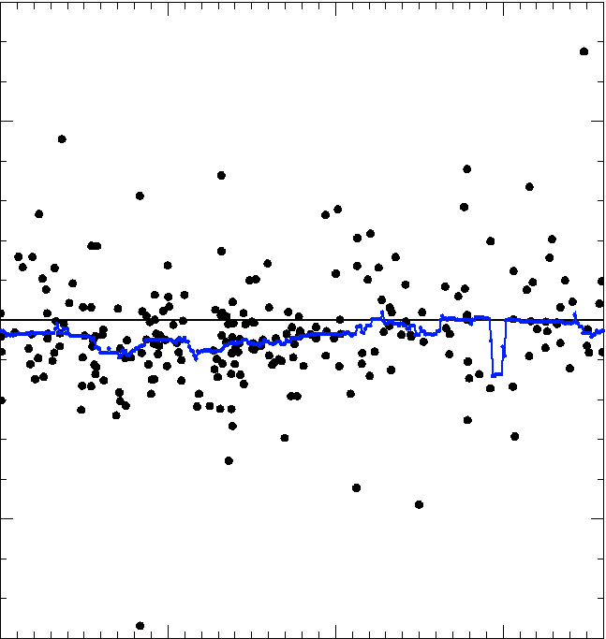
Wind-Induced Emissivity Difference
(4.74 GHz SFMR – Model)
10 to 20 m/s
20 m/s +
0.05
Wind-Induced Emissivity Difference
0.00
-0.05
0
100
200
300
0
100
200
300
Storm Relative Azimuth Angle (°)
Storm Relative Azimuth Angle (°)

Slide 8
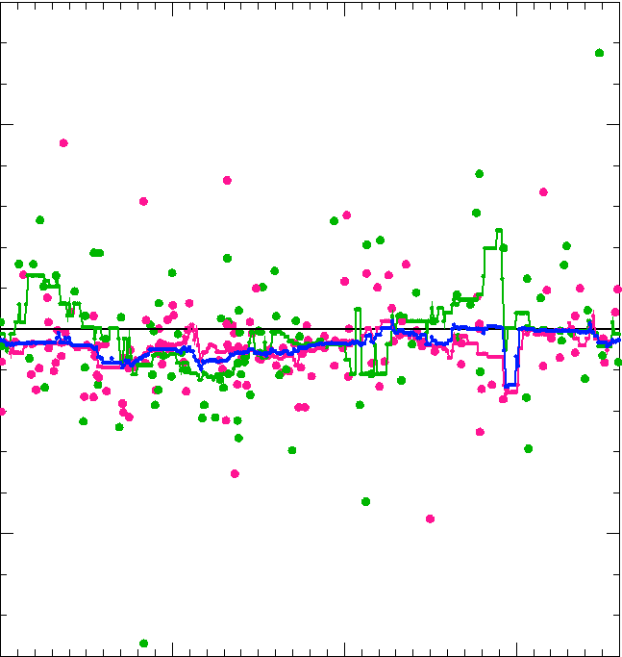
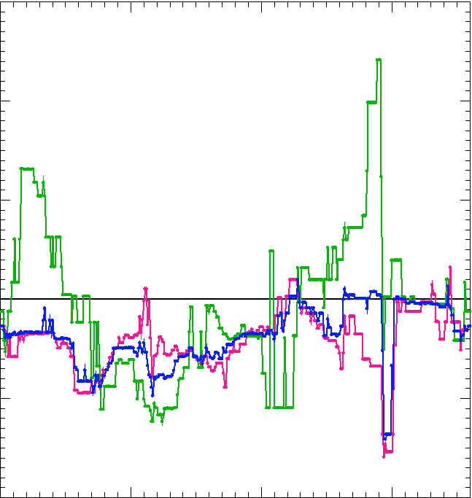
20 m/s + (Radius ≤ 50 km vs Radius > 50 km)
0.03
R ≤ 50 km
R > 50 km
All
R ≤ 50 km
R > 50 km
All
0.05
0.02
n (R ≤ 50 km) = 97
n (R > 50 km) = 141
0.01
Wind-Induced Emissivity Difference
0.00
0.00
-0.05
-0.01
Lines: Running medians of 30° azimuthal bins
a
b
-0.02
0
100
200
300
0
100
200
300
Storm Relative Azimuth Angle (°)
Storm Relative Azimuth Angle (°)

Slide 9
Storm Relative Azimuthal Asymmetry and Swell
0.03
R ≤ 50 km
R > 50 km
All
Higher Emissivity
0.02
0.01
Higher Emissivity
Wind-Induced Emissivity Difference
0.00
Lower Emissivity
-0.01
-0.02
0
90
180
270
Storm Relative Azimuth Angle (°)
Fig. 3 Holthuijsen et al. (2012)

Slide 10
Conclusion
Following and opposing swell increases wind-induced emissivity measured by SFMR
Cross swell decreases it
Wind waves and swell combination in outer regions of storm dampen the asymmetry
These results are further evidence that directional wind and wave interactions modify ocean surface stress and must be considered in model development

Slide 11
SFMR Update
SFMR data from 1998 to 2014 have been reprocessed using the current algorithm (Klotz and Uhlhorn 2014)
In the process of updating the data files on the HRD website
Blog post and message on HRD website will be posted when complete
These data will be used in Jonathan Vigh's FLIGHT+ dataset

Slide 12
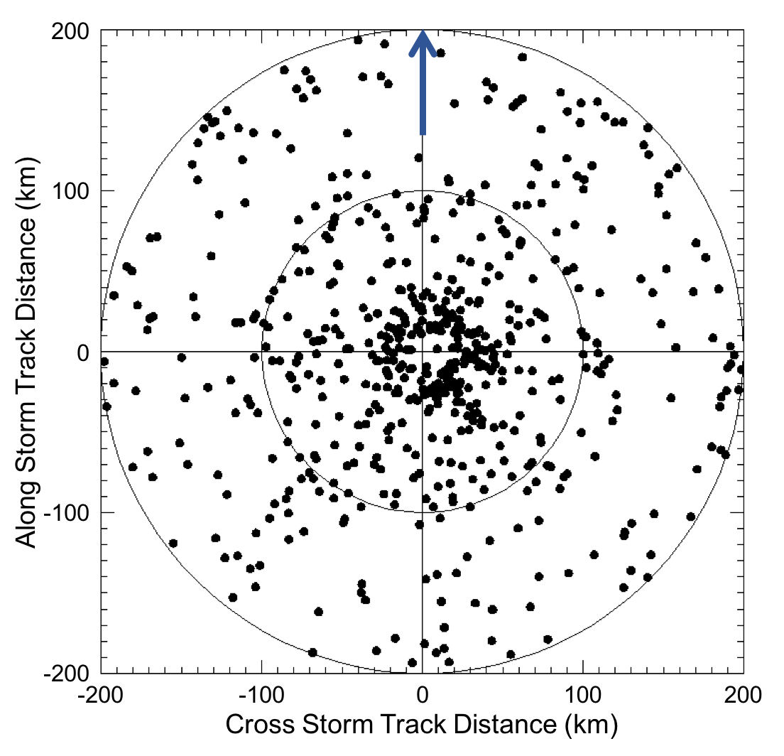
Collocation Restrictions
Storm Motion
WL150 surface adjusted wind speed and 10-s avg. SFMR wind speed greater than 10 m/s
Located greater than 5 km and less than 200 km from storm center
Dropsonde cannot travel more than 9 km radially from the launch location
Aircraft roll angle could not exceed 10°
Total of 580 collocation pairs
Azimuth Angle

