Slide 1
An Overview of Tropical Cyclone Prediction at the Met Office
Julian Heming
International workshop on measuring high-wind speeds over the ocean
17 November 2016

Slide 2
Outline
Why is the Met Office interested in tropical cyclones?
Timeline of tropical cyclone prediction at the Met Office
Forecast products
Data assimilation and initialisation
Observations (measurements!)
Moving to higher resolution
Summary

Slide 3
Why is the Met Office interested in tropical cyclones?

Slide 4
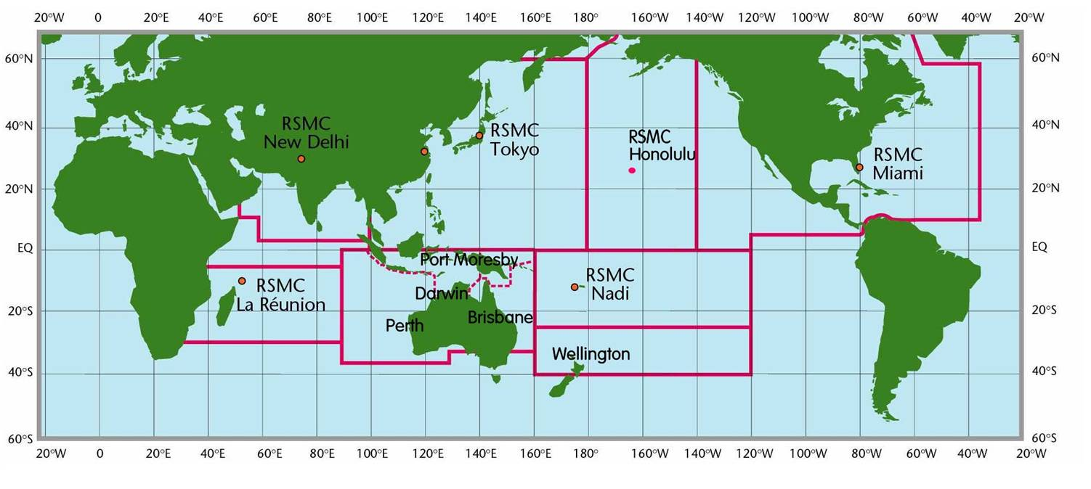
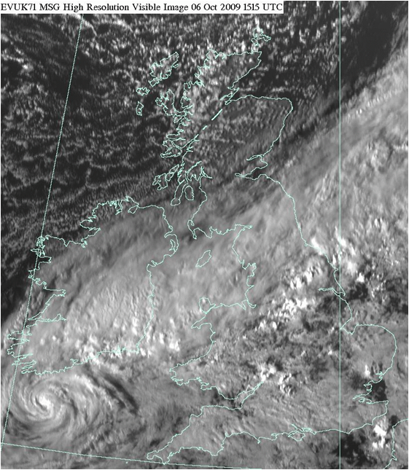
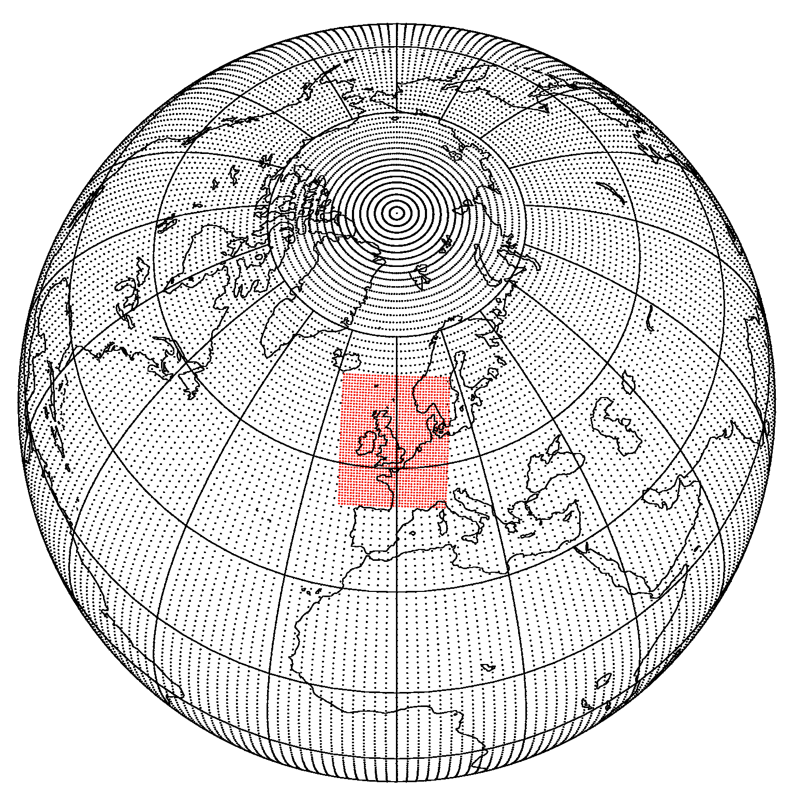
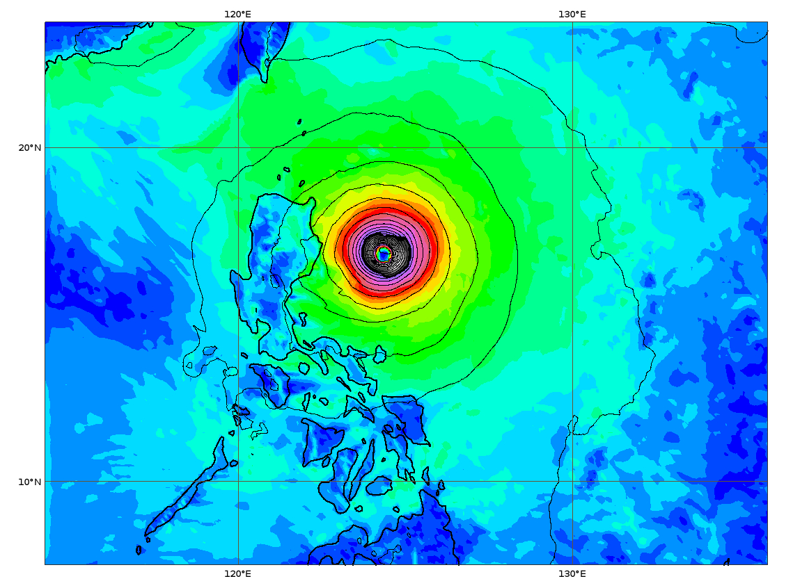
Why is the Met Office interested in tropical cyclones?
Support for RSMCs
Global guidance including support for FCO and UK interests overseas
Global Model development
Unified Model partners and collaborators in tropics
Extratropical transition

Slide 5
Timeline of tropical cyclone prediction at the Met Office

Slide 6
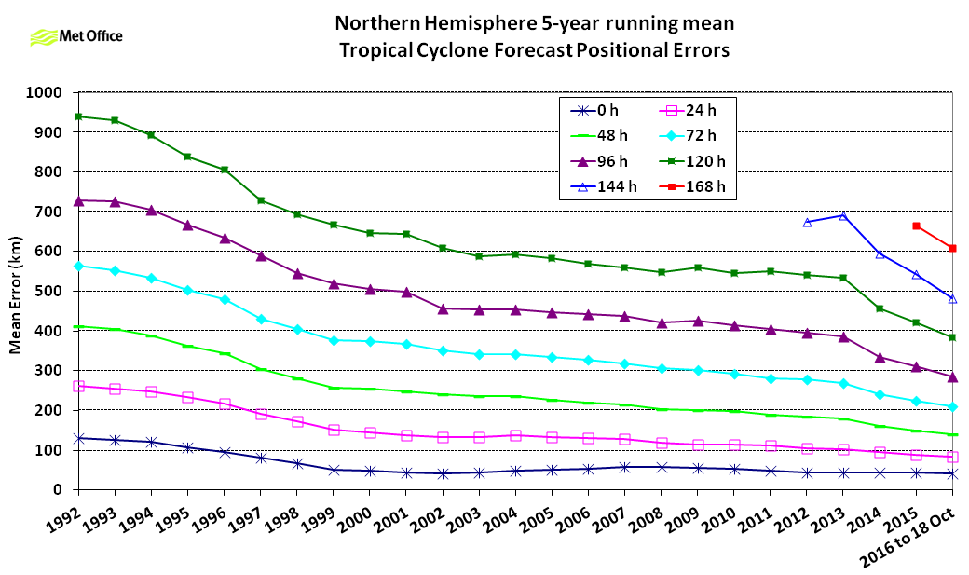
Timeline of tropical cyclone prediction at the Met Office
Early 1990s started verifying model performance
Mid-1990s initialisation scheme reduced track forecast errors by 30%
Mid-1990s issuing ‘guidance messages’ worldwide
Large impact changes in last 15 years
New Dynamics, 4D-Var, ENDGame
Removal of old initialisation scheme
Assimilation of central pressure
Track forecast errors on a long-term downwards trend

Slide 7
Forecast products

Slide 8
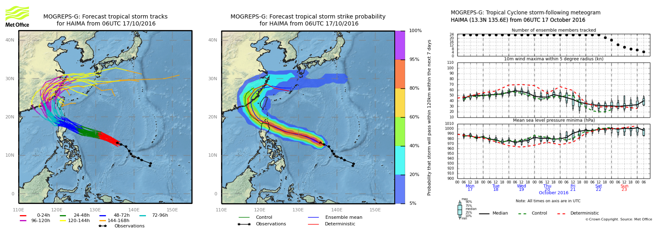
Forecast products
Track, intensity and model data to RSMCs

Slide 9
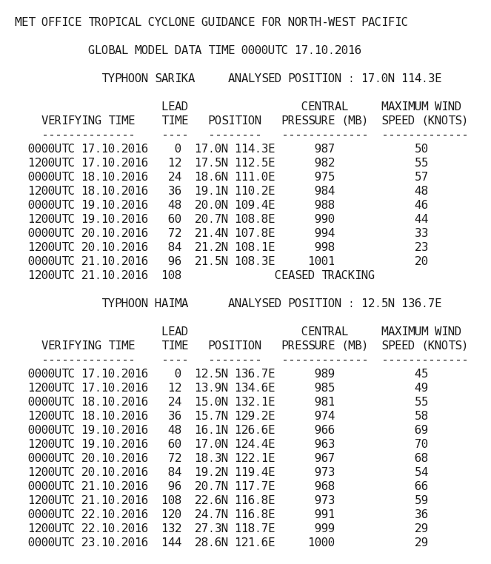
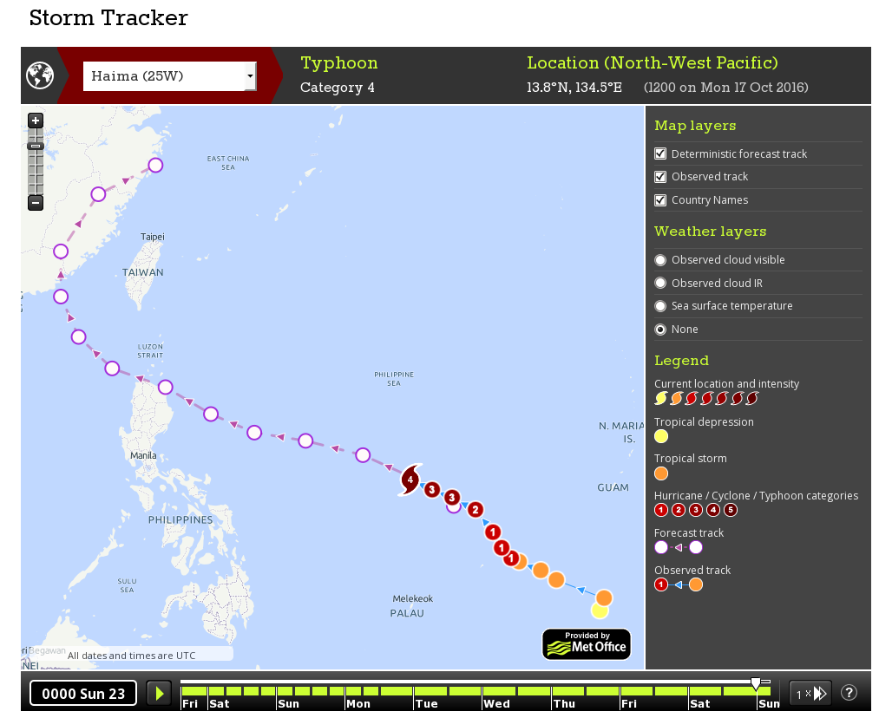
Forecast products
Text and graphics on the web and GTS

Slide 10
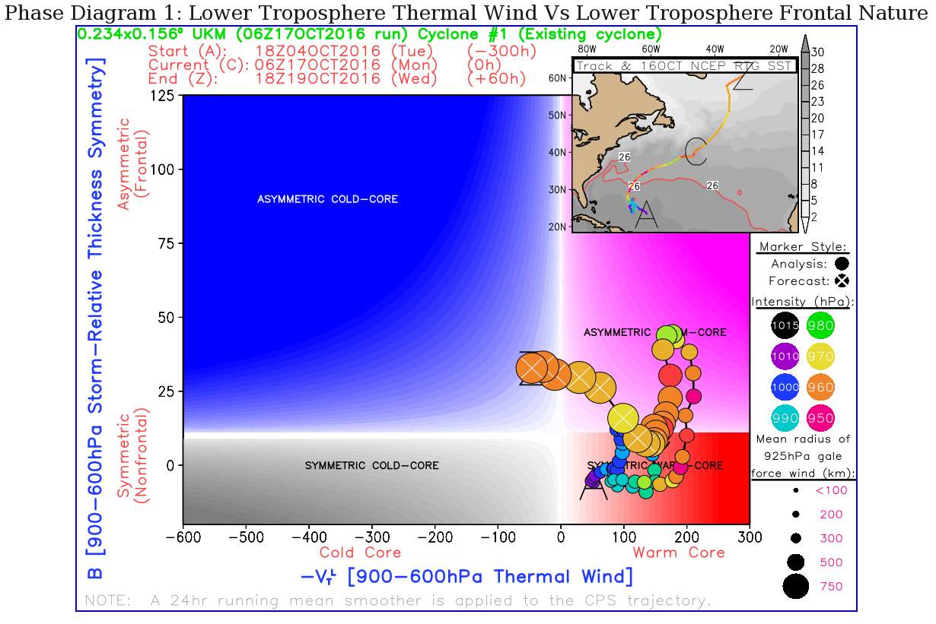
Forecast products
Data for research and forecasting tools

Slide 11
Data assimilation and initialisation

Slide 12
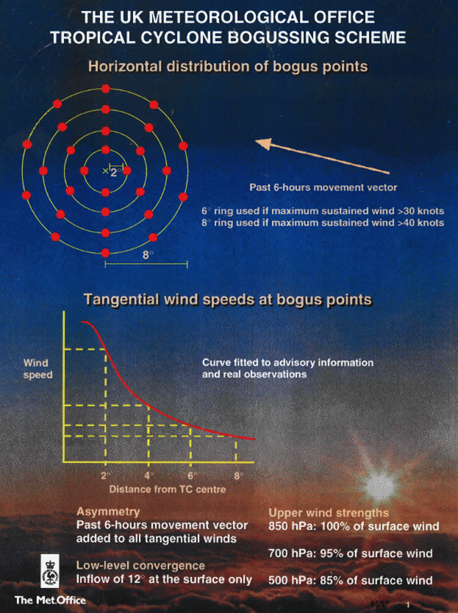
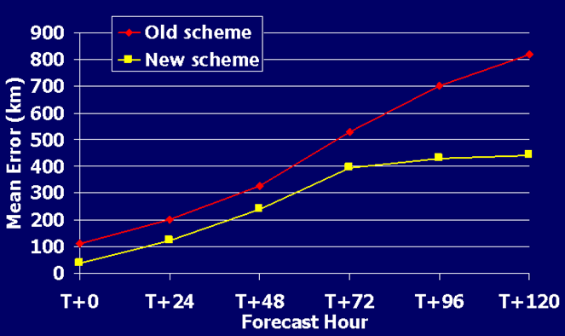
Data assimilation and initialisation
Initialisation Scheme introduced in mid-1990s
Track errors reduced 30%
Modifications 1998, 2007
Removed in 2012

Slide 13
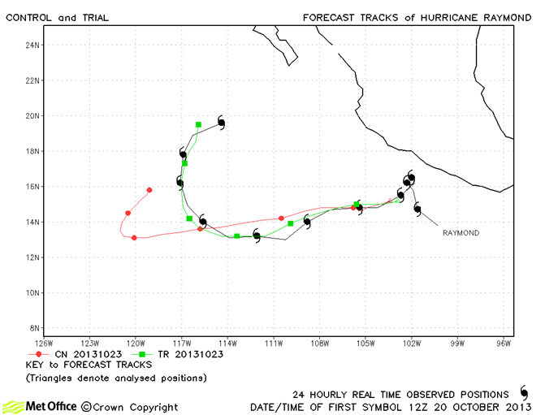
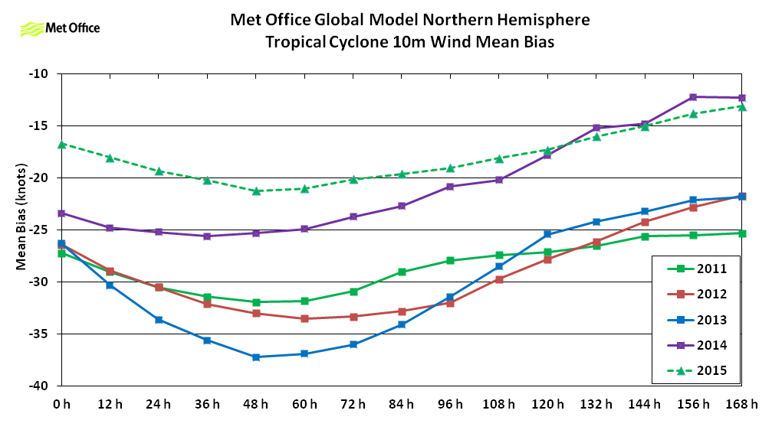
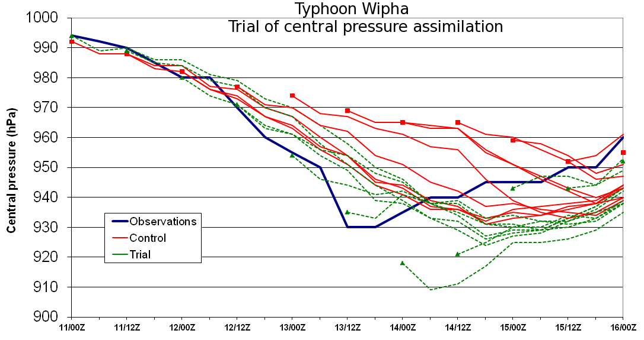
Data assimilation and initialisation
Central pressure assimilation introduced in 2015
Track forecast errors reduced by around 6%
Intensity predictions improved in most cases
Following introduction analysis and short lead time intensity forecast bias reduced
2014
2015
Notes:
Intensity errors now trending towards zero with increasing lead time, but still a weak bias in the analysis and short period forecasts.

Slide 14
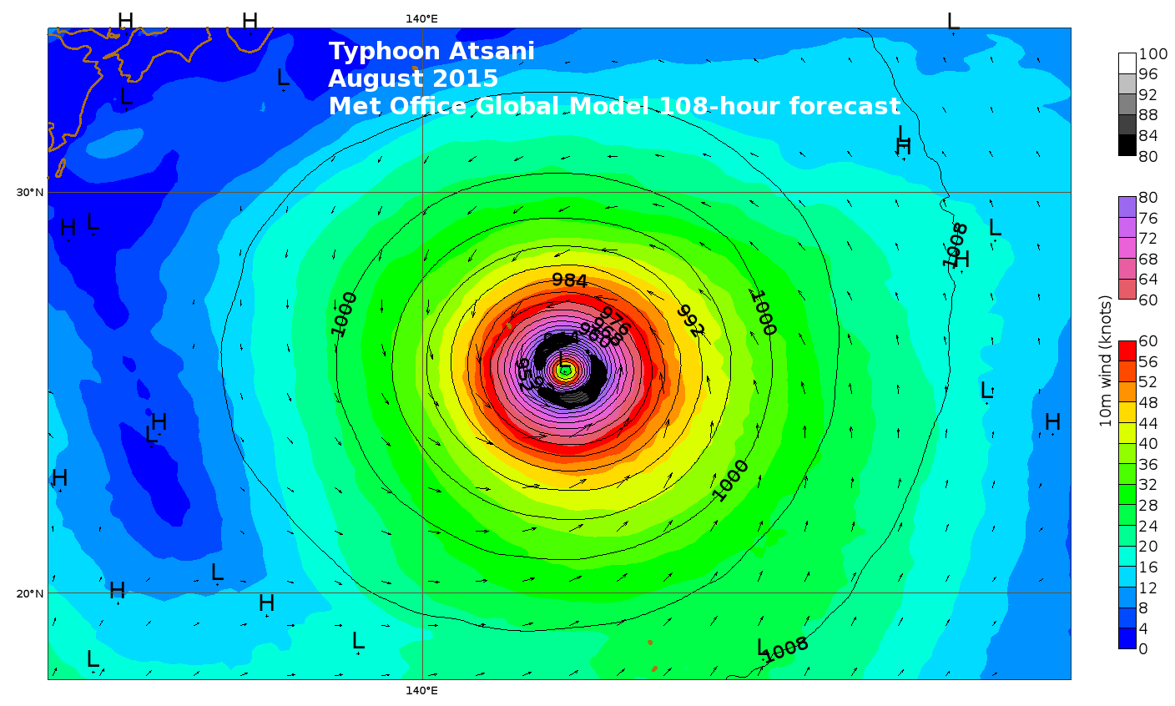
Data assimilation and initialisation
Global model now able to forecast tropical cyclones with central pressure near 900 mb and winds near 100 knots

Slide 15
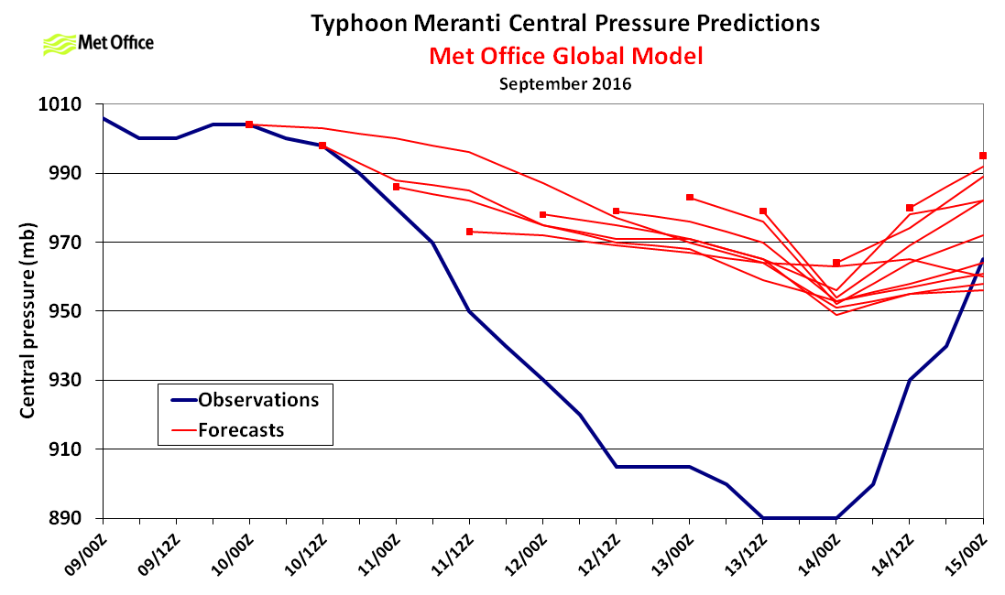
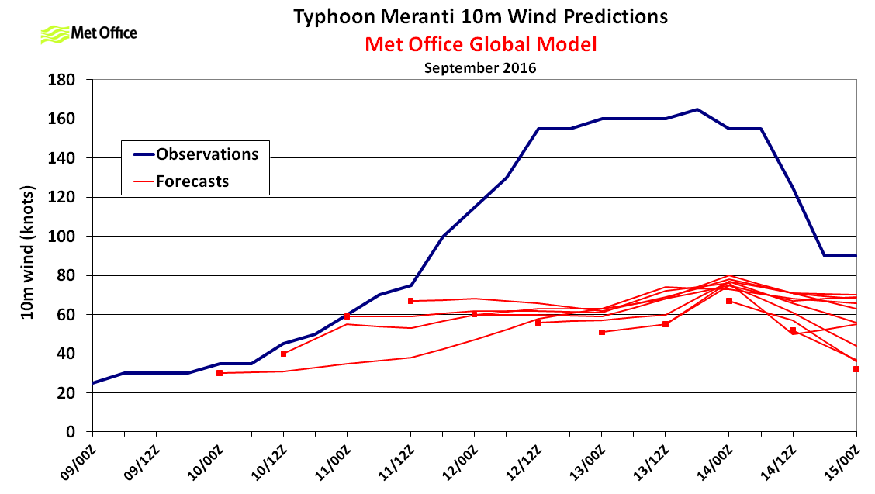
Data assimilation and initialisation
Central pressure data fails quality control for rapidly intensifying TCs
Subsequent model analyses fail to represent TC intensity
Can we expect remotely sensed observations of high winds to help resolve this?

Slide 16
Observations

Slide 17
Observations
Increasing requirement to initialise, forecast and verify structure of tropical cyclones in models
Remotely sensed wind observations contribute by:
Direct assimilation into models
Feeding objective methodologies (e.g. John Knaff’s talk on Tuesday)
Informing tropical cyclone warning centre analysis

Slide 18
Observations
Joint Typhoon Warning Center (JTWC) recent comments on the usefulness of remotely sensed winds around tropical cyclones:
Without aerial reconnaissance, remotely sensed measurements of winds are absolutely critical to our mission
A good scatterometer pass provides more than just the location and intensity of a tropical cyclone low level centre, it helps us characterise the wind structure
Even with a readily apparent well defined eye, tropical cyclone structure analysis from products like scatterometer, SSMI winds and GCOM winds help us estimate the radius of maximum winds and 34 and 50 knot winds
Getting an accurate analysis is not only essential for producing a good forecast, but as we report these data to modelling centres, it also impacts the quality of numerical weather prediction

Slide 19
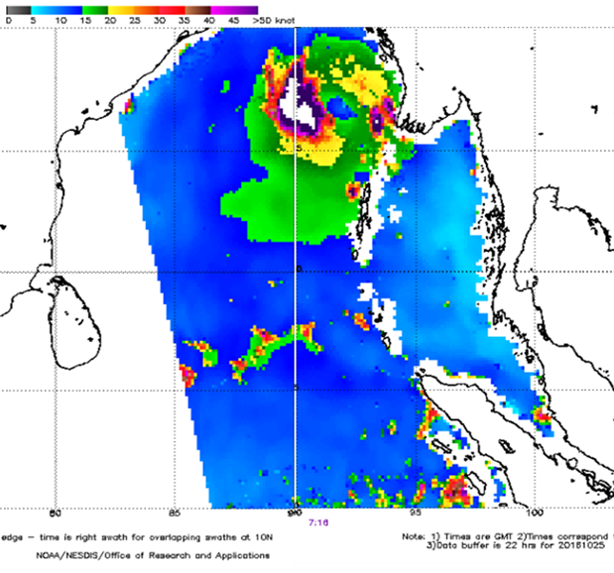
Observations
For recent Tropical Storm Kyant GCOM winds help define structure of the storm
Area of 50 knot winds on west side of storm

Slide 20
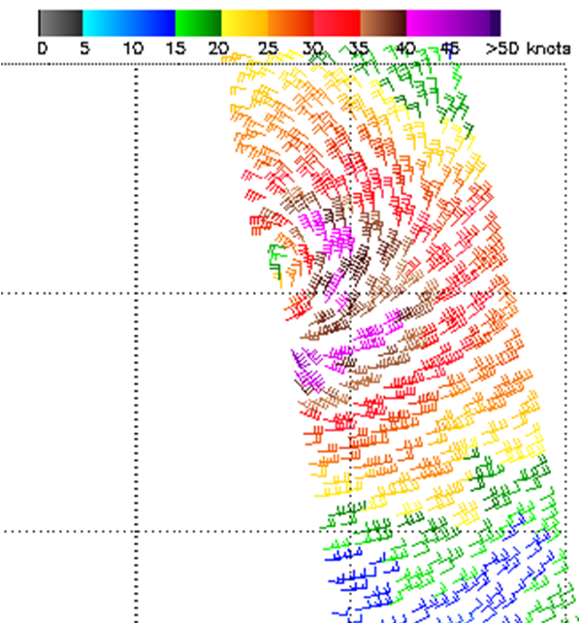
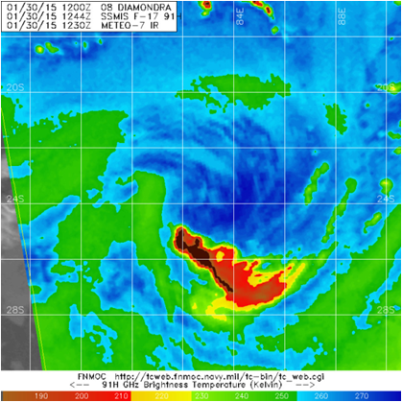
Observations
Tropical Storm Diamondra (2015) ASCAT winds used to determine large radius of maximum winds and transition to a subtropical storm

Slide 21
Moving to higher resolution

Slide 22
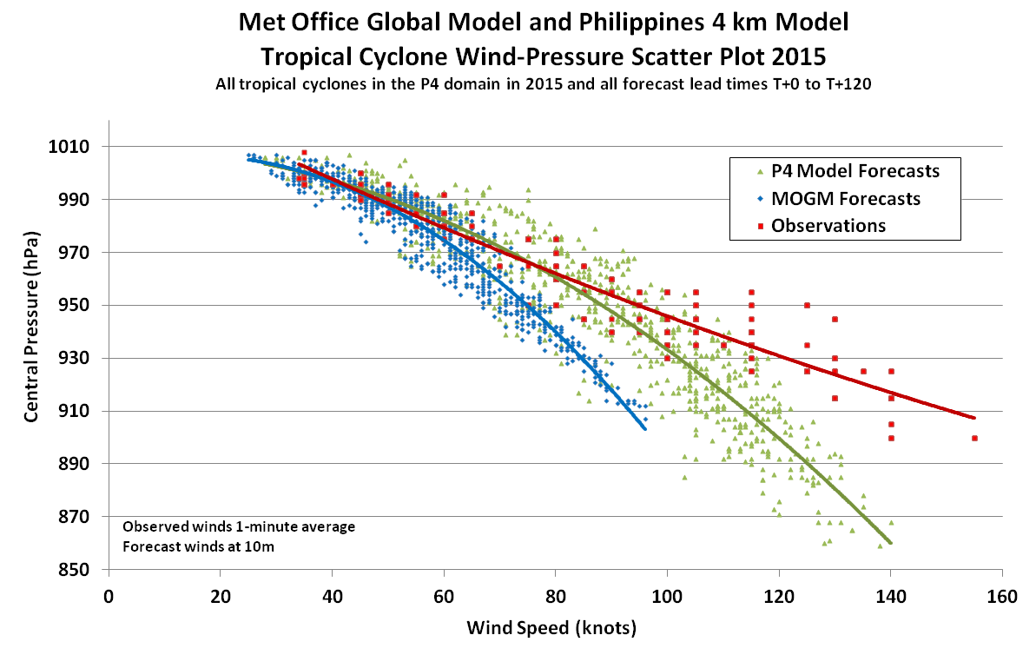
Moving to higher resolution
Met Office 4.4 km resolution model over the Philippines
Global Model downscaler (weak analysis), but quick spin up
Often over-deepens central pressure
Better wind-pressure relationship than Global Model
First results from 10 km resolution Global Model trial
tropical cyclones more intense, particularly in forecast
Atmosphere-ocean coupling will become increasingly important for tropical cyclone modeling

Slide 23
Summary

Slide 24
Summary
Met Office tropical cyclone track forecasts still improving
Intensity predictions also improving, but a weak bias present in the analysis and short period forecast
Analysis of tropical cyclone structure by warning centres benefits greatly from remotely sensed observations
Forecast models (even global) increasingly able to handle high intensity tropical cyclones with tight gradients
Models need observations and data assimilation techniques to better analyse intense tropical cyclones and improve forecasts further

Slide 25
THE END
THE END

