Slide 1

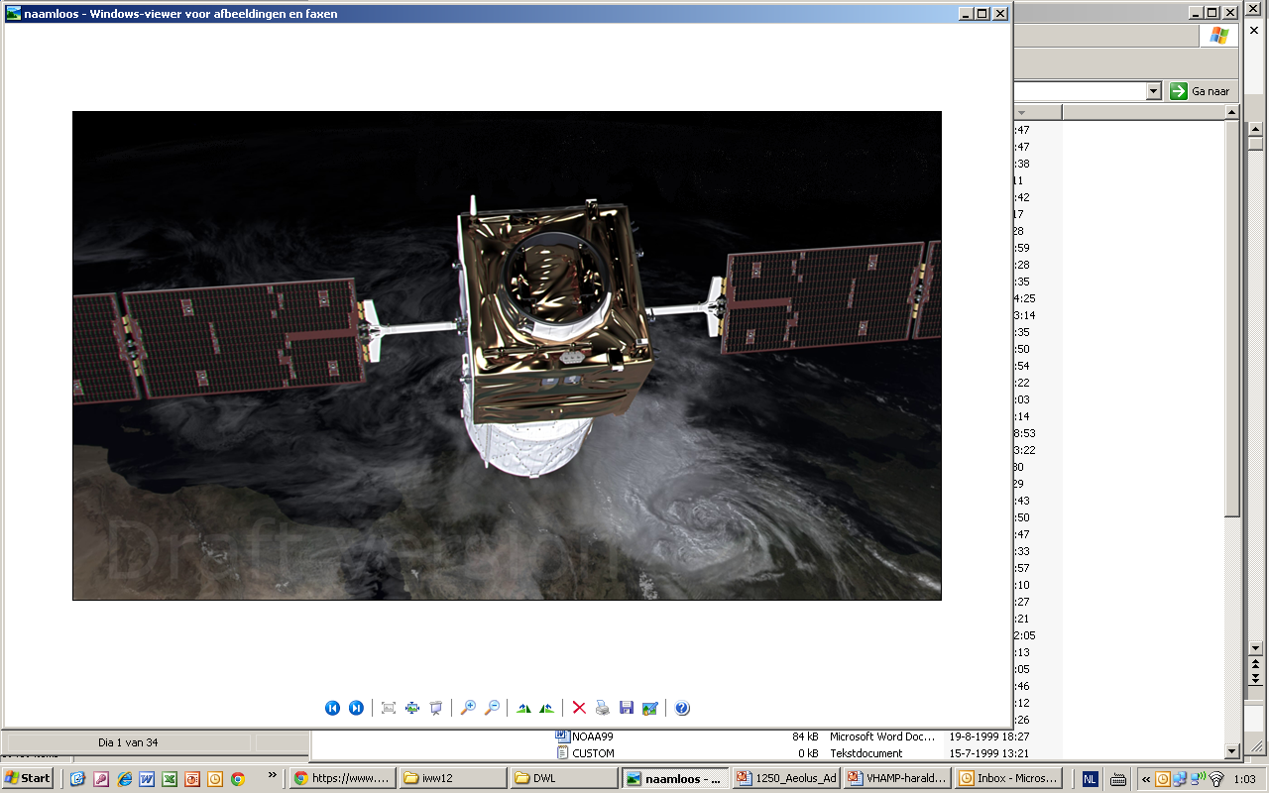

- Aeolus –
The Atmospheric
Dynamics Mission
Ad.Stoffelen@knmi.nl
Industrial Aeolus Team
ESTEC, ESRIN, ESOC A-teams
Aeolus MAG
Aeolus L1 and L2 team
Aeolus Cal/Val teams

Slide 2
Outline
ADM-Aeolus scientific motivation and objectives
Mission and instrument characteristics
Instrument and project status
Processing and data products
Mission CAL/VAL and campaigns
Conclusions

Slide 3
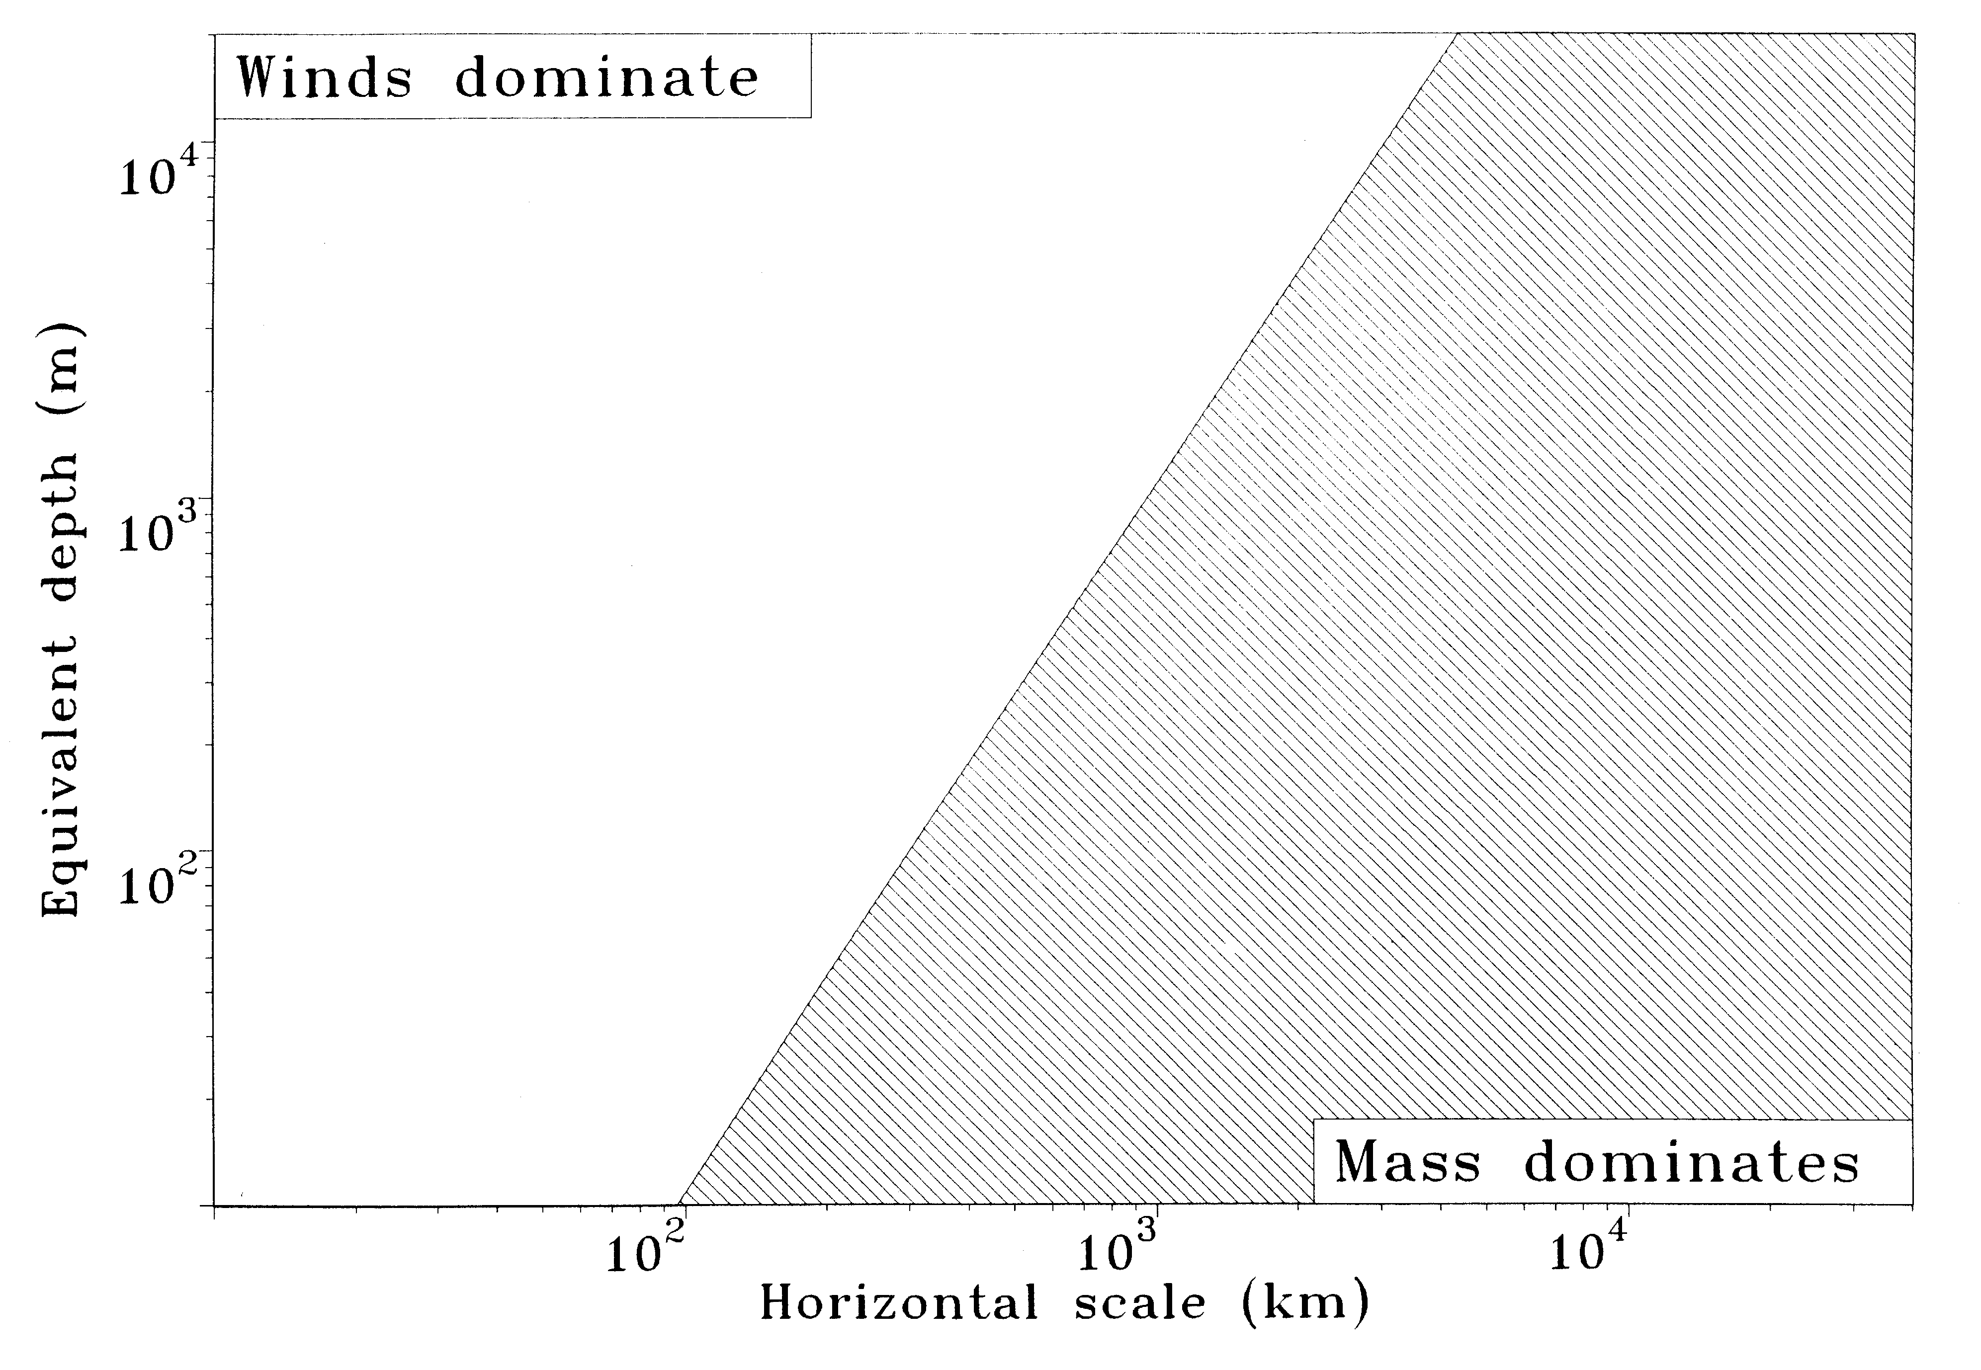
Bus?
Wind determines
weather evolution
mature systems
Slow
Development
Rossby limiet voor 45 N (of 45 Z)
developing systems
Mist Cloud layer Rain colomn
10 V [m] 100 1000 10.000
So:
Measure wind
With more spatial detail
More often, AND
More accurately
Fast
Temperature and pressure for
weather evolution
boundary layer
orographic circulations
storms, fronts
low pressure systems
planetary waves
10 100 1000 10.000 H [km]
Shower Front Storm Climate zone World

Slide 4
Differences in (re)analysis data
NCEP
Tropics
Oceans
Upper air
Baker et al., 2014

Slide 5
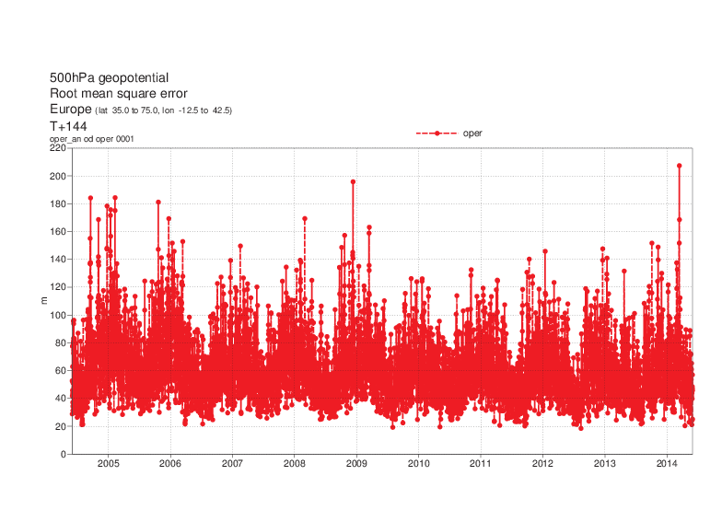
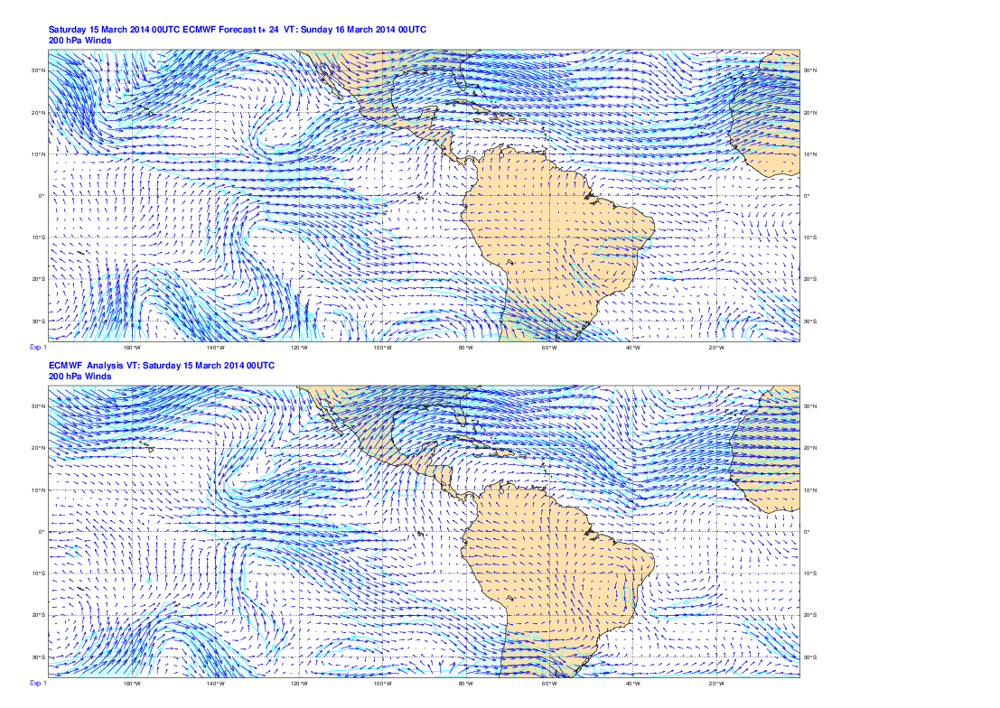
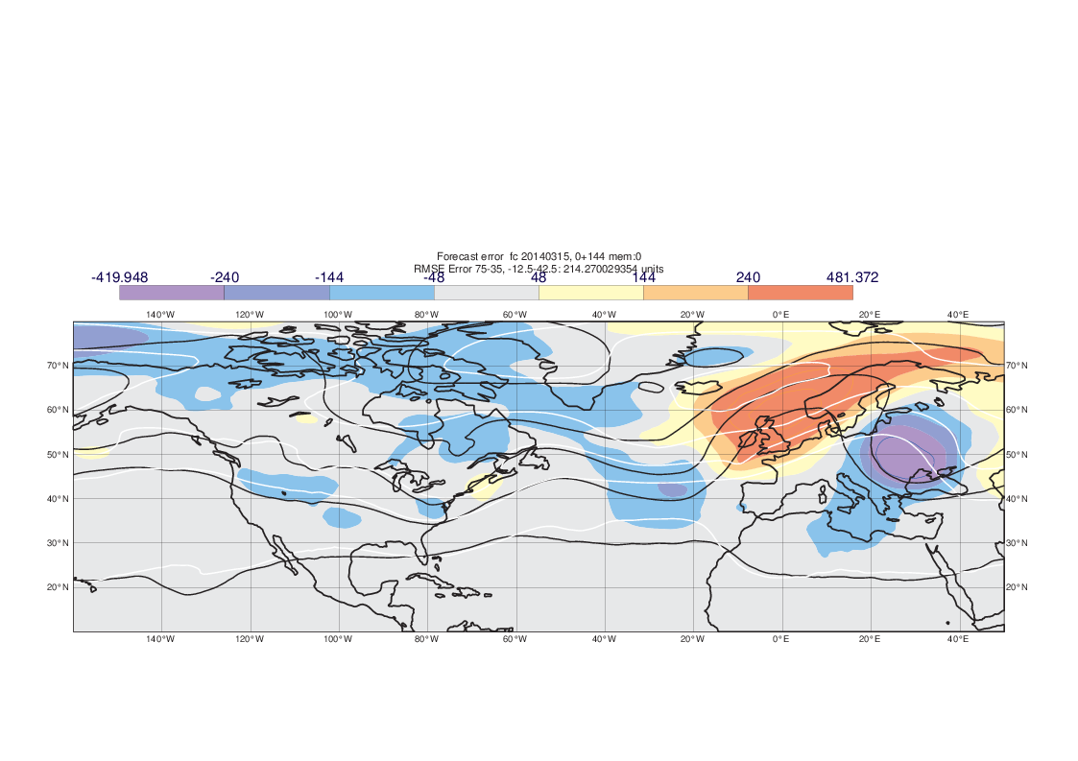
Tropics
A poor forecast
200 mb winds 15 Mar 2014
Tropical errors affect European forecasts on the predictable range
Amplification of error by moist convection
Error Propagation
Day 6
Day 5
Day 4
D3
Day 2
Notes:
But on any given day some forecasts can be poor!
ECMWF suffered a (mercifully extremely rare) data corruption problem on Saturday 28 June, which I’ll ask Florence just to say something about briefly.
If we come back to an occasion where the issue was meteorological rather than data corruption. On 15 March 2014 ECMWF had its worst 6 day forecast for over a decade!
Forecast had a ridge over western Europe and a trough over central Europe whereas in fact the flow was essentially zonal.
Largest EDA spread on the globe was over the eastern tropical Pacific and the signal of this reached Europe 6 days later.
2-3 days into the forecast strong convection appeared over southern U.S. and amplified the propagating error.
This indicates the importance of improved observations of tropical winds and the launch of the Aeolus satellite next year should help. It also suggests that the process of amplification of errors by convection needs to be understood better.

Slide 6
Absolute analysis increments u₁₅₀
18UTC average for Sept-Nov 2015
Full field
Balanced
Unbalanced
Dynamical errors in the tropics and in moist convection are mostly unbalanced and 3D winds are needed to observe them, hence Aeolus
Unbalanced

Slide 7
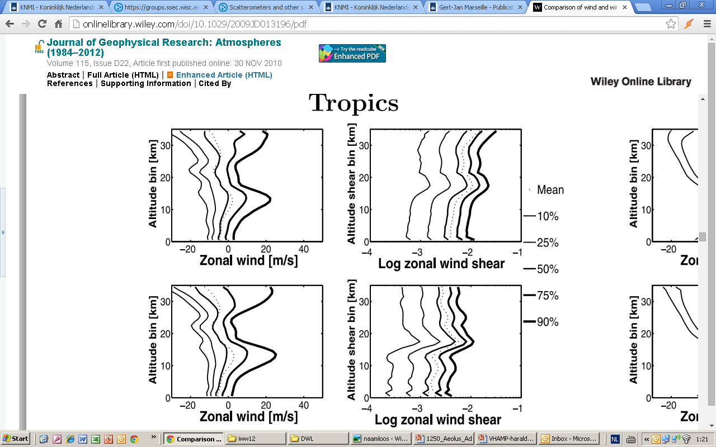
Hi-res radiosonde shear
ECMWF winds agree very well with sondes
Vert. shear in ECMWF model 2-3 times lower, however
Large tropical tropopause shear gradient
Shear determines mixing of air, air interaction, cloud dyn., ..
Houchi et al. 2010
Tropics
RAOB
RAOB
ECMWF
ECMWF

Slide 8
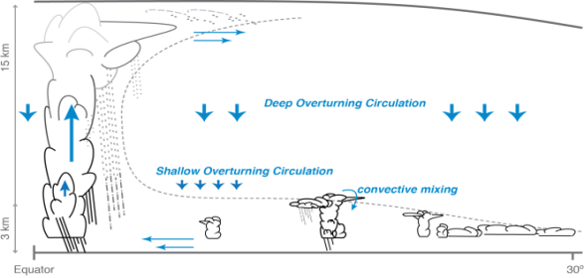

Importance for winds for climate applications
Example of Grand Challenges of the World Climate Research Programme
  Understanding coupling Troposphere and Stratosphere dynamics and its impact on climate variability
  Role of dynamically driven cloud circulation interactions for climate sensitivity
Courtesy S. Bony, B. Stevens

Slide 9
Importance of winds for climate applications
Example of Grand Challenges of the World Climate Research Programme
  Understanding coupling Troposphere and Stratosphere dynamics and its impact on climate variability
  Role of dynamically driven cloud circulation interactions for climate sensitivity
Tropical ozone strongly impacted by UTLS dynamics (e.g. convection, gravity waves, planetary waves)
Role of dynamics in formation of ozone holes in Arctic
Energy exchange atmosphere and ocean, …

Slide 10

Aeolus Mission Objectives
Scientific objectives
To improve the quality of weather forecasts
To advance our understanding of atmospheric dynamics and climate processes
Explorer objective
Demonstrate potential for operational use of space-based Doppler Wind LIDARs (DWL)
Observations
Global measurements of single line-of-sight wind profiles in the troposphere and lower stratosphere
Spin-off products are atmospheric extinction and backscatter profiles
Payload
ALADIN: Atmospheric LAser Doppler INstrument

Slide 11
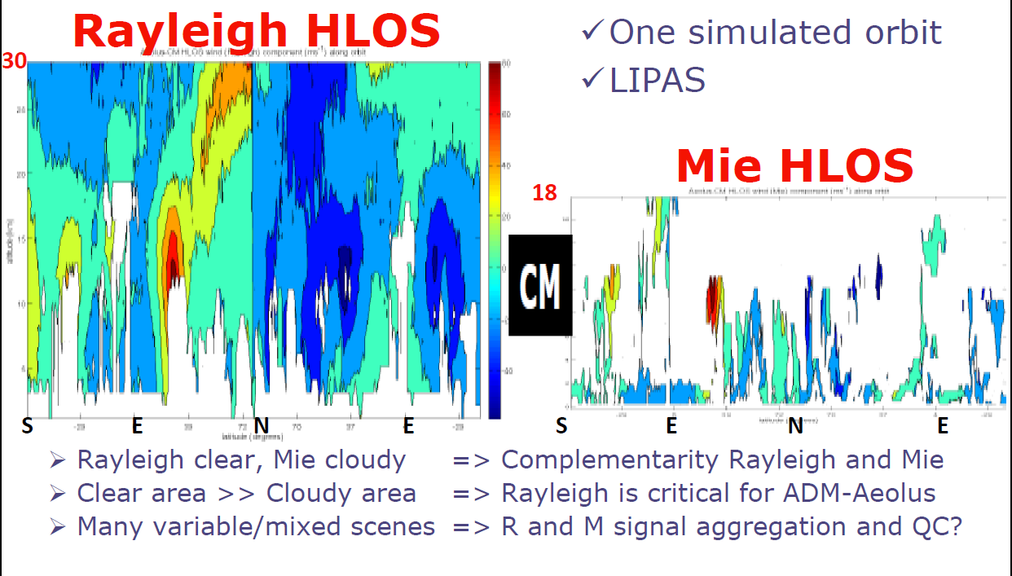
What will we see?

Slide 12
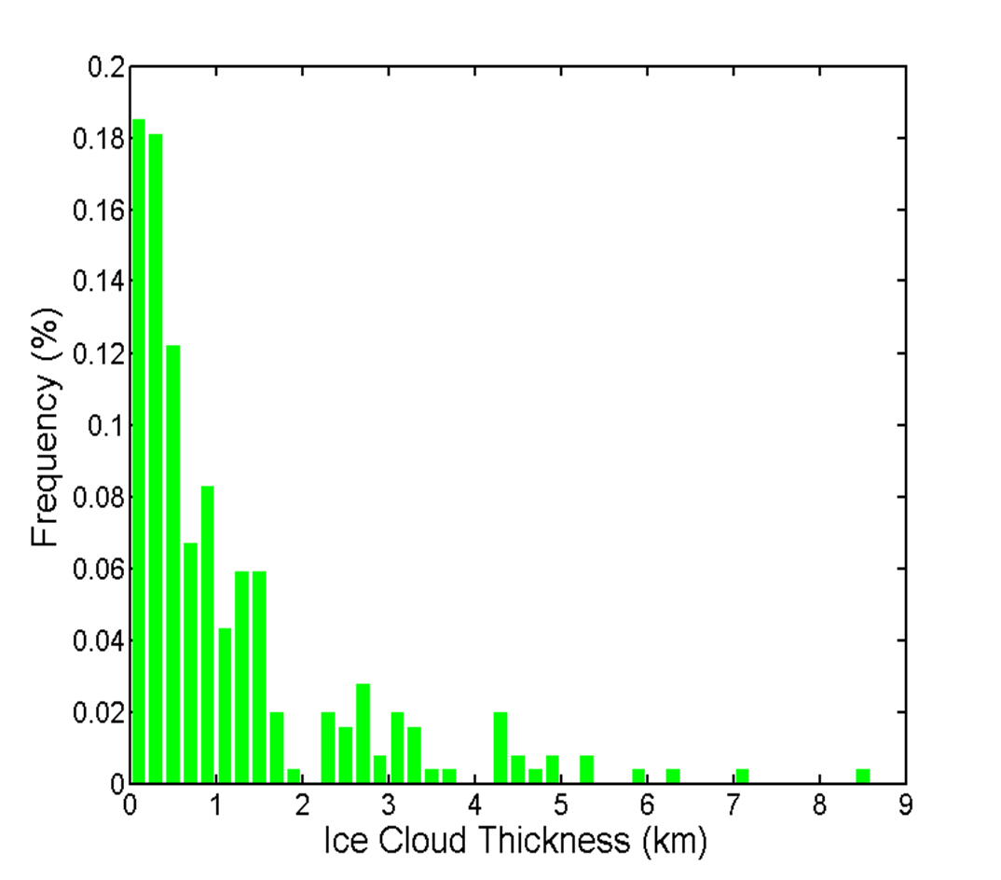
Cloud layer statistics from radiosondes
Aeolus height bins are typically 1 km
But, 1/3 of cloud layers are thinner than 400m
Such layers cause non-uniform Mie backscatter and extinction
Mean backscatter height will be uncertain
Wind and wind shear will be biased
(mean shear = 4 m/s per km height)
Advanced retrieval methods will be needed
Wei et al., 2014

Slide 13
Cloud/aerosol layer inside Aeolus bin
2-way cloud layer transmission: 0.7
10 m/s /km wind wind shear
30 m/s
Mie error
Rayleigh error
30.0 +10.0 25.10 +0.10
Mie wind errors are very sensitive to
atmospheric heterogeneity !!
27.5 +2.5 25.36 +0.36
1 km
25.0 +0.0 25.44 +0.44
27.5 +2.5 25.30 +0.30
20.0 -10.0 25.07 +0.07
20 m/s
Aeolus wind error can be large depending on (i) bin size, (ii) cloud/aerosol layer location inside the Aeolus bin, (iii) layer size, (iv) layer transmission and (v) wind-shear over the bin
Notes:
((1-f)*((30)+(10*f+20))/2+t*f*((10*f+20)+20)/2)/(1-f+t*f); t=2-way cloud transmission, f = cloud location in bin in [0,1]

Slide 14
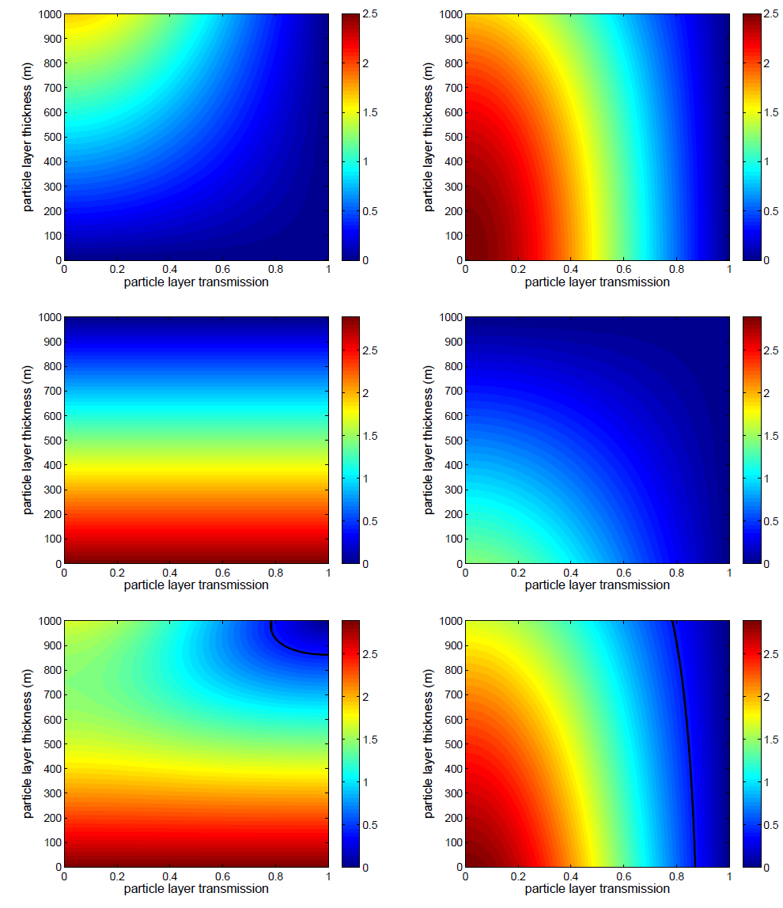
RMSE wind error
m/s
m/s
Mie Rayleigh
Rayleigh ΔHLOS insensitive to Δz
τ_{c} can be obtained from Aeolus optics
Rayleigh winds are under control
Mie ΔH however sensitive to Δz
τ
Δz
cloud layer
Bin height

Slide 15
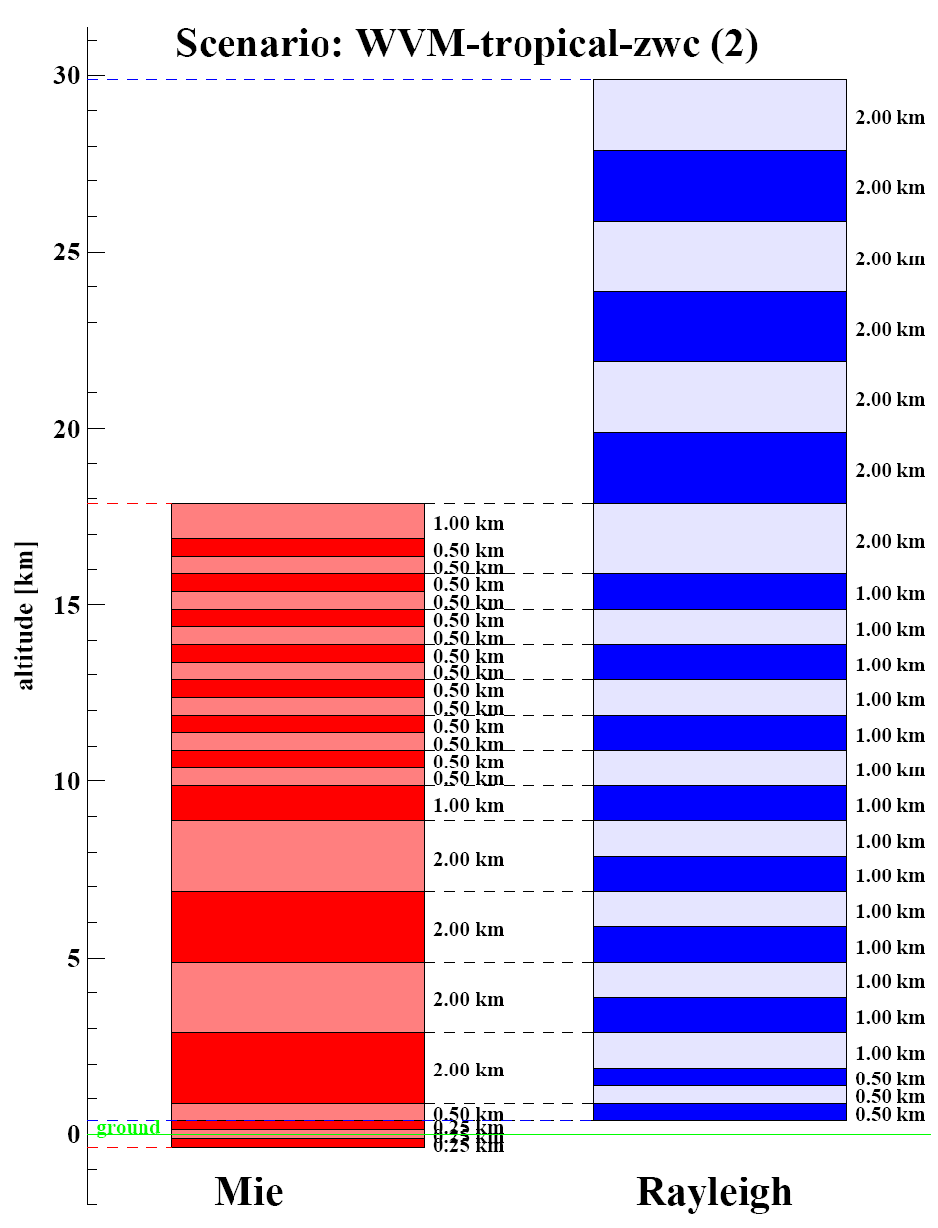
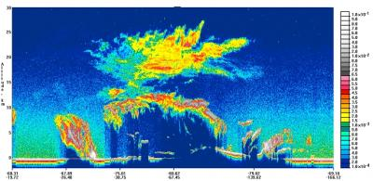
Polar Stratospheric Clouds
Quite a lot over Antarctic in August and Arctic in January
30 km
15 km
Mainly sampled by molecular channel

Slide 16
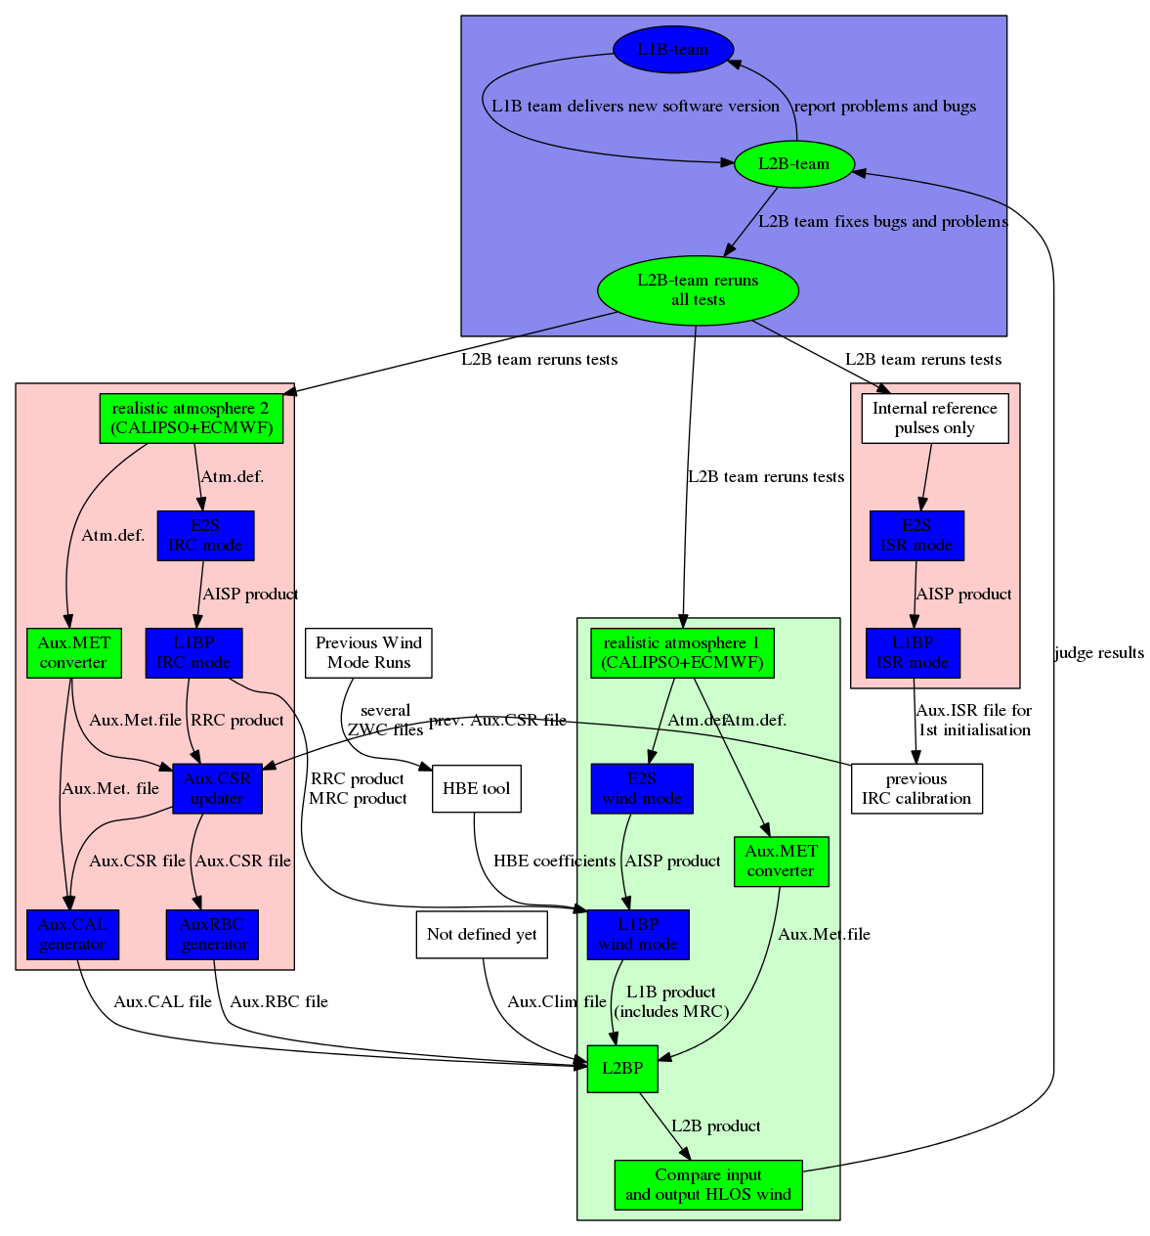
Forward
Engineering
KNMI developed a
Chain of Processors
to aid cal/val
feedback process
Mission success depends on reverse
engineering generally (in cal/val)

Slide 17
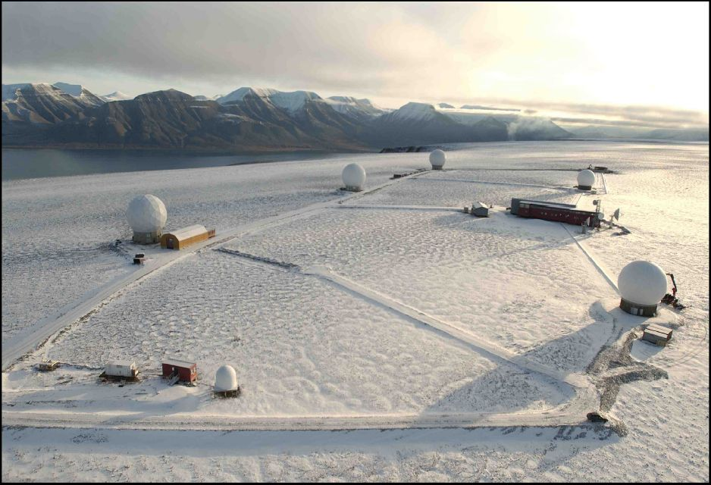
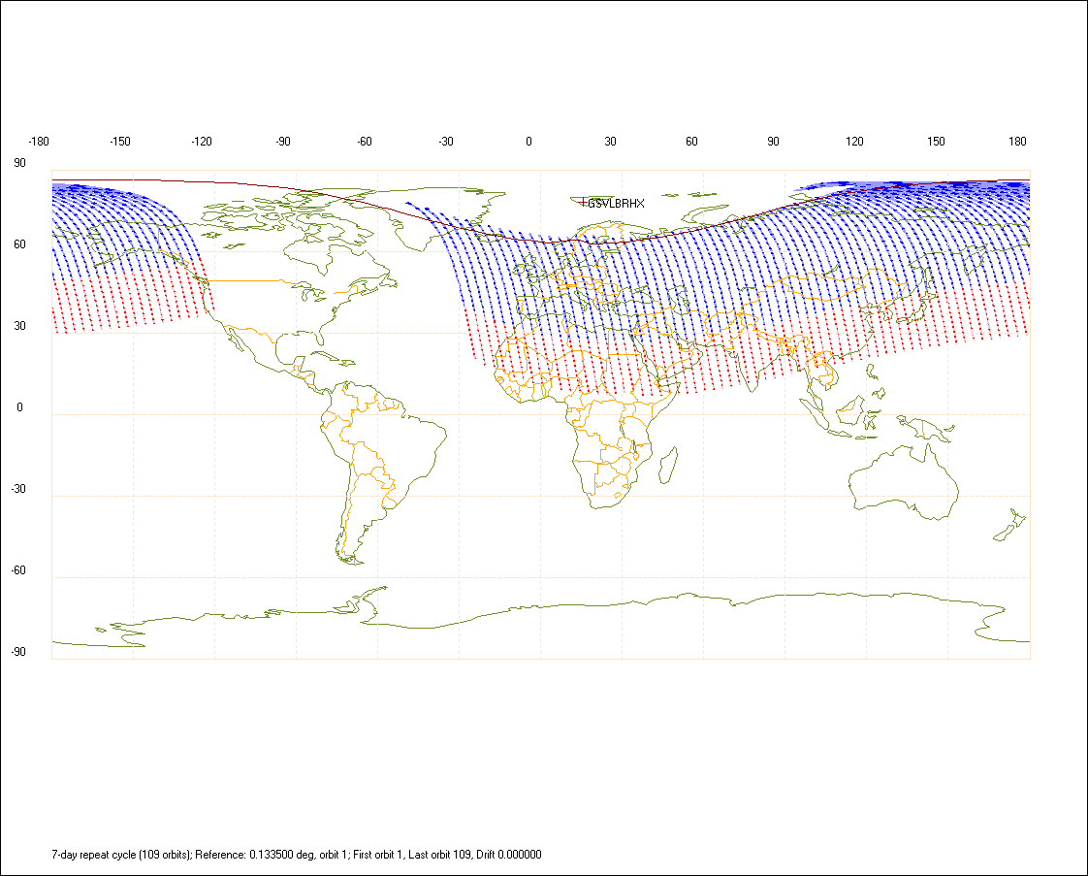
Quasi Real-Time (QRT)
QRT coverage
Dumps to Svalbard X-band station
Courtesy KSAT
QRT service: delivery of L1B BUFR to users within 30 min.
Explore possibility of L2B BUFR delivery to users in QRT/NRT to
enable regional short-range forecasting benefit

Slide 18
Prospect based on HiRLAM operations
~70-100% of Aeolus QRT L2B winds can be
used in current HiRLAM implementations
< 50% of Aeolus NRT L2B winds can be
used in HiRLAM
  These numbers vary for other NRT and QRT specs.
There is a general tendency to 3-h/1-h cycling
and fast cut-off in the coming years to
better exploit fast observations (like EARS),
increasing the need for QRT delivery in regional
NWP

Slide 19
What if Aeolus is a success?
13th International Winds Workshop, Monterey, 27 June - 1 July 2016
Draft report to WMO CGMS from Working Group 2 (WG2): Data Assimilation
6. New satellite mission proposals
There continues to be an unmet requirement of wind profile observations with sufficient global and temporal coverage. The group is looking forward to Aeolus data which will give profiles of line-of-sight winds, but notes that currently there is no secure follow-on mission. Some proposed missions with potential have been presented at the workshop.
Recommendation to space agencies: to implement satellite missions that allow the provision of wind profile / dynamical information with global coverage (e.g., DWL, hyperspectral IR with high temporal frequency and spatial resolution). .
Low-cost pre-design study?

Slide 20
Summary
Expectations of the impact of Aeolus remain high
Main improvements are expected in the tropical dynamics, the upper air and in the representation and parameterisation of dynamical processes, such as gravity wave drag, (moist) convection and turbulence
Data processing studies have been performed and errors assessed; subtleties in optical and wind processing appear important, certainly near clouds
A chain of calibration and wind processors is developed
To support the operational meteorological community, QRT/NRT ingestion is facilitated by ESA in the Ground Segment up to L1B
The cal/val phase will be an exiting time where the
A-team looks forward to!
Aeolus is a demonstrator in preparation for a follow-on

Slide 21
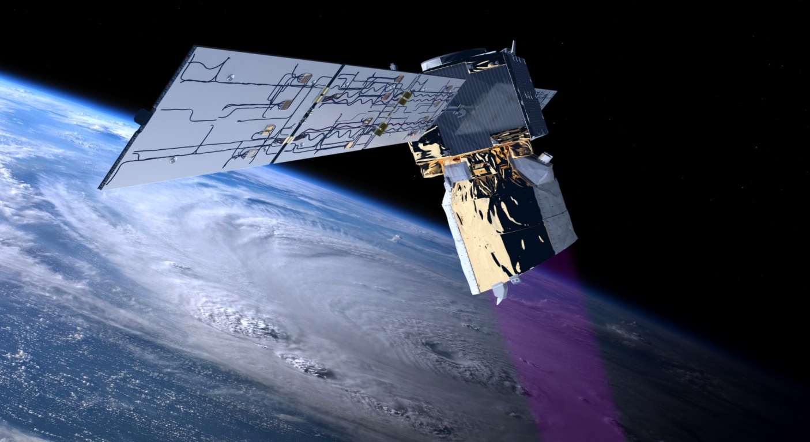
An artist’s view of Aeolus in flight
http://www.esa.int/livingplanet/ADM-Aeolus

Slide 22


