Slide 1
Blending multiple-source wind data including SMOS, SMAP and AMSR-2 new products
Joe TENERELLI, Fabrice COLLARD
OceanDataLab, Brest, France

Slide 2
SENSORS AVAILABLE FOR BLENDING
SMOS and SMAP for L-band
AMSR-2: on GCOM-W1; LTAN 1:30 PM; Swath width 1450 km.
But also :
METOP A/B: C-band radar; Double 500 km swaths. LTAN around 9:30 PM.
WindSat: fully polarimetric radiometer; several frequencies (not all FP) from 6.8 to 36 GHz; LTAN 6 PM (aligned with SMAP but not SMOS). Swath width 1000 km.
SSMI F16/F17:LTAN 4/6 PM (close to WindSat). Swath width 1400 km.
GMI: On GPM satellite with no fixed LTAN; Swath width 930 km.
RAPIDSCAT: Ku-band radar; Two beams with 900/1100 km swaths; Installed on ISS; Data since end of 2014. No fixed LTAN. Altitude around 400 km.
For AMSR-2 we use both retrievals using the method of RSS and Zabolotskikh et al. 2015, 2016 (to reduce rain impact).
For Metop A/B we use the retrievals using both the method of RSS and KNMI.

Slide 3
Review of Morphing Methodology
One approach for combining non-synoptic satellite wind speeds to create synoptic wind maps is to use variational data assimilation together with an atmospheric model.
A simpler approach, tested here, is to propagate the satellite wind speeds in time using propagation fields derived from the evolution of the wind in some atmospheric model (such as ECMWF). The propagation fields are derived by appyling an optical flow algorithm to the model wind speed fields. This is based on the assumption that storm structure evolution is continuous in time.

Slide 4
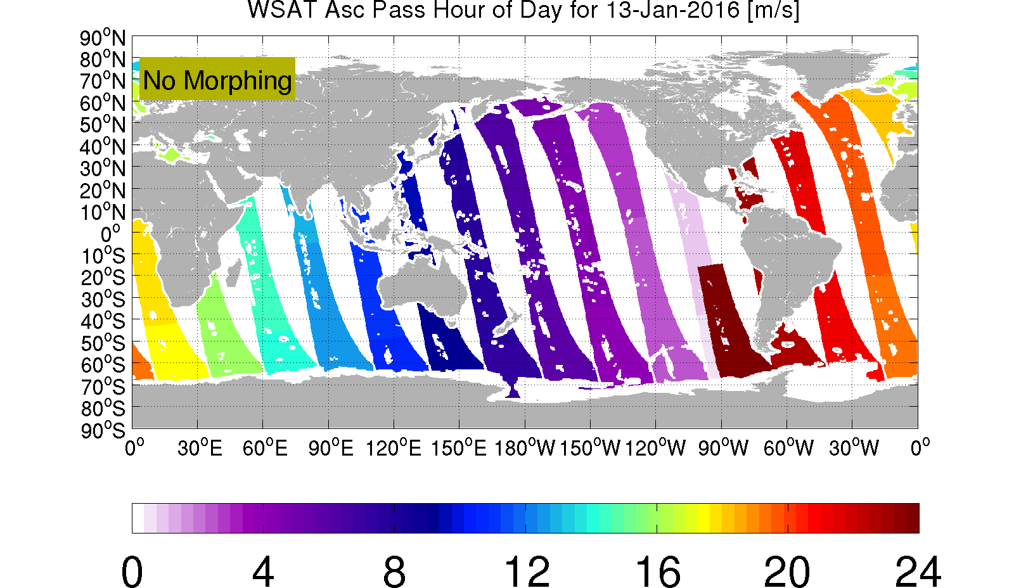
Objective: Create global maps of wind speed at some fixed time from satellite measurements distributed over many hours.
As an illustration of the typical distribution of measurement time for a LEO sun-synchronous satellite, the plot below shows typical hour of day (UTC) of ascending pass swaths for WindSat.

Slide 5
One approach (a spatially ‘local’ approach) is to use the time series of satellite measurements at any fixed point on earth to infer the wind speed at any arbitrary time at that point within the time period of these measurements (CCMP approach)
Another approach (a spatially ‘nonlocal’ approach) involves propagating some set of satellite measurements in space and time from the time of measurement to some arbitrary time. This propagation involves applying some sort of flow field to the measurements (note that this ‘flow’ does not necessarily correspond to the physical flow). In doing this propagation, some assumptions must be made about how the retrieved wind speed evolves following this ‘flow’ (lagrangian evolution).

Slide 6
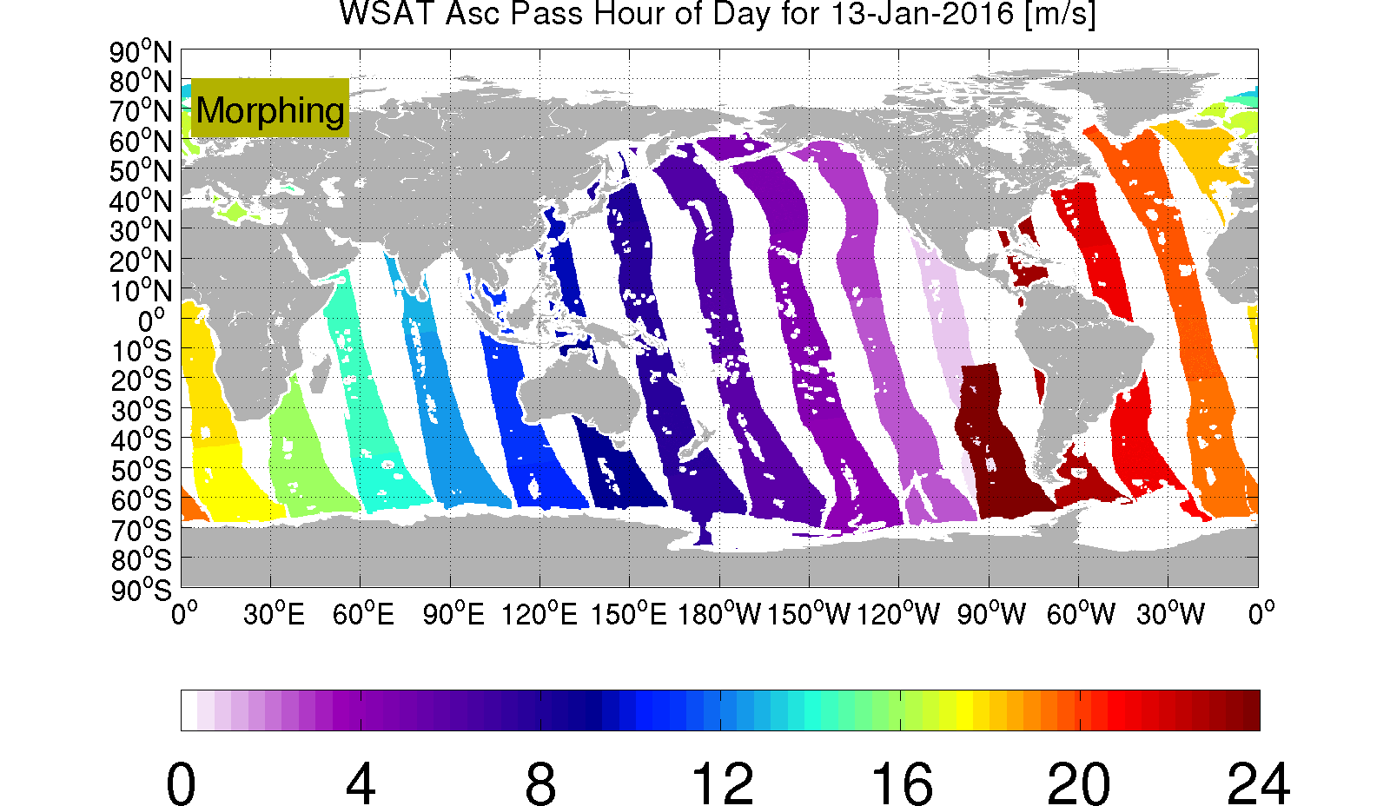
One approach (a spatially ‘local’ approach) is to use the time series of satellite measurements at any fixed point on earth to infer the wind speed at any arbitrary time at that point within the time period of these measurements.
Another approach (a spatially ‘nonlocal’ approach) involves propagating some set of satellite measurements in space and time from the time of measurement to some arbitrary time. This propagation involves applying some sort of flow field to the measurements (note that this ‘flow’ does not necessarily correspond to the physical flow). In doing this propagation, some assumptions must be made about how the retrieved wind speed evolves following this ‘flow’ (lagrangian evolution).
This propagation is typically referred to as ‘morphing’.
Example of propagated swaths

Slide 7
One approach (a spatially ‘local’ approach) is to use the time series of satellite measurements at any fixed point on earth to infer the wind speed at any arbitrary time at that point within the time period of these measurements.
Another approach (a spatially ‘nonlocal’ approach) involves propagating some set of satellite measurements in space and time from the time of measurement to some arbitrary time. This propagation involves applying some sort of flow field to the measurements (note that this ‘flow’ does not necessarily correspond to the physical flow). In doing this propagation, some assumptions must be made about how the retrieved wind speed evolves following this ‘flow’ (lagrangian evolution).
This propagation is typically referred to as ‘morphing’.
Example of propagated swaths

Slide 8
Here we adopt the second approach and attempt to propagate (or ‘morph’) all satellite swaths within a symmetric window about the desired analysis time to the analysis time. The window width is taken to be 24 hours to allow construction of complete global wind speed maps from available satellite data.
swath propagation or morphing

Slide 9
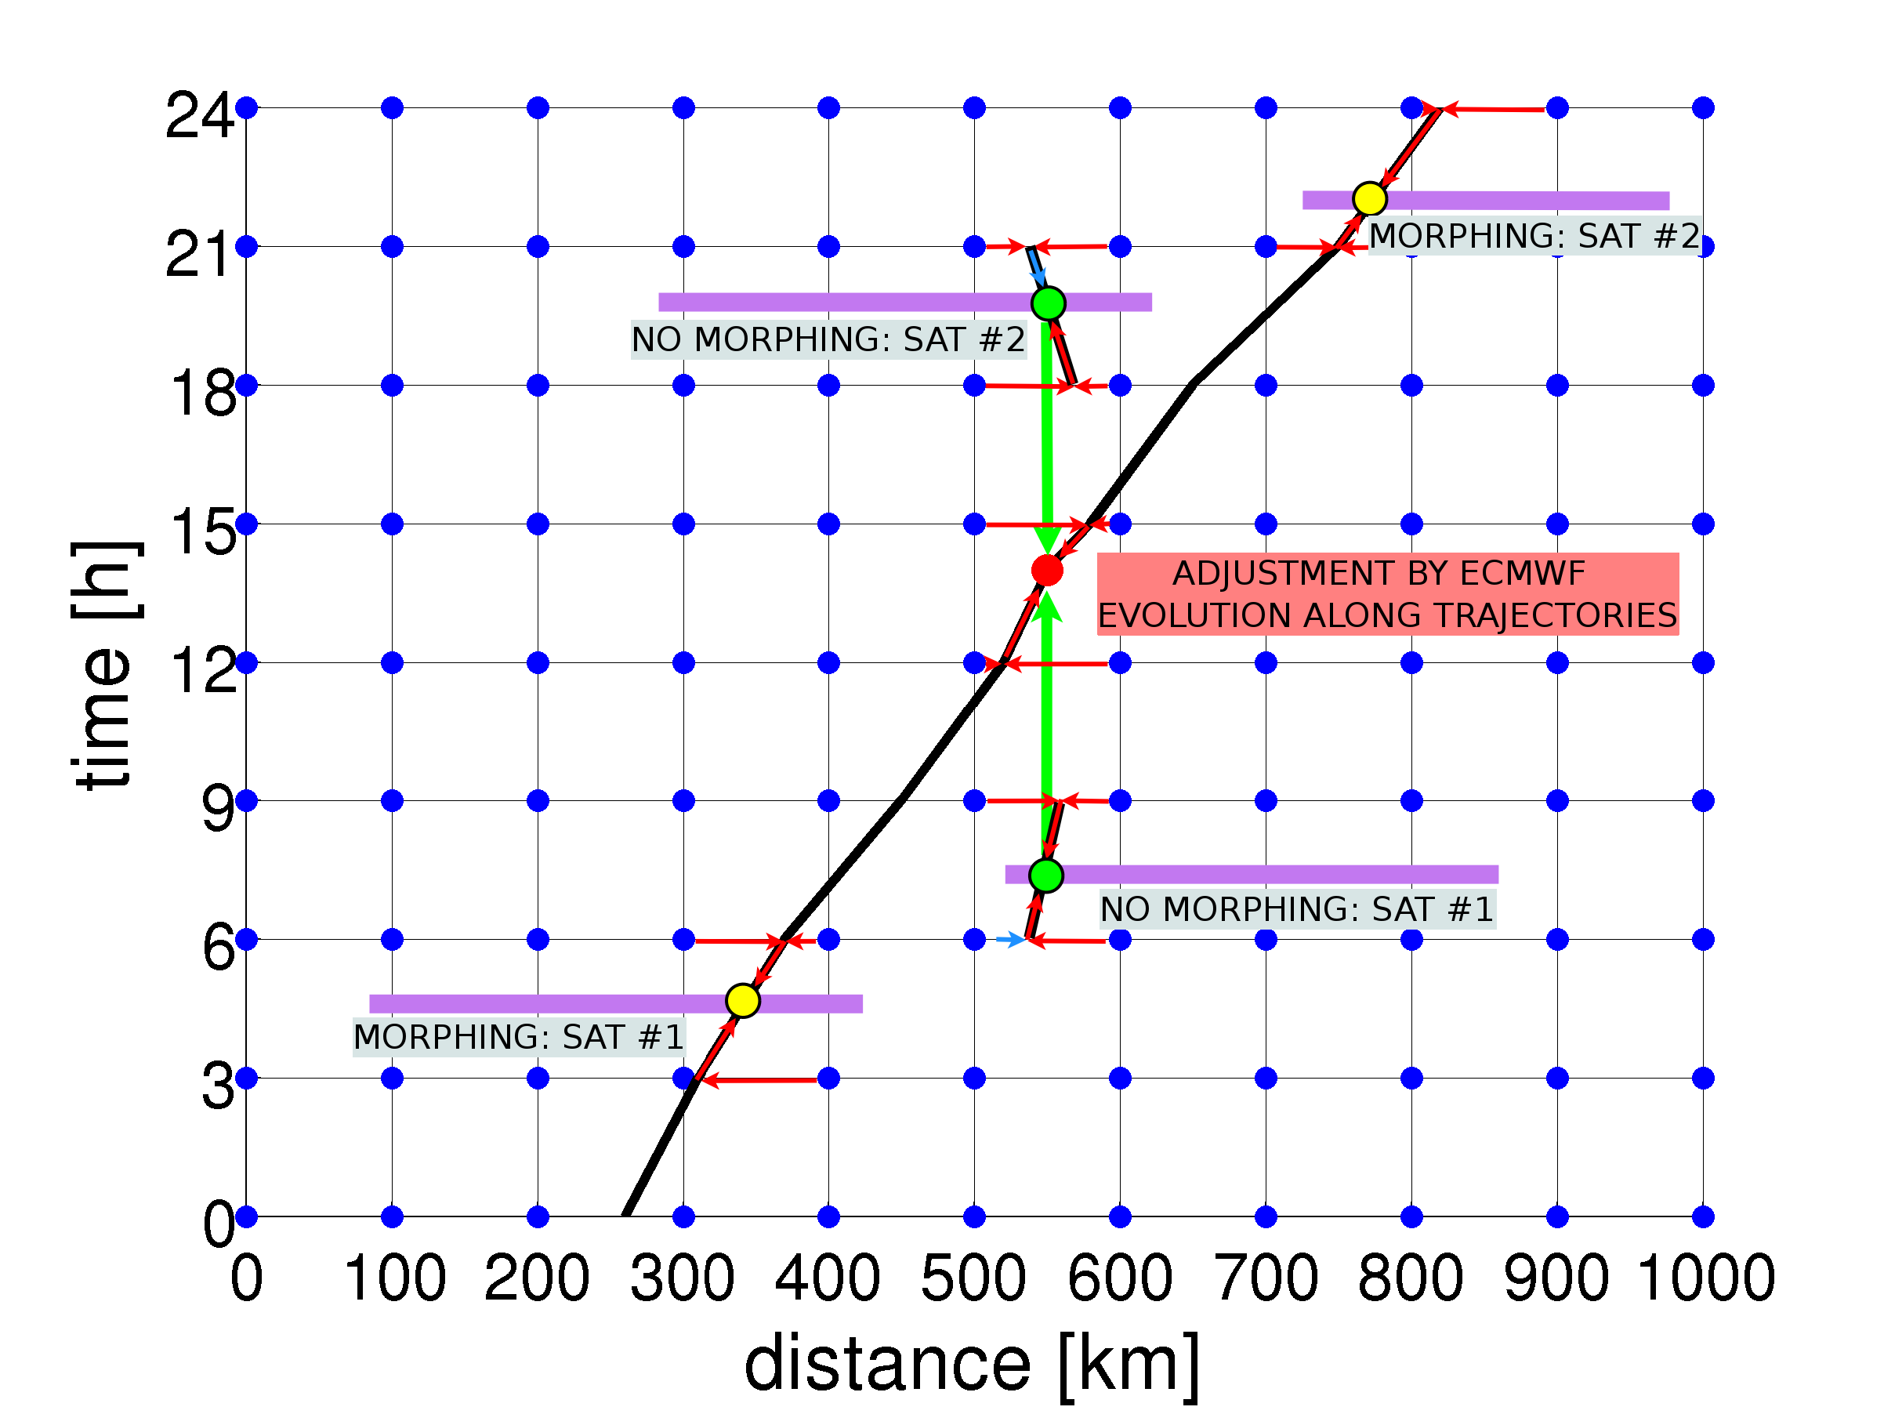
Sketch of Method in One Space Dimension

Slide 10
But we need to calculate the flow field used to propagate the swaths…

Slide 11
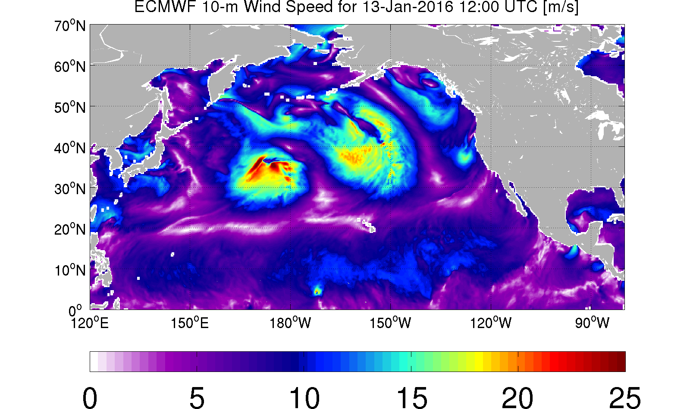
Here we use 3-hourly ECMWF analysis and forecasts wind speed fields and derive the flow field using an optical flow algorithm applied to the wind speed.

Slide 12
The flow is computed using a multi-level approach whereby the flow is computed on successively smaller scales in order to capture potentially large displacements (the ‘pyramid’ approach).

Slide 13
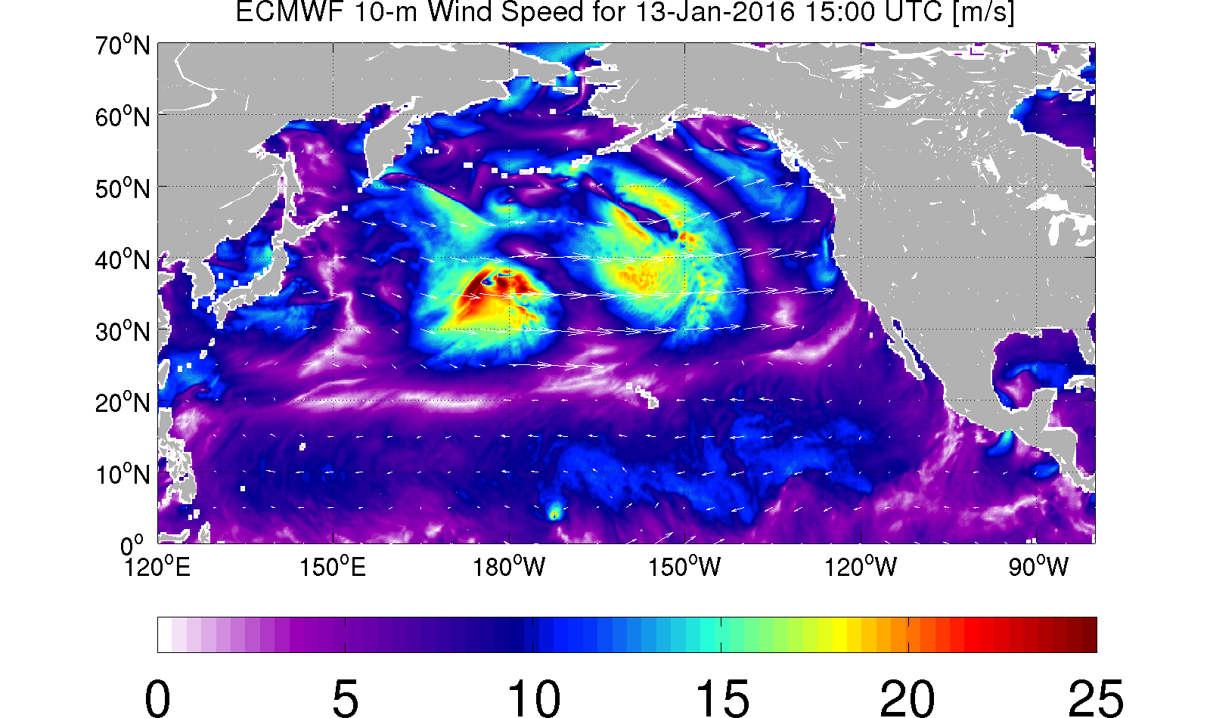

Slide 14
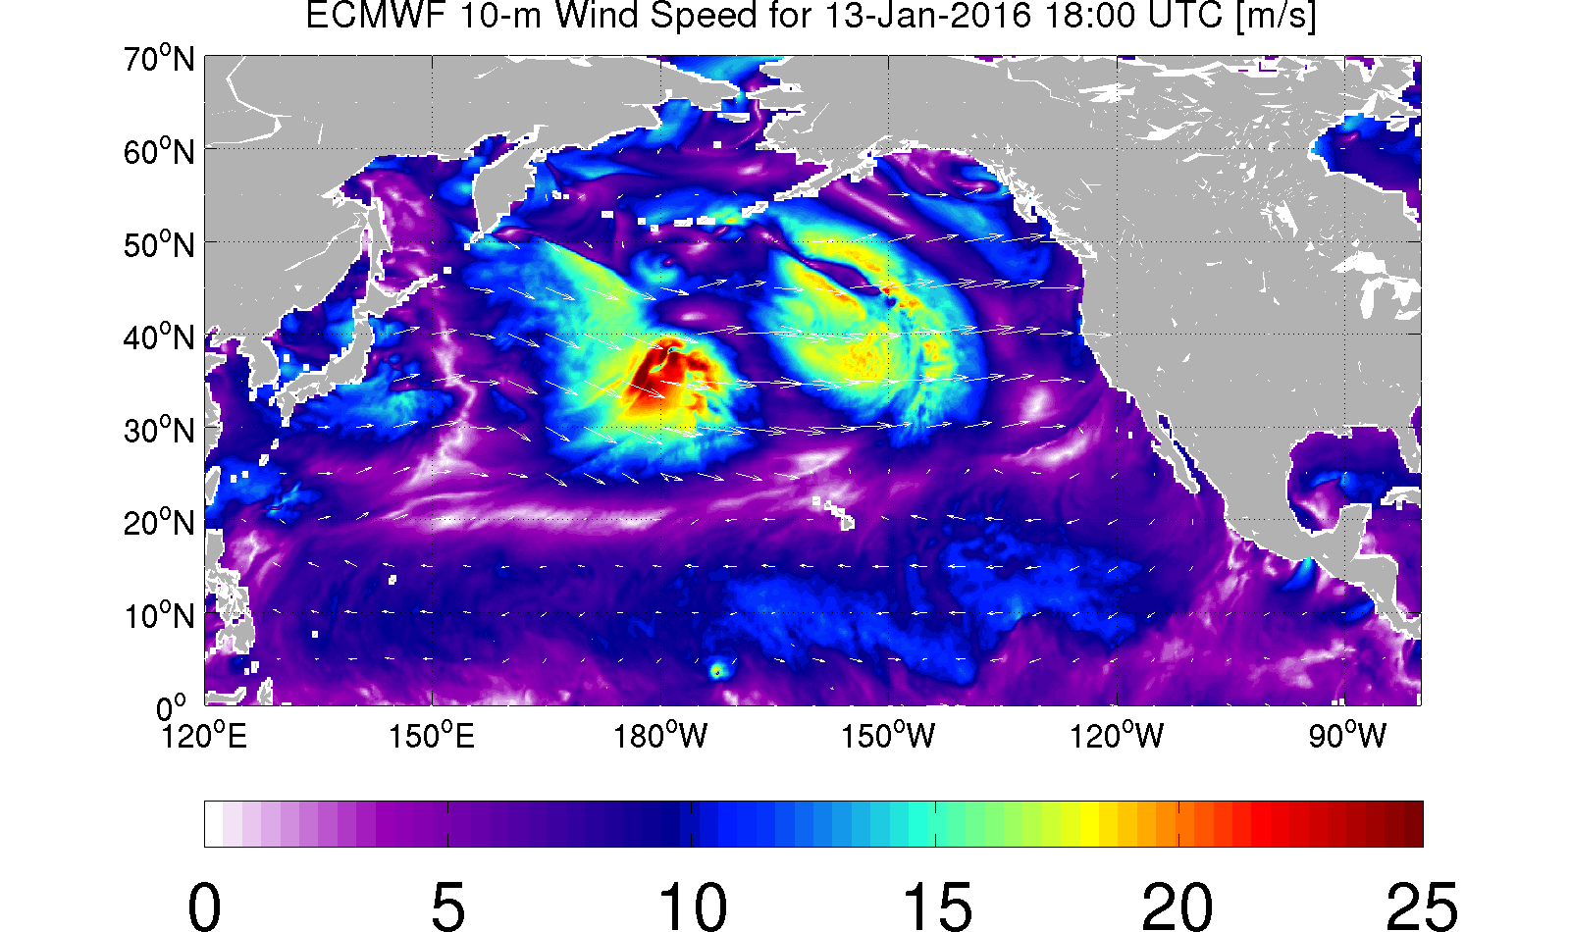

Slide 15
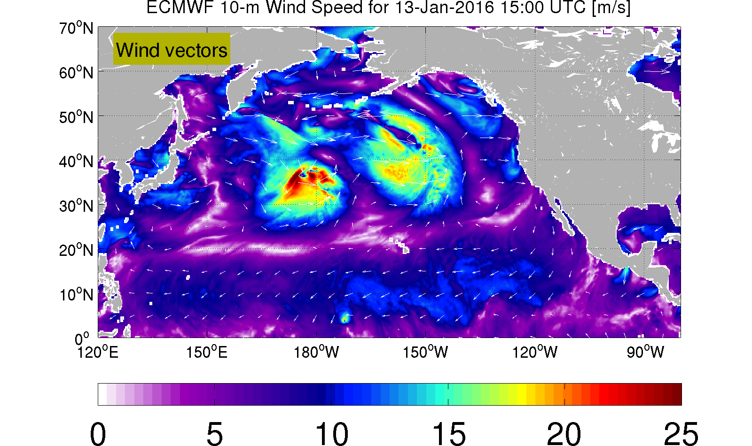
Below is shown the evolution of the ECMWF wind speed and the ECMWF wind vectors to illustrate how the wind speed field does not ‘propagate’ with the local flow.
In fact with the optical flow we are attempting to infer the evolution of the wind speed field associated with wave propagation (not simply advection).

Slide 16
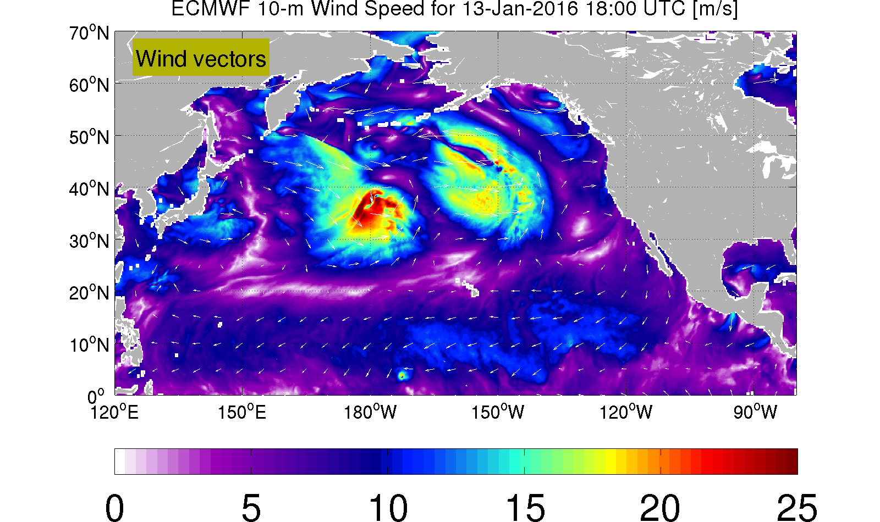
Below is shown the evolution of the ECMWF wind speed and the ECMWF wind vectors to illustrate how the wind speed field does not ‘propagate’ with the local flow.

Slide 17
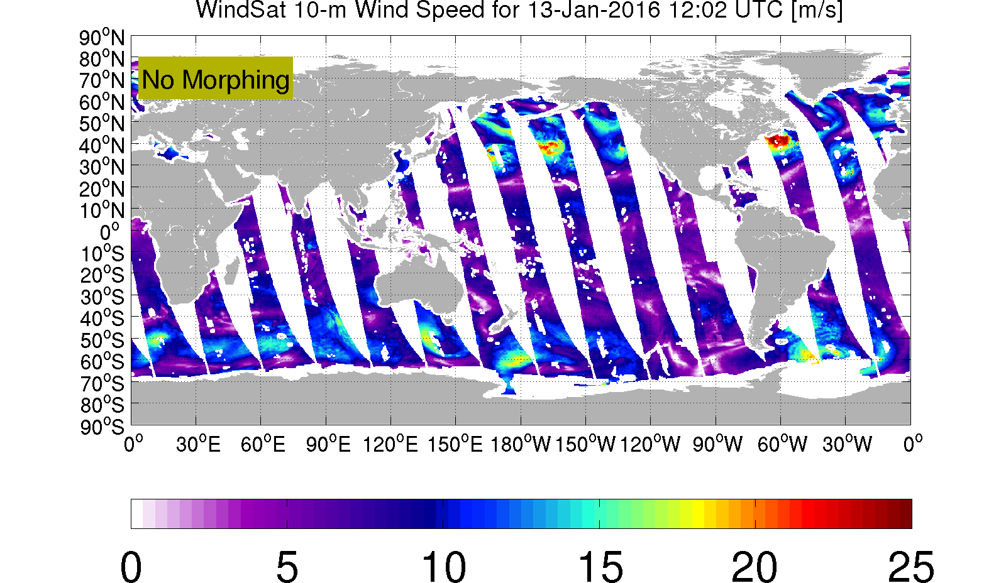
As an example of the optical flow morphing, below is shown the 10-m wind speed derived from WindSat brightness temperatures (obtained from Remote Sensing Systems) for ascending passes for 13 Jan 2016.

Slide 18
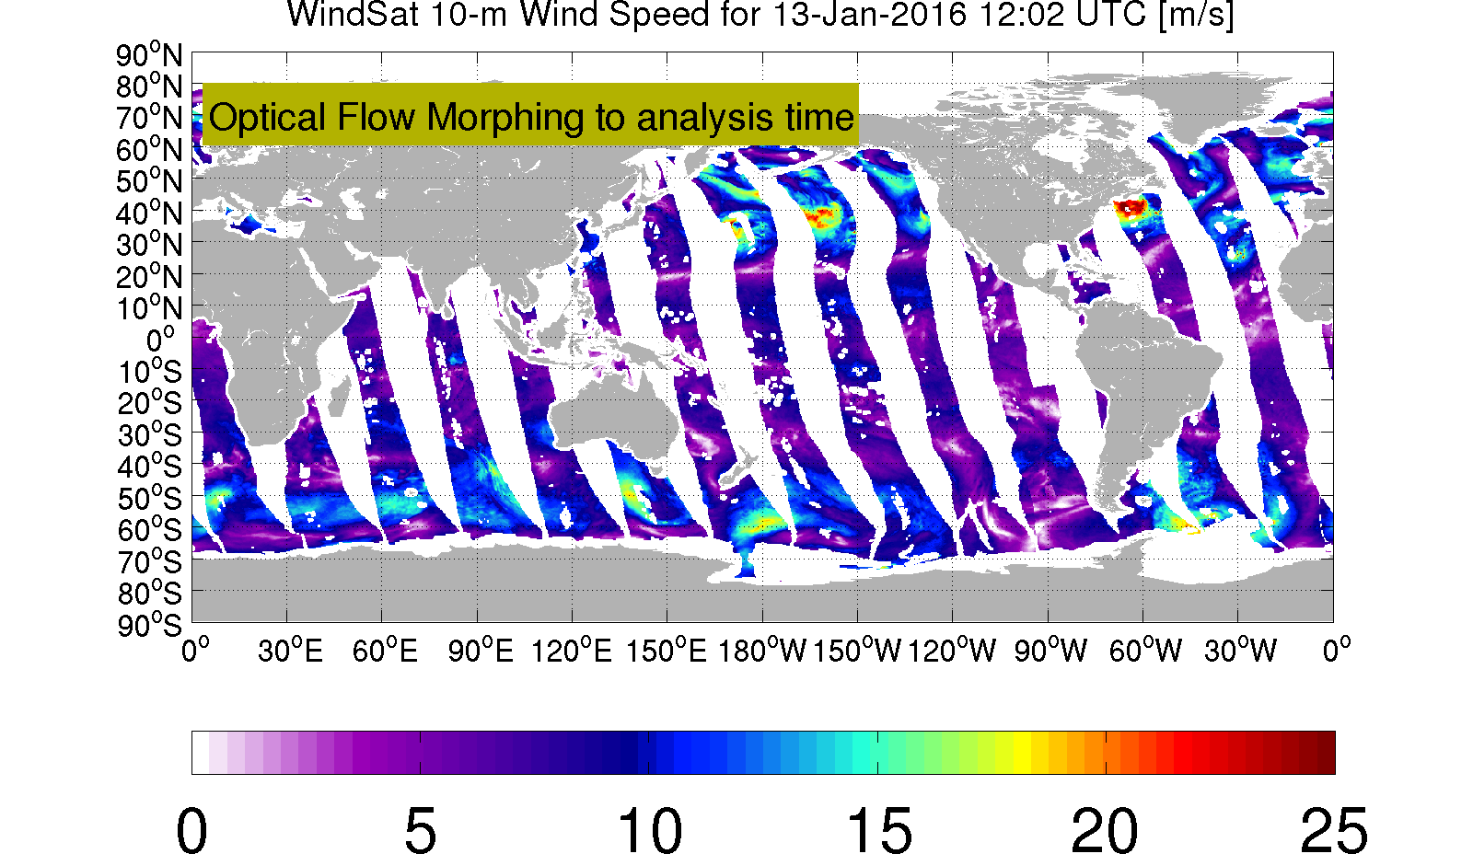
These non-simultaneous winds are then used to make a map valid at a single analysis time by propagating the swaths with the ‘flow’ field derived from the optical flow algorithm as applied to the successive 3-hourly ECMWF wind fields. Note that as we use data within a symmetric 24-h window about the analysis time, the data may require up to 12 hours of propagation, which involves the optical flow fields computed between four pairs of ECMWF wind speed maps.

Slide 19
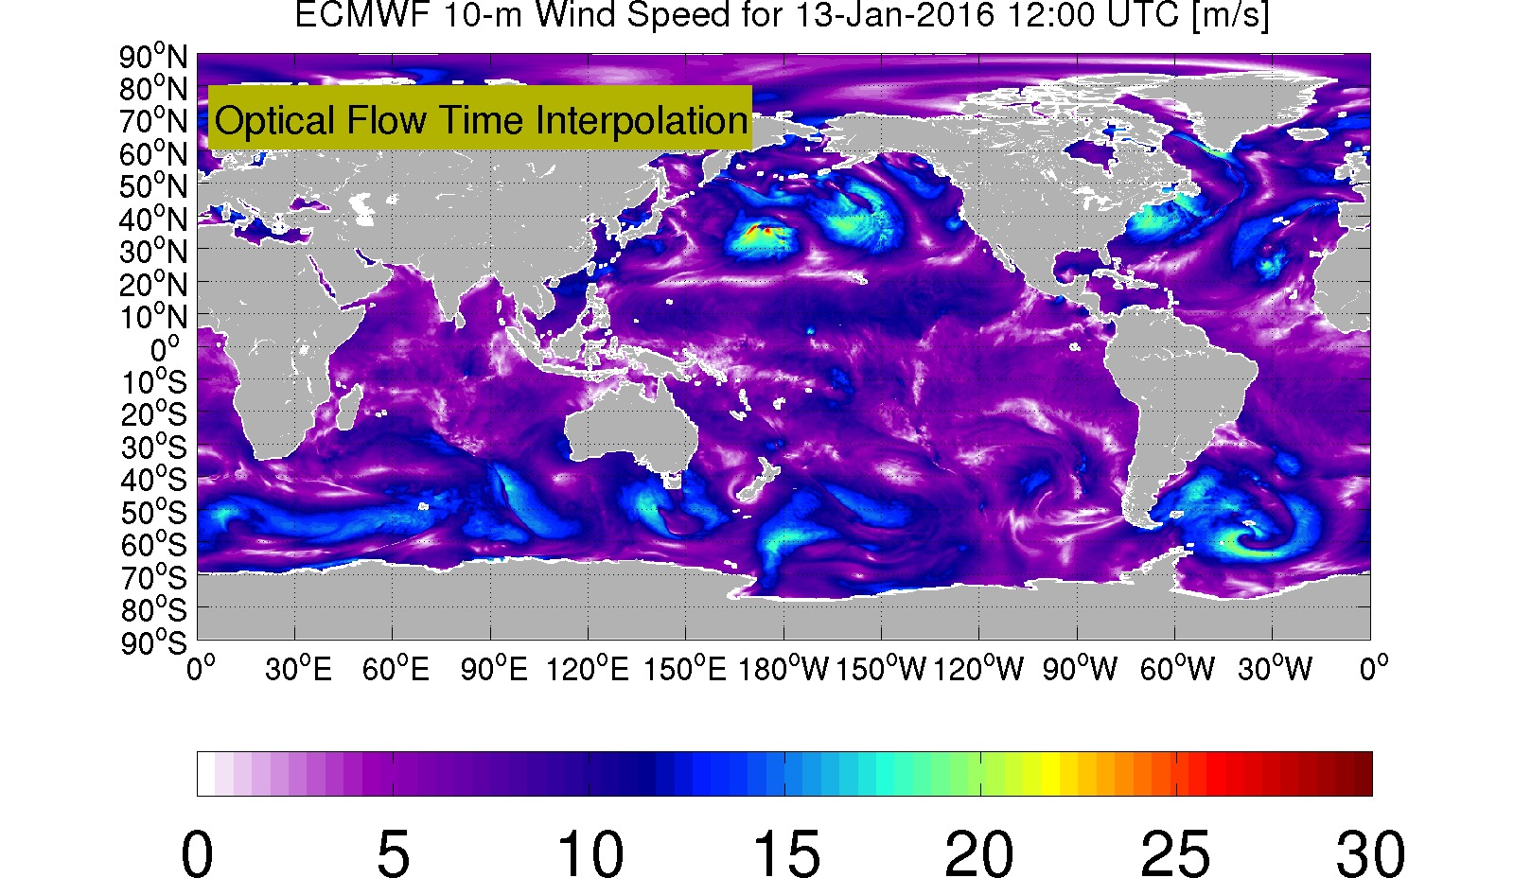
Example global 10-m wind speed from ECMWF model:

Slide 20
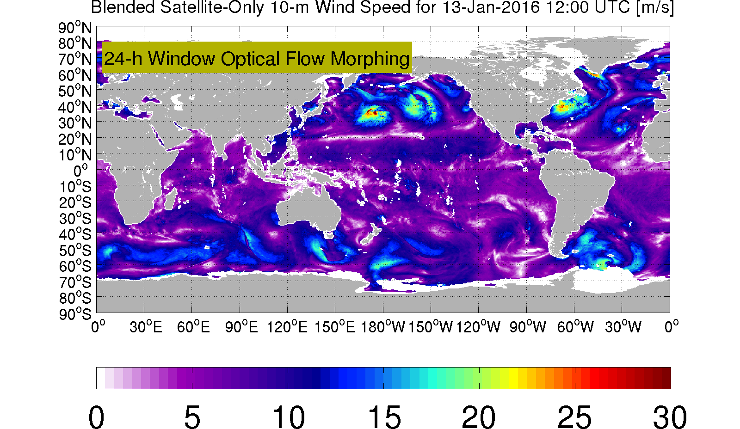
Application of the morphing approach to WindSat, SSMI F16 and F17, AMSR2, ASCAT (METOP-A) and GMI wind speed retrievals over a 22-h window yields the following wind speed map for the same time:

Slide 21
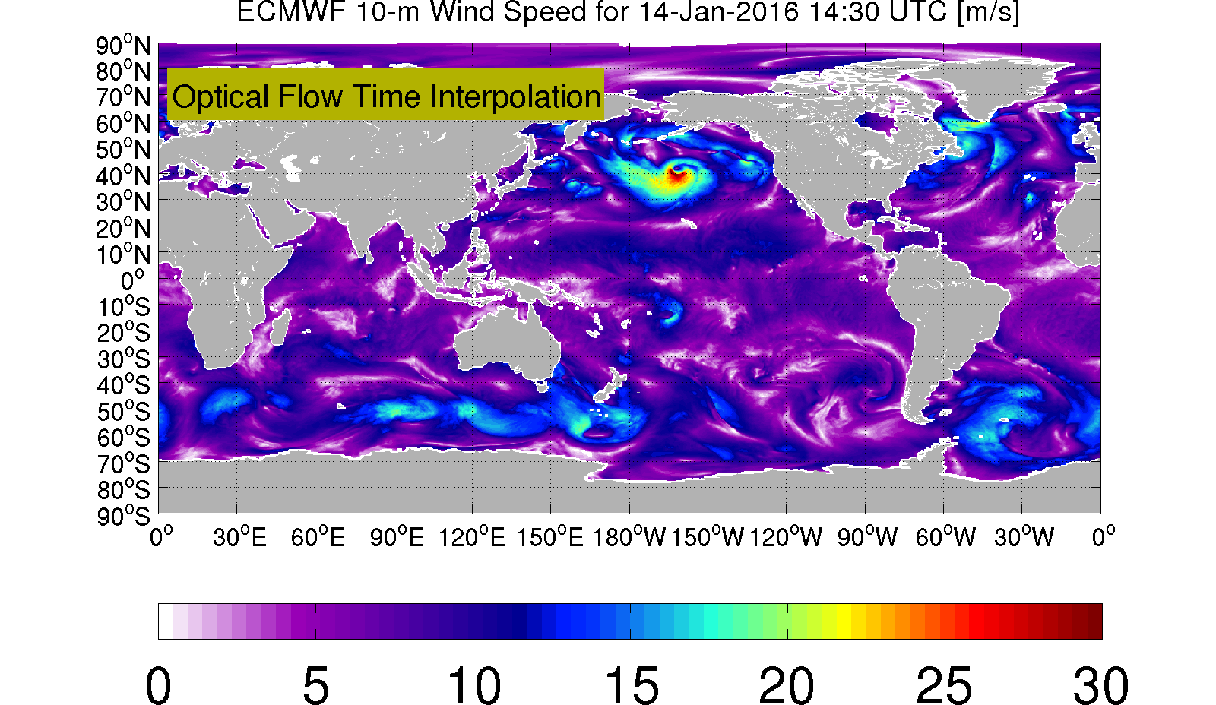
Another example of an ECMWF wind speed map:

Slide 22
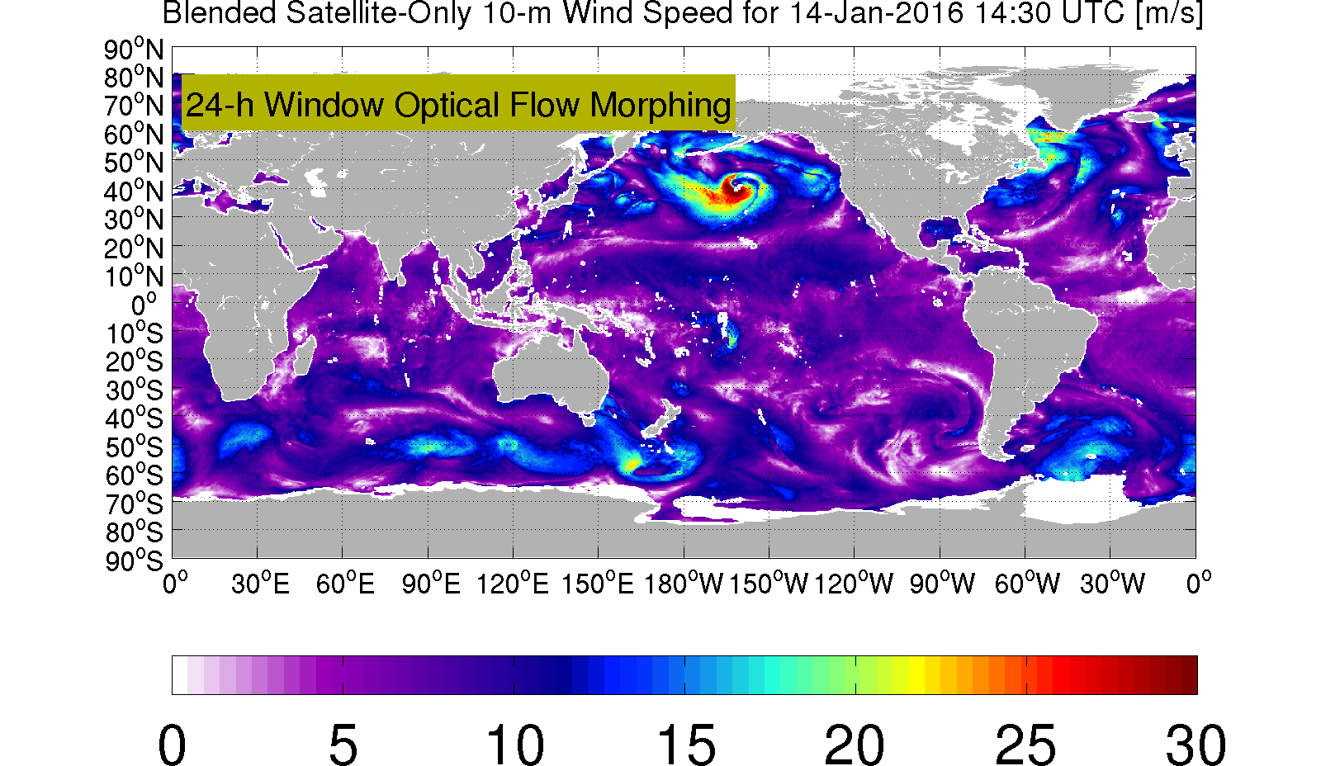
Using the morphing approach:

Slide 23
Evaluating the Impact of Morphing

Slide 24
Evaluating the Impact of Morphing
Approach: Collocate wind speed retrievals from all pairs of instruments within a 22 hour window. Do this for both the morphed and unmorphed retrievals. Stratify the collocations by both the time difference and the morphing distance.

Slide 25
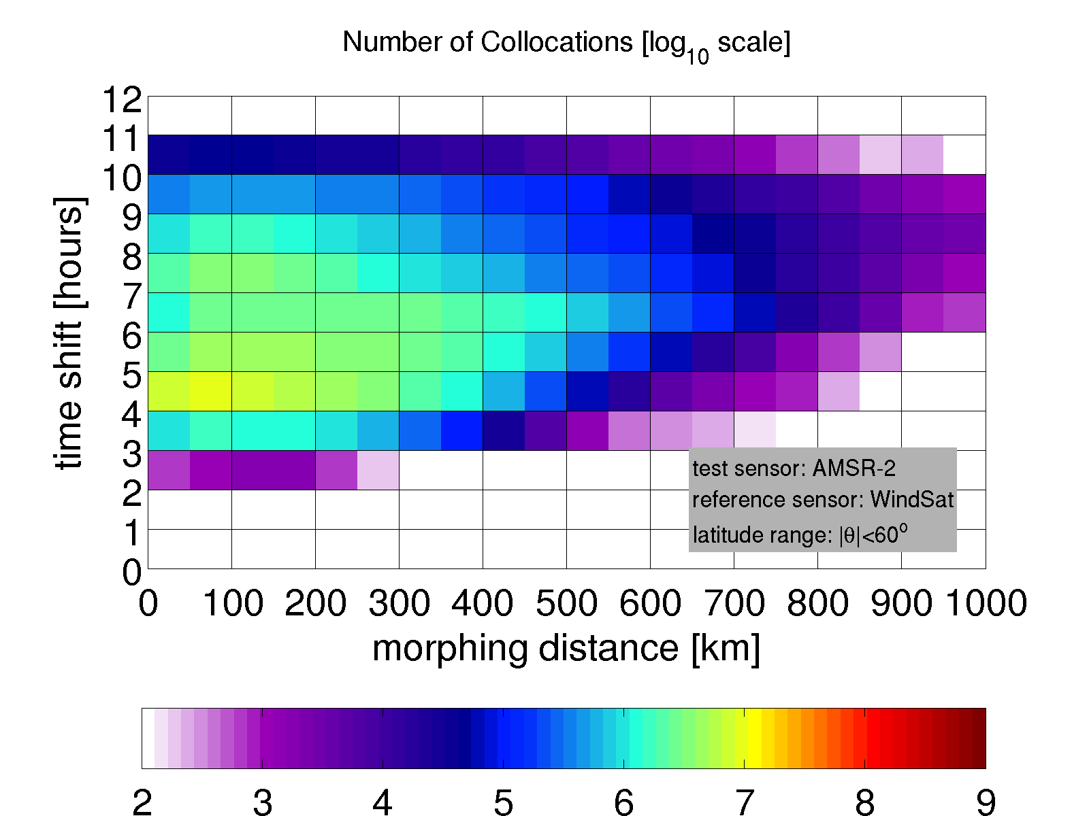
Evaluating the Impact of Morphing
For now use the wind speed data from Remote Sensing Systems and the wind speeds from SMAP and SMOS using the L-band model function developed for this project. Use all data for 2015.
All but two of the instruments are in sun synchronous orbits buth with different local overpass times. GMI and RapidScat are not sun synchronous and provide a large number of collocations at all time shifts within the window.
As an example consider WindSat and AMSR-2. WindSat has an ascending pass local time (LTAN) near 6 PM, while AMSR-2 has a LTAN near 1:30 PM. Consideration of both ascending and descending passes yields the following distribution of collocations as a function of morphing distance and time shift for the 2015 collocations:

Slide 26
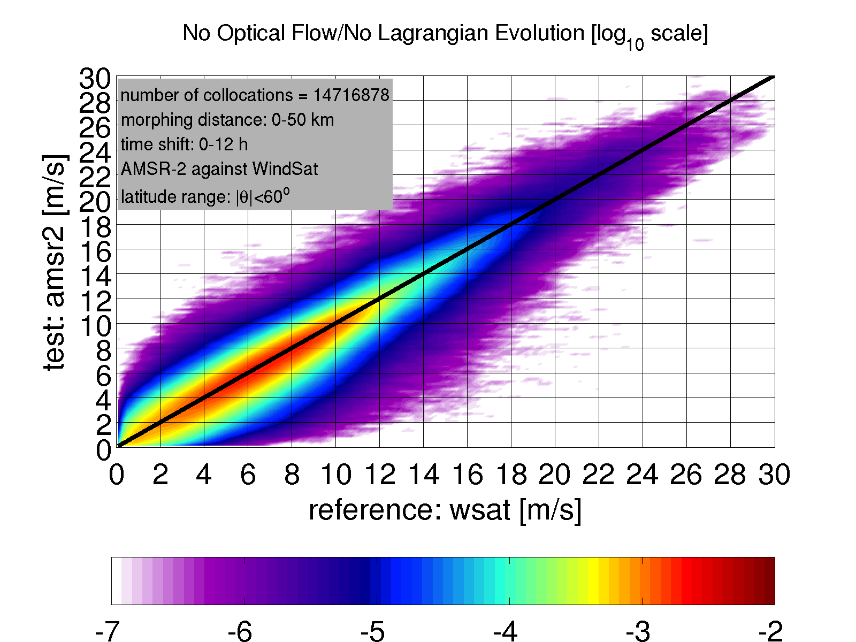
Evaluating the Impact of Morphing
Using as an example WindSat as the reference and AMSR-2 as the ‘test’ data, and considering only collocations with a morphing distance of less than 50 km, the following wind speed histogram (log scale) is obtained.
Morphing distance: 0-50 km
NO MORPHING

Slide 27
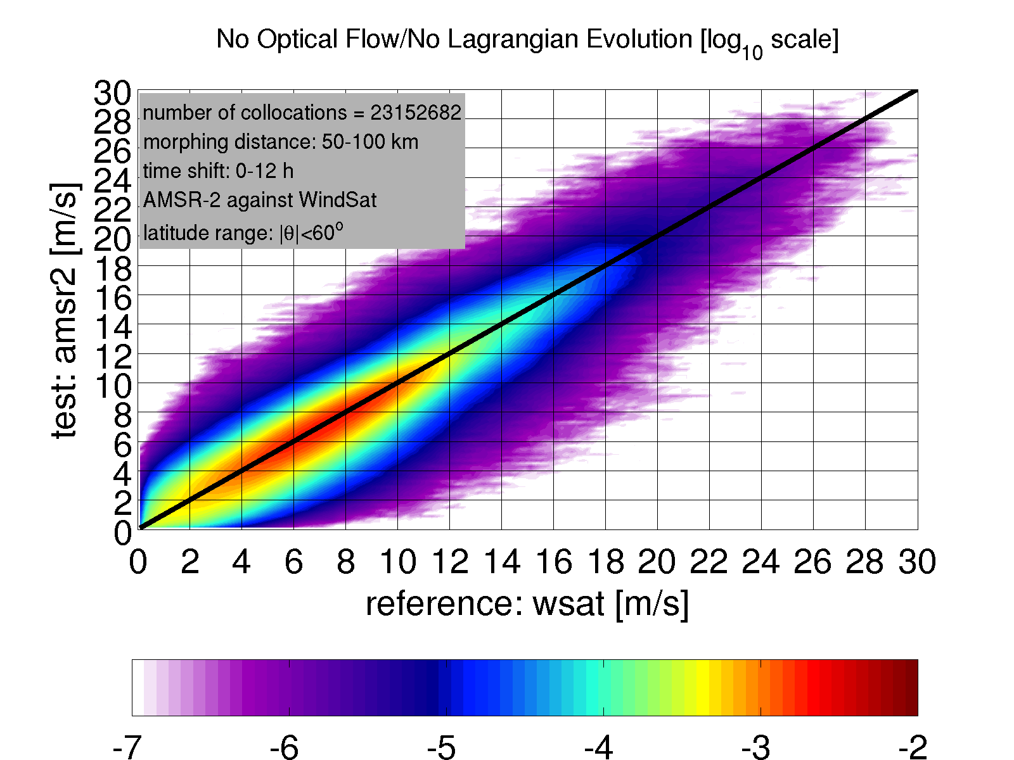
Evaluating the Impact of Morphing
As the morphing distance is increased, the spread in the histogram becomes more pronounced at all wind speeds:
Morphing distance: 50-100 km
NO MORPHING

Slide 28
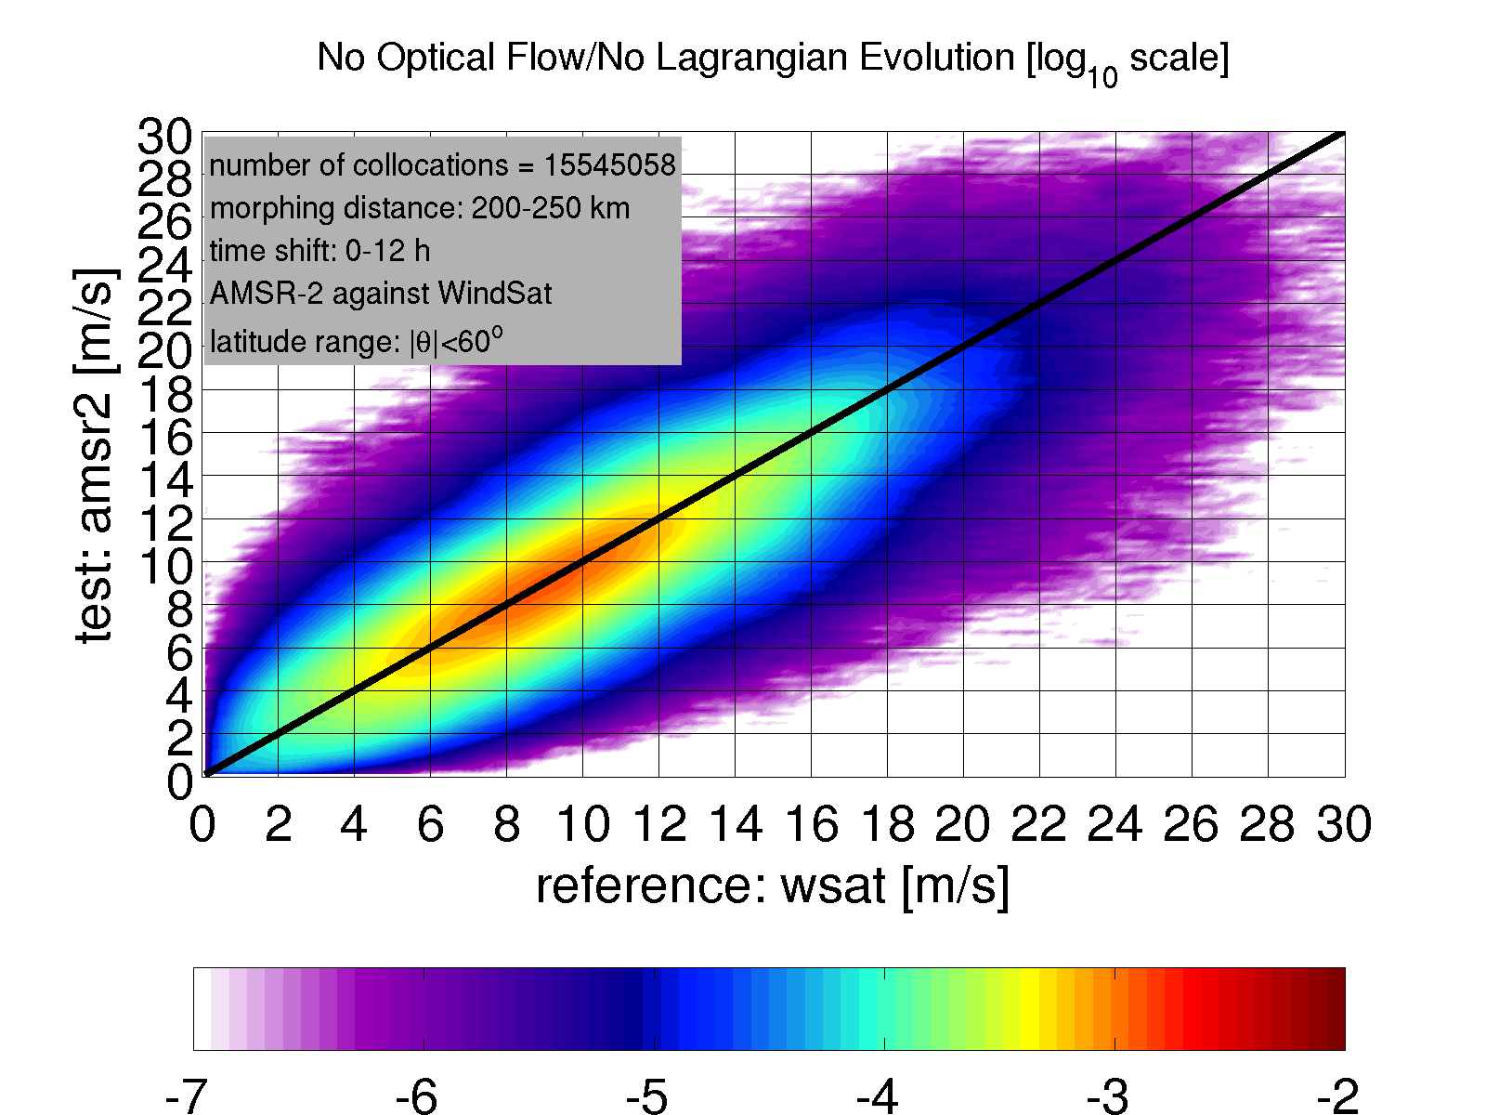
Evaluating the Impact of Morphing
As the morphing distance is increased, the spread in the histogram becomes more pronounced at all wind speeds:
Morphing distance: 200-250 km
NO MORPHING

Slide 29
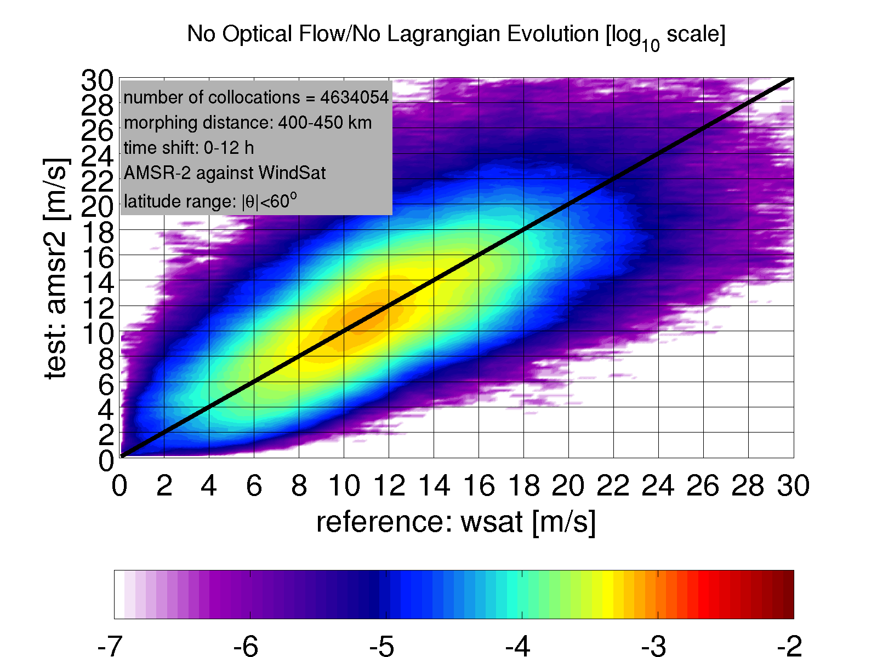
Evaluating the Impact of Morphing
As the morphing distance is increased, the spread in the histogram becomes more pronounced at all wind speeds:
Morphing distance: 400-450 km
NO MORPHING

Slide 30
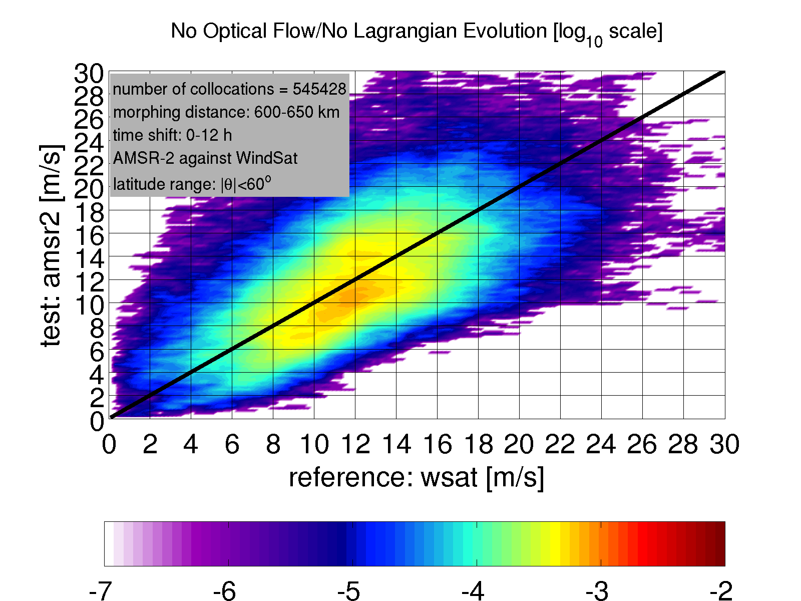
Evaluating the Impact of Morphing
As the morphing distance is increased, the spread in the histogram becomes more pronounced at all wind speeds:
Morphing distance: 600-650 km
NO MORPHING

Slide 31
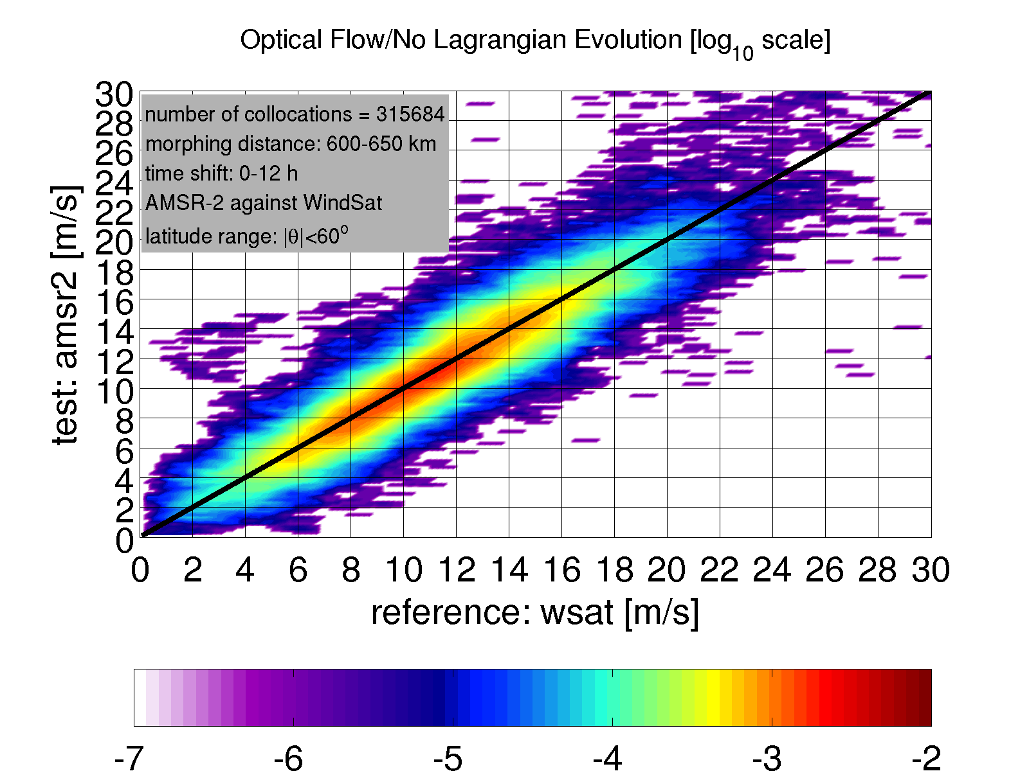
Evaluating the Impact of Morphing
Applying the optical flow morphing method reduces the spread in the distribution, even at large displacements beyond 600 km:
Morphing distance: 600-650 km
WITH MORPHING

Slide 32
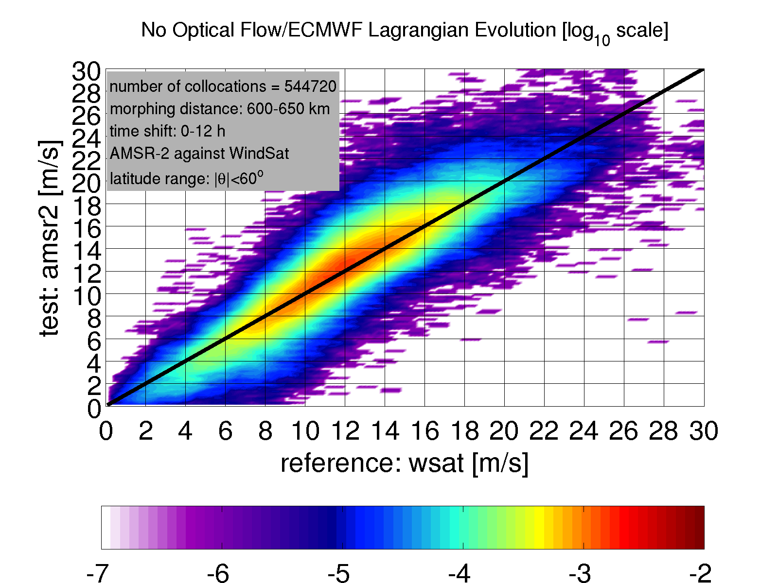
Evaluating the Impact of Morphing
Applying the ECMWF-based temporal correction but no morphing also reduces the spread, but some wind speed-dependent distortion is apparently introduced. This is especially evident for WindSat wind speeds around 10-15 m/s:
NO MORPHING
BUT WITH ECMWF EVOLUTION APPLIED TO SAT WINDS

Slide 33
Current Issue 1: Consistency between Remoting Sensing Wind Products
A key issue that remain to be resolved is how to deal with inconsistencies (biases) between different wind speed products included in the blended wind products.

Slide 34
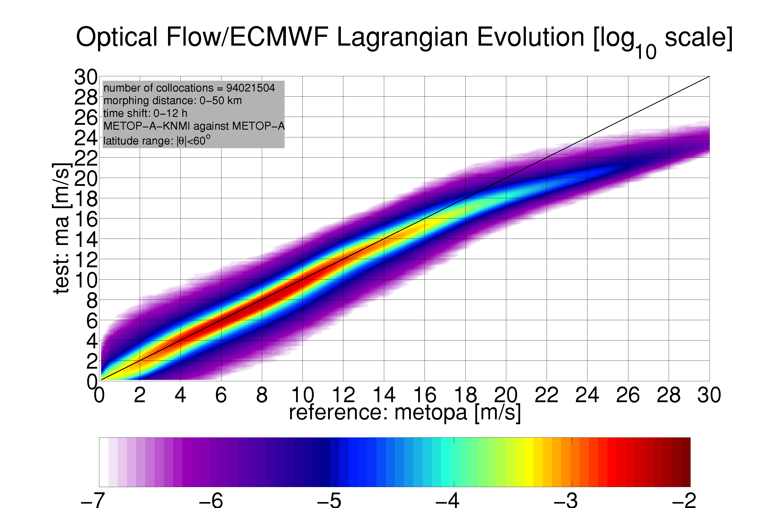
EXAMPLE :RSS vs KNMI ASCAT Wind Speeds

Slide 35
Current Issue 2: Morphing In the Vicinity of Tropical Cyclones
Another issue to be resolved is that in the vicinity of tropical cyclones the optical flow method frequently yields shifts that are not consistent with best track velocity.

Slide 36
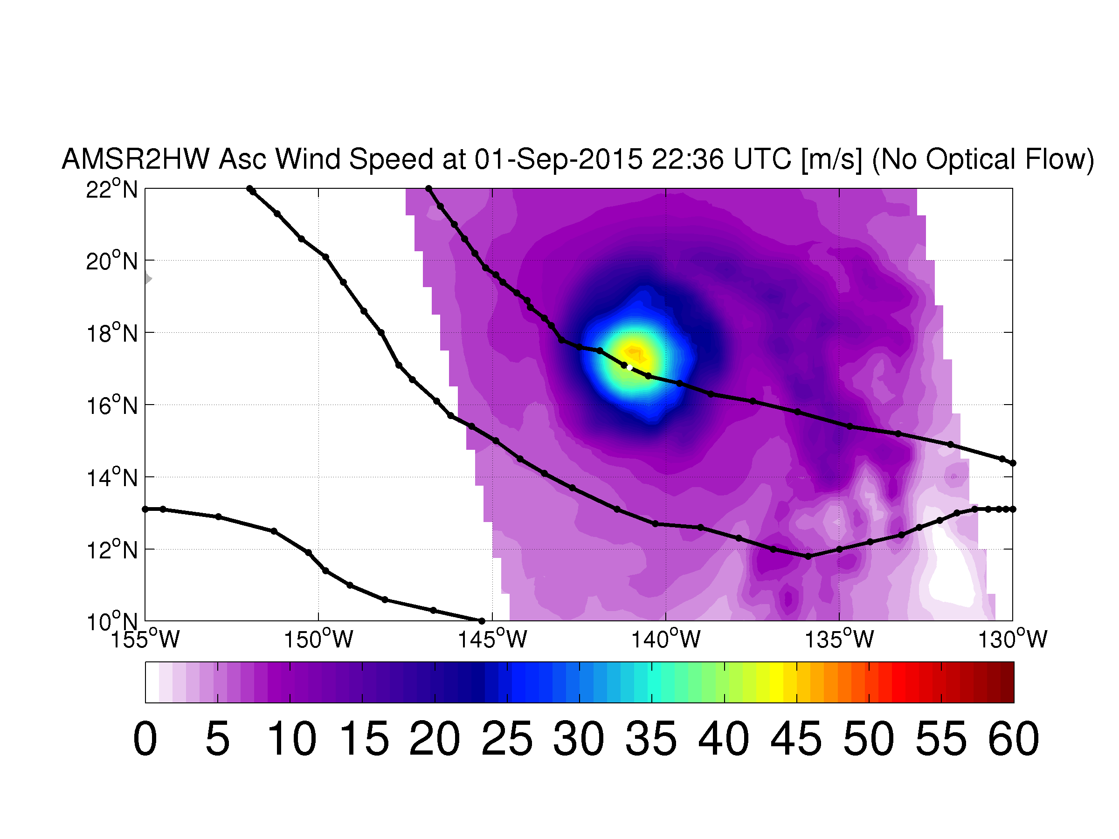
Example of Hurricane Jimena

Slide 37
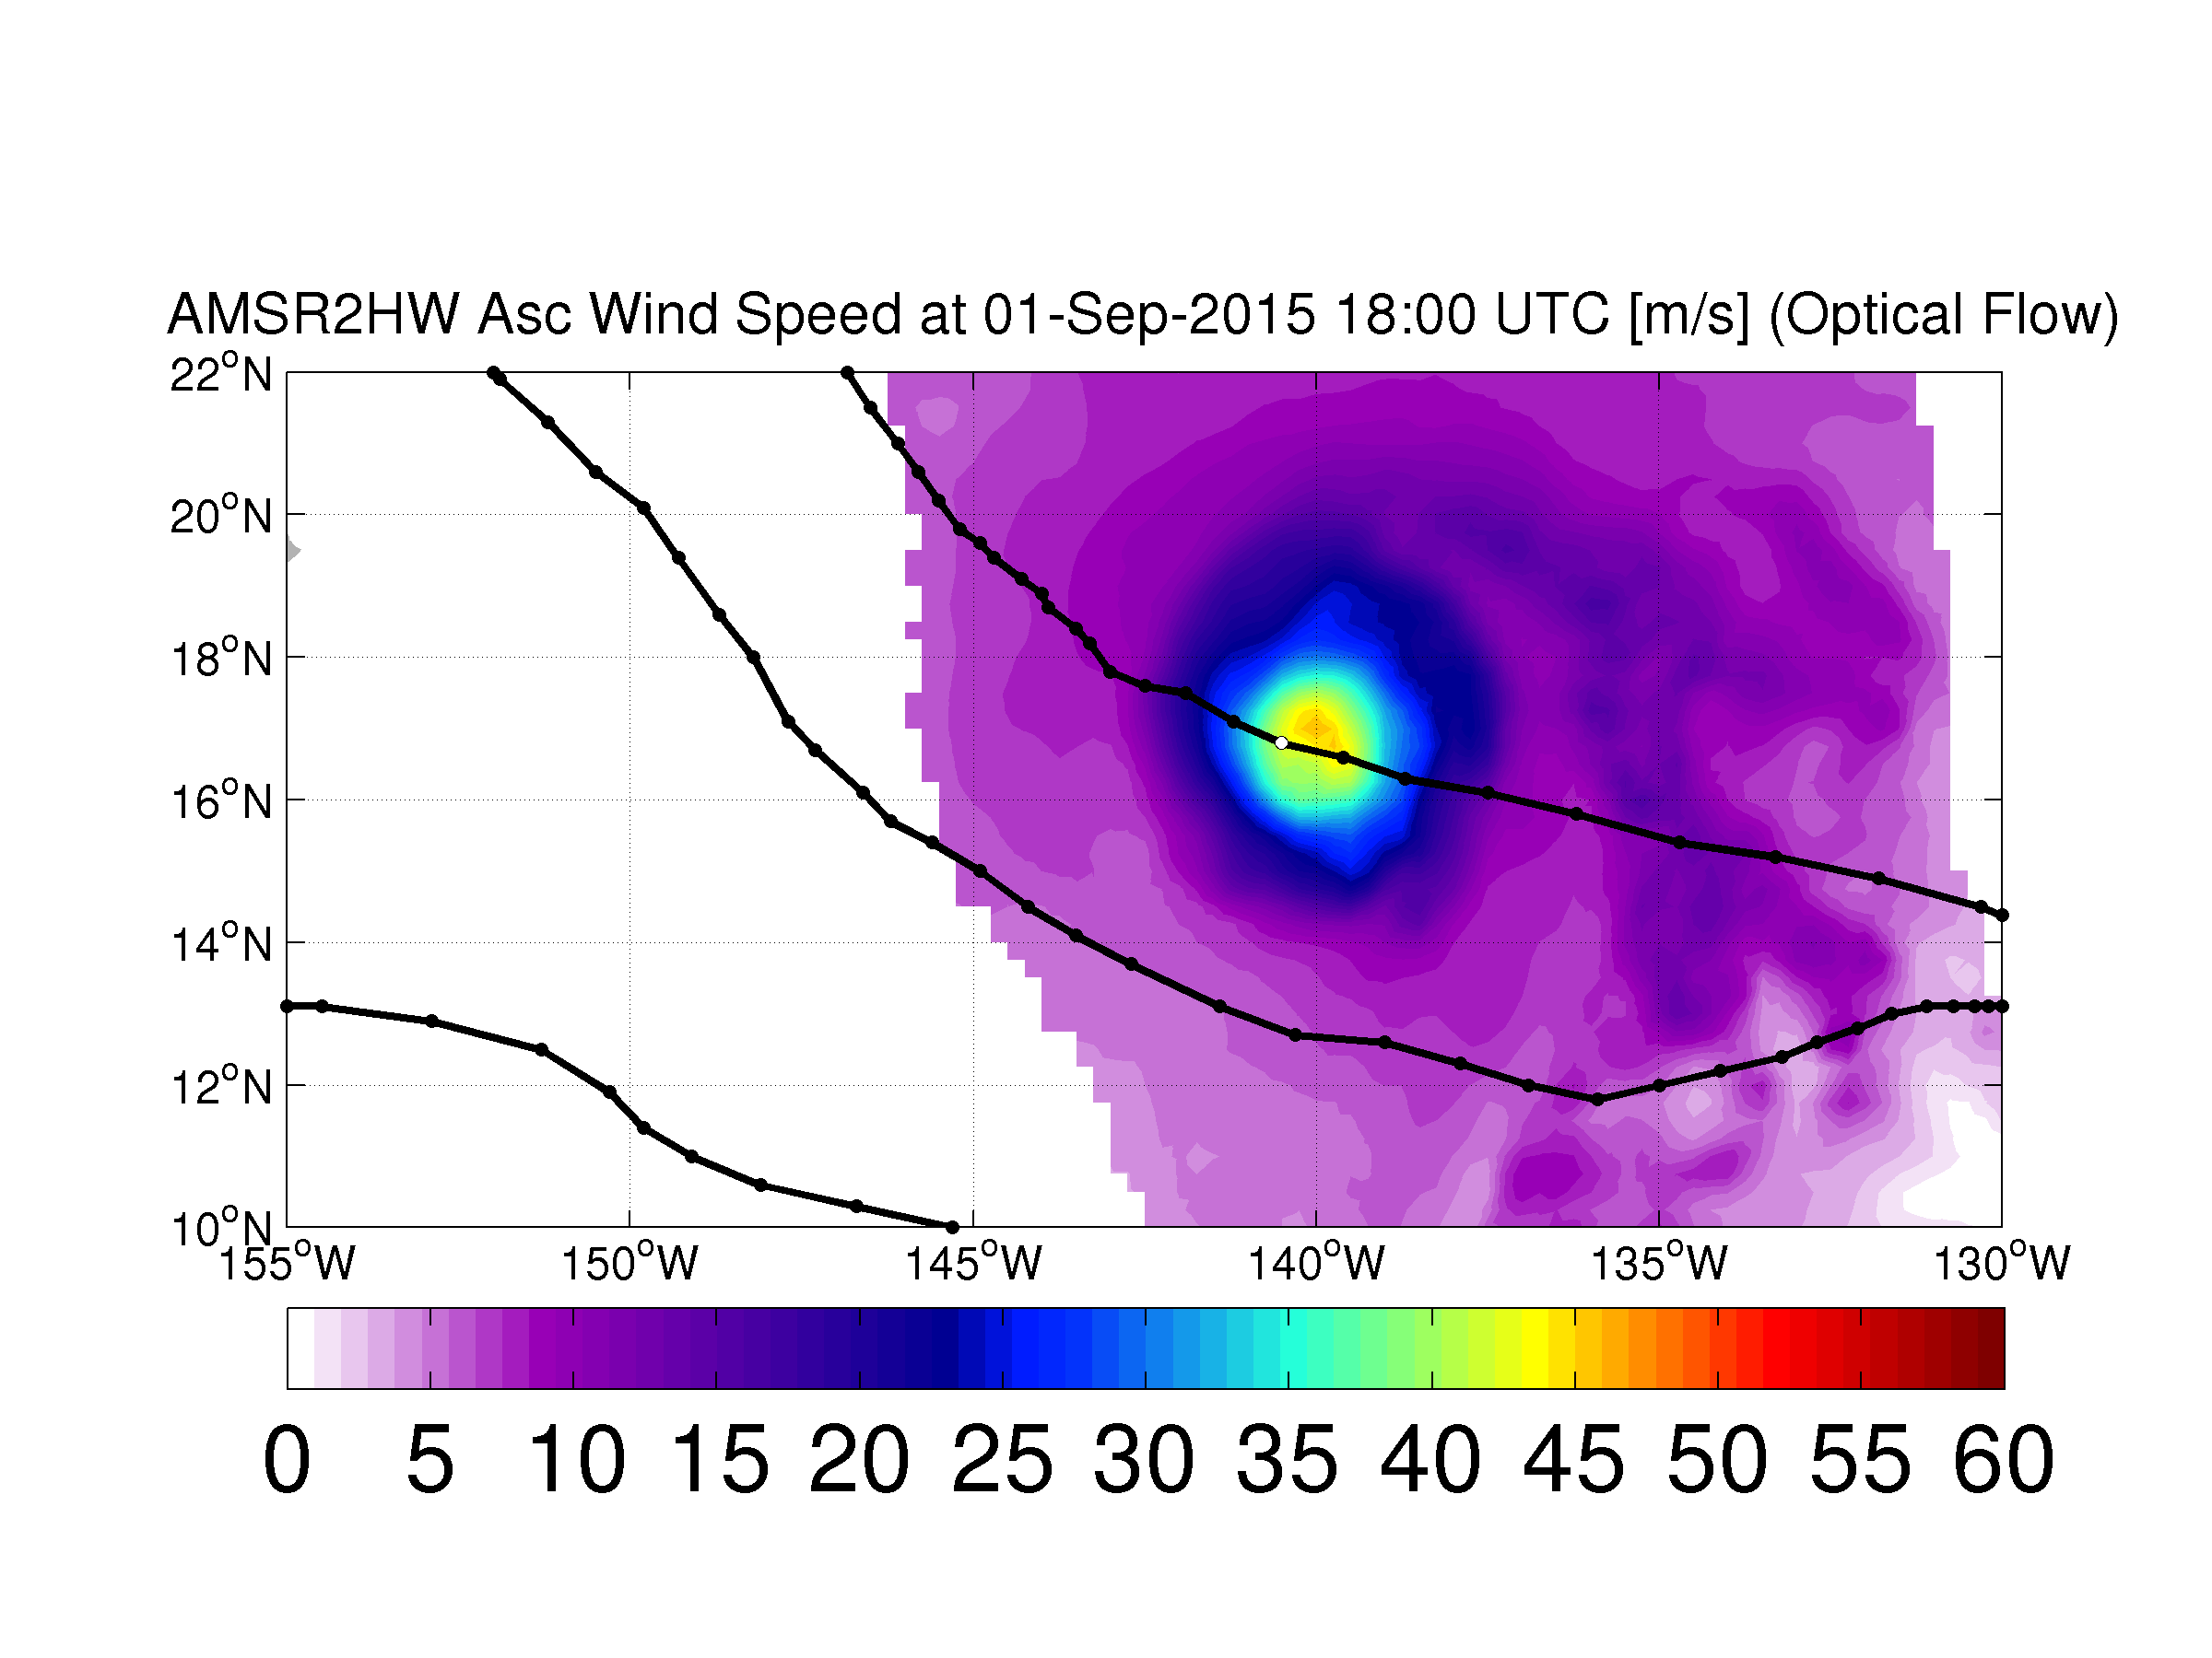
Example of Hurricane Jimena

Slide 38
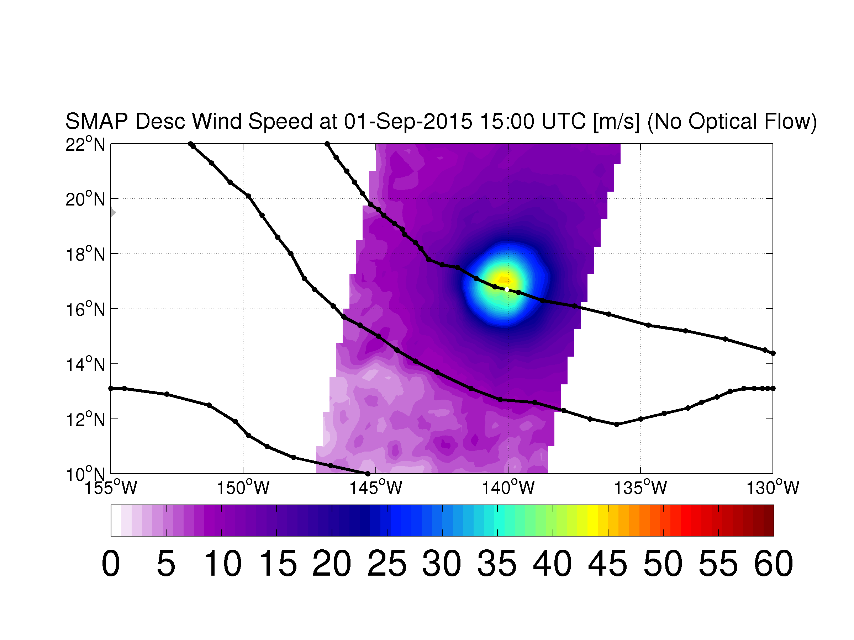
Example of Hurricane Jimena

Slide 39
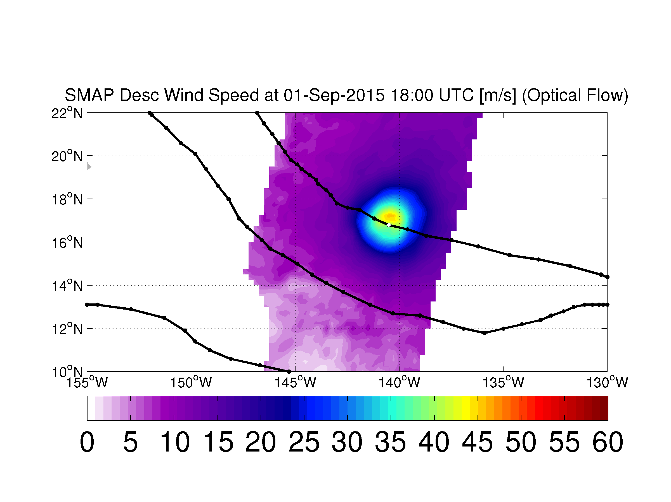
Example of Hurricane Jimena

Slide 40
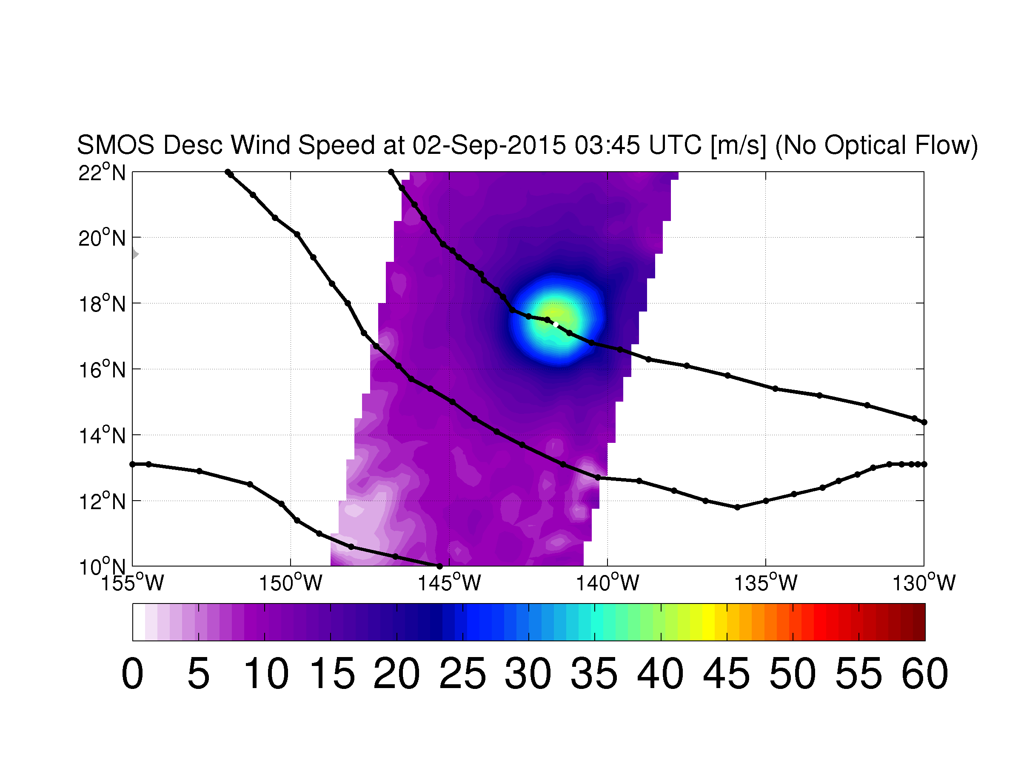
Example of Hurricane Jimena

Slide 41
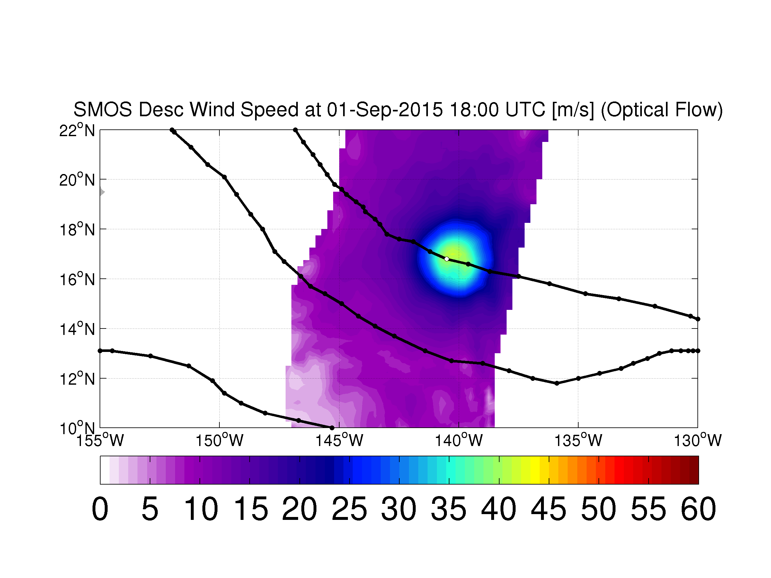
Example of Hurricane Jimena

Slide 42
Test Application of Blended Wind Speed Maps: Improving the Roughness Correction

Slide 43
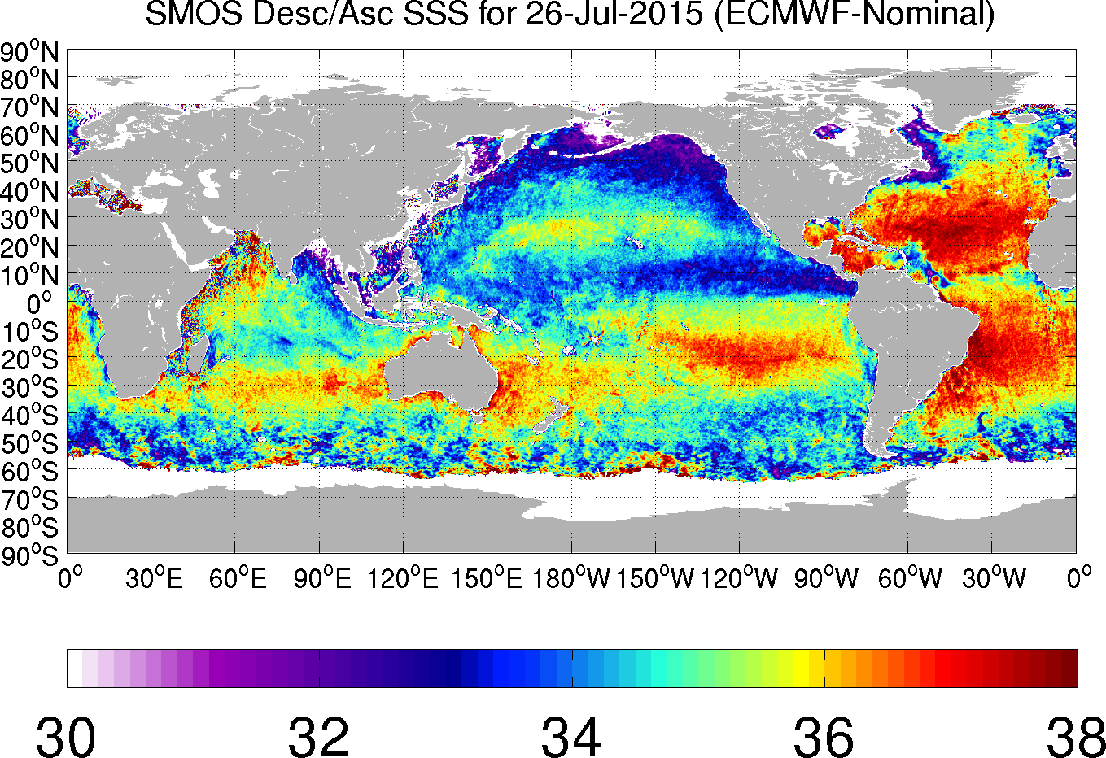
Test Application of Blended Wind Speed Maps: Improving the Roughness Correction

Slide 44
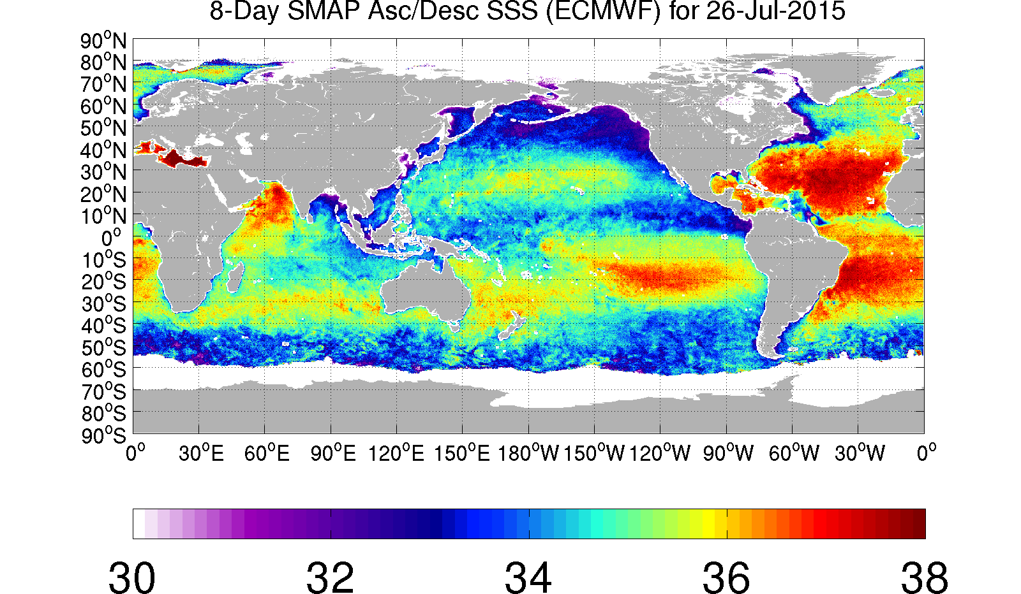
Example from SMAP
Impact of ECMWF vs Satellite wind speed on mid and high latitude variations in retrieved SSS

Slide 45
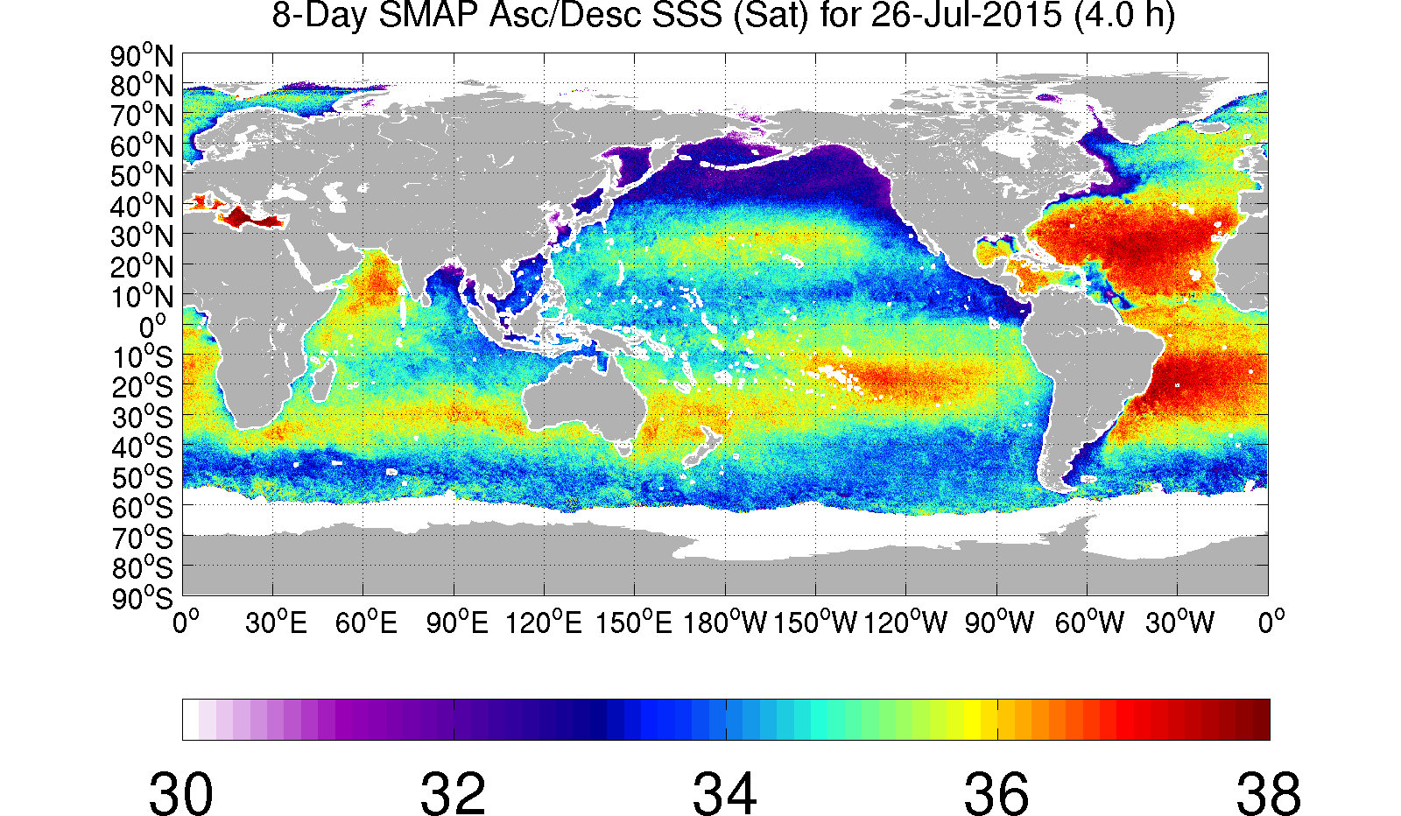
Example from SMAP
Impact of ECMWF vs Satellite wind speed on mid and high latitude variations in retrieved SSS

Slide 46
Impact on SSS Retrieval
Salinity retrievals have been performed using several 10-m wind speed maps to test the impact. Below is shown an example 8-day average SSS map centered on 26 July 2015, based upon the roughness correction obtained from Model 2 and ECMWF wind speed with linear space and time interpolation :

Slide 47
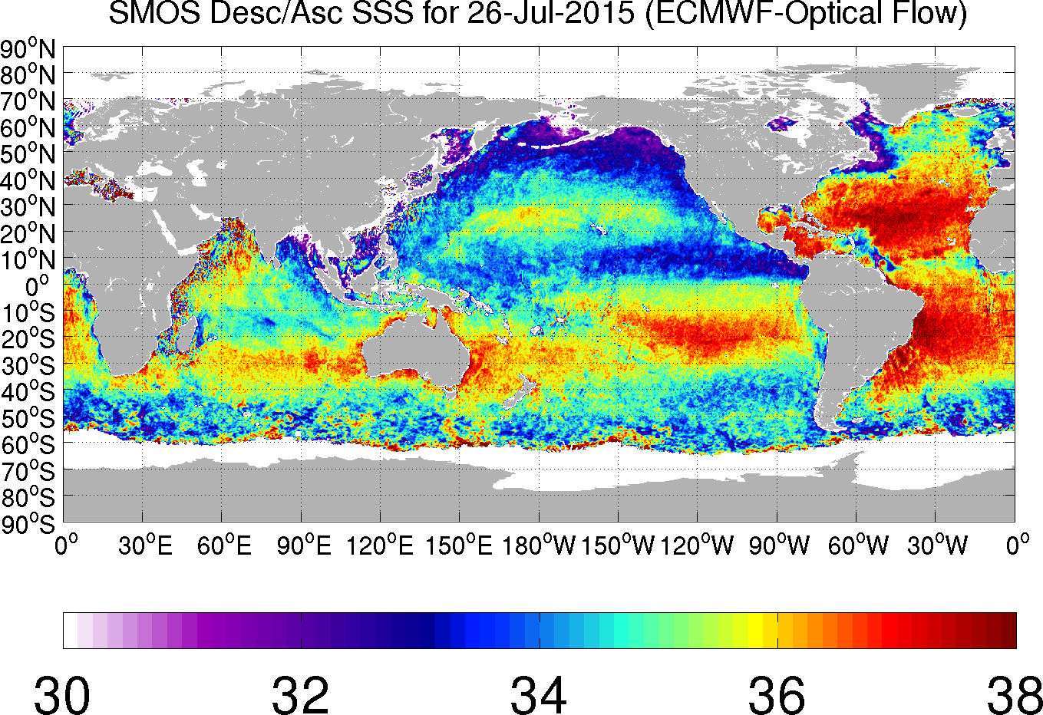
Impact on SSS Retrieval
Same as previous slide except that the space-time interpolation of the 3 hourly ECMWF wind speed maps is done following the optical flow field obtained from the ECMWF wind speed fields themselves :

Slide 48
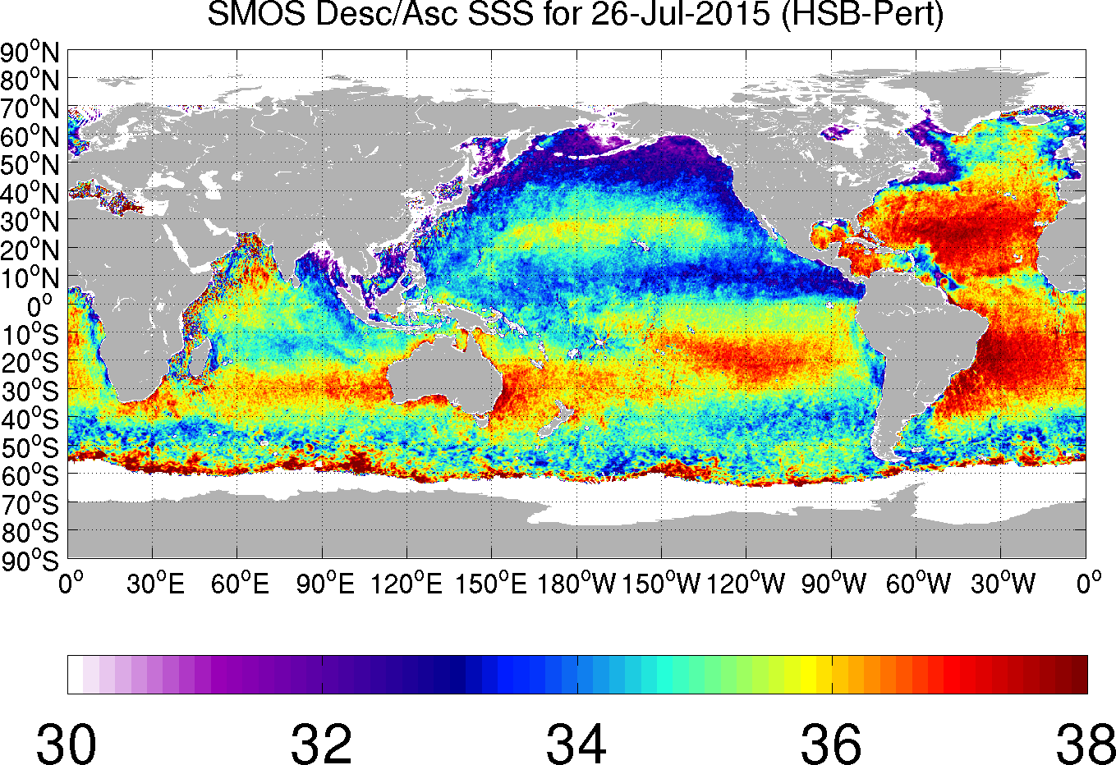
Impact on SSS Retrieval
Same as previous slide except using the blended wind speed maps derived through the morphing technique (including only SSMI 16/17, AMSR-2, GMI, WindSat). Time window is 22 hours centered on the wind speed map analysis time and a blended wind maps is available every half-hour.

Slide 49
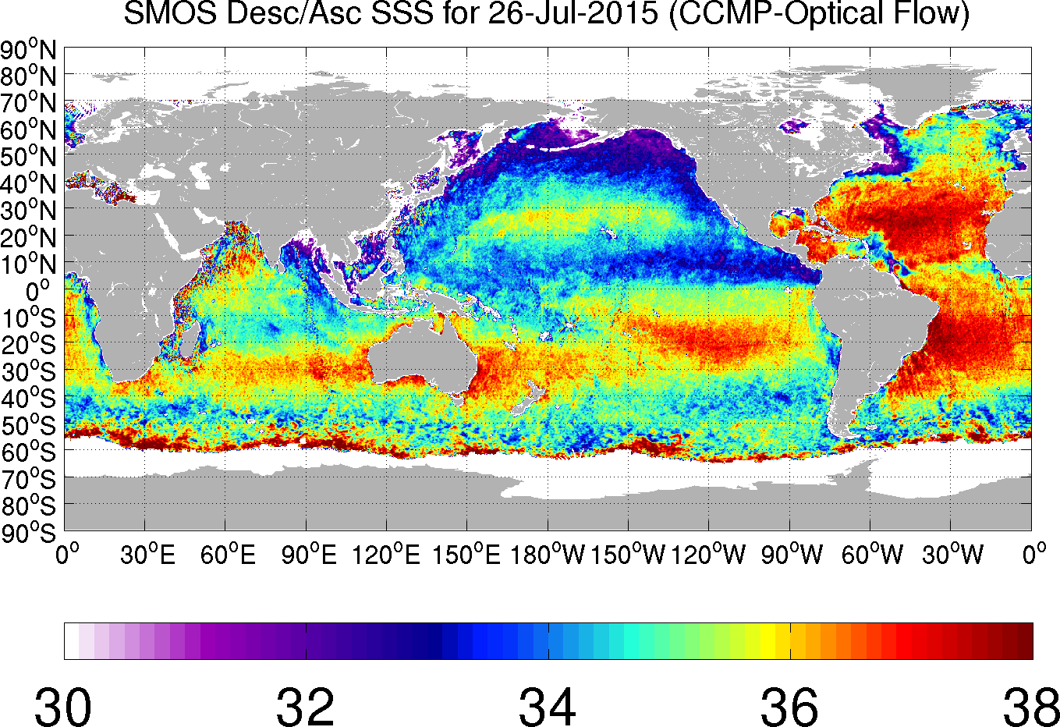
Impact on SSS Retrieval
Same as previous slide except using the CCMP wind speed maps obtained from RSS. Very similar to SSS map obtained using the morphed blended wind product.

Slide 50
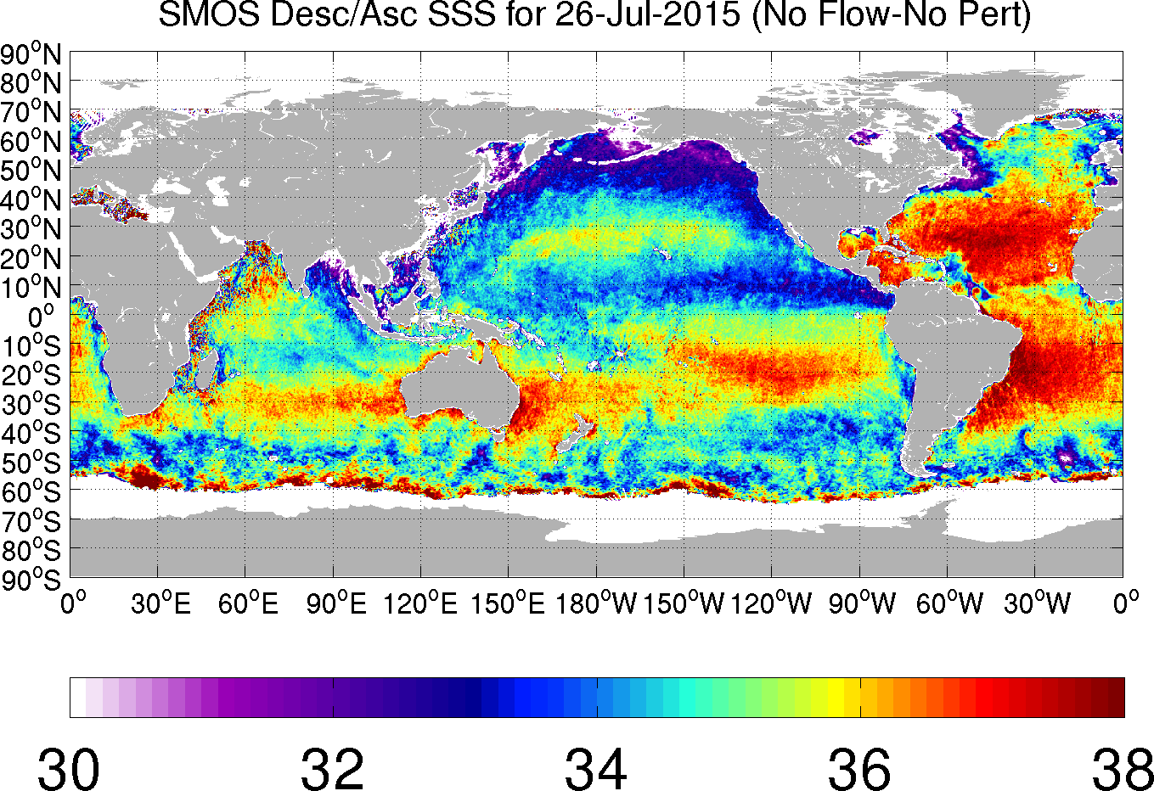
Impact on SSS Retrieval
Same as previous slide except without using optical flow morphing to account for the time differences between swaths and the analysis time in producing the blended wind speed maps.

Slide 51
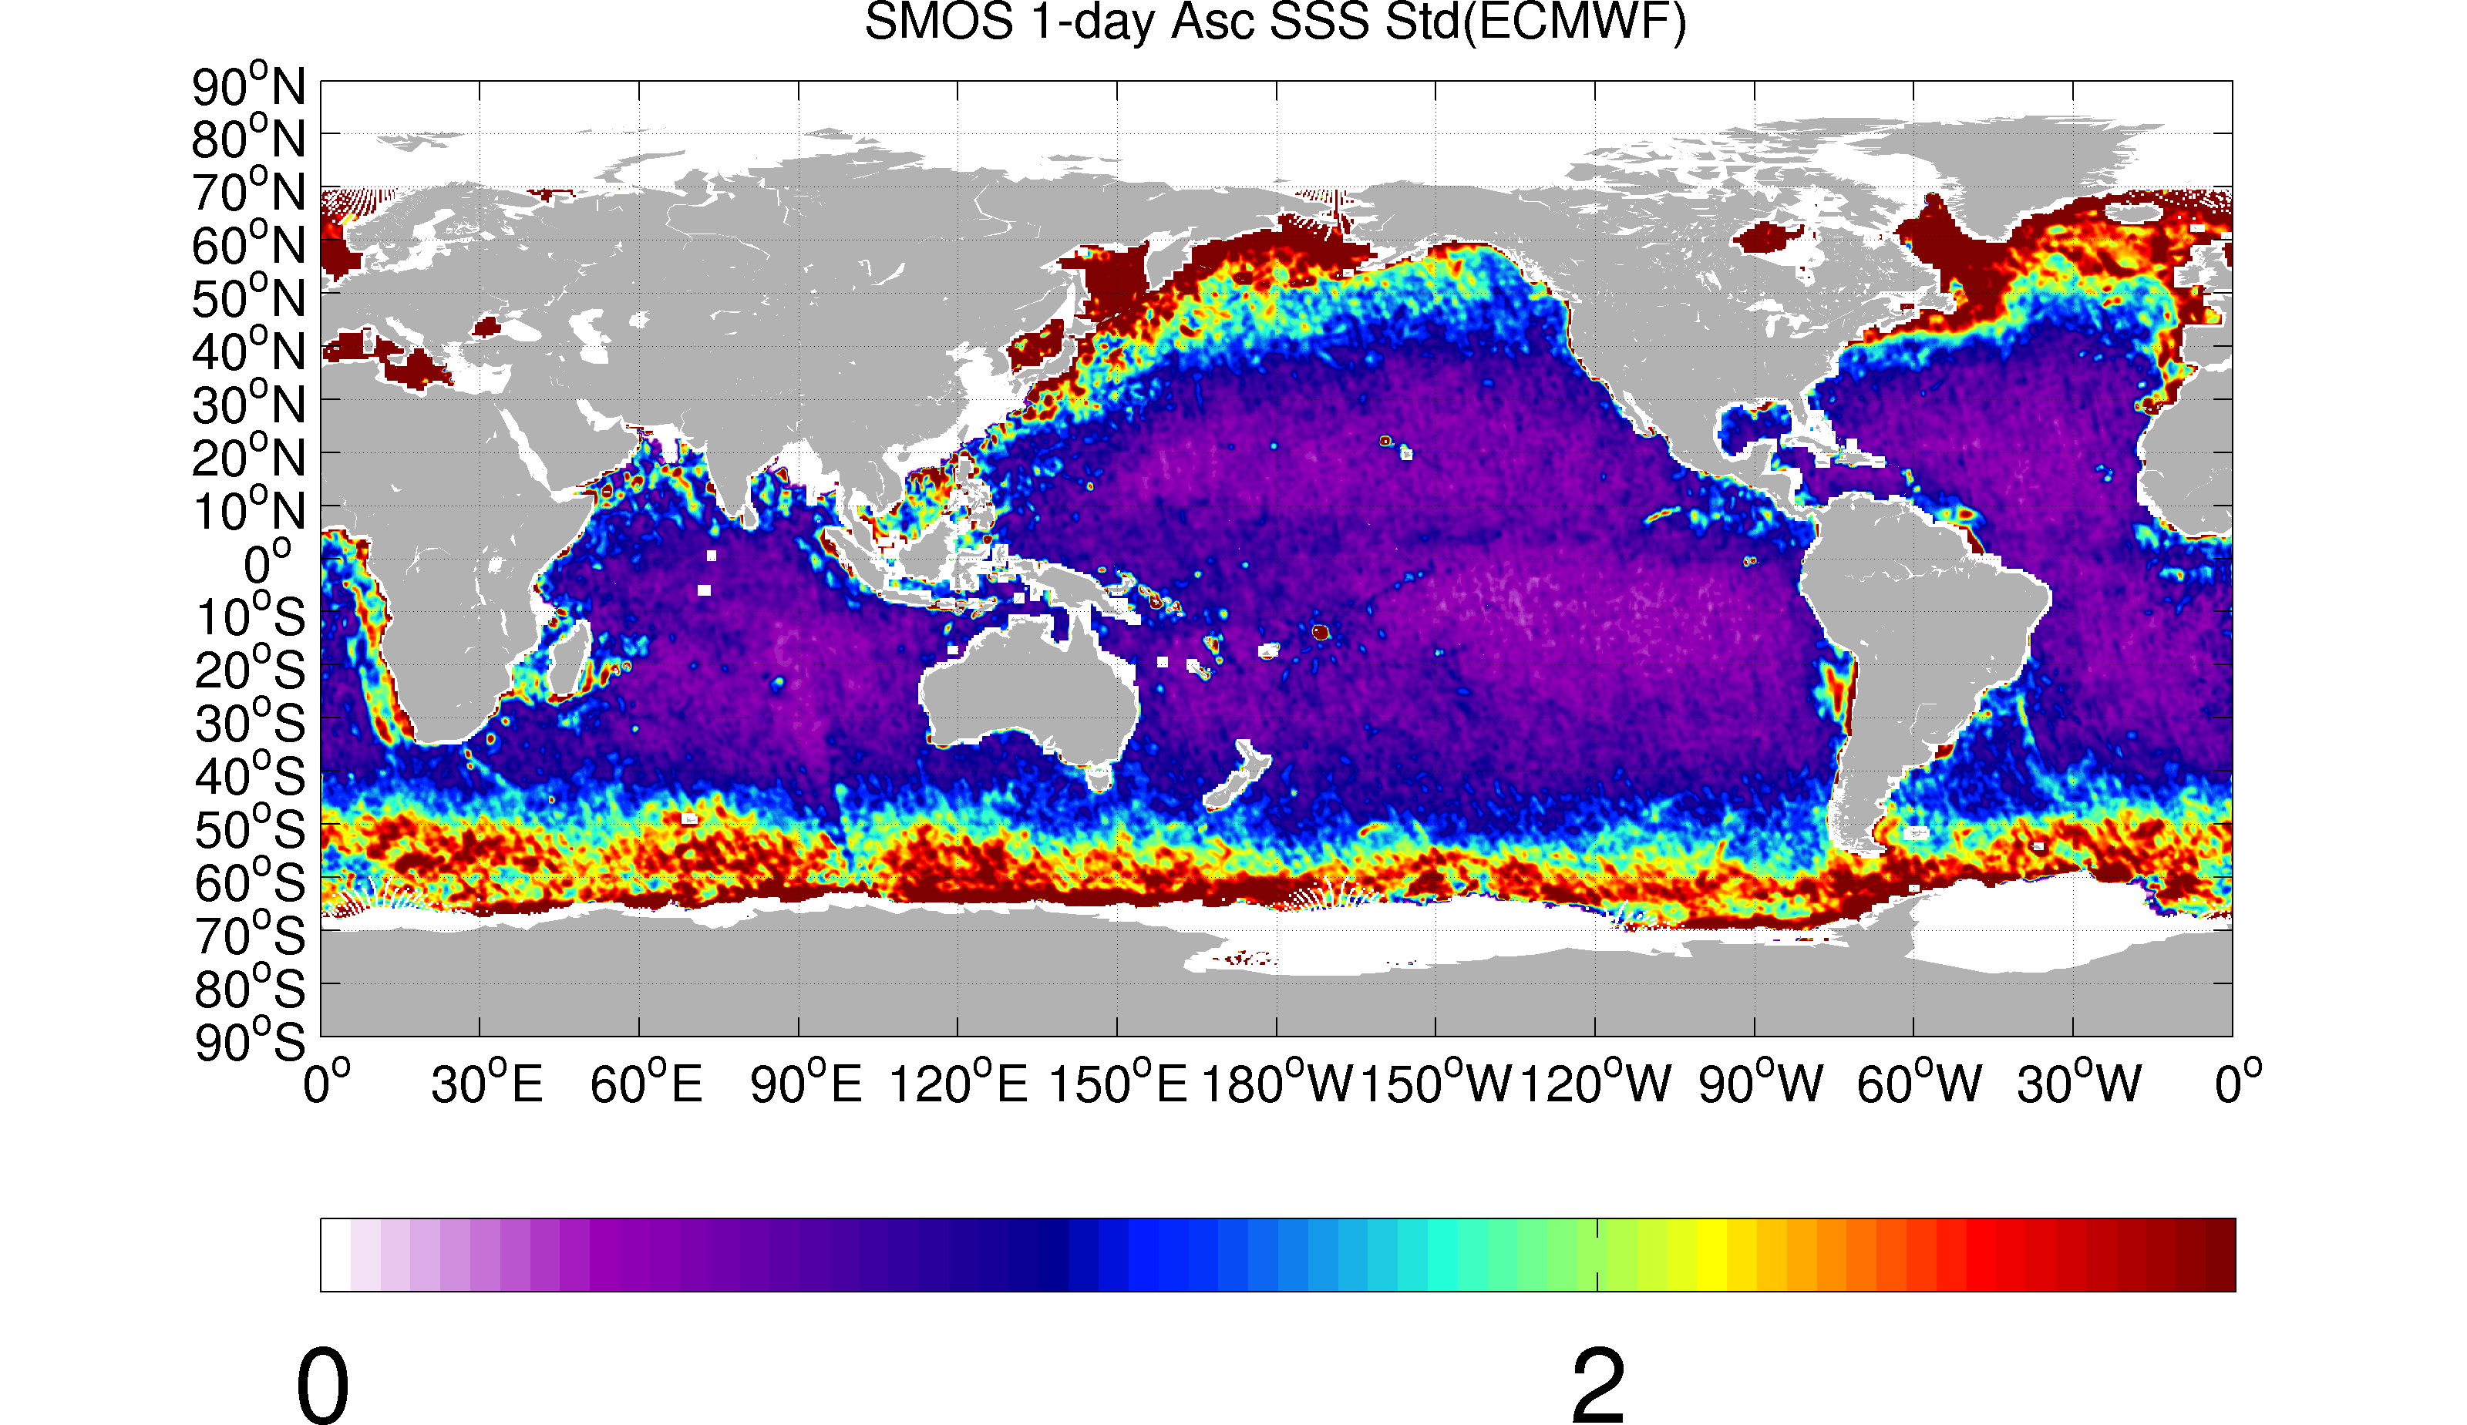
Impact on SSS Retrieval
Stdev of daily SSS Jan-July 2015 using ECMWF wind speed :

Slide 52
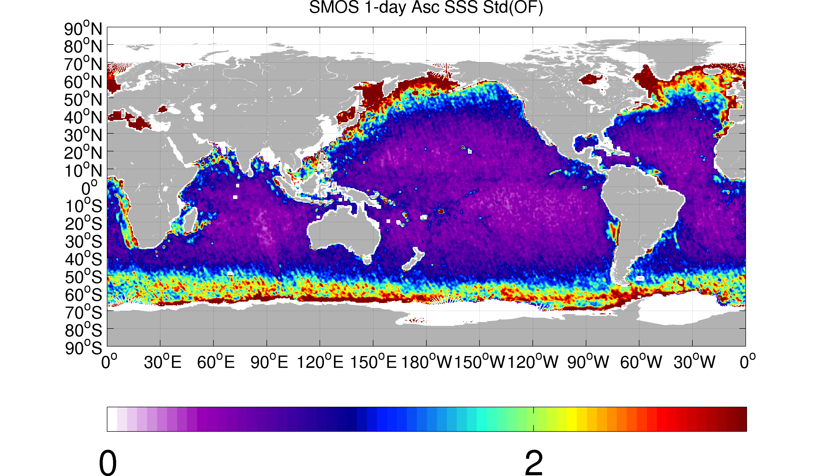
Impact on SSS Retrieval
Stdev of daily SSS Jan-July 2015 using blended morphed wind speed :

Slide 53
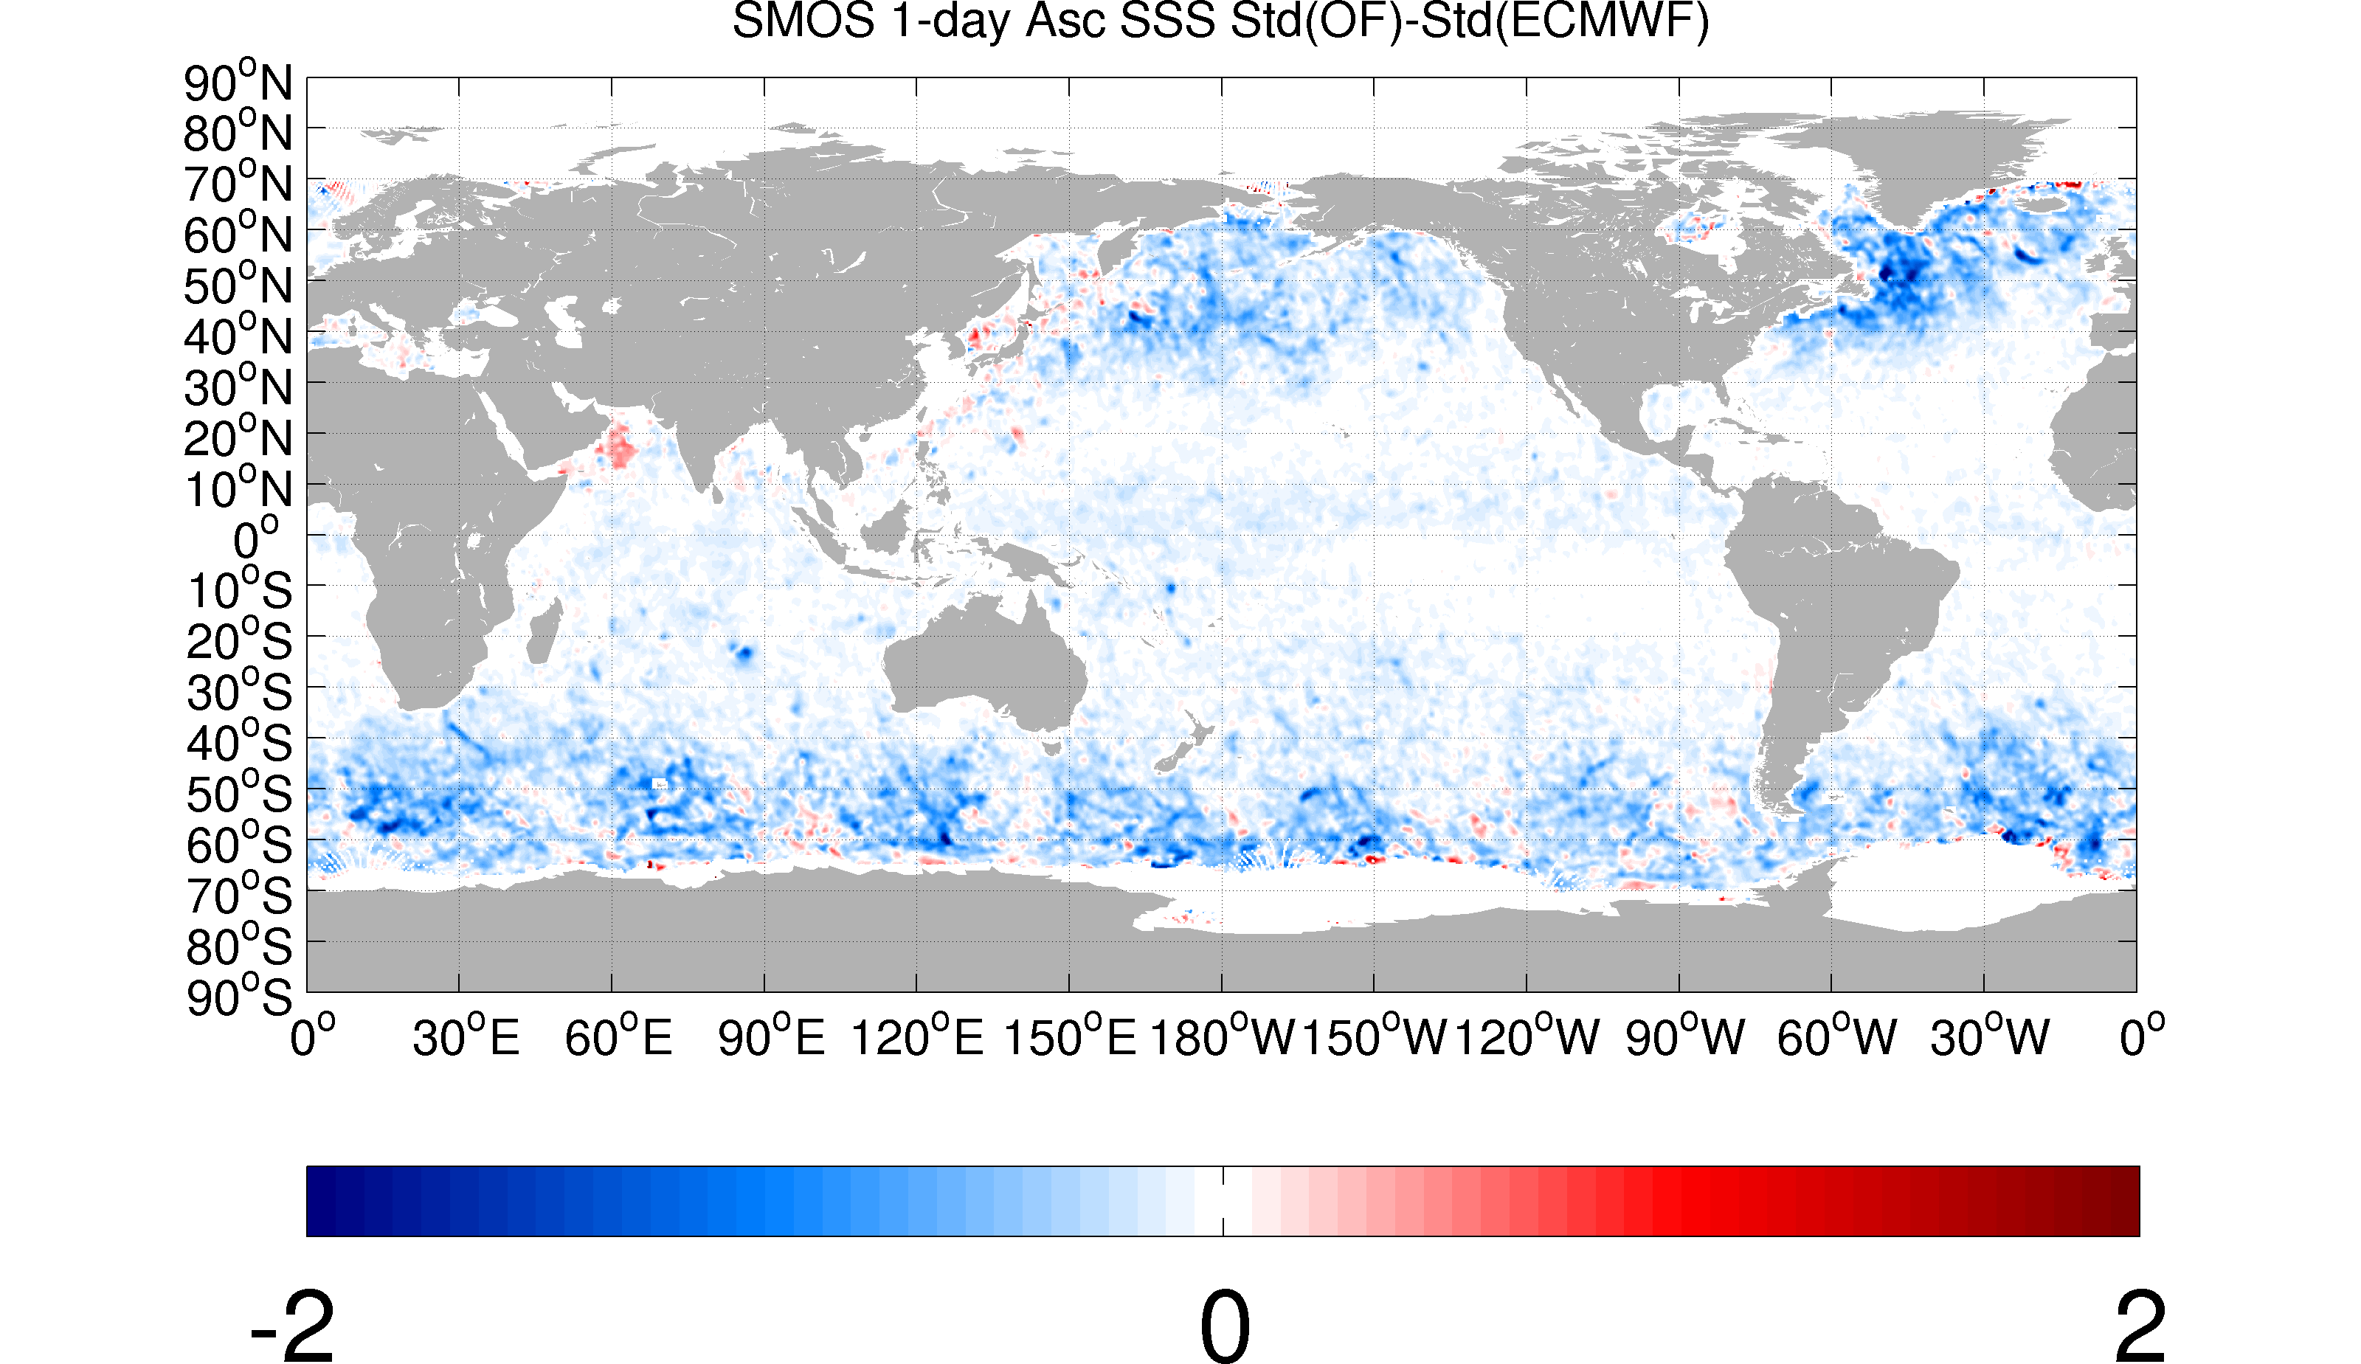
Impact on SSS Retrieval
Stdev blended-ECMWF :

Slide 54
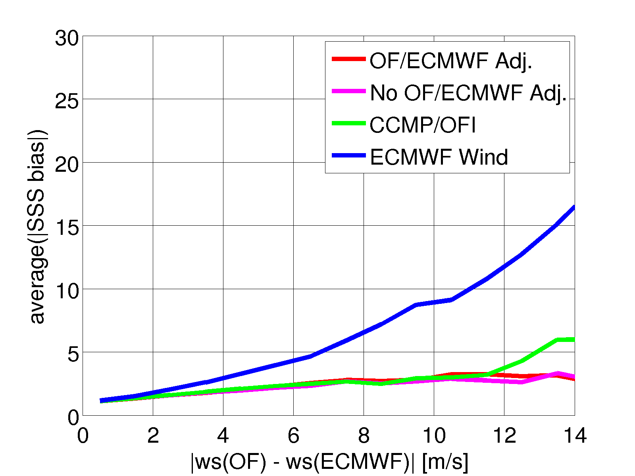
Impact on SSS Retrieval
If the absolute biases for each wind source are binned by the absolute difference between the blended morphed wind and ECMWF wind, the result is the following. Absolute SSS bias using ECMWF wind increases with this difference much more than that using the blended wind speed :

Slide 55
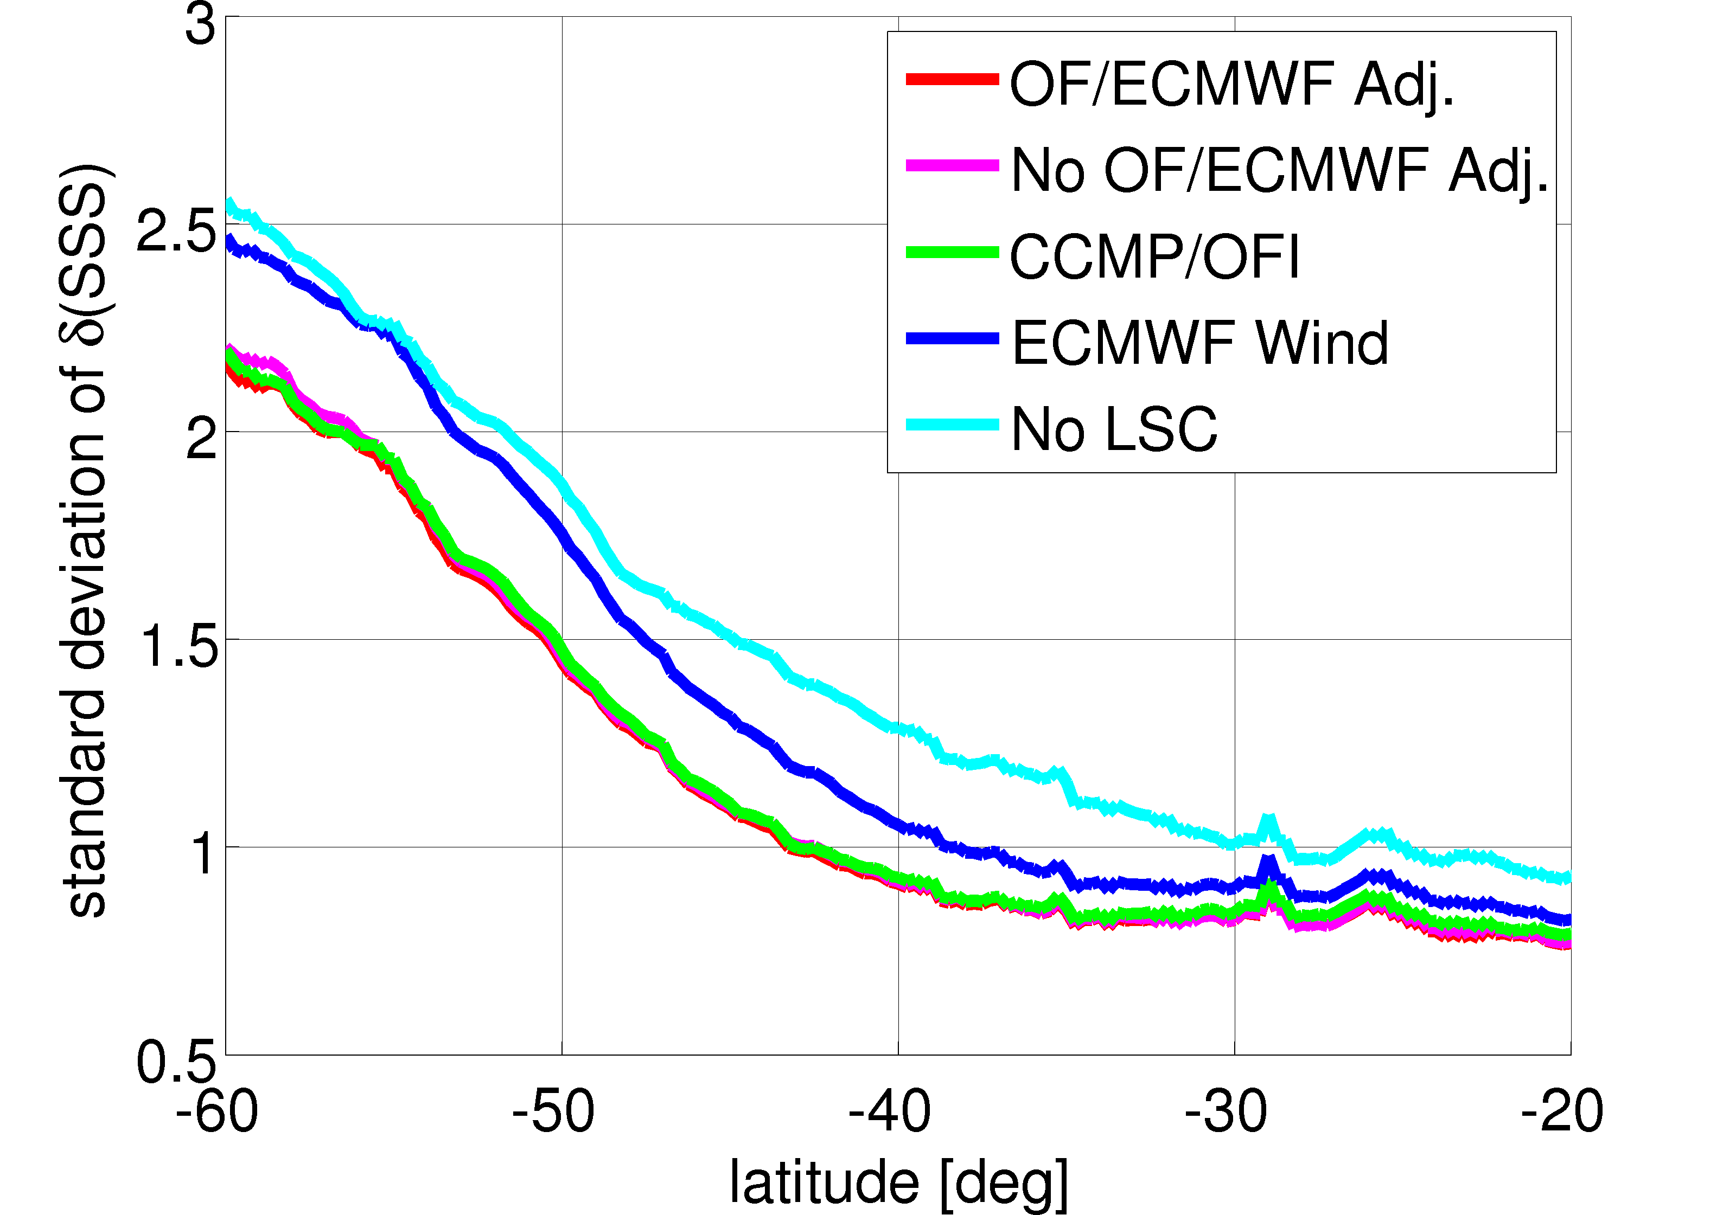
Impact on SSS Retrieval
Zonal average of standard deviation of daily SSS :

